Slide 1
HYDROGRAPHIC OFFICE OF
PAKISTAN NATIONAL
Pakistan
National Report
Ropme sea area
HYDROGRAPHIC COMMISSION (rsaHC)
15 – 17 NOVEMBER 2022, MUSCAT , OMAN

Slide 2
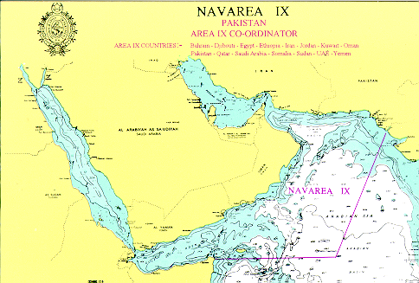
NAVAREA IX COORDINATOR
Hydrographer of Pakistan (HoP) Performs the duties of NAVAREA IX Coordinator on behalf of Govt of Pakistan
NAVAREA IX Coordinator is Responsible for transmission of MSIs to NAVAREA IX Region

Slide 3
NAVAREA IX HQ at Karachi, Pakistan is Capable of handling all kinds of MSIs
OPERATION AND BROADCAST
Agreement with IRIDIUM has been signed for Transmission of MSIs in 2020
MSIs are transmitted through INMARSAT & IRIDIUM daily at 0300 & 1500 UTC
Urgent message are transmitted on priority as and when required

Slide 4
STATISTICS
MSIs received from member states during last 03 years
 | 2019 | 2020 | 2021
Email | 452 | 411 | 390
Fax | 09 | 04 | -
Phone | 01 | - | -
Text | 73 | 70 | 91
Total | 453 | 469 | 517

Slide 5
INFORMATION RECEIVED FROM COASTAL STATES
Coastal State / Country | 2020 |  |  | 2021 |  |  | 2022
 | E-mails | Fax | Courier | E-mails | Fax | Courier | E-mails | Fax | Courier
Pakistan | 11 | 10 | 62 | 08 | 05 | 70 | 27 | - | 44
Bahrain (MENAS) (Qatar, UAE, Kuwait, and Iraq ) | 306 | - | - | 347 | - | - | 319 | - | -
Dubai | - | - | - | 08 | - | - | 10 | - | -
Saudi Arabia | 13 | - | - | 20 | - | - | 22 | - | -
Oman | 09 | - | - | 08 | - | - | 09 | - | -
Egypt | 03 | - | - | 02 | - | - | - | - | -
Iran | - | 01 | 03 | 05 | 01 | 12 | 05 | 01 | 05
Yemen | - | - | - | 03 | - | - | 01 | - | -
Information’s received from various sources | 10 | - | - | 15 | - | -- | 04 | - | -
Total | 352 | 11 | 65 | 416 | 06 | 82 | 397 | 01 | 49
Note: No information received from Somalia, Djibouti, Eritrea, Sudan and Jordan in last three years

Slide 6
STATISTICS
MSIs issued during last 03 years
2019 | 2020 | 2021 | 2022
453 | 469 | 517 | 456 (Till to date)
Additional Information provided to Mariners during last 03 years
2019 | 2020 | 2021
300 | 425 | 363

Slide 7
CONTIGENCY ARRANGEMENTS
Well rehearsed secondary NAVAREA IX HQ established
Agreement with NAVAREA VII (South Africa) held as External Contingency arrangement

Slide 8
CONTACT INFORMATION
Rear Admiral Mian Zakirullah Jan
Hydrographer of Pakistan
National Hydrographic Office
11, Liaquat Barracks
Karachi – 75530
PAKISTAN
Fax – 009299201623
Phone – 009248506821/819/151
Email – hydropk@paknavy.gov.com
hydrpk@gmail.com
Note: Information on the website (www.paknavy.gov.pk/hydro) is updated on daily basis for mariners

Slide 9
Thank you

