Slide 1
RSAHC9 IHO Secretariat Report
Rear Admiral Luigi SINAPI
IHO Director

Slide 2
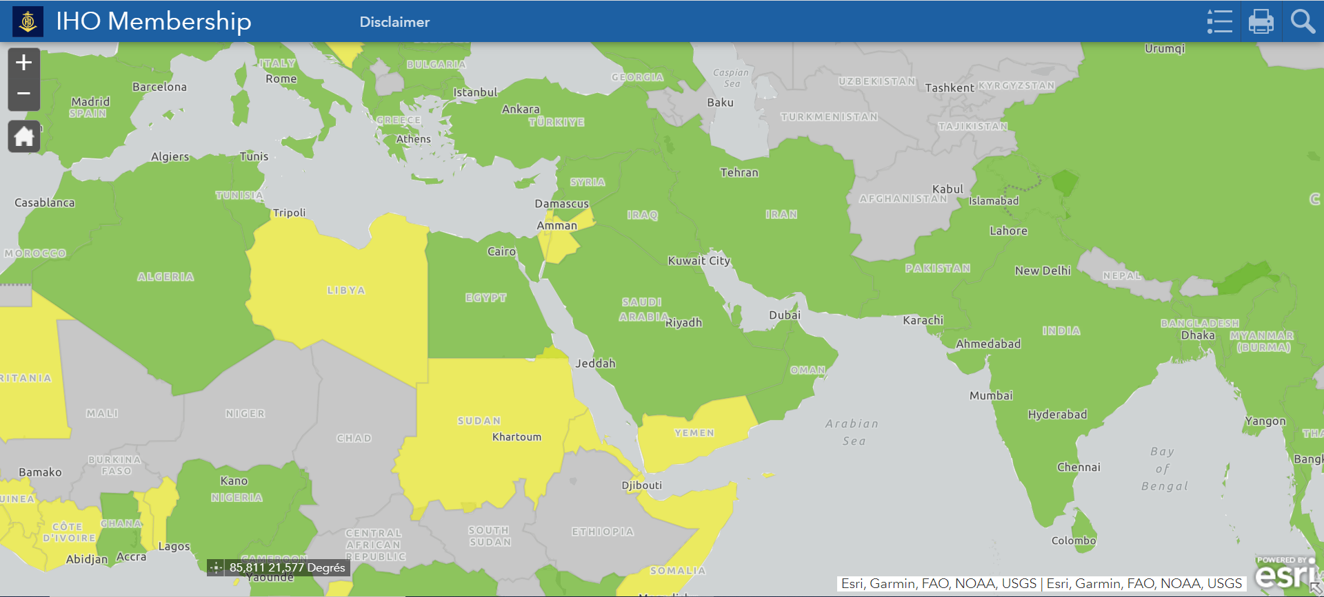
Iho membership & Regional applicaTion for IHO membership
Since RASHC8, Guyana, Solomon Islands, Ghana, Samoa, Lebanon, Kenya, Iraq, Angola and Albania joined IHO
IHO Membership now stands at 98
Serbia and Syria remain suspended
Following the accession to the IHO Convention (see IHO CL 45/2021), in accordance with art. 2 a) of the RSAHC Statutes, Iraq will become full Member of the Commission
IHO Membership
Recommendation - RSAHC is invited to encourage and propose to the IHO Secretariat High Level Visits also to those non-coastal States not yet IHO Member States and support the IHO Secretariat in the future initiative in the Caspian Sea region.

Slide 3
Outcomes of the 6th Meeting of the IHO Council
IHO Work Programme and Budget for 2023 and the three-year Work Programme and Budget 2024–2026
Goal 1 and its Targets in the IHO Strategic Plan should have the highest priority in the 2023–2026 Work Programme
To develop guidelines for the automated production of paper charts meeting S-4 chart minimum content requirements from S-101 ENC data
Member States to participate in the Republic of Korea S-100 test-bed project

Slide 4
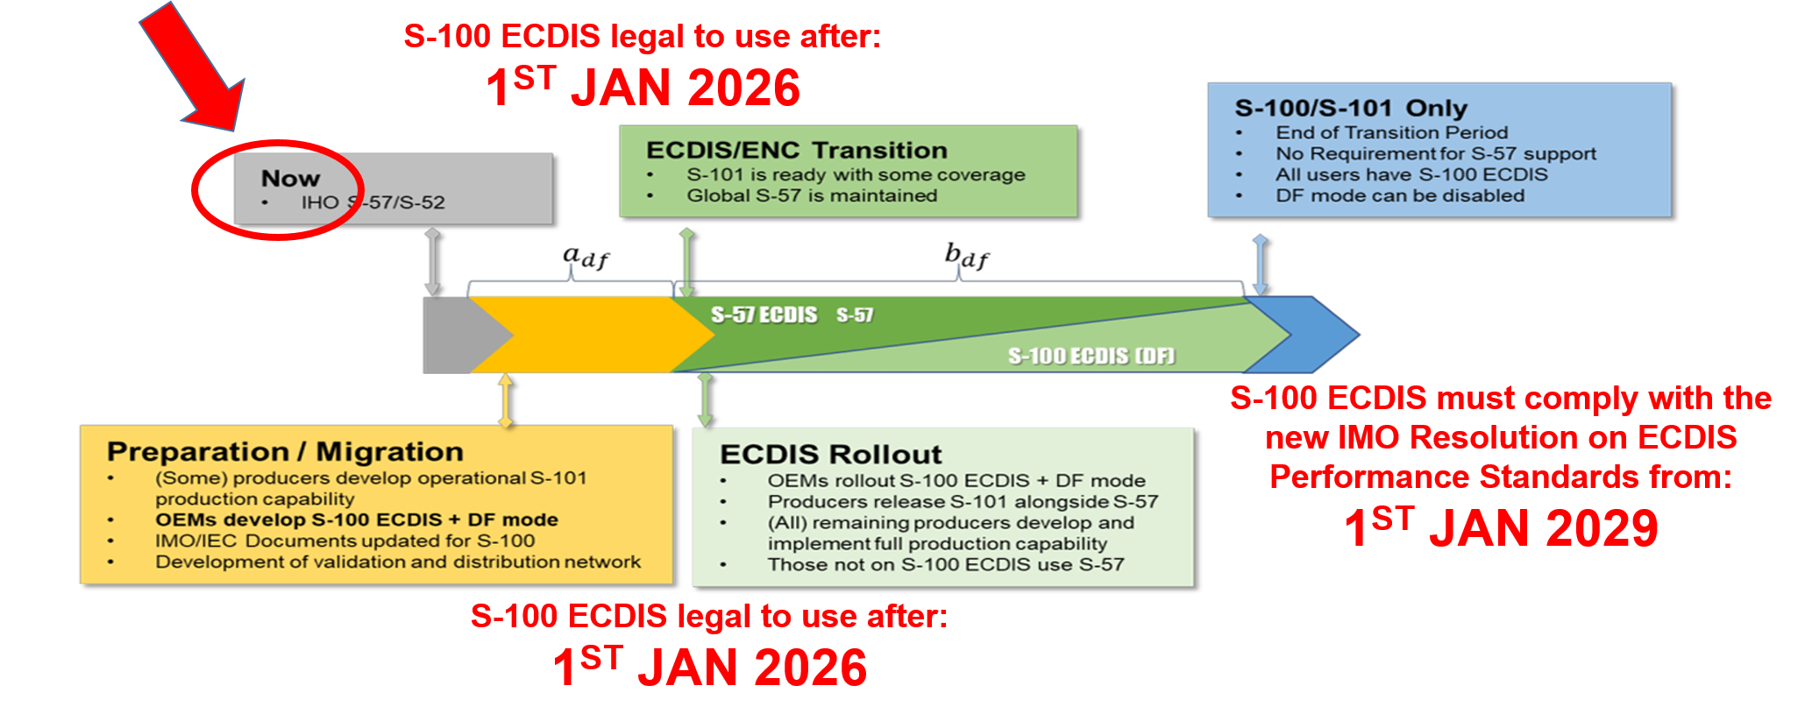
Outcomes of the 6th Meeting of the IHO Council
From IMO NCSR and MSC last meetings, transition period for S-100 ECDIS to become legal to use after 1 January 2026 and from 1 January 2029: the Council endorsed the Dual Fuel Concept for S-100 ECDIS Executive Summary:

Slide 5
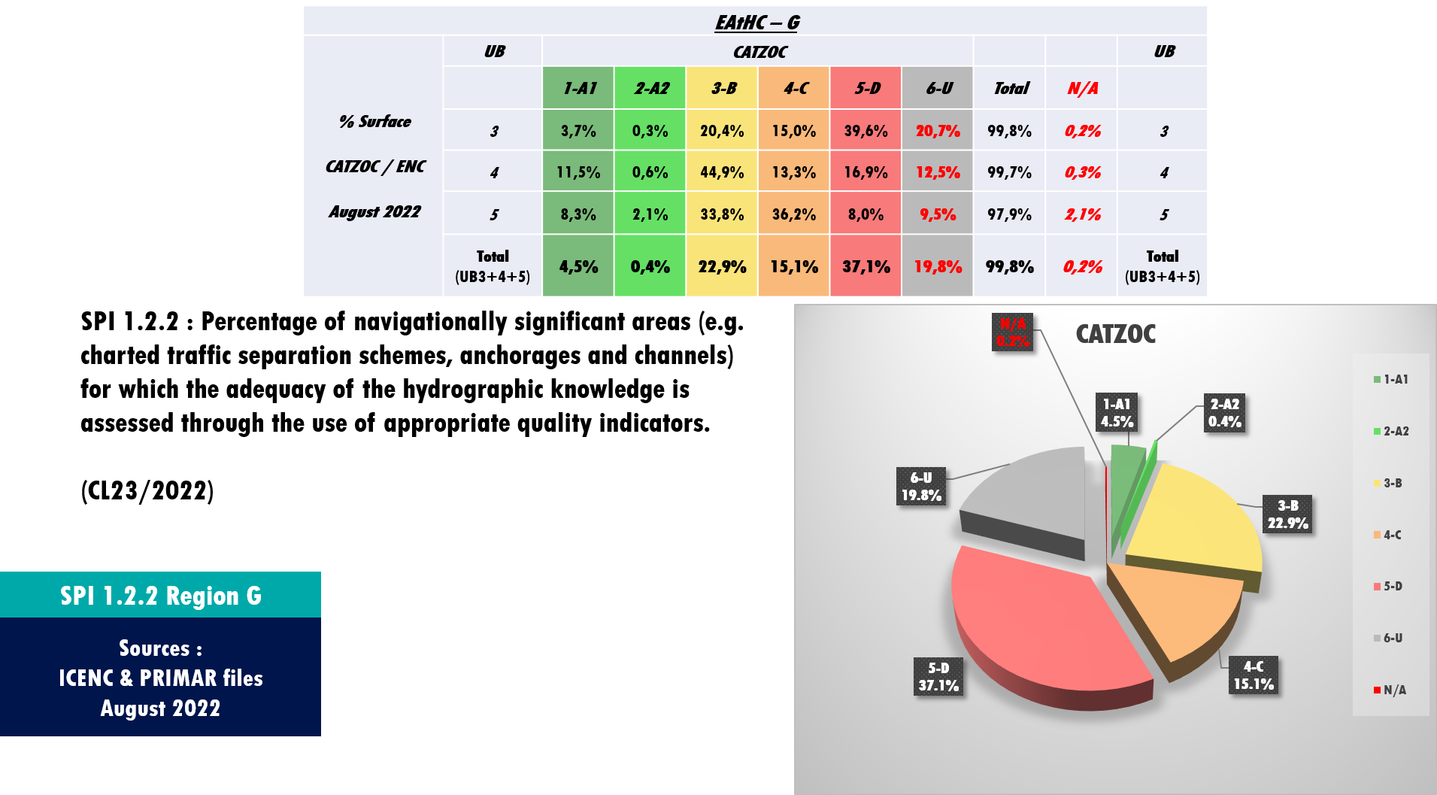
Outcomes of the 6th Meeting of the IHO Council
The Council endorsed the IRCC proposals as reported in IHO CL 23/2022 for measuring the SPIs, with particular attention to SPI 1.2.2 - Percentage of navigationally significant areas for which the adequacy of hydrographic knowledge is assessed through the use of appropriate quality indicators (CATZOC) assigned by the Member States:

Slide 6
Outcomes of the 6th Meeting of the IHO Council
The Council approved the updated version 2.0 dated July 22 of the S-100 Implementation Roadmap
The Council approved version 1.0 of the Guidelines on the Implementation of the WEND-100 Principles
In view of the preparation of the new Council 2023-2025, the IHO CL 43/2022 provides the resultant distribution of the 20 seats on the Council allocated to the RHCs and those States that are eligible to be selected to occupy those seats, whilst the Secretariat will use the table of tonnages (2021-2023) to determine the remaining 10 seats to be occupied on the Council

Slide 7
Outcomes of the 6th Meeting of the IHO Council
Recommendations: RSAHC is invited to:
Continue on the implementation of the IHO Strategic Plan and support IRCC in identifying measures and values to measure those SPI of regional interest allocated to IRCC, and to consider providing their CATZOC values - through the RENCs - to support the IHO Secretariat in the process of measuring SPI 1.2.2
Note the updated version 2.0 of the S-100 Implementation Roadmap, and the version 1.0 of the Guidelines on the Implementation of the WEND-100 Principles, with particular attention to the creation of a new role of S-100 Services Coordinator or the expansion of the role of Regional Chart Coordinator to include S-1xx products
To declare the identity of the State/s selected to occupy the first 20 seats on the Council that are allocated on a regional basis

Slide 8
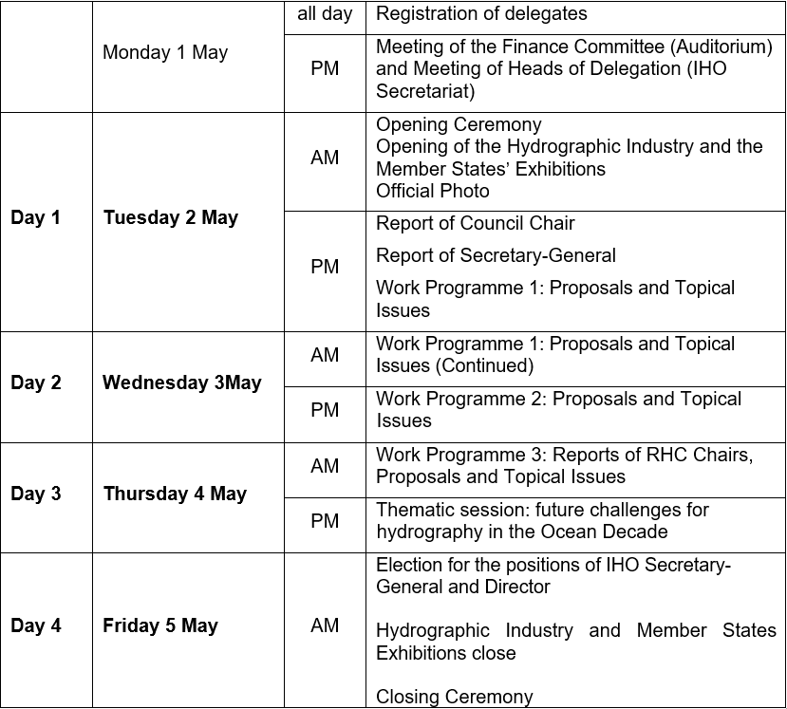
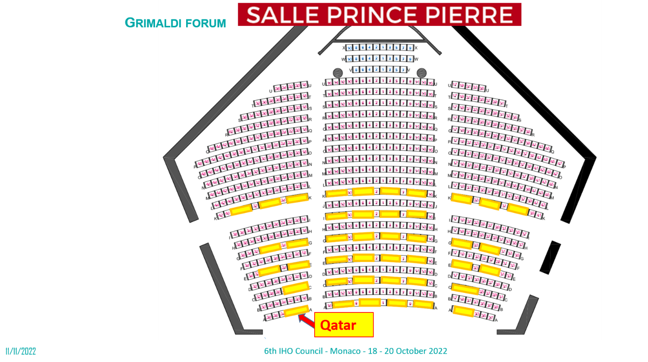
Preparation of the 3rd Session of IHO Assembly
D R A F T

Slide 9
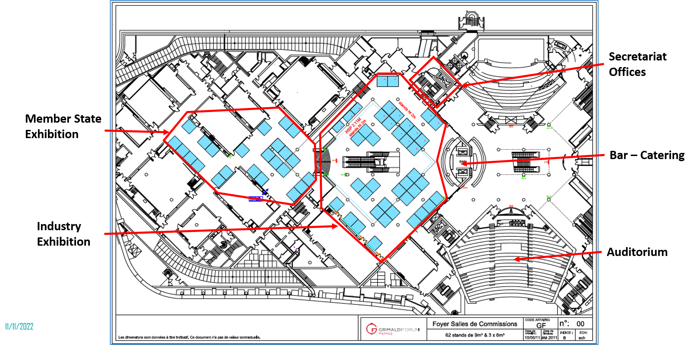
Preparation of the 3rd Session of IHO Assembly
IRAN
Recommendation: RSAHC members are encouraged to register on line their delegations and submit proposals if any by 20 December 2022.

Slide 10
Capacity Building programme
The level of activity of the IHO Capacity Building (CB) Programme was clearly affected in 2020 and 2021 by the COVID 19 pandemic
The 2021-2022CBWP funded activities not executed in 2021-2022 can be moved to the 2022-2023CBWP
The CB finance situation will be more difficult in 2023 with the expected reduction of the non-earmarked funds
RSAHC has one funded CB project in 2022CBWP and one in 2023CBWP:
2022: A-17 Technical Visit to Iran (former 2021 A-14)
2023: A-04 High Level Technical Visit to Iraq
and two planned CB projects in the 2023CBWP:
P-26 MSDI and Database Management (5 days)
P-28 Basic ENC Production Training

Slide 11
Capacity Building programme - courses
2 candidates were selected for 2022/2023 Master of Science Programme in Hydrographic Science at the University of Southern Mississippi (USA), sponsored by the Republic of Korea, 14 candidates were selected to participate in the 13th and 14th GEOMAC courses in Cartography Cat B (see IHO CL 19/2022) sponsored by Nippon Foundation, and 10 candidates for 2022 Cat B Hydrographic Survey Programme sponsored by the Republic of Korea were selected (see IHO CL 22/2022). For 2023/2024, the Master of Science Programme in Hydrographic Science at the University of Southern Mississippi (USA), sponsored by the Republic of Korea, was announced with IHO CL 34/2022

Slide 12
Empowering women in hydrography (ewh) project
IHO CL 26/2022: survey to determine the percentage of female employees in Hydrographic Offices and in leadership roles (Questionnaire - the deadline has been extended till 30 November 2022)
With Letter IOC/VR/22.377/JB/AC/mb dated 9 September 2022, IOC endorsed the project entitled “No. 62.2 - Empowering Women in Hydrography” as a project forming part of the UN Decade of Ocean Science for Sustainable Development 2021-2030.

Slide 13
Capacity Building programme - courses
Recommendations: RSAHC is invited to:
Continue follow and evaluate the possibility to contribute to the CB Programme
Participate at the EWH project and provide proposals via the specific webpage (https://iho.int/en/basic-cbsc-ewh) set up under the Capacity Building Sub-Committee (CBSC) for this project, and answer to the Questionnaire issued with IHO CL 26/2022
Provide contributions of online learning material to the Project Team established for the IHO e-Learning Center at KHOA.

Slide 14
Maritime safety information services
Recommendations: RSAHC is invited to:
Encourage all information providers (NAV and MET Area Coordinators and RCCs) to complete agreements with all RMSS and commence the necessary testing of the SafetyCast system to progress towards declaring full operational status
Establish and maintain effective communications with the relevant NAV and MET Area Coordinators to ensure the timely provision of MSI
Use and follow the guidance provided in S-53 – Joint IMO/IHO/WMO Manual on Maritime Safety Information – to ensure the necessary facilities and capabilities are provided and maintained for the gathering and communication of MSI within their area of national responsibility.

Slide 15
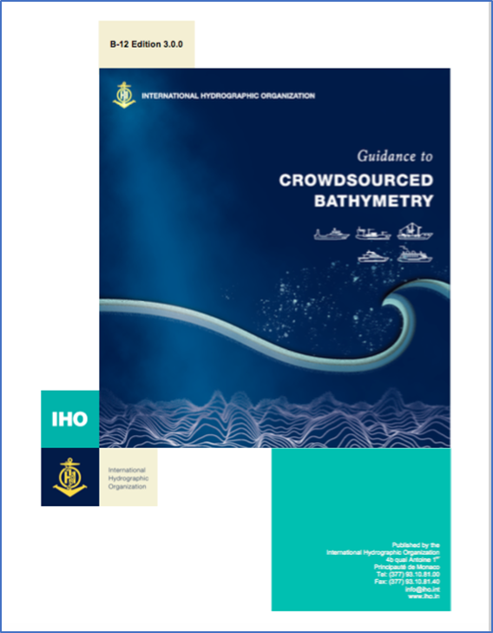
Crowdsourced bathymetry - GEBCO - seabed 2030
With IHO CL 41/2022 new Edition 3.0.0 of B-12 was approved by 37 Member States. Updates include: incorporating feedback from operational use and experience, making the document more "equipment agnostic”, simplifying the document and making it more accessible to ALL readers (data collectors, providers and users)

Slide 16
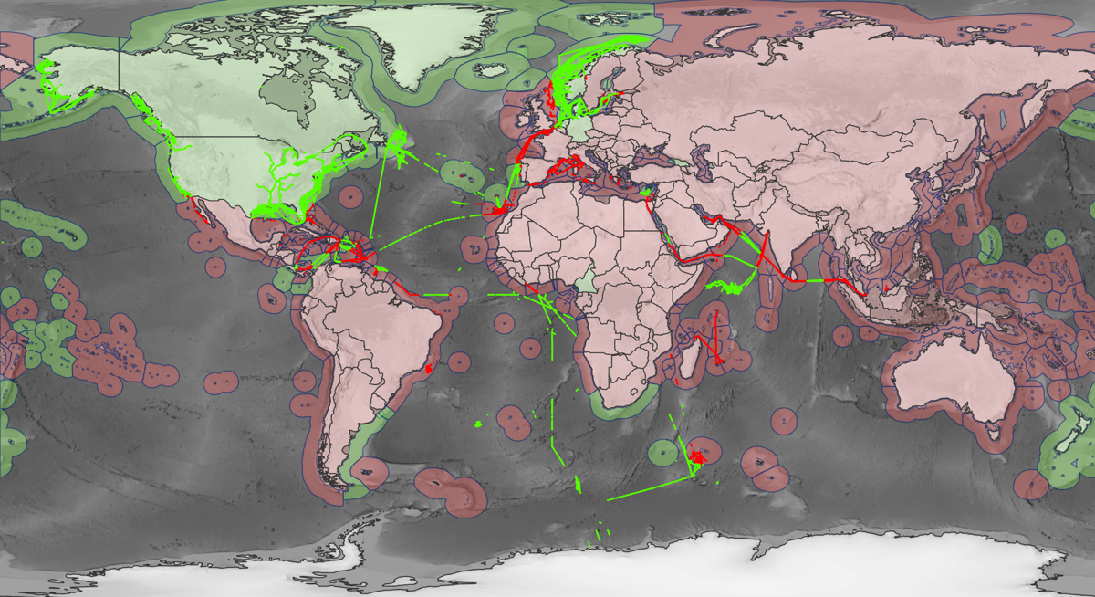
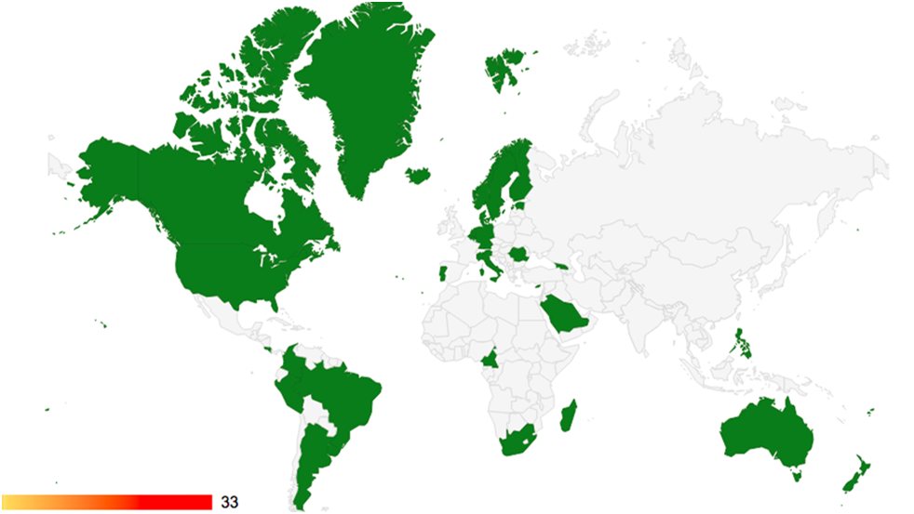
Crowdsourced bathymetry - GEBCO - seabed 2030
The Circular Letters (IHO CL 21/2020 and IRCC CL 1/2020) to request MS to indicate their positions on the provision of CSB data received 32 replies
Green = Positive Response
Red = Negative Response, No Response
RSAHC IHO Member States:
Bahrain, IR of Iran, Iraq, Kuwait, Oman, Pakistan, Qatar, Saudi Arabia, United Arab Emirates
The IHO encourages coastal states to review the circular letters and, if possible, offer a positive response to the IHO Secretariat.
iho.int/uploads/user/circular_letters/eng_2020/CL21_2020_EN_v1.pdf
iho.int/uploads/user/Inter-Regional%20Coordination/IRCC/IRCC_Letters/IRCC_Letter_2020_01_CSB_Activities.pdf

Slide 17
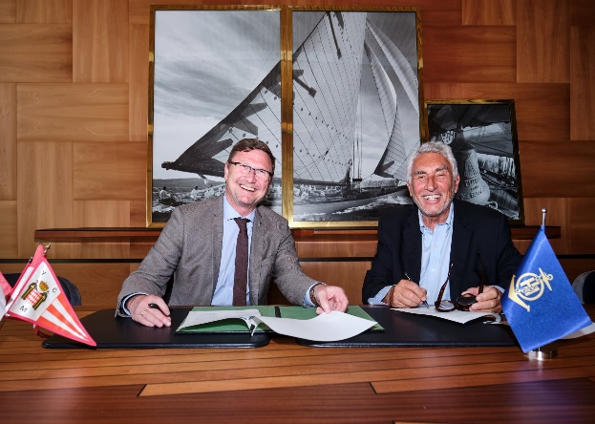
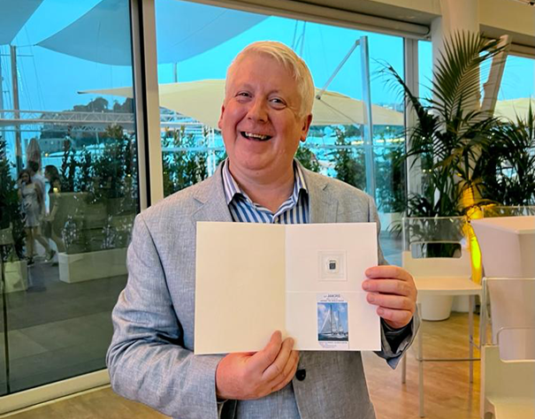
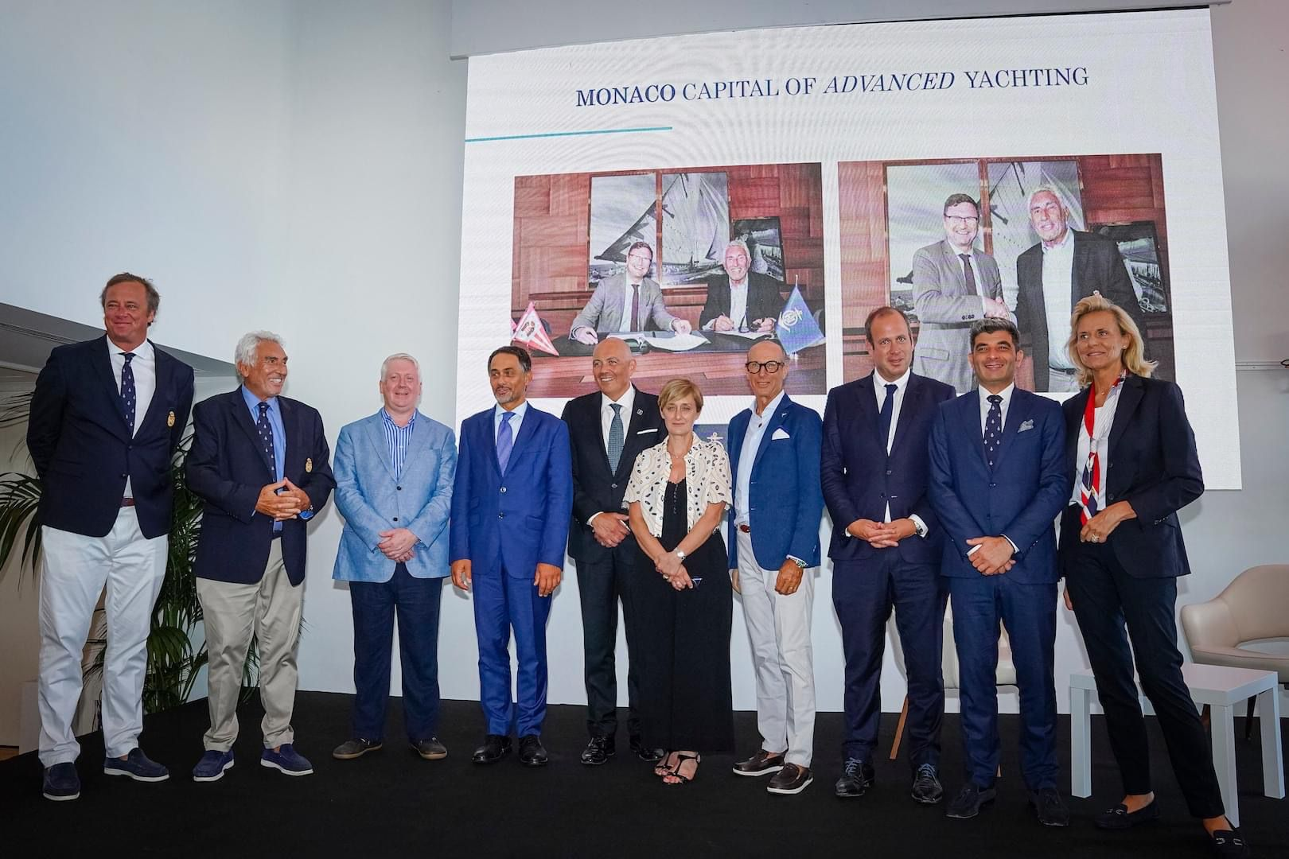
Crowdsourced bathymetry - GEBCO - seabed 2030
Thanks to the support of CSBWG, GEBCO and Nippon Foundation Seabed2030 project, the IHO Secretariat also promoted CSB through three sailing boats departed from Monaco and France for expeditions to and from the Antarctica in late 2021/early 2022.
In July 2022 signed a Letter of Cooperation with the Yacht Club of Monaco to engage the world of yachting (yachts and mega yachts) in the CSB

Slide 18
Crowdsourced bathymetry - GEBCO - seabed 2030
It was decided to review the GEBCO Governance and write a GEBCO Strategy aligned with with the IHO Strategic Plan (2021-2026) and the IOC Medium Term Strategy (2022-2029)
With IHO CL 10/2022 the IHO advised Member States on the 19th course of the IHO-IOC-Nippon Foundation/GEBCO Training Program leading to a Graduate Certificate in Ocean Bathymetry at the University of New Hampshire (UNH), USA (the 19th course began in late August 2022)
A new GEBCO Sub-Committee on Education and Training (SCET) was established in 2022 and it is now operational

Slide 19
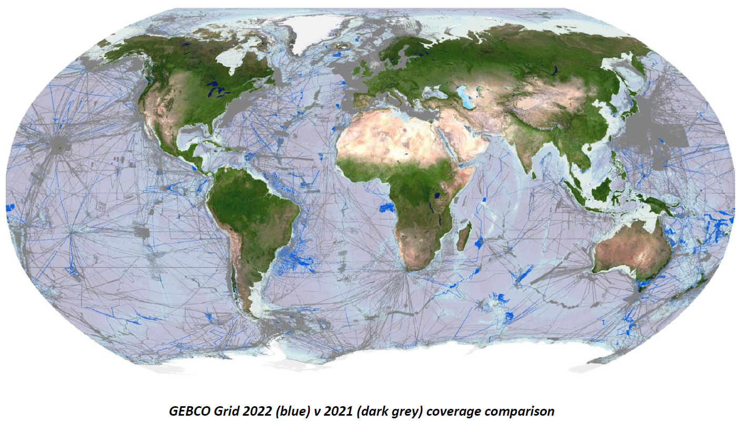
Crowdsourced bathymetry - GEBCO - seabed 2030
Nippon Foundation GEBCO-Seabed 2030 project was endorsed as an Action of UN Decade of Ocean Science for Sustainable Development
Global mapping coverage now stands at 23.4% (June 2022)

Slide 20
Crowdsourced bathymetry - GEBCO - seabed 2030
Recommendations: RSAHC is invited to:
Consider the impacts of the increasing global societal and United Nations (UN) driven need to complete the picture of the seafloor as well as the potential benefits to individual coastal States
Make data freely available for inclusion in the DCDB and the widest possible use, in accordance with IHO Resolution 1/2017
Nominate the CSB-GEBCO-Seabed 2030 Regional Coordinator
Consider to review national legislation to remove barriers restricting CSB activities within their waters

Slide 21
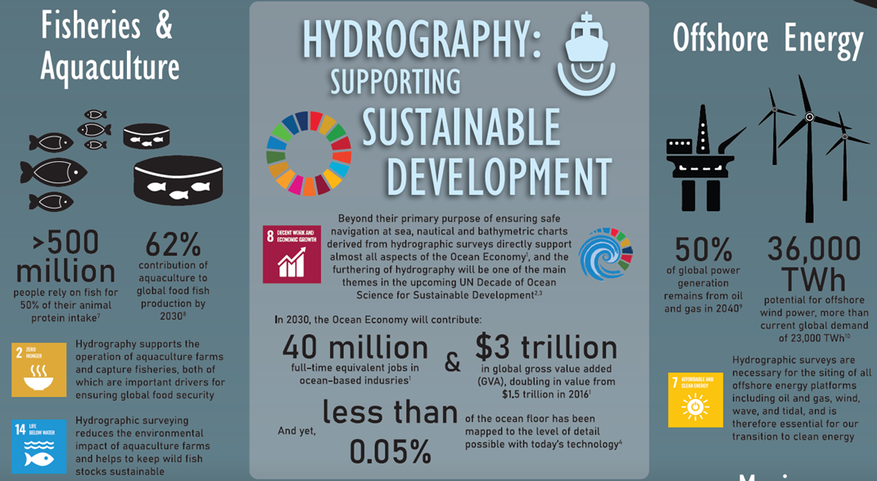
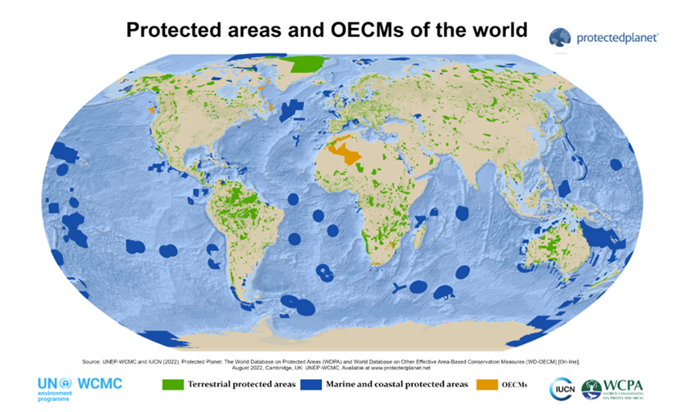
IHO and United Nations Decade of Oceans for Sustainable Development
Depth to be added to the list of Essential Ocean Variables (EOVs)
For the “Global Ocean Alliance” to protect 30% of the world’s land mass (land and ocean) by 2030, SP-122 – Marine Protected Areas will play a role in supporting the sustainable use of such areas
IHO to be the key point of contact for seabed mapping and hydrography in the Organization for Economic Co-operation (OECD) in the report “the Ocean Economy in 2045”

Slide 22
IHO GIS and Databases
Yearbook (P-5) and Status of Hydrographic Surveying and Charting Worldwide (C-55) are regularly updated
The IHO Online Form system has been used since March 2019 IAW IHO CL20/2019 and CL03/2020
An Esri-based GIS solution has been implemented for the efficient visualization of geospatial data stored in the Country Information System
Recommendation - RSAHC is invited to review their entry in the IHO Yearbook P-5 and C-55 and to provide the IHO Secretariat with the appropriate updates or to report no change (CL 20/2019 refers)

Slide 23
Iho outreach
The theme for WHD 2022 is “Hydrography - contributing to the United Nations Ocean Decade”
As announced with IHO CL 42/2022, the proposed theme for WHD 2023 is “Hydrography - underpinning the digital twin of the ocean”
Through IHO CL 03/2022, since 5 January 2022, the IHR has a new editor Dr Patrick Westfeld from Germany; IHR volumes from the entire collections (1923 to 2018) are available online https://journals.lib.unb.ca/index.php/ihr
Recommendation - RSAHC Members are invited to submit papers for publication in the IHR

Slide 24
Action Requested of RSAHC
Note this report
Consider all the Recommendations proposed in this report
Review entries related to IHO C-55 and P-5 (Yearbook) annually
Consider submitting papers for publication in the International Hydrographic Review
Take any other actions as considered appropriate

