Slide 1
Capacity-Building Status RSAHC9
Agenda Item 11
By: CB Coordinator (I.R. of Iran)
Muscat, Sultanate of Oman
15-17 Nov. 2022

Slide 2
New Capacity-Building Coordinator
In order to participate in CB programs, every RHC should have a CB Coordinator.
After the previous CB Coordinator of RSAHC region(Mr. Jeff Bryant), Iran has accepted the responsibility as CB Coordinator in this region, and was therefore introduced to IHO by the RSAHC8 Chair.

Slide 3
IHO Capacity-Building Strategy
The IHO Capacity Building Strategy classifies the development of hydrographic services into three phases:
Phase 1: Collection and circulation of nautical information, necessary to maintain existing charts and publications up-to-date;
Phase 2: Creation of a surveying capability to conduct coastal and offshore projects; and
Phase 3: Production of paper charts, ENC and publications independently.

Slide 4
How to Prioritize CB Programs
Phase of Capacity-Building, according to the IHO Capacity-Building Strategy:
Phase 1 10 Points
Phase 2 5 points
Phase 3 1 point
Number of States Benefitted:
10 or more States 5 points
5 to 9 States 3 points
Less than 5 States 1 point

Slide 5
How to Prioritize CB Programs
Priority within RHC
A value to be established by the RHC, as follows:
a) 1 = Top Priority 5 points
b) 2 = Very Important 3 points
3 = Important 1 point
4 = Lowest Priority 0 point

Slide 6
Aims and Objectives
The aims of capacity building are:
To train staff, at various levels, to ensure a much needed capability on hydrography and nautical cartography, particularly after natural disasters or other incidents, which could affect water depths in harbors and approaches; and
To comply with IHO resolutions and guidelines regarding hydrographic and nautical cartographic activities.

Slide 7
Medium-term Objective
To ensure a basic level of MSI is established in all coastal states to produce Local/Coastal/NAVAREA Warnings, communicate effectively with the charting authority and implement the MSI elements of GMDSS;

Slide 8
Long-term Objectives
To instruct staff in the region on the methods of carrying out hydrographic surveys, to improve safety of navigation through enhanced navigational products;
To promote the establishment of Hydrographic Services (HS) and the evolution of CB Phases of the established ones.

Slide 9
Methodology and Procedures
CB Plan will be reviewed each year, and adjustments made as necessary.
Each year the Commission will decide responsibilities for the programmed events of the subsequent year.
The RSAHC Capacity Building Coordinator will send details of all planned projects to the Chair, no later than January 31st of each year. The projects must be written in the standards established by the IHO CBSC (see next slide).
Projects supported by IHO CB Fund must follow the IHO CBSC procedures published at the IHO website.
The Chair will check the proposed projects and, if requesting IHO CB Fund support, will send them to the IHO CBSC Chair and Secretary no later than MARCH 15th, otherwise, will take the appropriate action.

Slide 10
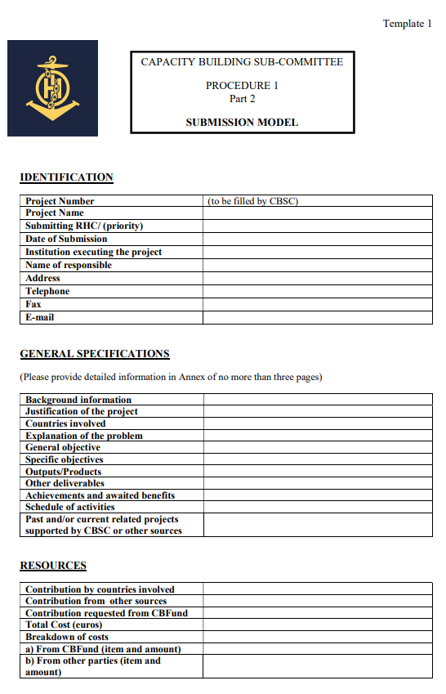
Submission Model

Slide 11
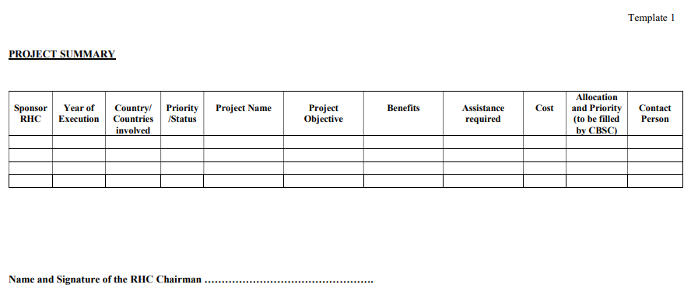
Project Summary

Slide 12
Activities Completed since RSAHC8
“Compiling for Navigational Safety” Course, conducted on 20-21 January 2022 as a VTC platform, in which RSAHC Member States participated.
“Introduction to S-57” Course, conducted on 25 January 2022 as a VTC platform, in which RSAHC Member States participated.
“Understanding ENCs” Course, conducted on 26 January 2022 as a VTC platform, in which RSAHC Member States participated.
IHO – NIPPON FOUNDATION GEOMAC PROJECT: SUCCESSFUL
NOMINATION OF CANDIDATES FOR THE 13TH AND 14TH
COURSES, for which Mr. Mohammed AL-AAMRI from Oman was
accepted from the RSAHC region.
Category "B" Hydrographic Survey Program, sponsored by Republic of Korea, 25 July 2022 to 09 December 2022, for which Mr. Seyed Mojtaba ZAREI from IRAN was accepted from RSAHC Region.

Slide 13
Activities Planned for 2022
Technical Visit to Iran, which is planned to be conducted in December 2022 by IHO/IALA.
MSI Course, which is planned to be conducted as a joint activity between RSAHC and NIOHC Regions in November 2022.

Slide 14
Challenges Faced in the Region
In our region, usually three or four Member States are highly active in IHO programs.
Some do not participate actively in any programs at all, while some others prefer to work with adjacent regions (some Member States of RSAHC are members of NIOHC as well, and have their needs regarding Capacity-Building met through that Commission).
For this reason, it is almost impossible to have integrated and up-to-date information from all IHO activities in the region. I hope that under the chairmanship of Oman as the RSAHC Chair, we would achieve better cooperation between all the regional Member States.

Slide 15
Achievements and Lessons Learned
A number of the Member States have announced their training needs for the next three years through the CB Coordinator for this region, and all Member States of RSAHC could be trained at various levels.
In most cases, we could ignore our political differences, and consider safety of navigation in our regional waters as the region's first priority.
In line with the efforts of IHO to economize CBSC program, the RSAHC has negotiated and planned a number of activities and trainings, to be conducted jointly with the NIOHC as the adjacent region, or have some virtual trainings .
It is hoped that the planned activities, as mentioned in the RSAHC 3-Year Work Plan for CBSC (2022-24), will be conducted successfully, and result in the planned outcomes.

Slide 16
Conclusion
With the election of Oman as the present RSAHC Chair and Saudi Arabia as the vice chair of this region, we hope to encourage the involvement of all Member States in the RSA region, and have better achievement in CB programs, because it is necessary to have excellent and effective means of communication between all Member States.
Moreover, the IHO Secretariat strongly supports joint CB submissions, also having virtual trainings in the favor of promoted cooperation between the neighbor RHCs and cost-effective use of the limited CB funds.
For this reason, I am also keen to have joint CB programs for at least the next 3 years between RSAHC and NIOHC.

Slide 17
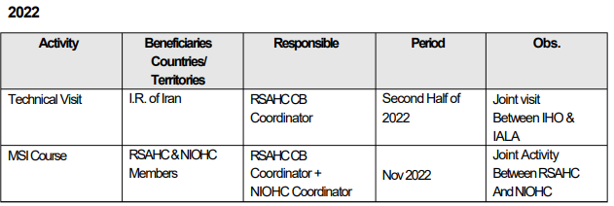
Suggested Capacity-Building Program for the Year 2022

Slide 18
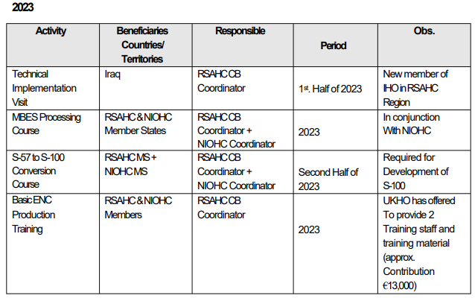
Suggested Capacity-Building Program for the Year 2023

Slide 19
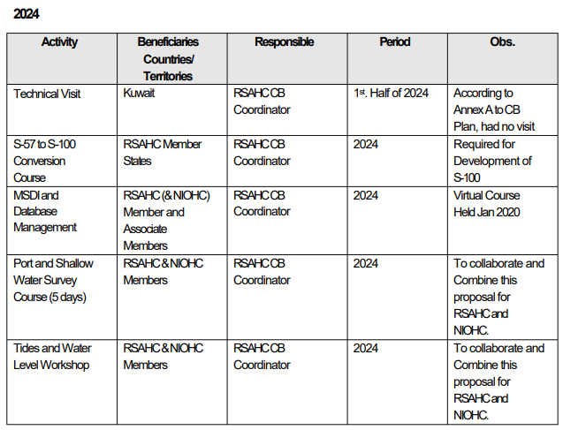
Suggested Capacity-Building Program for the Year 2024

Slide 20
Actions Required for RSAHC9
RSAHC Member States are invited to:
A. Take note of this update of RSAHC CB 3- Year Work Plan, and
B. Take any actions considered appropriate.

Slide 21
Thank you for your attention!
Any questions?

