Slide 1

RSAHC9-8
Report by
INT Charts Coordinator
(I.R. of Iran)
Muscat
Sultanate of Oman
15-17 Nov. 2022

Slide 2
List of new INT Charts provided by RSAHC MS
Produced & Submitted INT charts in IHO Web Chart Catalogue:
Bahrain: 5 charts
Iran: 48 Charts
Pakistan: 9
GB: 82 Charts

Slide 3
During the RSAHC8, Member States were reminded to:
review their C-55 and IHO Yearbook (P-5) entries annually;
submit information in non-meeting years;
promote login for the INToGIS services, required to manage the national information contained in the database;
obtain their ID and passwords, and to start revising their schemes using the INToGIS Service to allow the Regional Coordinator to approve the amendments and generate an updated version of the regional scheme.

Slide 4
INT Charts Produced by RSAHC Member States in IHO Web Chart Catalogue
Country | Scheme | Produced | Country | Scheme | Produced
Bahrain | 16 | 5 | Saudi Arabia | - | -
IR of Iran | 46 | 48 | Sultanate of Oman | 25 | -
Kuwait | 9 | - | UAE | - | -
Pakistan | 3 | 9 | UKHO | 40 | 82
Qatar | - | -

Slide 5
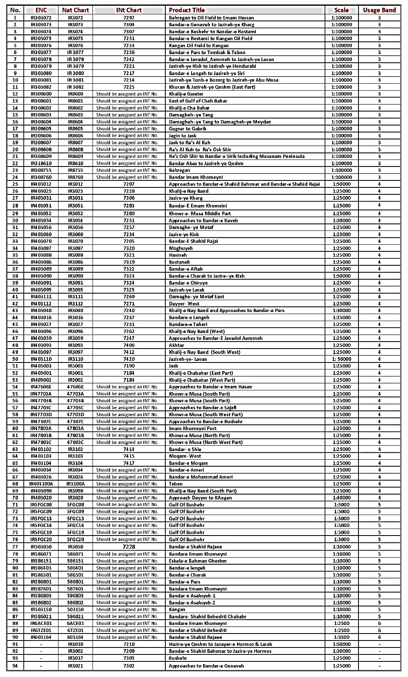
I.R. of Iran Schemed and Produced INT Charts

Slide 6
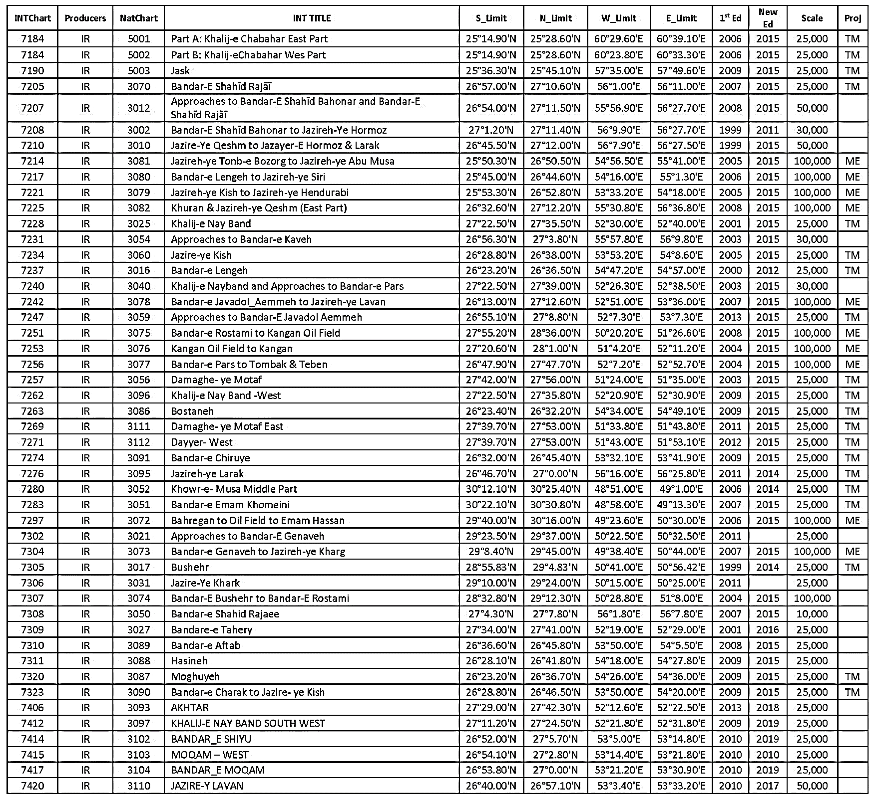
I.R. of Iran Produced INT Charts

Slide 7
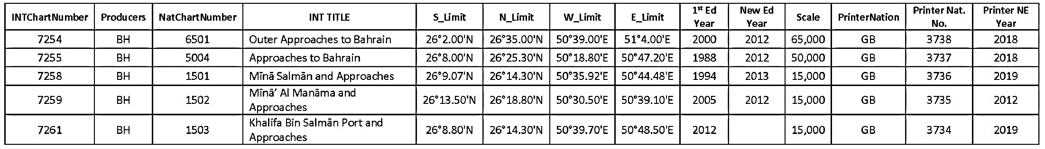
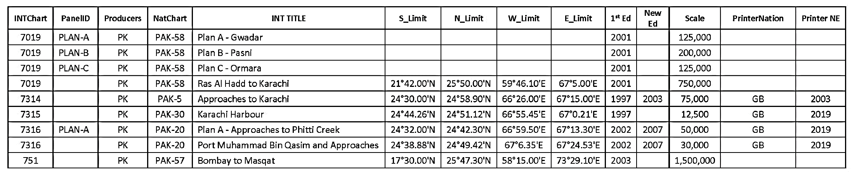
Bahrain
Pakistan

Slide 8
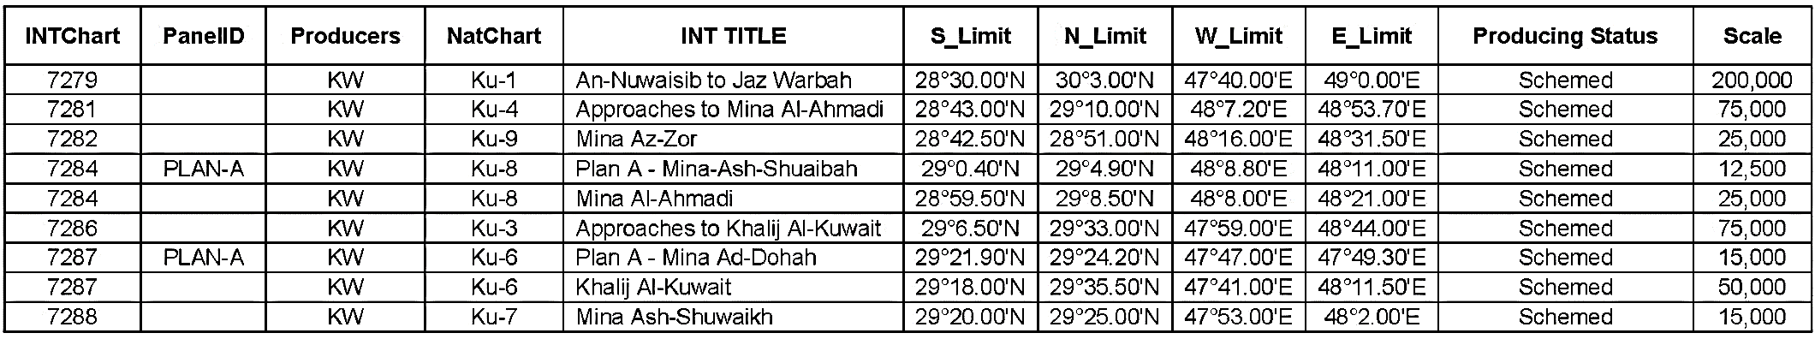
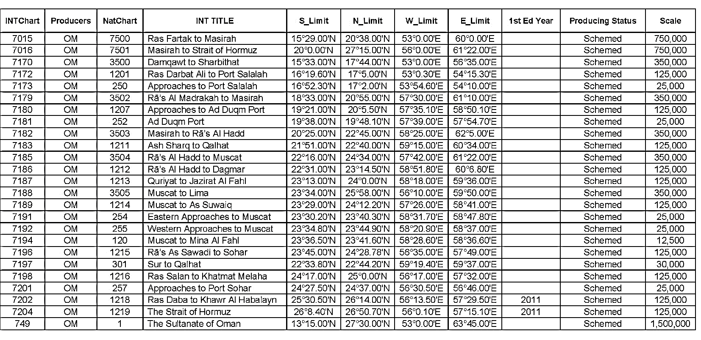
Kwait
Oman

Slide 9
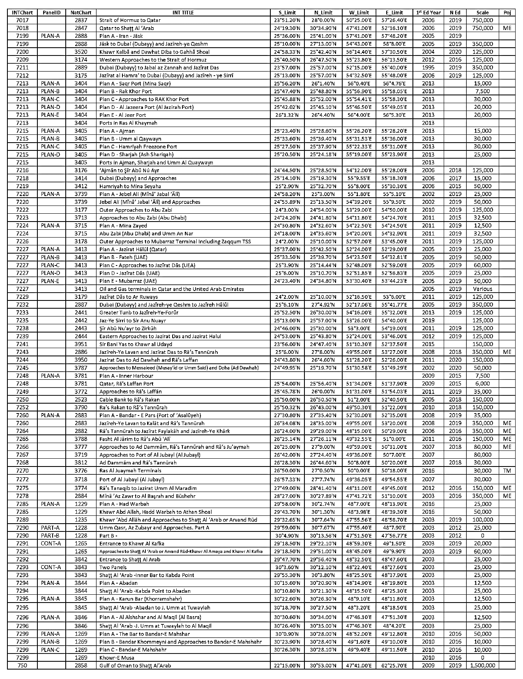
UK

Slide 10
Problems and Challenges
1. The present web chart catalogue has the following problems:
- searching for available new chart numbers (codes) is lengthy;
- a number can be designated for several charts, without any errors by the system; and
- chart numbers pertaining to one country are dispersed, both in terms of waters under jurisdiction, and chart scales. It would be great if such numbers could follow a sequence.
2. Chart Catalogue S (S11-Part B for Region I) is not up-to-date and available on the IHO website, due to the inconsistency of regional States in reporting comprehensive information and accurate figures about the produced charts;
4. Statistics regarding charts produced by UKHO cannot be categorized in terms of the countries they cover;

Slide 11
Recommendations
-Member States are requested to fill out all the fields of INT Chart tables in IHO web catalogue as much as possible.
-Member States are requested to give all the INT reports one month prior to each RSAHC Meetings (in last two years no items in IHO web catalogue are present).
-INT Chart 751 is still unsolved between Pakistan and India. The Chair of RSAHC is requested to contact both parties for the settlement.
-It is necessary that Member States provide their information to the Regional Coordinator, so that the catalogue can be updated for the region. However, only Bahrain, Iran, Oman and Pakistan have provided their information so far, and it is required that other countries establish a higher level of cooperation with the coordinator about information sharing, etc.

Slide 12
Thank you for your attention
Any Questions

