Slide 1

Progress on the Implementation of
ENC Coverage and other Issues
Agenda Item 9
Reported by ENC Regional Coordinator
I.R. of IRAN
RSAHC9
Muscat, Sultanate of Oman
15-17 Nov. 2022

Slide 2
ENC Report
The ENC Coordinator needs to submit a report of the progress and details pertaining to the terms of reference approved by RSAHC4, and Member States are required to provide the ENC Coordinator with the necessary information.
As agreed during IRCC10, it is necessary that an IHO ENC Coverage catalogue be established and used as the initial mechanism to build the ENC Schemes database within the INToGIS II system. This will provide for effective monitoring of ENC production, in the same manner as INT Charts.

Slide 3
IRCC10 Recommendations to RHCs
Endorse that the management of overlap cases should be implemented by RHCs.
Note that RHCs should make their own assessment of the level of navigational risk for ENC overlaps, using one of the RENCs' Policy on Risk Assessment as a first step where applicable.
Encourage RHCs to provide updated reports on the implementation of ENC Schemes to the WENDWG in advance of the yearly WG meeting.

Slide 4
ENCs Released by RSAHC Member States
RSAHC released 253 ENCs, as follows:
Country | Released | Producer | Country | Released | Producer
Bahrain | 8 | BH | Saudi Arabia | - | GB
IR of Iran | 105 * | IR | Sultanate of Oman | 27 | GB
Kuwait | - | GB | UAE | - | GB
Pakistan | 9 | PK | UKHO | 119 | GB
Qatar | - | GB
Iranian ENCs:
* 90 cells in Persian Gulf & Gulf of Oman
* 15 cells in Caspian Sea

Slide 5
ENCs Released by RSAHC Member States
Since RSAHC8
Country | New ENC | New Edition/Update | Country | New ENC | New Edition/Update
Bahrain | ? | ? | Saudi Arabia | - | -
IR of Iran | 22 | 138 | Sultanate of Oman | ? | ?
Kuwait | - | - | UAE | - | -
Pakistan | ? | ? | UKHO | Band 6 :1 Band 5 : 1 | NE: Band 6 :0 Band 5 : 16 Band 4 :20 Band 3 : 16 Band 2 :0 Band 1 :0
Qatar | - | -
 |  |  |  |  | * 66 additional updates as business.

Slide 6
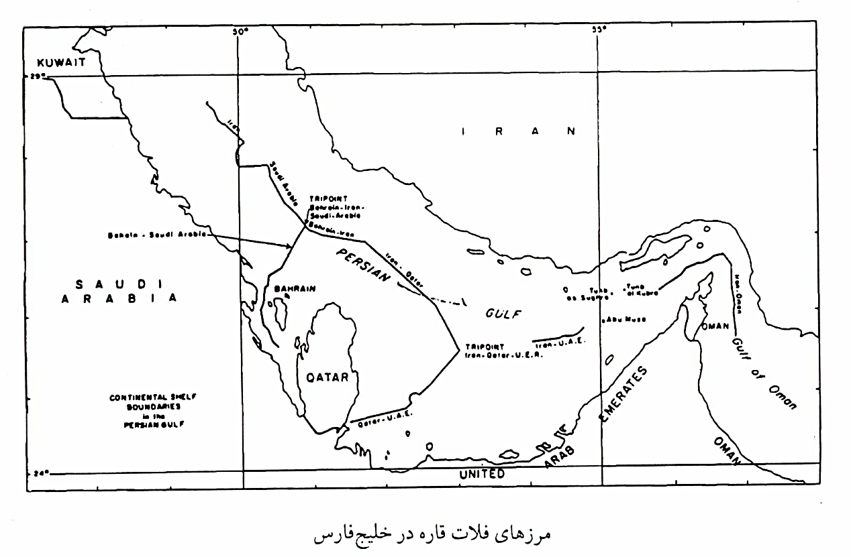
Continental Shelf Boundary in the
Persian Gulf

Slide 7
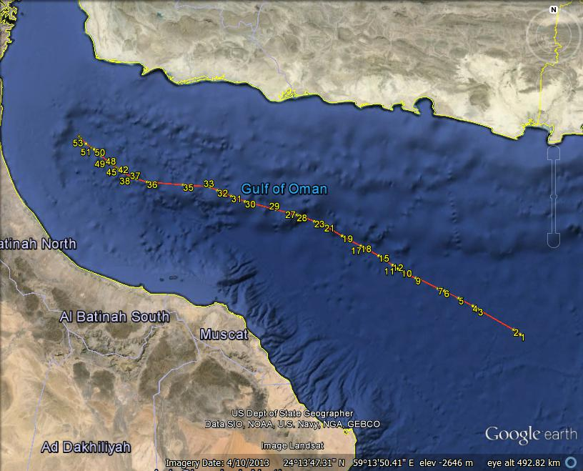
Borders between Oman & Iran

Slide 8
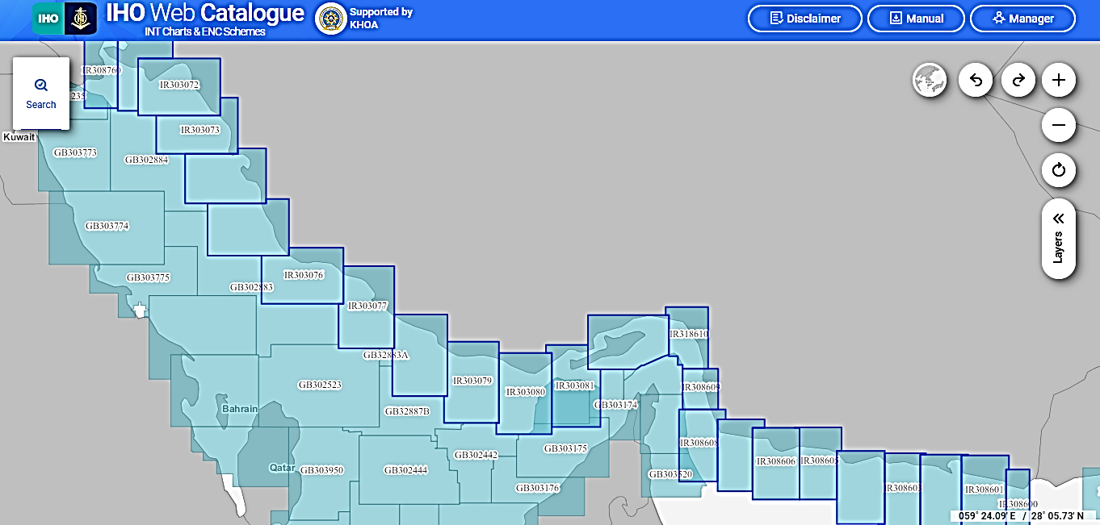
Iranian Coastal Coverage

Slide 9
IRAN ENC Overlaps
Close to Strait of Hormuz
IR 303080 GB 302441 & GB 303175
IR 303081 GB 302441, GB 303174 & GB 303175
Nautical Charts IR 303080 (INT 7217) & IR 303081 (INT 7214): Resolution of the maritime boundaries between the coastal states need to be solved by discussion.
Note: Nautical Chart IR 303082 (INT 7225) covered a portion of Omani waters, which was modified by Iran.

Slide 10
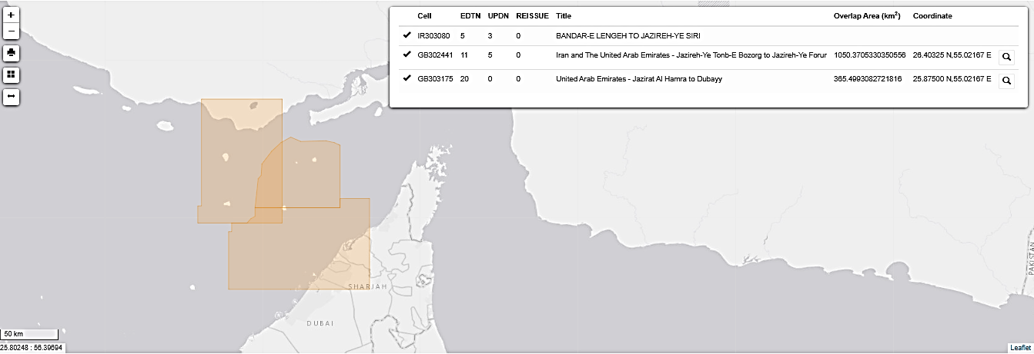
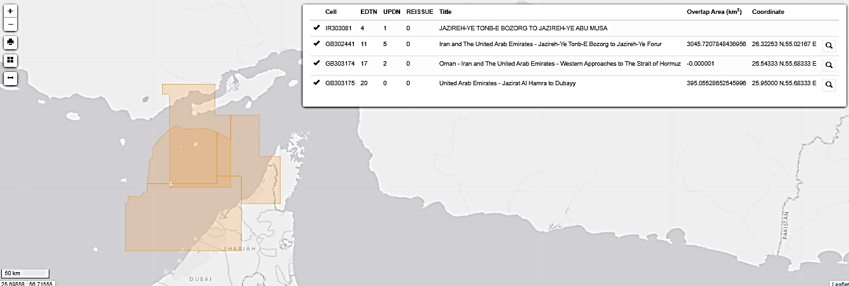

Slide 11
IRAN ENC Overlaps
Gulf of Oman
IR308608 GB 303171 & GB 303520
IR308609 GB 303171 & OM 301219
IR318610 OM 301219
The GB cells (GB 303171 & GB 303520) have been clipped to adjust to IR308608 & IR318609. The meridian line between Oman & Iran should be discussed.
It is worth mentioning, for instance, that the Omani Chart 301219 (INT 7204) produced at 1:125000 for the Strait of Hormuz also covers some Iranian waters (IR308609 & IR318610).
Persian Gulf
IR 308760 GB 301235, 302884 & 303773: Due to the undesignated borderline between Iran & adjacent States. This dispute should be resolved politically.

Slide 12
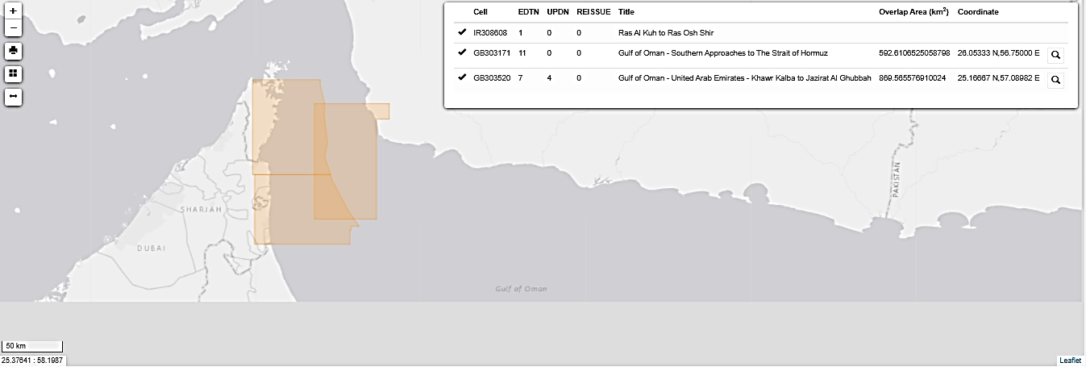
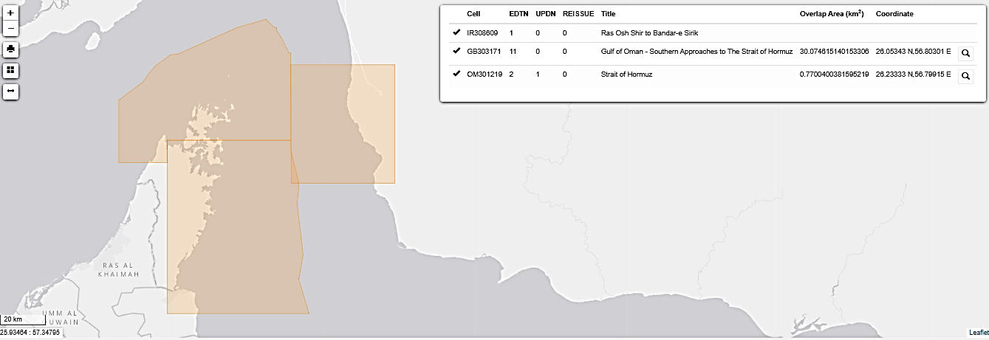

Slide 13
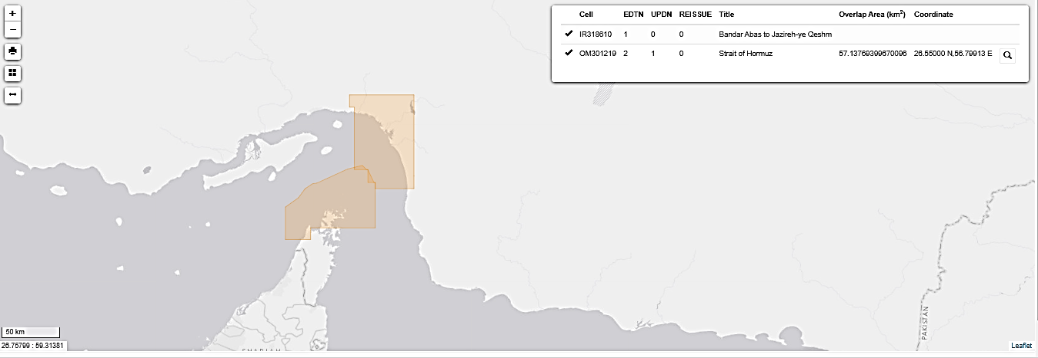
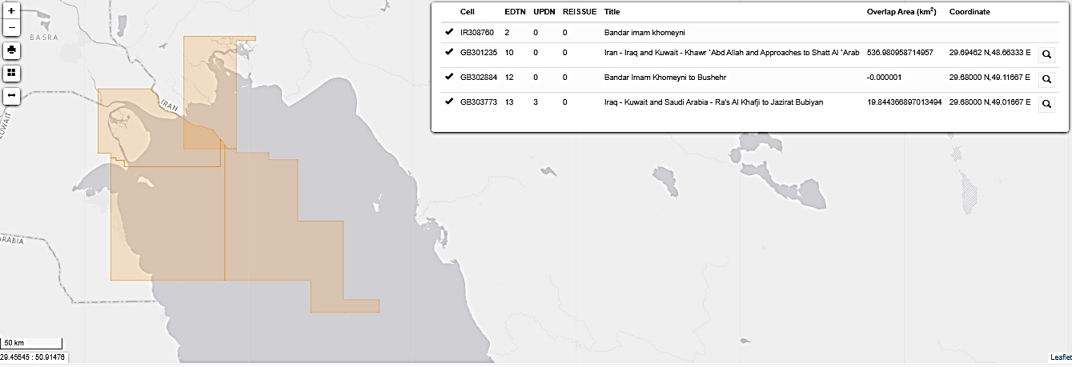

Slide 14
Compilation Scale Error
Persian Gulf
● IR 403031 GB 500011 ( it will be settled soon between GB and Iran )
GB 500011 (Approach 1:22000) has the same compilation scale with IR 403031 (Approach 1:25000), but in different usage bands. UK changed to harbor while compilation scale remained unchanged and set 1:22000.
Harbor> 1:22000 ≤ 1:4000
Approach> 1:90000 ≤ 1:22000
● GB 500011 is in approach usage band as compilation scale saying so. It must then be replaced with IR’s cells.

Slide 15
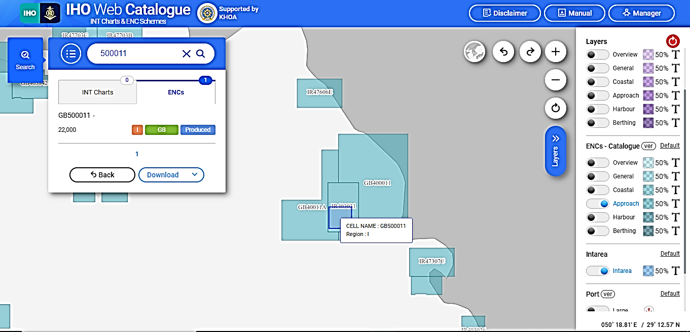

Slide 16
ICENC Report (Live)
ENC 1 | ENC 2 | ENC 1 Scale | ENC 2 Scale | Overlap Extent | Risk | Justification | Action
IR303072 | GB41268B | 90000 | 90000 | 43Km x 23Km | M | Some buoyage and WRECKS differences noted in content differences. Approaches to Khowr-e Musa lots of traffic. | Agree scheming between producers
IR308755 | GB41268B | 90000 | 90000 | 26Km x 37Km | M | Some buoyage and WRECKS differences noted in content differences. Approaches to Khowr-e Musa lots of traffic. | Agree scheming between producers
IR308760 | GB41268B GB301235 GB302884 GB303773 | 90000 | 90000 90000 180000 90000 | 21Km x 5Km 30Km x 24Km 3Km x 4Km 3.7Km x 6.7Km | M L L L | Some buoyage and WRECKS differences noted in content differences. Approaches to Khowr-e Musa lots of traffic. Overlap in the location of an estuary with lots of local traffic. Some inconsistency in the bathymetry and capture of wrecks. A small overlap located in the approach to a Delta. Content consistency is reasonable. | Agree scheming between producers. Request GB to clip cell Request GB to clip cell. Request GB to clip cell
IR403031 | GB500011 | 22000 | 22000 | 11.97km x 11.28km | M | Larger sized IR cell completely overlaps smaller GB cell. Overlap covers an island and close coastal waters. The island is a main oil/gas terminal for the locum. Data content for the bathymetry is consistent, however the GB cell has extended land area to the south for new harbor and extended coast line to the north for airfield extension. South cardinal buoy to the south of the island has different location. High level of traffic around the south of the island, lots of minor traffic routes surrounding island. | Request GB to clip cell (it was resolved)
IR303080 | GB302441 GB303175 GB302442 | 90000 | 90000 | 24Km x 59Km 14Km x 32Km 45Kmx0.4m | L | Overlap is in a location which includes waters surrounding an island, and high traffic areas with TSS. The content is reasonable with Cables not being captured on IR cell. Overlap situated seaward of coastal waters. Content similar, except for pipeline and pipe area not captured in GB cell. High level of traffic using this area Less than a meter overlap between 2 different producers | HOs to discuss and resolve overlaps HOs to discuss and resolve overlaps
IR303081 | GB302441 GB303175 GB303174 | 90000 | 90000 | 62Km x 52Km 66Km x 12 Km 47Km x 15 Km | L | Overlap is in a location which includes waters surrounding an island, and high traffic areas with TSS. The content is reasonable with Cables not being captured on IR cell. Overlap situated seaward of coastal waters. Bathymetry and OFSPLT similar, Pilot boarding and cables captured on GB cell. High level of traffic using this area. Overlap located offshore. Depths located in the approach to the TSS can differ by 10m but are all deeper than 60m. Cables captured on GB cell. | HOs to discuss and resolve overlaps

Slide 17
ICENC Report (Live)
ENC 1 | ENC 2 | ENC 1 Scale | ENC 2 Scale | Overlap extent | Risk | Justification | Action
IR303082 | OM301219 | 90000 | 90000 | Less than 0.1m wide | A | Very thin overlap | Request producers to liaise ( was modified by Iran)
IR308608 | GB303171 GB303520 OM301218 | 90000 | 90000 | 14Km x 60Km 34Km x 38Km Approx. 13.4 x 60.2km | L | Overlap situated in the entrance of Strait of Hormuz. Content similarity is reasonable, some inconsistent capture of cables. High level traffic and important routes. Overlap situated in the entrance of Strait of Hormuz. Depth contour inconsistent, but all over 100m depths. Some cables are not shown on IR cell. Lots of traffic between main routes. OM301218 has been clipped to match existing cell GB303171, so the overlap with IR308608 is smaller and matches the overlap currently on the market. | Producers to liaise about ENC scheming ( has been clipped by GB) Producers to liaise about ENC scheming ( has been clipped by GB)
IR308609 | GB303171 OM301219 OM301218 | 90000 | 90000 | 4Km x 10Km 220m x 6.2Km Approx. 3.6 x 15.5km | L | Overlap situated in the entrance of Strait of Hormuz. Content consistency reasonable, cable not captured in IR cell. High level traffic and important routes. This small overlap is located in the Strait of Hormuz. Bathymetry is consistent in area and no other objects within Overlap. There are main routes into the Gulf with a lot of traffic. OM301218 has been clipped to match existing cell GB303171, so the overlap with IR308609 is smaller and matches the overlap currently on the market. | Producers to liaise about ENC scheming( has been clipped by GB) Request producers to liaise ( has been clipped by GB)
IR318610 | OM301219 | 90000 | 90000 | 5.7km x 10.6km and 3.7km x 10.7km 5Km x 2.5Km and 10,5Km x 3Km | L | Two overlaps located in the Strait of Hormuz, to the south of the island Jazireh_Ye Qeshm. The bathymetry content consistency is reasonable, the capture of cable is inconsistent with the alignment is over the tolerance of 3mm at chart compilation. OM have captured a MIPARE whilst IR have this as point SEAARE. There are main routes into the Gulf with a lot of traffic. | Request producers to liaise. IC-ENC will notify Primar of the overlap with IR318610, requesting clipping to reduce the extent of the overlap. In the meantime, IC-ENC will assess the overlap based upon the 7 criteria and will inform the Regional Hydrographic Commission to facilitate further ENC scheming agreement

Slide 18
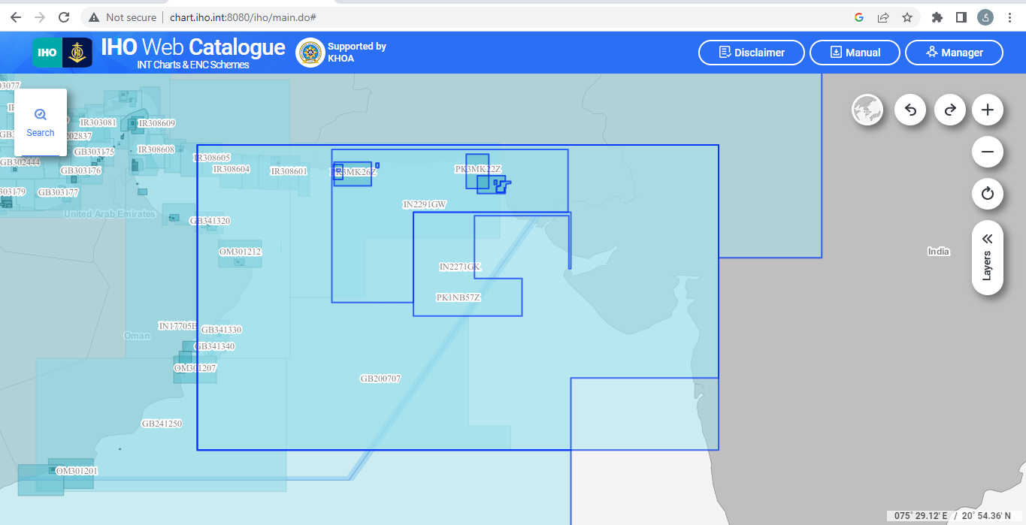
Other Producer States
India & Pakistan

Slide 19
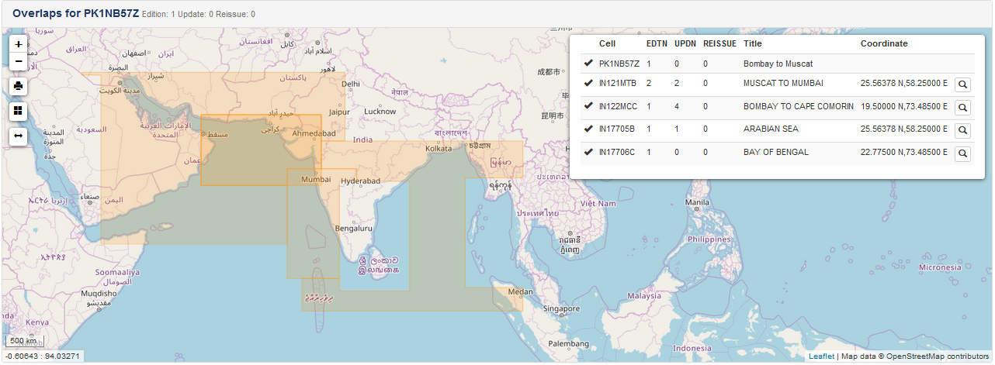

Slide 20
ICENC Report
ENC 1 | ENC 2 | ENC 1 Scale | ENC 2 Scale | Overlap extent | Risk | Justification | Action
BH46501B | BH45006B | 45000 | 45000 | 900m x 2m | L
GB200707 GB202851 GB241250 GB241400 OM207500 OM207501 PK1NB57Z | IN121MTB | 700000 1500000 | 700000 | 694Km x 466Km 270Km x 637Km 268Km x 283Km 615Km x 451Km 223Km x 56Km 471Km x 406Km 1525Km x 918Km | U | small scale ENCs Based compilation scale | Agree scheming between producers. HOs to discuss and resolve overlaps
GB241400 | IN2251AA IN2271GK IN2291GW | 700000 | 180000 350000 700000 | 76Km X 67Km 256Km x 77Km 614Km x 458Km | U | Compilation scales are very different. Offshore, port bound traffic Different compilation scales, offshore, lots of light traffic routes Larger scale covering coastal waters and offshore. Lots of light traffic | HOs to discuss and resolve overlaps
OM207501 | GB200707 GB202851 GB241250 | 700000 | 700000 | 217km x 407km 129km x 538km 553km x 229km | L | Not many differences between the ENCs but the overlap is big. | IC-ENC will liaise with UKHO on the overlaps with the existing coverage to resolve the overlap before the ENC is released.
OM301218 | GB303171 | 90000 | 90000 | 65km x 80.4km | L | OM301218 has been clipped to match the coverage area of this existing cell GB303171, which should now be cancelled.
OM301219 | GB303172 | 90000 | 90000 | Less than 0.1m wide | A | Very thin overlap | Request GB to clip cell
PK3MC27Z | PK3MK26Z | 90000 | 90000 | 13.58 x 33.87NM | L | This New Cell contains more up-to-date information than the existing cell. | Requested PK clip existing coverage to this New Cell
PK4MK06Z | PK4SC05Z | 45000 | 45000 | 18.1 x 13.4NM | L | This New Cell contains additional features to those captured on the existing "adjacent" cell | Suggested PK clip existing cell to this New Cell
PK1NB57Z | IN17705B | 1500000 | 3000000 | 165m x 330 Km + 180m x 1525Km | A | Overlap situated on land.

Slide 21
IC-ENC'S OVERLAP REPORT DEFINITIONS
Live | Overlap exists in IC-ENC Folio
Potential | Overlap identified at IC-ENC validation stage, actions are underway to be resolved between producers before new data is released. But, there is the potential that this is unsuccessful and a new overlap will be introduced.
Accept | Overlap exists, but is acceptable. Likely to be due to the 5-m allowable tolerance at international boundaries, or insignificant.
Resolved | An overlap, or potential overlap, that has been successfully resolved by the two producers, through IC-ENC facilitation.
Low | The overlapping data content poses little risk to the safety of shipping. However, there is always the underlying concern of unpredictable behavior of certain ECDIS with any type of overlap, and so there is still justification for the two HOs to resolve the overlap
Medium | The overlapping data presents some risk to the safety of shipping. IC-ENC will track the resolution of the overlap to its conclusion
High | The overlapping data presents significant risk to the safety of shipping. IC-ENC will proactively track and facilitate resolution of the overlap to its conclusion. IC-ENC will issue such warnings as it thinks fit in the circumstances of the case, and shall bring such warnings to the attention of Value Added Resellers
Unable | Initial assessment, IC-ENC unable to conduct full assessment because does not have access to the ENC (i.e. it is a non-RENC ENC)
Unassessed | Overlap not yet assessed, work ongoing

Slide 22
Thank you for your attention!
Any questions?

