Slide 1
17th Meeting of the Southern African and Islands
Hydrographic Commission
National Report by France
(Shom)
[SAIHC Member State]
SAIHC17, VTC, 3 – 4 February 2021

Slide 2
Top achievement during the year
Surveys works have just been completed with BHO Beautemps-Beaupré in the French overseas departments & territories in the Mozambique channel (June-September 2019)
Survey off Mayotte Island and Geyser Reef
Survey off Juan de Nova Island
(Scattered Islands)
Survey off Europa Island
(Scattered Islands)

Slide 3
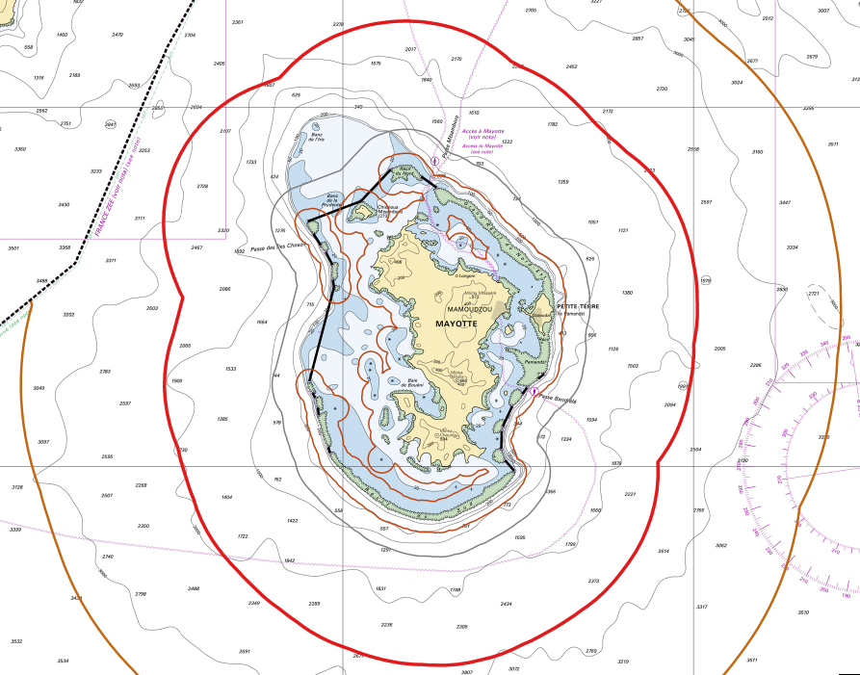
Top achievement during the year
French MSDI portal data.shom.fr: new layers or new editions in the SAIHC region
New layers:
  Outer limits of the territorial sea and contiguous zone of Mayotte Island
  Limits related to fishery uses (3 and 100 NM) for Mayotte and La Reunion Islands
  Limit of the preventive archeology licence fee (1 NM) for Mayotte and La Reunion Islands
New editions:
  Annual edition for wreck and obstruction layer
  Maritime Altimetric References
  New tools and services (https://services.data.shom.fr/support/fr)
Maritime limits off Mayotte Island including 1, 3 and 100 NM (data.shom.fr)

Slide 4
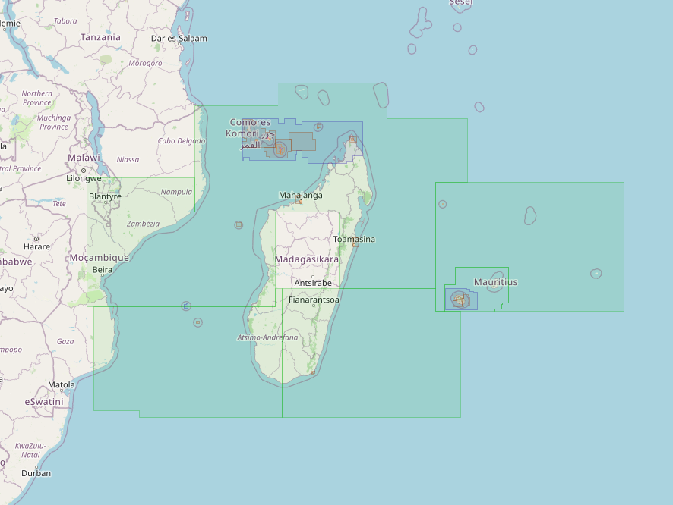
Progress on charting and msi
Charting:
  ENCs : 4 new produced in region H (FR36643D, FR46643A, FR46643C & FR56643B) – 62 FR cells currently available for the region H
  Paper charts : 4 new editions (INT7747 [FR6498], INT7749 [FR6741], INT7710 [FR7490] & FR7170)
MSI: no change (no NAVTEX station in French overseas territories, MSI warnings are broadcast through SafetyNet network)
Shom’s ENC production within Region H except Saint Paul, Amsterdam, Kerguelen and Crozet Islands
(source: Primar online catalogue)

Slide 5
CAPACITY BUILDING
Due to the covid-19 crisis, the following actions, foreseen in the CBWP2020, could not be carried out by France:
    Technical visit to Comoros (CBWP2020 activity A-03)
    High level and technical visit to Madagascar (CBWP2020 activity A-05)
> The possibility of postponing these two activities to the year 2021 will be studied

Slide 6
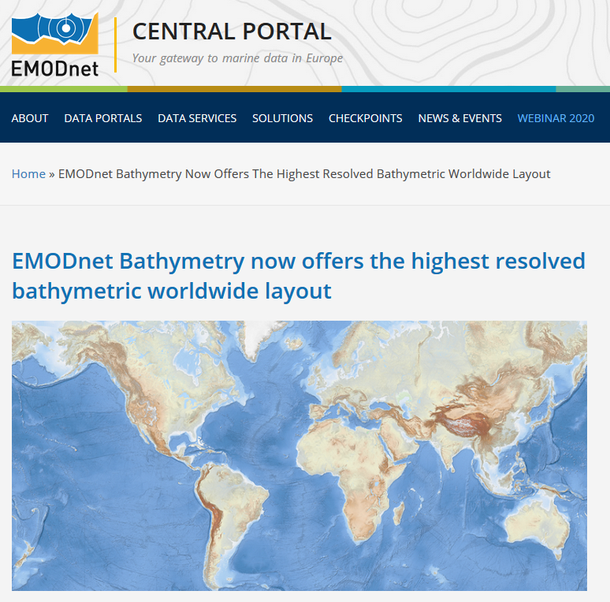
REPRESENTATION OF SAIHC AT IENWG
France represents the SAIHC at the IHO-EU Network WG (IENWG) since its creation
EMODnet EU initiative celebrated its 10th anniversary in 2020
Provides since June 2020 a Bathymetry World
Base layer via the open standard OGC WMTS
https://tiles.emodnet-bathymetry.eu/
Based on EMODnet DTMs in European sea
regions and GEBCO

Slide 7
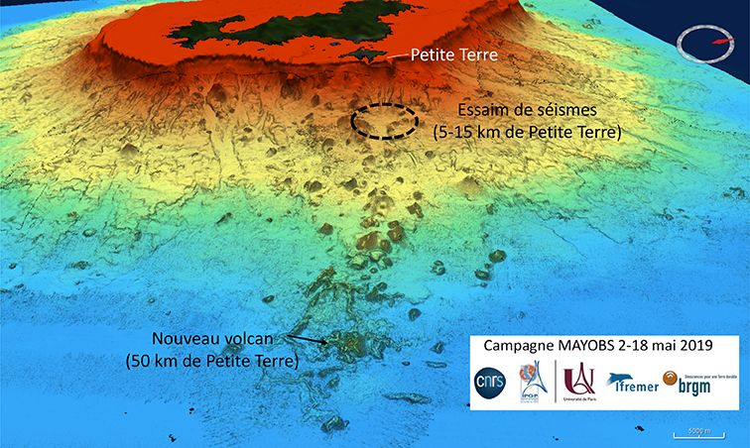
Top challenges
Since May 2018, Mayotte Island has been undergoing a "seismic crisis“
Several dozen earthquakes, some of which were felt by the population, have been recorded since that date and located in an area about 50 km east of the island. These earthquakes have been associated with the appearance of an underwater volcano in the zone of origin of the seismic activity.
very significant subsidence observed > mechanical apparent rise of the mean sea level
DTM from MAYOBS Campaign showing the new volcano

Slide 8
Top plans that affect the region
(charts, surveys, training, other)
Deployments of the Survey Vessel Beautemps-Beaupré and the Research Vessel Pourquoi Pas? in the Indian Ocean in 2021
Planned works :
  Hydrographic survey off Mayotte Island with Beautemps-Beaupré
  Geophysical and acoustic campaign in the Mozambique Channel, between Juan de Nova and Mozambique, with Pourquoi Pas?
  Next deployment of the Survey Vessel Beautemps-Beaupré in the Indian Ocean : 2023

