Slide 1
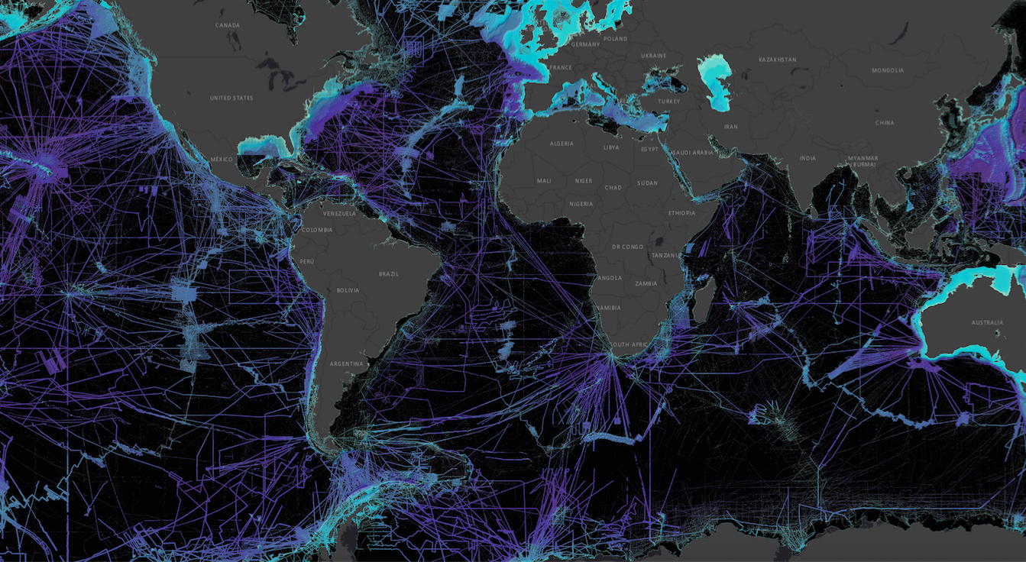
IHO Crowdsourced Bathymetry Initiative
An IHO-led collaborative project to better enable mariners and professionally manned vessels to collect “crowdsourced bathymetry”
bathydata@iho.int

Slide 2
Crowdsourced bathymetry (CSB) is the collection of depth measurements from vessels, using standard navigation instruments, while engaged in routine maritime operations.
Notes:
This is not systematic surveys on hydro ships; any vessel operating that has an interest in collecting and providing that data.
Fugro sometimes presents themselves as collecting CSB...but really, they are collecting mulitibeam data while in transit...we refer to that as Transit Data. It is not CSB by this definition.

Slide 3
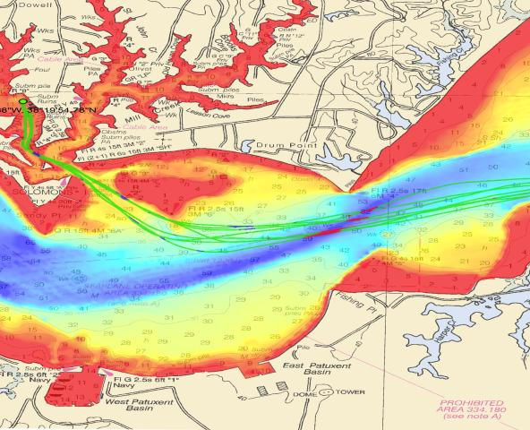
The Role of CSB Data:
  Valuable data with scientific, commercial & research value at no cost to the public sector
Support national and regional development activities
Fill gaps where data is scarce
Useful along shallow, complex coastlines that are difficult for traditional survey vessels to access and may be more frequently visited by recreational boaters
Identify uncharted features
Assist in verifying charted information
Confirm whether charts are appropriate for the latest traffic patterns.
NOAA’s Bay Hydro II CSB test tracks in green overlaid on multibeam survey data demonstrates how changes can be detected. Image courtesy of NOAA.
  ...but only if vessels collect and donate depth information while on passage

Slide 4
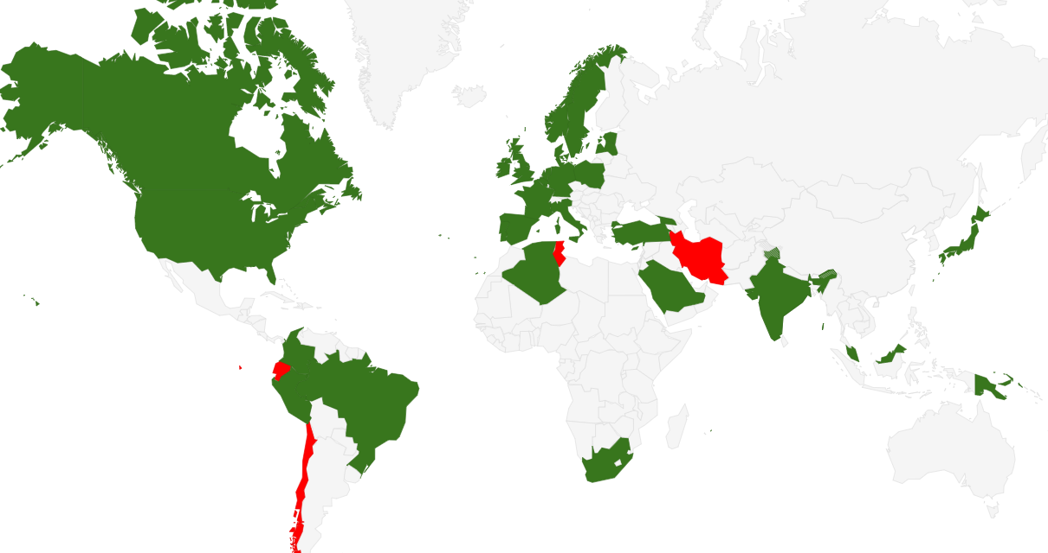

IHO CL 11/2019
https://www.iho.int/iho_pubs/bathy/B_12_Ed2.0.2_2019.pdf
“CALL FOR APPROVAL OF EDITION 2.0.0 OF IHO PUBLICATION B-12”
35 Member States approved the adoption of B-12 out of 38 replies.
Notes:
This document, B-12 IHO Guidance on Crowdsourced Bathymetry, was published earlier this year and is available online.

Slide 5
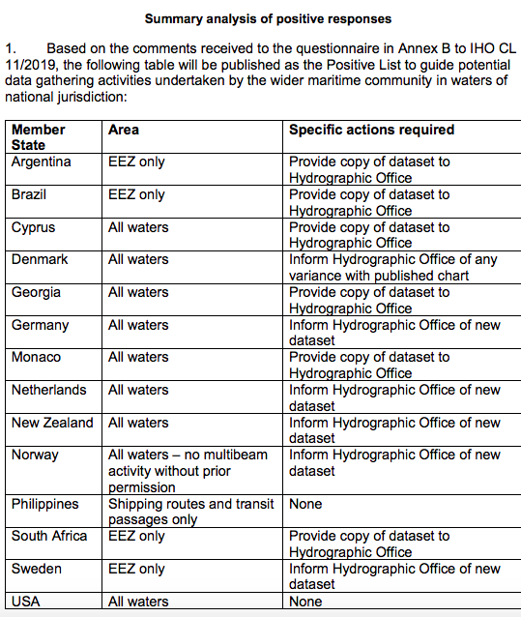
IHO CL 11/2019 Annex B
“ACCEPTANCE OF CROWDSOURCED BATHYMETRY ACTIVITIES IN NATIONAL WATERS OF JURISDICTION”
13 IHO MS have replied “positive”
  CL 47/2019 provides a summary analysis of positive responses ==>
The IHO DCDB will filter out CSB data collected from the waters of all coastal countries not included on the positive list. This includes:
  MS we believe are pro-CSB but have not replied
  Coastal countries that are not IHO MS

Slide 6
IHO Member States:
The IHO encourages member states who have not responded to review Annex B CL 11/2019 and, if possible, offer a positive response before the Assembly.
Note: A MS can include "conditions" or "prerequisites" as needed.
Notes:
Example caveats shown in right hand column

Slide 7
Non-IHO Coastal States:
The IHO encourages all coastal states of the SWAtHC to provide their official position on CSB Activity in their areas of national jurisdiction to the Chair of SWAtHC.
Note: A Coastal State can include "conditions" or "prerequisites" as needed
Notes:
tell MACHC Seabed 2030 Coordinator

Slide 8
Final Thoughts:
The activity of crowdsourced bathymetry contributes to the greater goal
“to complete our global image of the planet”.
All data contributions will help improve the accuracy of the GEBCO grid as the sole global dataset of seabed topography available.
The GEBCO grid is where CSB and Seabed 2030 data collections are combined.

Slide 9
ALL states are invited to ask questions and share perspectives during and after the meeting.
Thank you.

