Slide 1
17th Meeting of the South West Pacific Hydrographic Commission National Report by
FRANCE

Slide 2
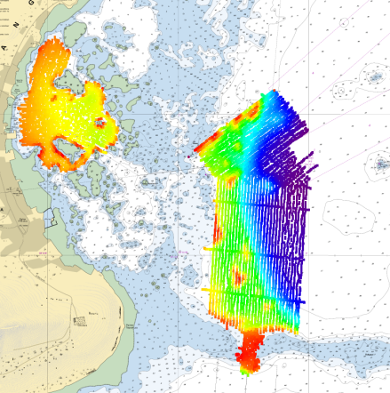
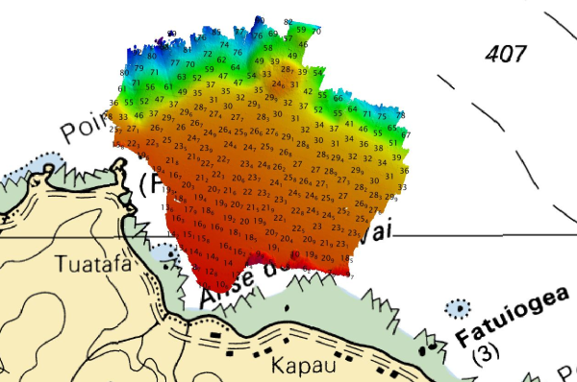
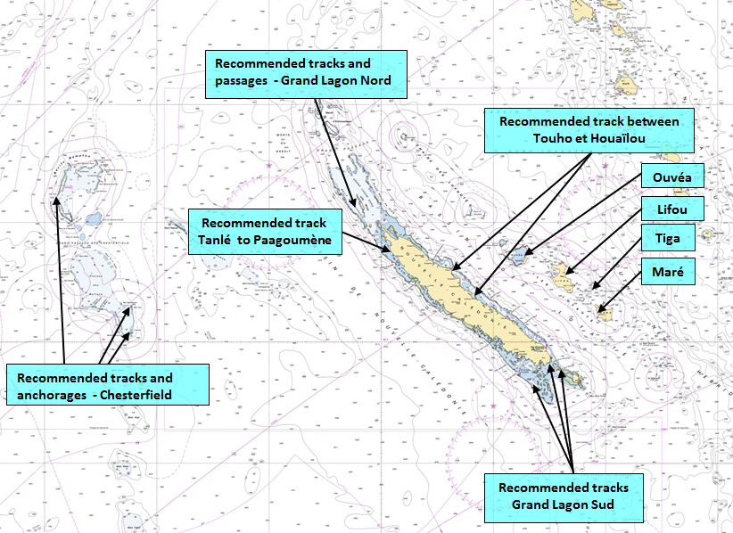
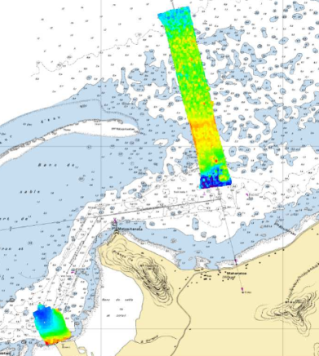
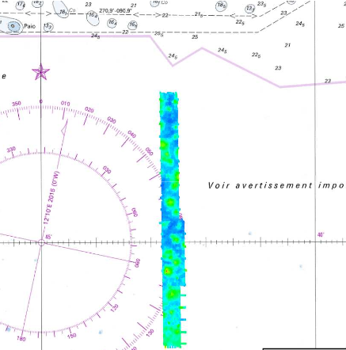
Main achievements during the year
Numerous hydrographic surveys carried out in New Caledonia, French Polynesia and Wallis and Futuna, planned in close cooperation with local authorities in support to maritime surveillance, commercial and cruise activities
Raivavae
Rikitea
Futuna
Rangiroa

Slide 3
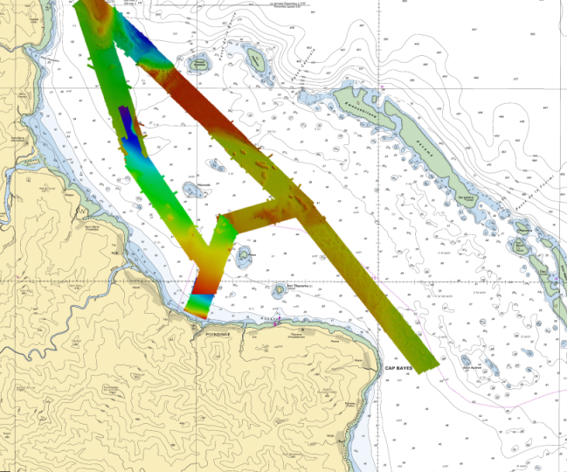
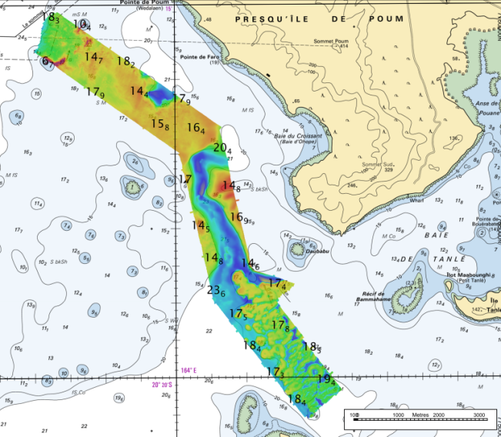
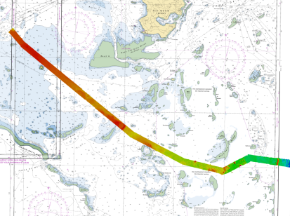
Main achievements during the year
The switch to an all-MBES capacity in New Caledonia has made it possible to speed up the conduct of the surveys considerably
The hydrographic unit in Papeete will be equipped with portable MBES at the second semester 2020
Recommended track between Houaïlou and Touho
Tanlé to Paagoumène tracks
Grand Lagon Sud

Slide 4
Main challenges and/or obstructions
The means of acquisition at sea in French Polynesia remain limited in view of the size of the area and of the logistical constraints linked to the projection of teams and equipment
The maintenance of the French tide gauge network in the Pacific remains a challenge

Slide 5
Progress on surveys, charting and MSI
Surveys:
Area of responsibility
Survey Status Updated December 2019C |  | Depth < 200m |  |  | Depth > 200m
 |  | A | B | C | A | B | C
L | French Polynesia | 26.2 | 13.0 | 60.8 | 19.1 | 0.2 | 80.7
 | New Caledonia | 13.8 | 20.9 | 65.3 | 16.4 | 3.3 | 80.3
 | Wallis & Futuna | 16.6 | 31.0 | 52.4 | 12.5 | 0.0 | 87.5
Coastline: 7 900 km
EEZ: 6.4 M km²
Large lagoon areas (NC: 24 000 km²)

Slide 6
Progress on surveys, charting and MSI
Charting:
ENCs : 41 new cells produced since the last conference
207 cells currently available for the region L
50 new cells planned for 2020
INT Charts 5 new or limited editions since the last conference
National charts 1 new chart (FR7459 Tikehau), 14 new or limited editions since the last conference
FR6686 (INT6843 Loyauté islands) and FR6768 (INT6844 Osle of Pines) are planned for 2020-2021
Charting Status Updated January 2020 |  | Small (<1 M) |  |  | Medium (1M < / < 100 000) |  |  | Large (> 100 000) |  |  | Metric | WGS84
 |  | A | B | C | A | B | C | A | B | C
L | French Polynesia | 100 | 0 | 100 | 100 | 0 | 100 | 60 | 0 | 72 | 100 | 96
 | New Caledonia | 100 | 0 | 100 | 100 | 0 | 100 | 92 | 0 | 100 | 100 | 100
 | Wallis & Futuna | 100 | 0 | NA | 100 | 0 | NA | 75 | 0 | 100 | 100 | 100

Slide 7
Progress on surveys, charting and MSI
MSI: no change, no NAVTEX station in French overseas territories, MSI warnings are broadcast through SafetyNet network

Slide 8
Contributions to the IHO DCDB and GEBCO
Shom does not provide directly to the DCDB bathymetric data on waters under French jurisdiction.
These data (in the form of bathymetric datasets : soundings) are accessible online:
http://diffusion.shom.fr/pro/amenagement/bathymetrie/lots-bathy.html
Distributed under Creative Commons « CC-BY-SA 4.0 » licence
Bathymetric datasets collected in international waters are provided regularly for integration in the GEBCO products
Distribution of coverage survey polygons along with associated metadata on the IHO DCDB website, is ensured for Shom, trough the EMODnet Bathymetry WFS webservice

Slide 9
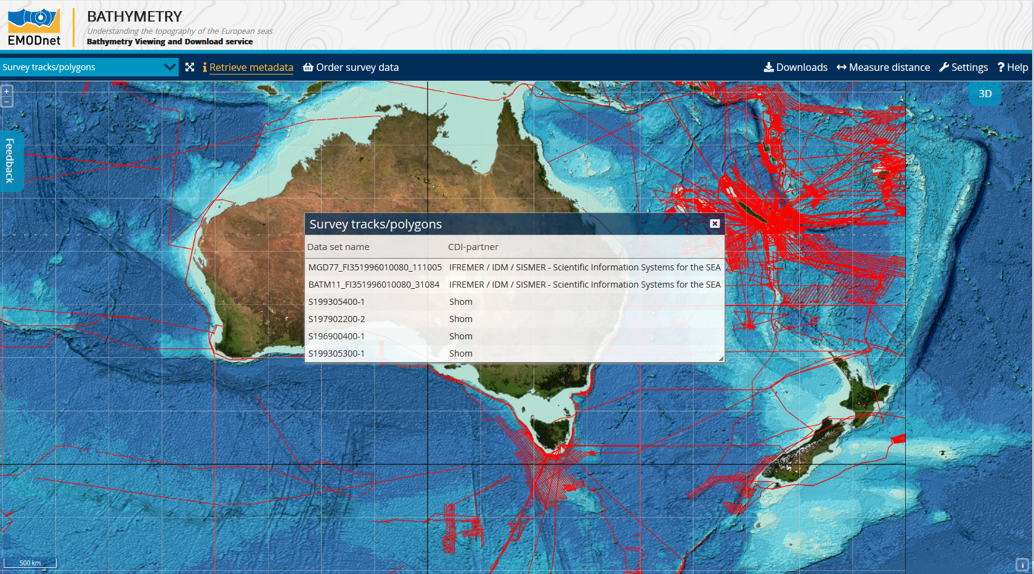
Contributions to the IHO DCDB and GEBCO

Slide 10
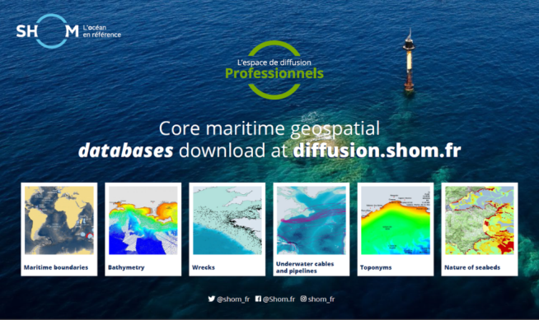
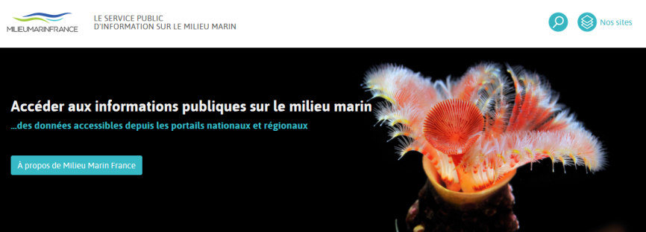
Progress on MSDI
Shom’s maritime and coastal geographic information portal
data.shom.fr
diffusion.shom.fr
French maritime limits portal
https://limitesmaritimes.gouv.fr https://maritimelimits.gouv.fr
New national portal (Marine Environment Information System – SIMM -https://www.milieumarinfrance.fr) to facilitate the sharing and dissemination of data on the marine environment.
Extension to overseas territories in the future.
Regularly updated with new product and services
Notes:
National site for consultation and diffusion of the official information on the maritime delimitations of France : French maritime limits portal https://limitesmaritimes.gouv.fr/

Slide 11
Plans that affect the region
Reinforcement of the acquisition capacity at sea: reinforcement of the team based in Papeete, changeover to “full-MBES”
New nautical means for the French Navy (planned for the end of 2022):
Oversea Patrol Boat (Patrouilleur d’Outre-Mer), equipped with a Travocean moonpool
Remote sensing : SDB performance improvement and possible lidar projects
Shom tide gauge network should start its renovation at the end of 2020

Slide 12
Save the date !
You are all invited to Paris on November 19th 2020 to celebrate the 300th anniversary of French hydrography
https://www.shom.fr/fr/300_ans

