Slide 1
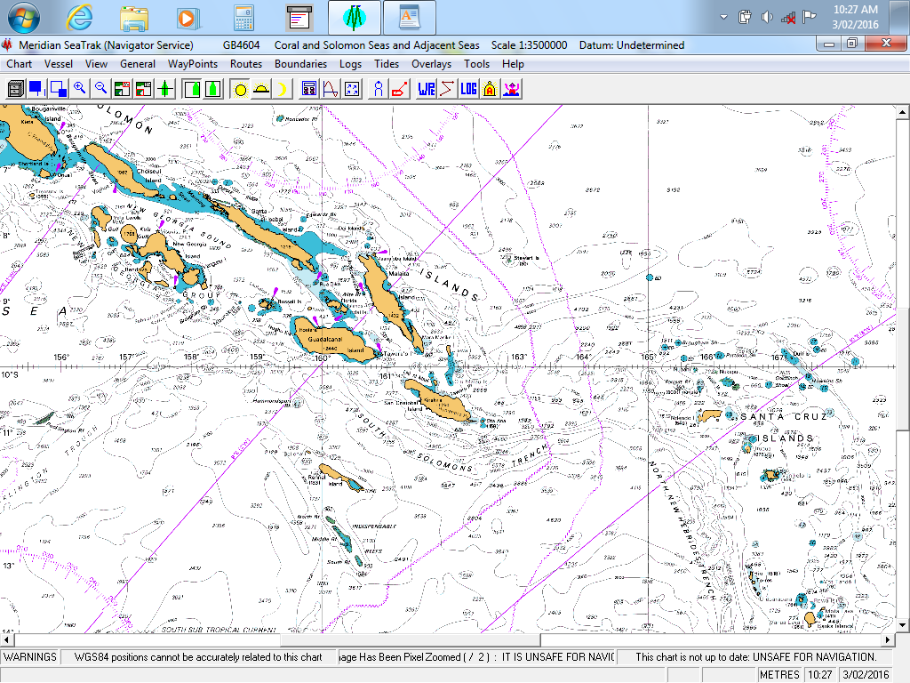
17th Meeting of the South West Pacific Hydrographic Commission National Report by
Solomon Islands Hydrographic Unit
SIHU/SIMA

Slide 2
Main achievements during the year
Solomon Islands become IHO Member State (MS) as of 15th July 2019.
New SI Chart SLB08 published by AHO on 12th July 2019.
SIHU took delivery of SI Tide Tables 2020 from AHO in Dec 2019.
SIHU Cartographer completed a 4 weeks IALA level 3 (AtoN) manager’s course at SPC in Fiji.
SIHU Cat B Surveyor graduated from USQ with a degree in Spatial Science Technology.
Solomon Islands Maritime Safety Administration (SIMSA) become Solomon Islands Maritime Authority (SIMA) 31st December 2019.

Slide 3
Main challenges and/or obstructions
Shortage of trained manpower.
SIHU does not have control over its budget.
Inability of SIHU to raise awareness at the decision making levels of the importance of Hydrography/Charting and the role of SIHU.

Slide 4
Progress on surveys, charting and MSI
Surveys: HMAS LEEUWIN of AHS conducted a survey of Bina harbour on Malaita Island in the last quarter of 2019. The harbour would be developed to gain international port status.
HMAS LEEUWIN may also conduct surveys of Diamond Narrows and Lucas Channel on New Georgia Island in the western part of SI and a site at the PNG/SI border for a SI Patrol Boat Base. TBC.
Charting: SIHU will negotiate with PCA (AHO) for production of new charts of certain areas of SI.
MSI: - SIHU needs to negotiate with SIMA management to create a position within its structure for the post of MSI National Coordinator and then to have the position filled with a competent person to carryout the responsibilities.

Slide 5
Contributions to the IHO DCDB and GEBCO
SIHU as yet does not contribute to the IHO DCDB and GEBCO.

Slide 6
Progress on Marine Spatial Data Infrastructures
Governance
Standards
Technology
Data
SIHU needs capacity building to bring it to the level where it can develop its MSDI and the above.
- will require assistance from PCA, SWPHC or IHO etc., to establish such capabilities.

Slide 7
Plans that affect the region
There are no plans currently in place that will affect the region.

Slide 8
Lessons learned to share
Membership of IHO. Other PICs represented here at SWPHC17 who are not yet IHO member states are encouraged to convince their Governments to seek membership of the IHO. It took SI 16 years trying to qualify for IHO membership until July of 2019.

Slide 9
Success stories to share
Refer to the achievements earlier indicated in Slide 2 of the presentation.
End of Presentation.
“TAGIO TO MAS”

