Slide 1
17th Meeting of the South West Pacific Hydrographic Commission NIUE

Slide 2
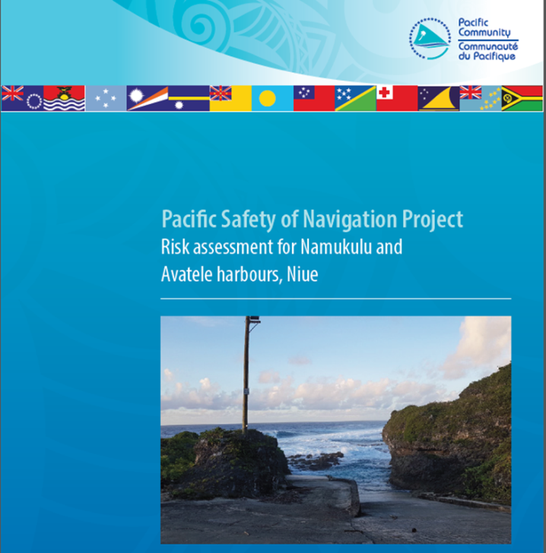
Main achievements during the year
Aids to Navigation Risk Assessment
of Avatele and Namukulu Channels
Notes:
February 2019, after the last SWPHC, SPC completed an AtoN risk assessment

Slide 3
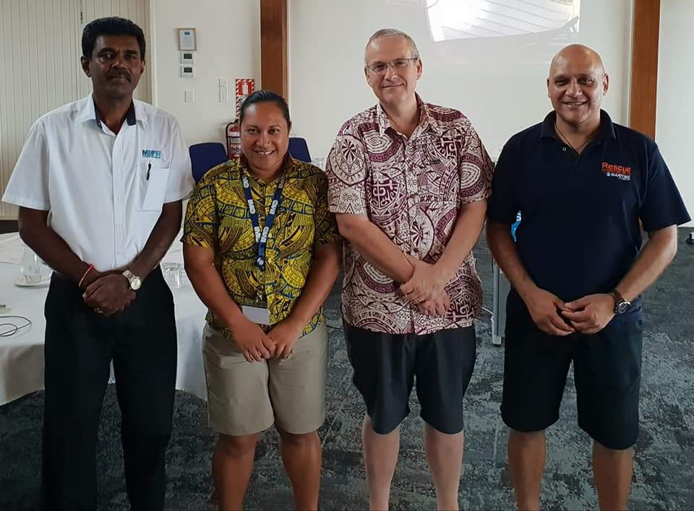
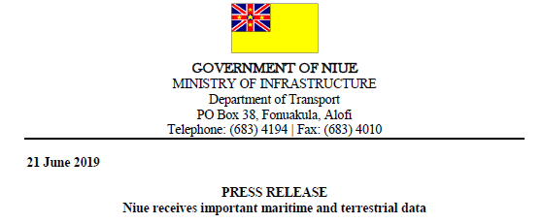
Main achievements during the year
IHO Technical Implementation Visit
MSI Training
PRNI Data Handover
Notes:
In June last year an opportunity was taken to provide a 1-day MSI training course in Niue.
This was delivered by NAVAREA XIV, MSAF(Fiji’s National MSI Coordinator) and LINZ, working together under the NZ aid programmes PRNI and PMSP
Sunil Kumar joined the team, strengthening his position as an experienced trainer within the region

Slide 4
Main achievements during the year
Progress with the legislation and the compliance strategy giving effect to the Large Scale Marine Protected Area
Drafting of the Maritime Safety Bill, which includes sections on MSI and AtoN
Local MSI warnings promulgated
Notes:
As was seen in the workshop before this meeting, Niue have been actively engaged with NAVAREA XIV and LINZ as the PCA for promulgating MSI

Slide 5
Main challenges
No full VHF Ch16 coverage around Niue
Marine radio operators require more training for MSI

Slide 6
Future focus
Installing Aids to Navigation at Avatele and Namukulu
Updated chart for Niue and new chart for Beveridge Reef
Full VHF Channel 16 coverage
Marine Spatial Plan, compliance and sustainable financing
Draft / amend legislation to implement the IMO conventions

