Slide 1
SWPHC18 Goal 3 Gap Analysis 18th Meeting of the South West Pacific Hydrographic Commission

Slide 2
Contents
Part 1 – Update on SWPHC17 Action 11
Recap on the UN Decade and SDGs
UN Decade Actions
Part 2 – Goal 3 Gap Analysis
Overview of Goal 3
Observations on gap analysis returns received
Summary of gaps and actions
Considerations for next steps

Slide 3
Part 1 - SWPHC17 Action 11
Action 11: UK and NZ to work with SPC and look into how the SWPHC should start addressing the challenges for implementing the SDGs of the UN Decade of Ocean Science for Sustainable Development
Borne out of the observations that:
Delivery of UN SDGs and UN Ocean Decade dependent on active engagement of the hydrographic community
To date, Hydrographic Office involvement in preparatory efforts has been limited
The Pacific region and by extension the SWPHC has a key part to play

Slide 4
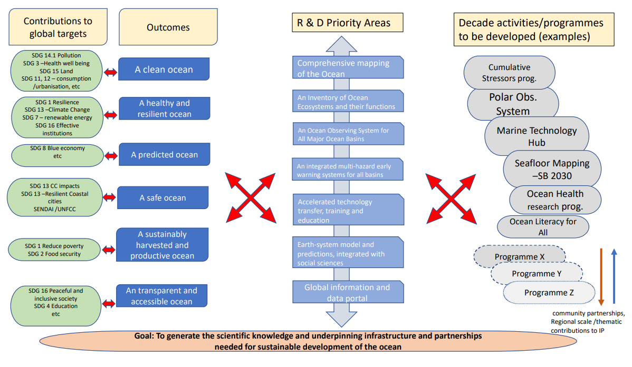
UN Decade as a delivery Framework for the SDGs

Slide 5
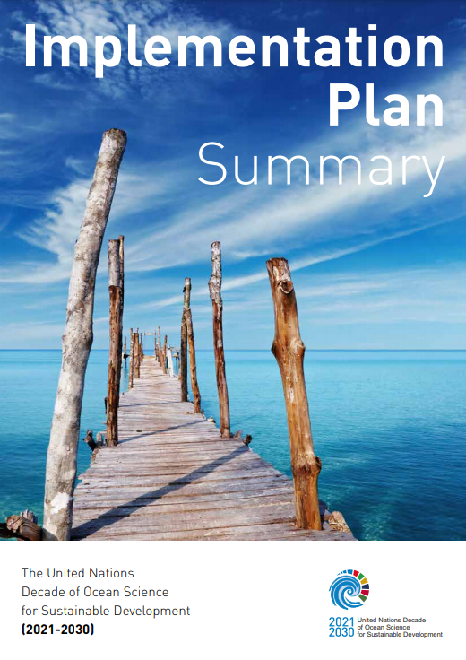
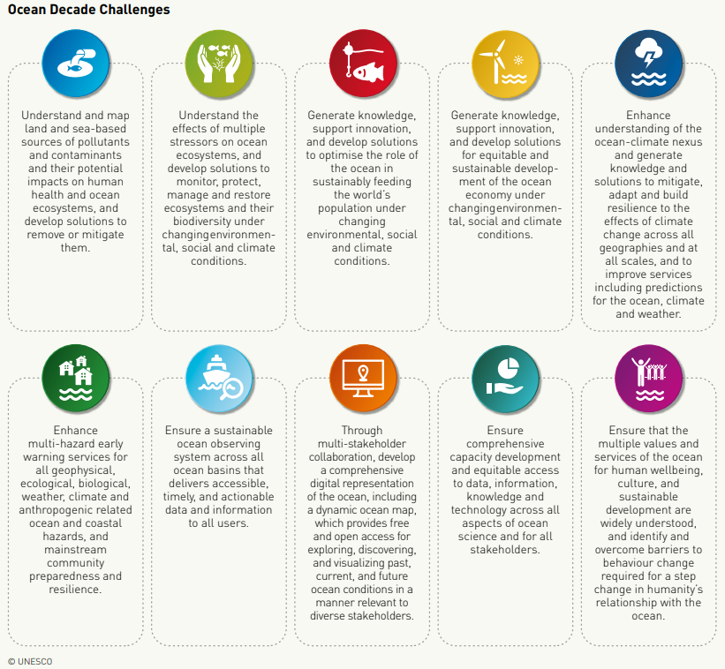
UN Decade as a delivery Framework for the SDGs
https://oceanexpert.org/document/27348

Slide 6
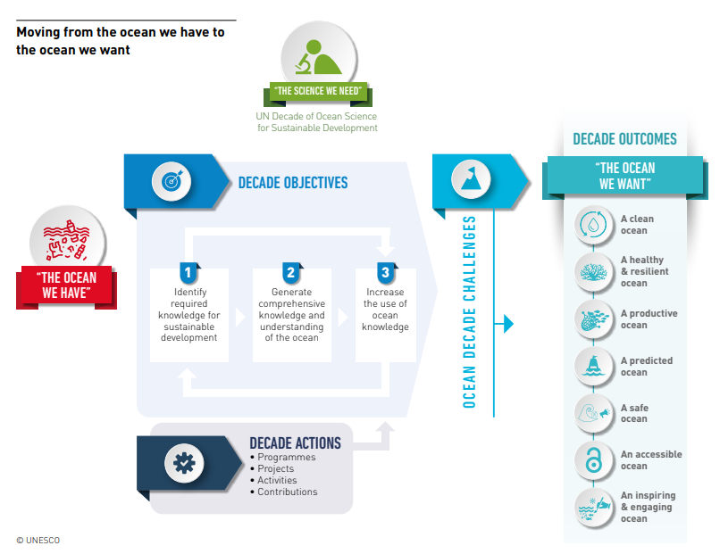
UN Decade as a delivery Framework for the SDGs
Decade Actions
Programme
Regional or Global
One or more Ocean Decade
Challenges
Long term
Interdisciplinary
Project
Discrete and focused
Regional , National or sub-national
Activity
- One of standalone initiative
Contribution
- supporting contribution e.g. funding or resource

Slide 7
Part 2 - Goal 3 Gap Analysis
Goal | Targets | SPIs
Goal 3: Participating actively in international initiatives related to the knowledge and the sustainable use of the Ocean | Collaborate with other bodies who deliver capacity-building and training to improve effectiveness of capacity-building activities and programmes | 3.1 | Percentage of Coastal States that are capable to provide marine safety information (MSI) according to the joint IMO/IHO/WMO manual on MSI (2026: 90%)
 |  | 3.2 | Percentage of Coastal States that are able to provide marine safety information (MSI) according to the joint IMO/IHO/WMO manual on MSI (2026: 90%)
 | Improve knowledge of the world's seafloors | 3.3 | Number of contributors to DCDB who are not hydrographic offices
 |  | 3.4 | Percentage of total sea area that is Seabed 2030 compliant for incorporation into the GEBCO dataset and services
 | Implement a comprehensive IHO digital communication strategy in order to enhance its visibility and accessibility to its work | 3.5 | Number of visits, likes, re-postings, etc. associated with the IHO social media sites
 |  | 3.6 | Volume downloaded from the IHO website and Geographical Information System (GIS)

Slide 8
Observations on gap analysis returns received
Returns received from:
Australia
France
New Zealand
Samoa
UK
United States of America
Cook Islands
Marshal Islands
Observations:
Different approaches taken
Most very specific to national challenges
Apparent gaps in info needed to inform meeting goal 3
Goal 3 supports delivery of Goal 2

Slide 9
Summary of gaps and actions
Gaps | Actions
Consistency of MSI proficiency | Strengthen MSI training offering and associated governance
Lack coordinated approach and visibility to international initiatives | Map international Ocean Affairs landscape Identify associated value chains Be present at key events e.g. MDB annual meetings
Clear linkages between SWPHC work Plan/CB plan and UN Decade | Develop ideas and associated plan for submission of Decade Actions and representation
Visibility in Ocean Science/policy making domain | Build evidence base to support bids/inclusion in initiatives Clear policy briefs on critical issues
Communications and outreach | Develop Comms Plan

Slide 10
Considerations for Next Steps
The Following Considerations are offered:
Do we have all the SPIs we need for the region?
Do we need to combine Goal 2 and 3 in our analysis of gaps and associate actions?
To what extent can we use the CB fund for catalytic activity for the region?
Should we develop a theory of change model to support the SWPHC work plan?

