Slide 1
18th Meeting of the South West Pacific Hydrographic Commission
SWPHC Disaster Response Framework
Update & next steps

Slide 2
SWPHC Disaster Response Framework
Disaster Response Framework adopted at SWPHC17
SWPHC17 Action 16: Coastal States to identify points of contact and means of communications

Slide 3
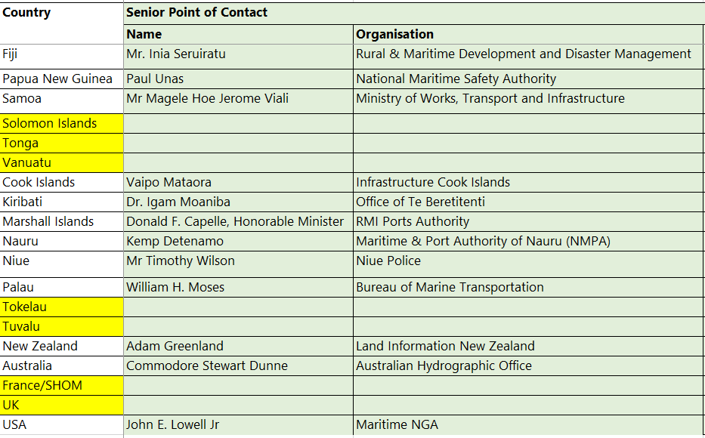
Points of Contact (@17/02/2021)

Slide 4
Next steps
Further work is required to clearly define the objective of the framework and roles & responsibilities
Rearrange content and headings to improve clarity and impact
Further discussion required to confirm activities i.e. 2 b) and 3
Create templates as required
Consider CB activities to drill and evaluate the procedures

Slide 5
Actions for SWPHC18
Note the report
Agree to continue the development of the framework by correspondence lead by the Chair
Request Members agree a ‘redline’ version via correspondence or at SWPHC19

