Slide 1
19th Meeting of the South West Pacific Hydrographic Commission National Report
NIUE

Slide 2
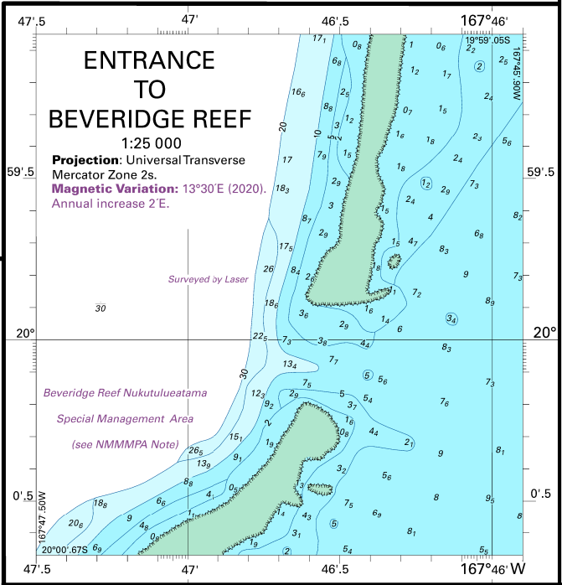
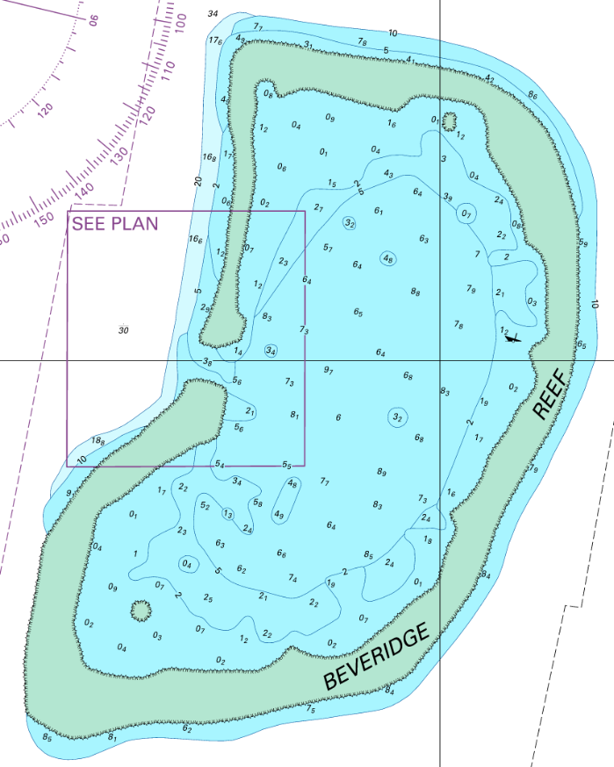
Main achievements during the year
NU131 Niue and Beveridge Reef

Slide 3
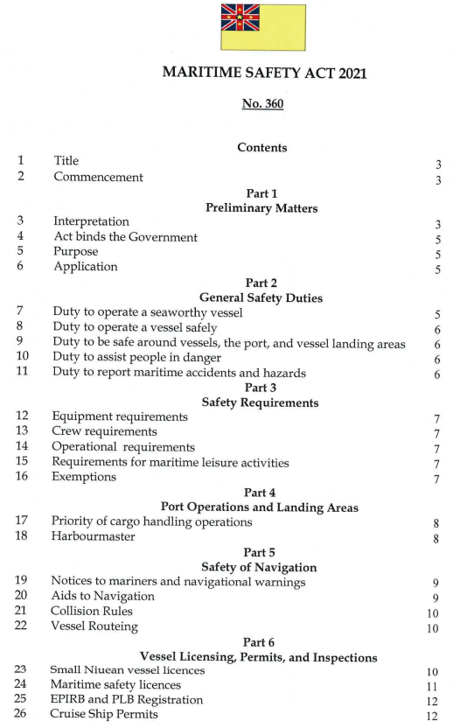
Main achievements during the year
Maritime Safety Act 2021
Section 19: Notices to mariners and navigational warnings
Section 20: Aids to Navigation
No anchoring within any submarine cable or pipeline protection zone

Slide 4
Main achievements during the year
Marine Spatial Management
Plan

Slide 5
Main challenges
Capacity building for staff
Marine radio operators
MSI for stakeholders
Delays to project implementation
Expansion of the VHF network
Maintenance and installation of aids to navigation

Slide 6
Future focus
Capacity building for staff
Expansion of the VHF network
Maintenance and installation of aids to navigation
Implementation of the Maritime Safety Act 2021
Re-installation of the tide gauge
Sustainable Financing Strategy under the NOW Project

