Slide 1
Marine Data Innovation Project
A technical proof of concept to enable integrated marine management through improved access to marine spatial data
Rachel Gabara
New Zealand Hydrographic Authority
SWPHC 23-25/02/2022

Slide 2
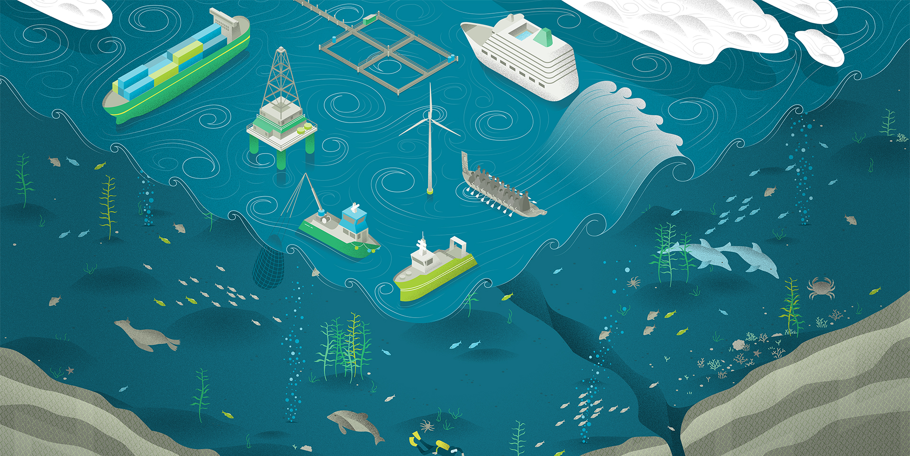
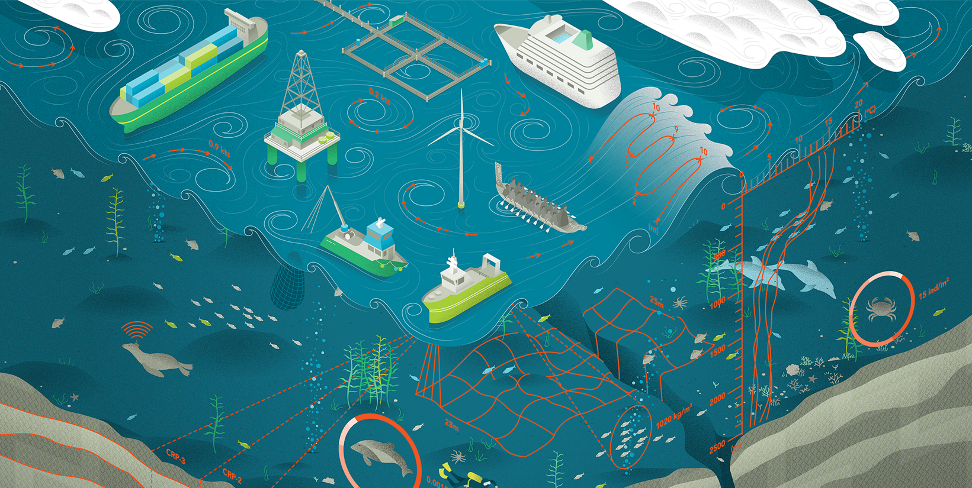
NZ MGI Working Group

Slide 3
The Problem
Fisheries / Aquaculture
Biosecurity & Climate Change
Minerals & Mining
Conservation
Resource Management
Shipping
Other
Conservation Act 1987
Marine Reserves Act 1971
Wildlife Act 1953
Marine Mammals Protection Act 1978
Hauraki Gulf Marine Park Act 2000
Fiordland (Te Moana o Atawhenua)
Marine Management Act 2005
Sugar Loaf Islands Marine Protected
Area Act 1991
Kaikōura (Te Tai o Marokura) Marine
Management Act 2014
Fisheries Act 1996
Treaty of Waitangi (Fisheries Claims)
Settlement Act 1992
Māori Commercial
Aquaculture Claims
Settlement Act 2004
Māori Fisheries Act 2004
Fisheries (Quota Operations Validation)
Act 1997
Biosecurity Act 1993
Climate Change Response Act 2002
Crown Minerals Act 1991
Continental Shelf Act 1964
Resource Management Act 1991
Exclusive Economic Zone and
Continental Shelf (Environmental Effects)
Act 2012
Maritime Transport Act 1994
Exclusive Economic Zone and
Continental Shelf (Environmental Effects)
Act 2012
Heritage New Zealand Pouhere Taonga
Act 2014
Marine and Coastal Area (Takutai Moana)
Act 2011
Submarine Cables and Pipelines
Protection Act 1996
Exclusive Economic Zone and
Continental Shelf (Environmental Effects)
Act 2012

Slide 4
DIA Innovation Fund

Slide 5
Fund Application Partners

Slide 6
The Technical Solution

Slide 7
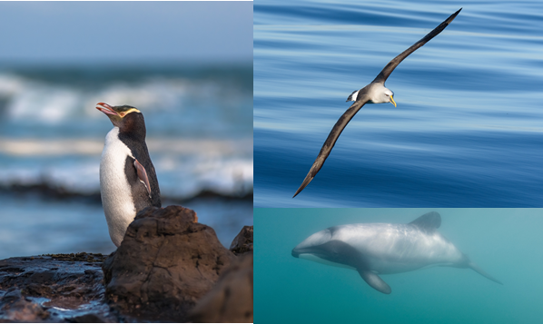
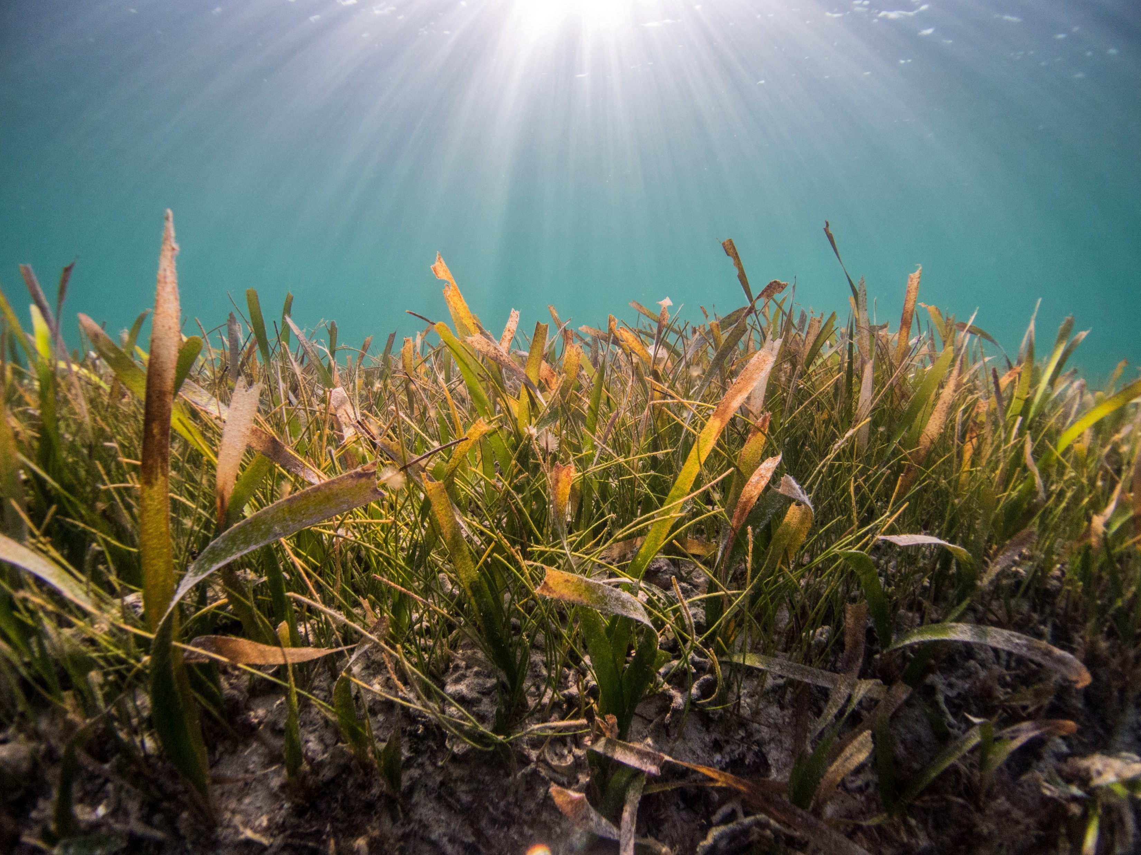
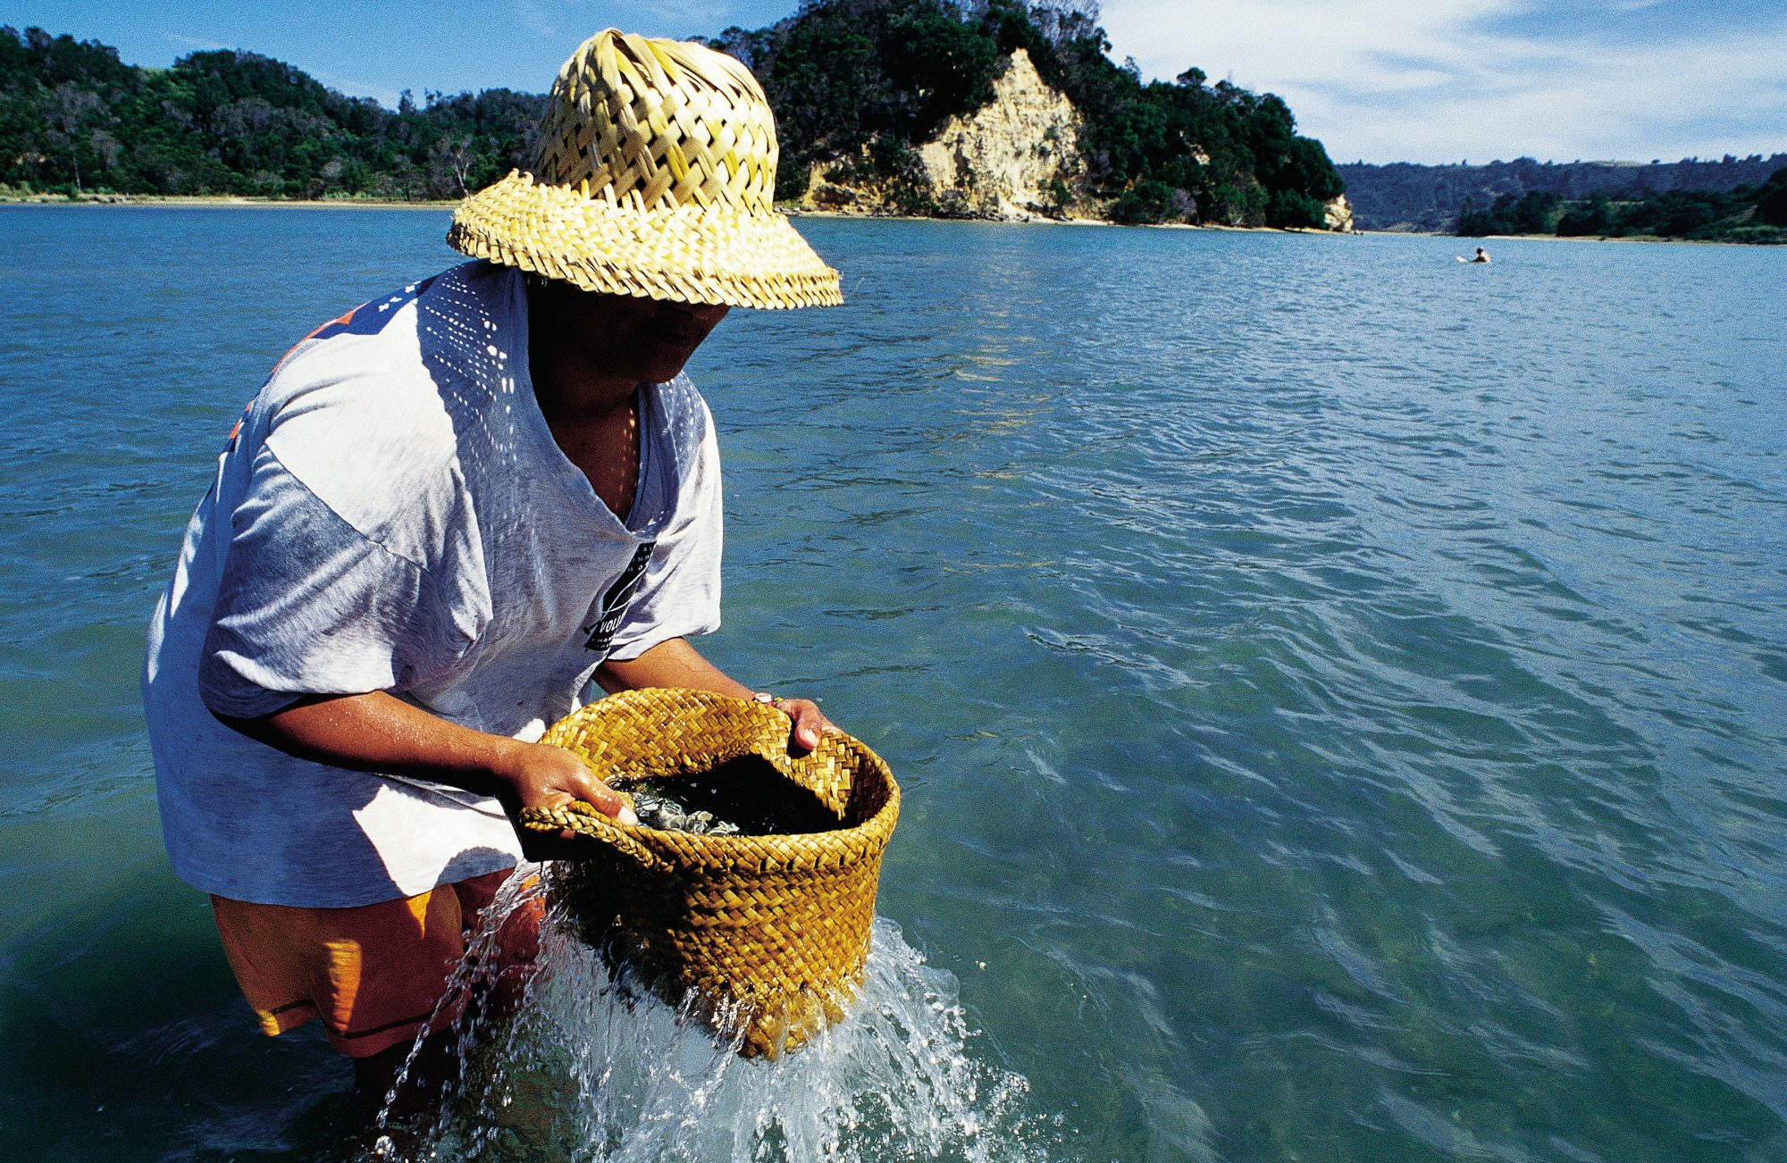
Proof of Concept
Use case 1: Protected species
Use case 2: Coastal planning
Use case 3: Customary rights
Use case 4: Resilience

Slide 8
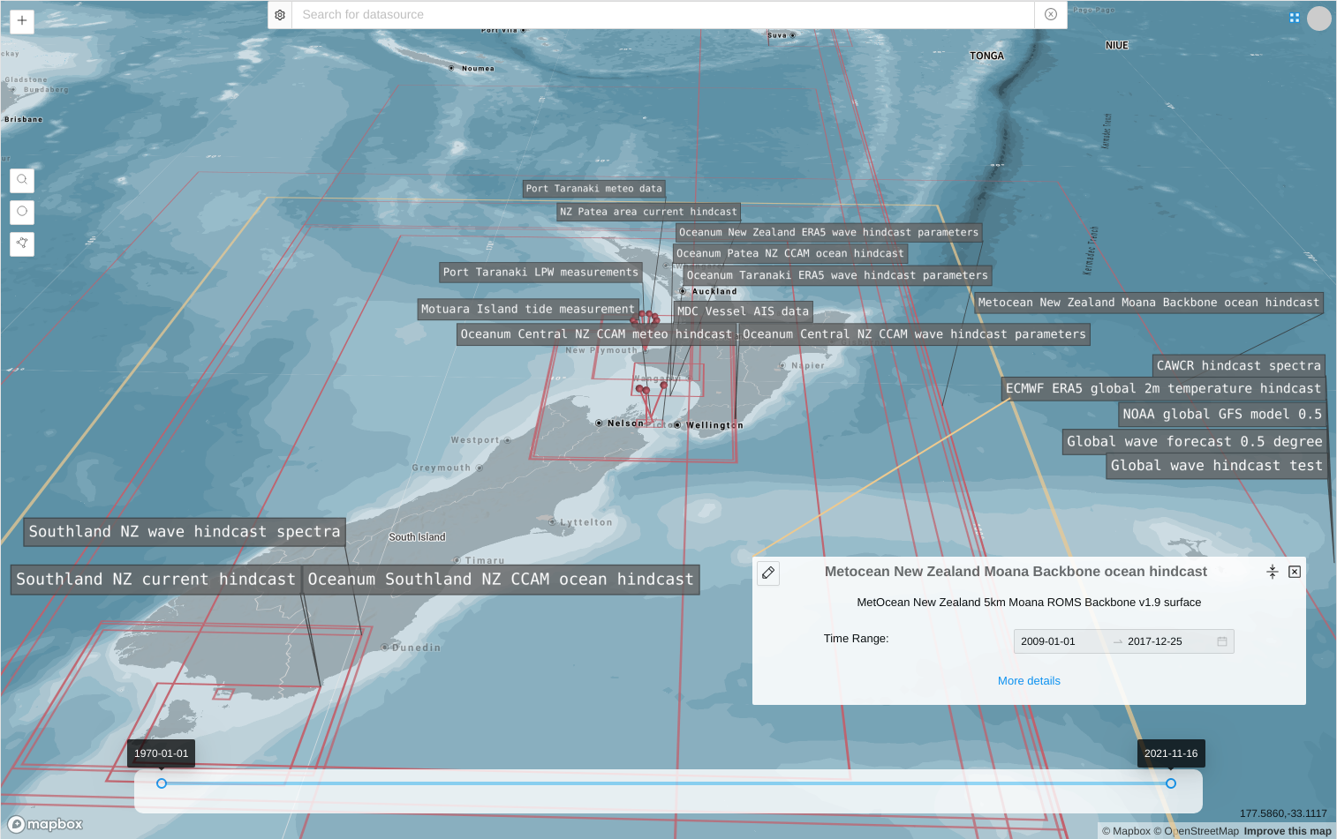
“”Google” style search
User Interface
Area and time period of interest

Slide 9
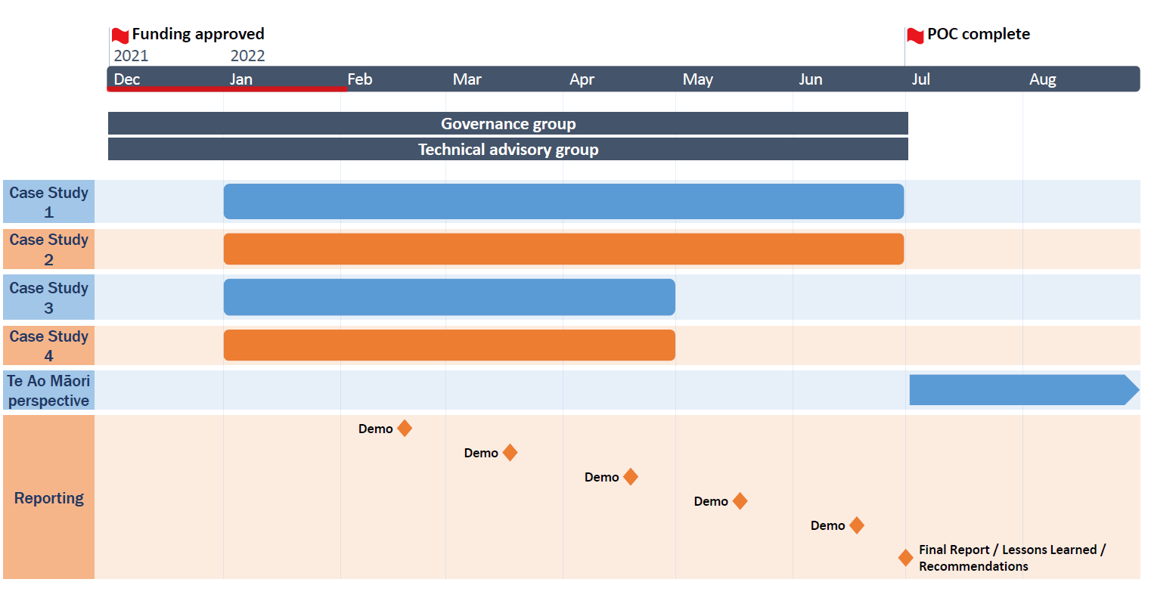
Project Roadmap
To the PoC
Te Ao Maori

Slide 10
Any questions? Thank you!

