Slide 1
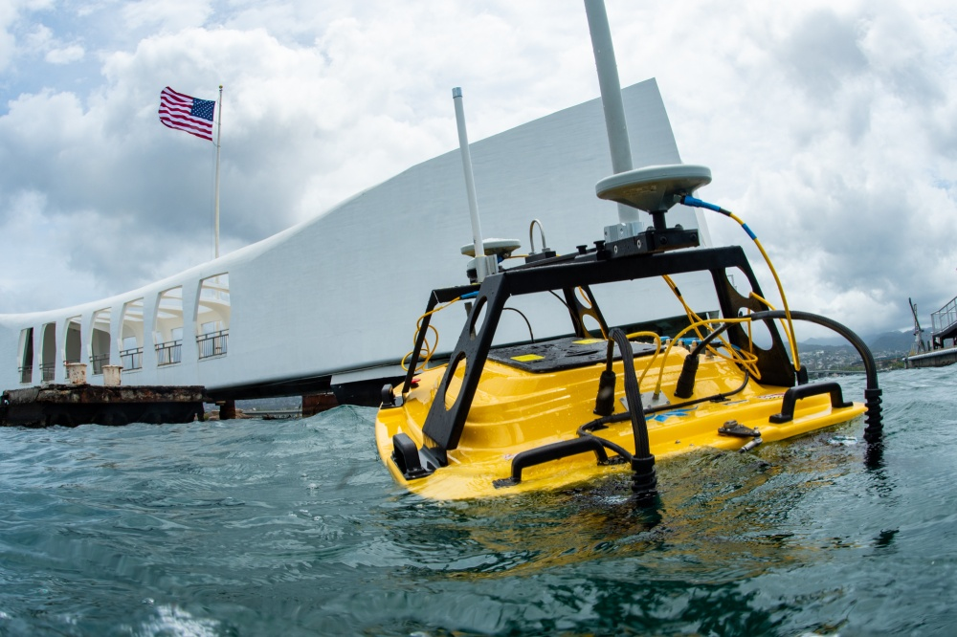
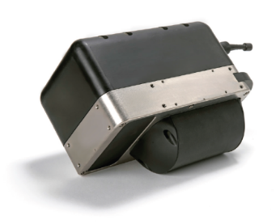
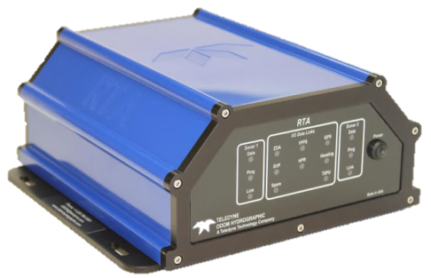
Fleet Survey Team, NAVOCEANO
Unmanned Systems
Teledyne Z-Boat
FST Configuration
Odom MB2 MBES
  1.8° x 1.8° beamwidth
  100m maximum depth
  200 – 460 kHz frequency
  140° maximum swath
AP18 SurfMaster POSMV
  Fully integrated with MB2
  1m baseline vector
  GNSS only aided by WAAS

Slide 2
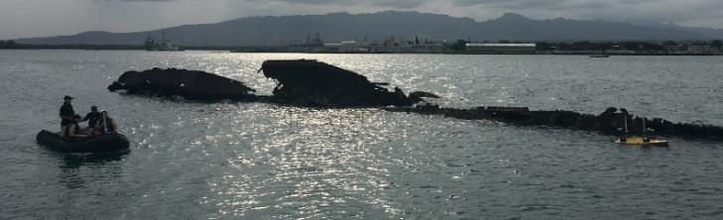
Fleet Survey Team, NAVOCEANO
Unmanned Systems
Operation Overview
Create line plan and autonomous mission plan using Hypack
Setup base station and connect to USV using Remote Desktop
USV Operator and base station
USV
Transfer line plan and autonomous mission plan to USV computer through Remote Desktop
A chase boat, typically a small boat of opportunity or CRRC, will field the USV Operator and base station maintaining line of sight and a range of less than 100m from the USV.
Attempts to operate the USV from shore at the advertised telemetry ranges from Teledyne invite very significant gaps into the collected data. For example, at a range of ~700m from shore, we experienced multiple IMU gaps exceeding 60 seconds while internally logging True Heave on the computer onboard the USV.
Teledyne is aware of this issue, and possible improvements are on the way.
Activate Hypack, MB2 Sonar User Interface, Z-Boat Control, and POSMV on the USV computer
Log data, execute line plan, and tune the MB2 sonar settings accordingly

Slide 3
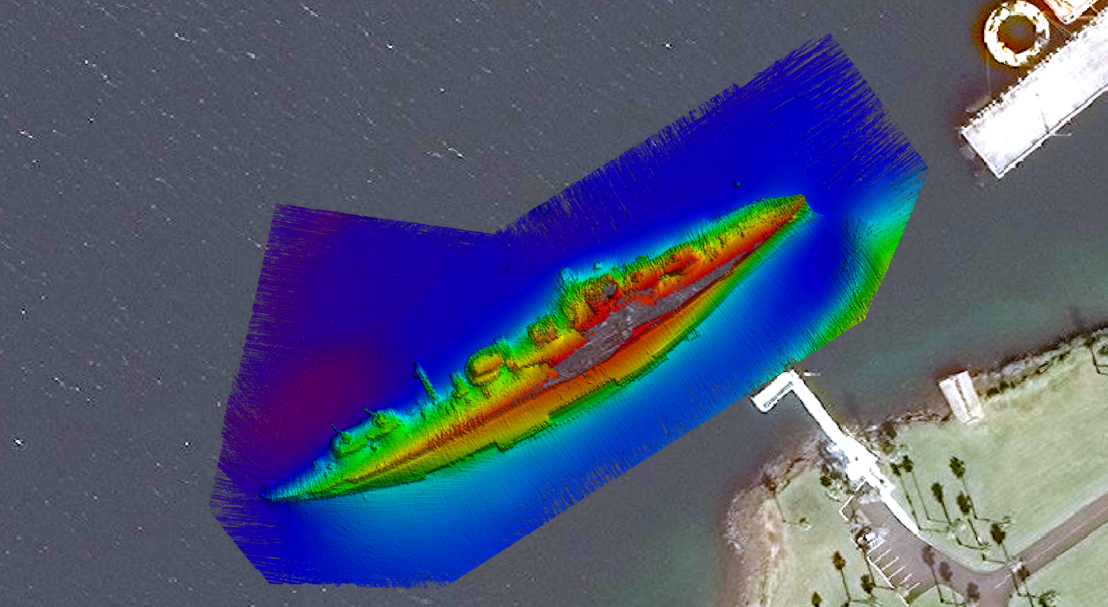
Fleet Survey Team, NAVOCEANO
Unmanned Systems
Data Processing Overview
Using CARIS HIPS import bathymetry files from Hypack (*.hsx and *.raw) or Sonar User Interface (*.s7k)
Import True Heave
Load Tide
Import Sound Velocity Profiles
Using POSPac post process True Heave files, create *.sbet and *.smrmsg, then import
Clean Data
Interpolate SV probe spikes
Reject quality flags
Run surface filter on high resolution surface
Swath editor
Subset editor
Inspect & repeat
Merge
Compute TPU
Create CUBE Surface(s)

Slide 4
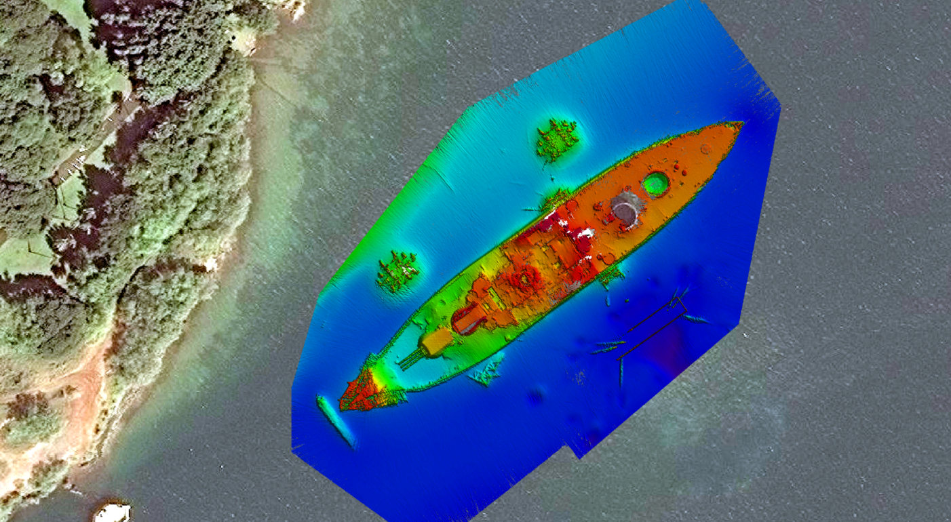
Fleet Survey Team, NAVOCEANO
Unmanned Systems
Data Processing Overview
Using CARIS HIPS import bathymetry files from Hypack (*.hsx and *.raw) or Sonar User Interface (*.s7k)
Import True Heave
Load Tide
Import Sound Velocity Profiles
Using POSPac post process True Heave files, create *.sbet and *.smrmsg, then import
Clean Data
Interpolate SV probe spikes
Reject quality flags
Run surface filter on high resolution surface
Swath editor
Subset editor
Inspect & repeat
Merge
Compute TPU
Create CUBE Surface(s)

Slide 5
Fleet Survey Team, NAVOCEANO
Unmanned Systems
Operational Limitations
Battery life
  < 4 hours with NiMH
  May hot swap batteries in calm seas absent precipitation
  Survey speeds exceeding 3 knots will greatly reduce the battery life
Sea state
  2-3 feet maximum, largely dependent on wave period
Telemetry range
  Keep the USV a stone’s throw distance for ideal performance
  Source of data gap problems is unknown, but additional contributing factors may be the USV’s computer limitations or MB2’s software engineering
1m Baseline vector
  Short baseline vector increases heading uncertainty

Slide 6
Fleet Survey Team, NAVOCEANO
Unmanned Systems
Proven Capabilities
Expedite survey time
  FST conducted a survey using one traditional survey vessel with two USVs operating simultaneously, completing the survey in half the estimated time with seamless integration
Agility of Operations
  Man portable and highly precise survey platform
  Very cheap and simple to mobilize and quickly respond to emerging mission requirements
Minimize Risk
  Small USV can operate with just a few centimeters of water depth
  No risk to humans and almost no risk to USV to survey over extremely shoal features
Deepest water surveyed to date by FST with the Odom MB2 are 78m

