Slide 1


Moving to the Grid in the Great Lakes
CHS/NOAA
March 2019

Slide 2
Large-Medium-Small Model at the CHS
Old Usages | New Usages | Possible Tile size (Coverage)
Overview (>1:500,001) | Level 2 - Small scale (>1:150,001) | 1° X 1° ≈ 100km x 100km
General (1:150,001 - 1:500,000)
Coastal (1:50,001 - 1:150,000) | Level 4 - Medium Scale (1:20,001 – 1:150,000) | 1° X 1° ≈ 100km x 100km or 0.1° X 0.1° ≈ 10km x 10km
Approach (1:20,001 - 1:50,000)
Harbour (1:2,001 - 1:20,000) | Level 6 - Large Scale (<1:20,000) | 0.1° X 0.1° ≈ 10km x 10km or 0.02° X 0.02° ≈ 2km X 2km
Berthing (<1:2,000)

Slide 3
How the new usages and scale ranges aligns
USA |  |  | Canada
Navigational Purpose | Code | NOAA Compilation Scale | CHS Compilation Scale | Level | Navigational Purpose
Overview | 1 | 1:2,560,000 – 1:5,120,000 | <1:150,000 | 2 | Small Scale
General | 2 | 1:640,000 – 1:1,280,000
Coastal | 3 | 1:160,000 – 1:320,000
Approach | 4 | 1:40,000 – 1:80,000 | 1:20,001 – 1:150,000 | 4 | Medium Scale
Harbor | 5 | 1:10,000 – 1:20,000 | ≥1 :20,000 | 5 | Large Scale
Berthing | 6 | 1:2,500 – 1:5,000

Slide 4
Cell dimensions
USA |  |  | Canada
Navigational Purpose | Code | NOAA Cell dimension | CHS Cell dimension | Level | Navigational Purpose
Overview | 1 | 19.2° x 19.2° | 1° X 1° | 2 | Small Scale
General | 2 | 4.8° x 4.8°
Coastal | 3 | 1.2° x 1.2°
Approach | 4 | 0.3° x 0.3° | 1° X 1° or 0.1° X 0.1° | 4 | Medium Scale
Harbor | 5 | 0.075° x 0.075° | 0.1° X 0.1° or 0.02° X 0.02° | 5 | Large Scale
Berthing | 6 | -

Slide 5
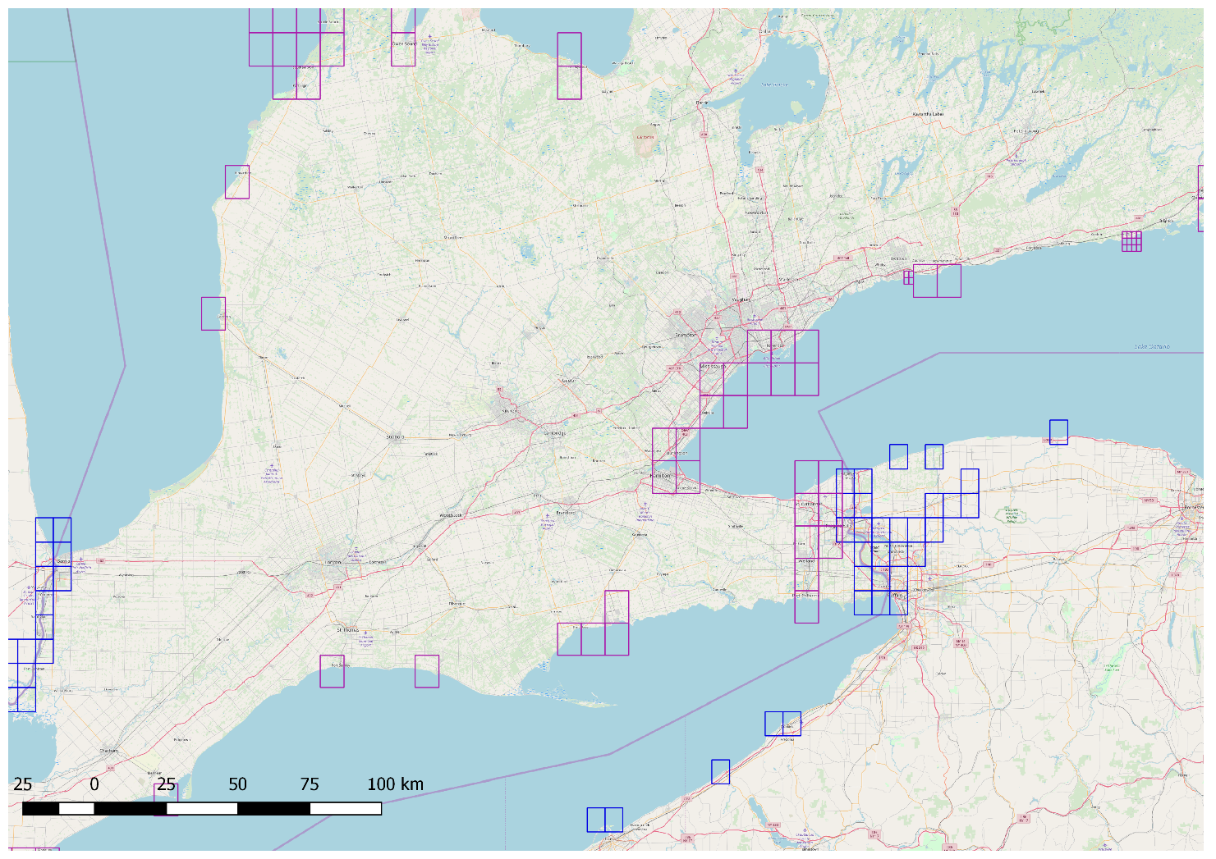
Level 5 grid, Ontario Lake to Erié Lake
CHS cells (Pink) 0.1° X 0.1°
and
0.02° X 0.02°
NOAA cells (Blue) 0.075° X 0.075°

Slide 6
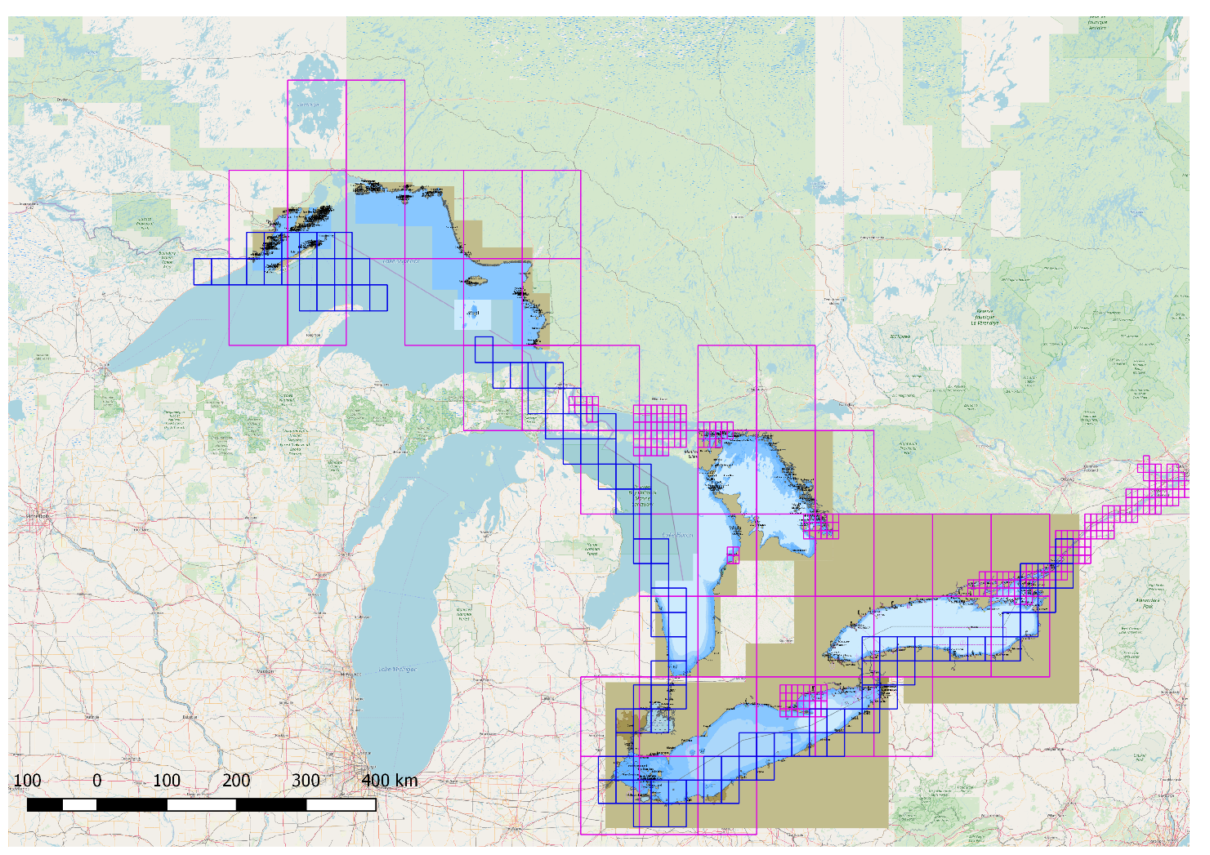
Level 4 grid, in the Great Lakes
CHS cells (Pink) 1° X 1°
and
0.1° X 0.1°
NOAA cells (Blue) 0.3° X 0.3°

Slide 7
Some considerations
M_COVR objects (1-Coverage; 2-No Coverage) will be be used to avoid data duplication per usage between Canada and USA.
CHS and NOAA will be reviewing the current transboundary agreement in light of the new grid and existing data coverage.
The grids are in development, some refining is in progress.
CHS has contracted out a grid study with the private sector. Outcome from this study is soon to be delivered.
CHS is considering aggregation of grid tiles in some areas to decrease number of products while preserving a gridded system

Slide 8
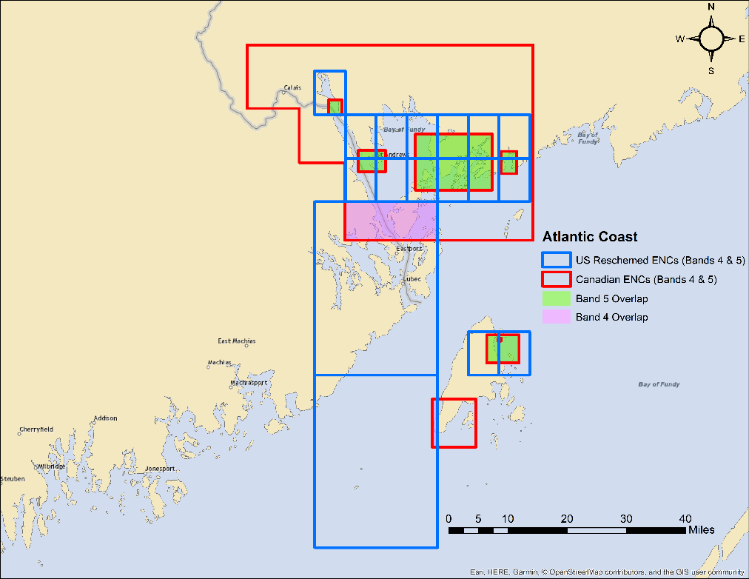
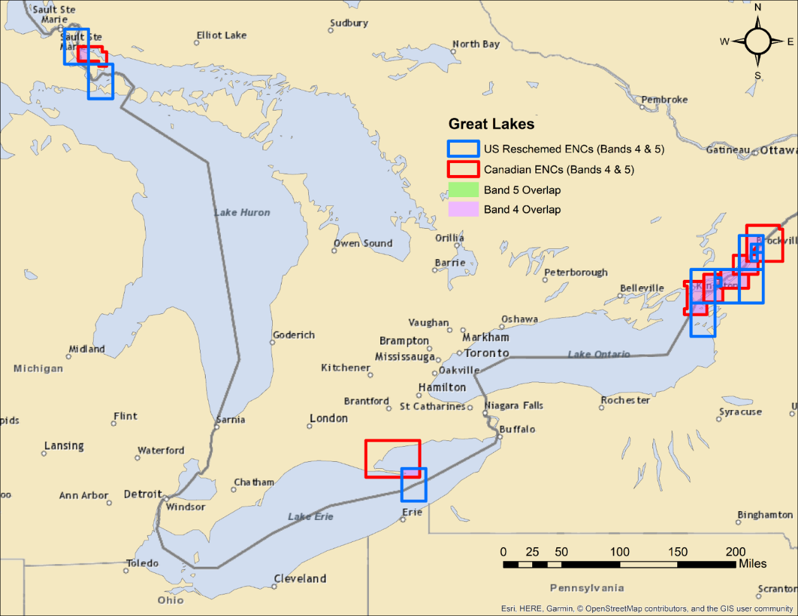
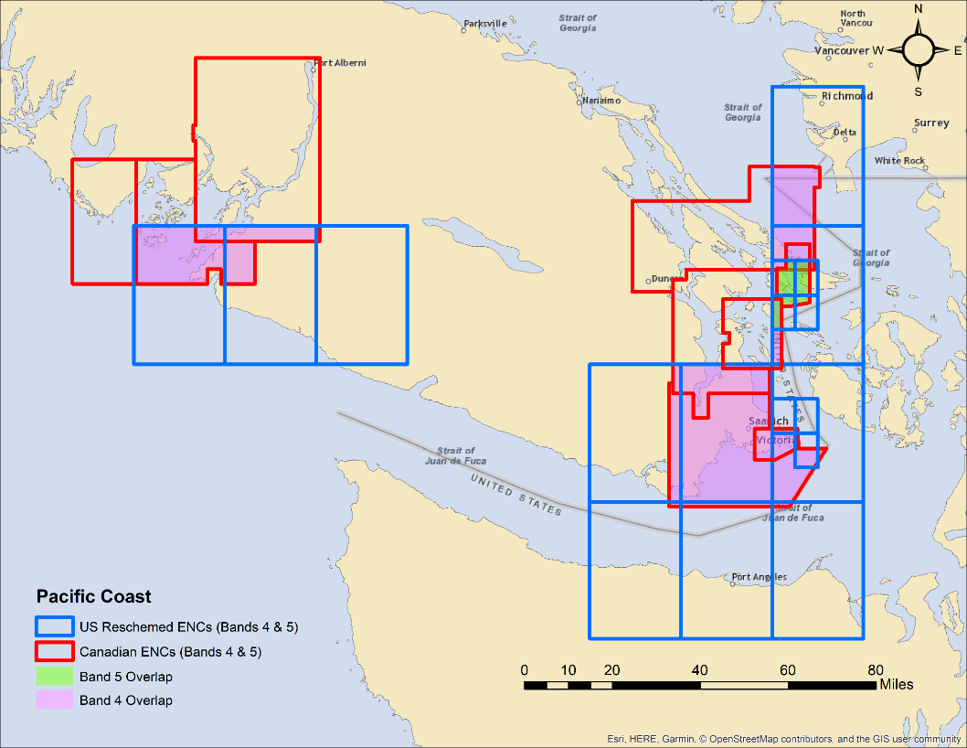
US Reschemed ENC and Current Canadian ENC Overlaps
Band 5 Overlap
Region | US ENCs | CA ENCs | Overlap (NM²)
Pacific Coast (WA/BC) | 7 | 3 | 67
Great Lakes | 4 | 2 | 16
Atlantic Coast | 15 | 6 | 137
Band 4 Overlap
Region | US ENCs | CA ENCs | Overlap (NM²)
Pacific Coast (WA/BC) | 11 | 6 | 1182
Great Lakes | 8 | 7 | 1386
Atlantic Coast | 2 | 2 | 83

Slide 9
Additional considerations
Use of M_COVR objects to preserve cell shape and avoid data duplication
NOAA plans to have reschemed (S-57 Band 5) cells released in the Great Lakes and New England in the near future (6 months to a year).
Using the M_COVR encoding would preserve the gridded scheme and consistent cell shape while alleviating overlap issues at the US/CA boundary.
Transboundary MOAs will still need to be revisted.
  Gaps
  Narrow waterways (e.g., St. Lawrence River)
  Smaller scale usage bands (3 – Coastal, 2 – General, 1 – Overview)
  Future S-101 considerations
CATCOV = 2
(no coverage available)
CANADA
US
CATCOV = 1
(coverage available)
(Example of reschemed US ENC)

