Slide 1
NOAA/NGS Aerial Survey
Remote Sensing Division (RSD) Mission: To provide the national shoreline used to update nautical charts that ensure safety of navigation.
NGS/RSD has ongoing requirements to survey all U.S. coastal areas
On average, 1-3 projects per year are planned along the U.S.-Canadian border
Agency aircraft (N68RF) have blanket clearance for overflight but require specific permission for data collection
NGS has an MOU with Natural Resources Canada to improve spatial reference systems
The hydrographic MOU (Schedule A) may be more appropriate to request clearance for these projects

Slide 2
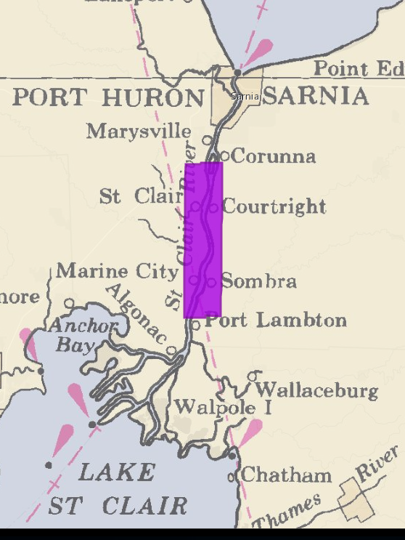
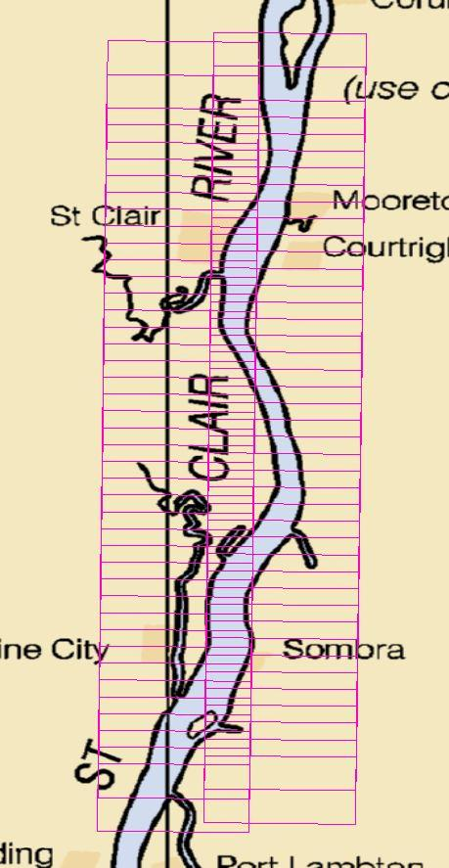
Current Projects
St. Clair and Marine City – MI1901-CS-N

Slide 3
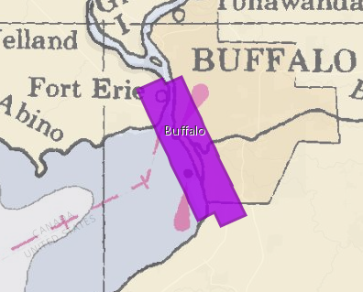
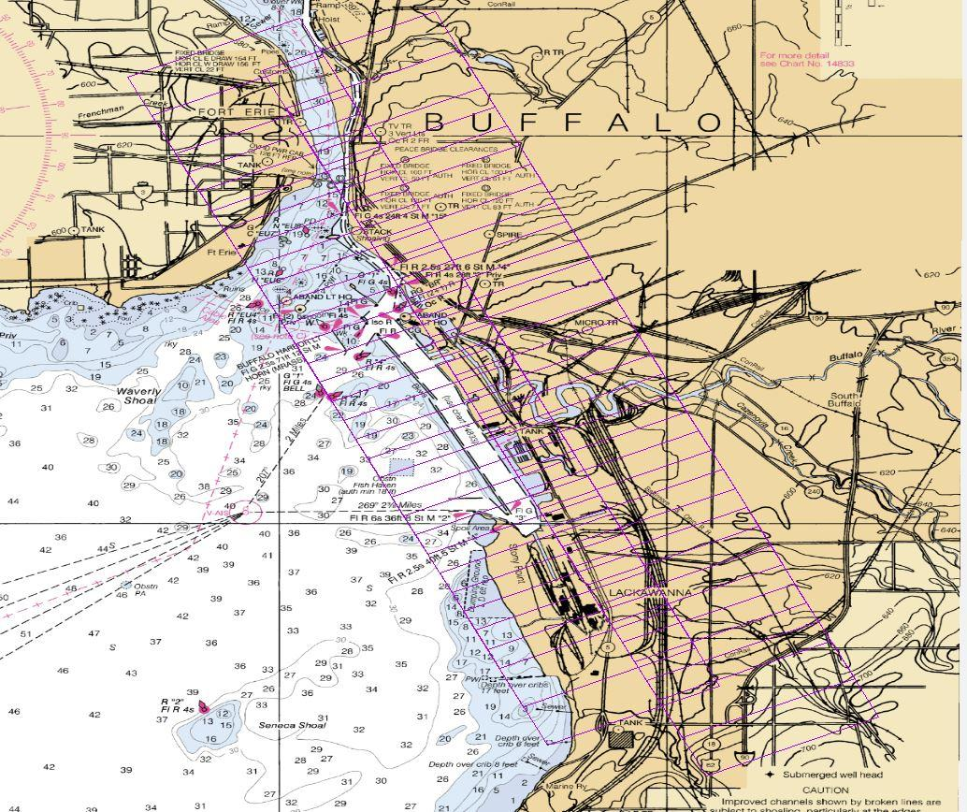
Current Projects
Buffalo – NY1902-CS-N

Slide 4
Future Projects & Data Availability
Planned FY20 Projects include Detroit, MI
Shoreline data is typically processed and available to the public within 1 – 2 years on the NOAA Shoreline Data Explorer website
https://www.ngs.noaa.gov/NSDE/

