Slide 1
UN-GGIM
Working Group on Marine
Geospatial Information
U.S. – Canada Hydrographic Commission Update

Slide 2
WG - Objectives
play a leading role at the policy level by raising political awareness and highlighting the importance of reliable, timely and fit-for-purpose marine geospatial information to support the administration, management and governance of the marine and ocean environments;
encourage the use of internationally agreed-upon geospatial information frameworks, schemas, systems and established standards to improve the growing inter-dependent relationships between people and the marine environments; and
support the Committee of Experts in the development of norms, principles, guides and standards to increase significantly the availability of high-quality, timely and reliable geospatial information including any regional capacity development initiatives
http://ggim.un.org/UNGGIM-wg8/
Notes:
play a leading role at the policy level by raising political awareness of marine geospatial information
encourage the use of internationally agreed-upon standards
support the Committee of Experts in the development of norms, principles, guides and standards
In large part to help track progress on the Sustainable development goals and encourage data availability from a national level to do so

Slide 3
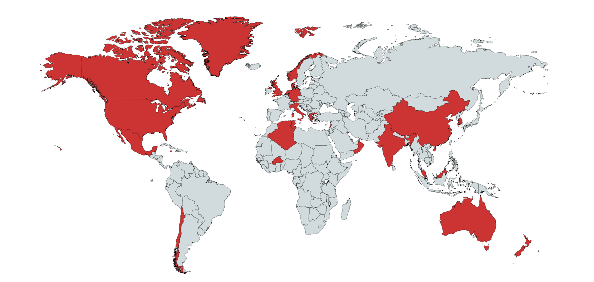
Notes:
24 members including 11 new this year
5 MACHC Members
3 private sector network, one UN System and 1 NGO

Slide 4
Link to UN-GGIM-WGMGI Report to the Committee of Experts
Notes:
https://ggim.un.org/meetings/GGIM-committee/10th-Session/documents/UN-GGIM_Agenda_11_Introductory_Statement.pdf

Slide 5
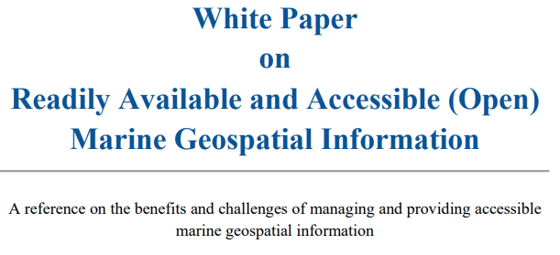
Notes:
https://ggim.un.org/meetings/GGIM-committee/10th-Session/documents/E-C.20-2020-31-Add_2-White-paper-on-readily-available-and-accessible-marine-geospatial-information-23Jul.pdf

Slide 6
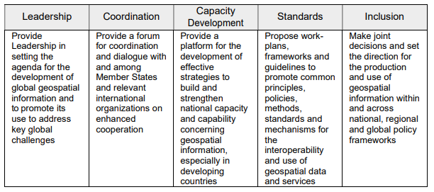
Work Plan 2021 - 2022
Notes:
https://ggim.un.org/documents/WG-MGI_Draft_work_plan_2021-22.pdf

Slide 7
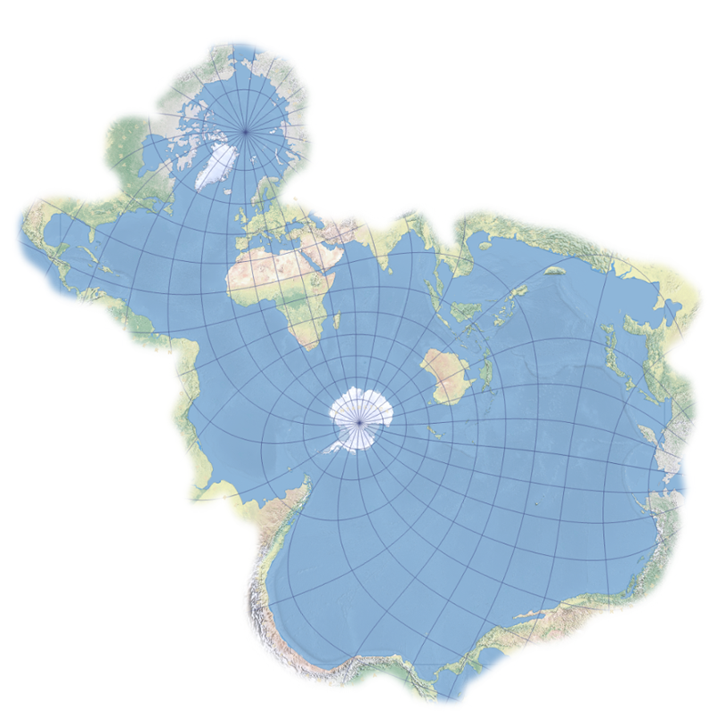
IGIF-W
A guide to assist IGIF implementers with aspects of the Water Domain
A water-centric view of the IGIF elements to assist implementers
Does not replace IGIF elements, approaches
Fundamental Data themes, institutional arrangements
Encompasses all parts of the Water domain
Usage – Maritime, Planning, Legislative, Scientific
Extents – Oceans, Seas, Inland, Wetlands, Watercourses

Slide 8
IGIF-W
Aim
Observations and Guidance on how Water can be approached in IGIF terms
Focused Value Propositions for the Water Domain
Water in the fundamental data themes
Focused on emerging rather than established infrastructures
WGMGI Work Plan = IGIF-W
Decade of Ocean Science for Sustainable Development
Use as a platform to endorse established standards – IHO
Expand on the build once, use many times approach
Include land/sea integration
Plan to deliver international seminar based on IGIF-W in conjunction with the launch of new IHO Innovation Laboratory

Slide 9
Upcoming Items of Interest
Initial Draft of IGIF-W posted for MS review and contribution
Online meeting at the end of March to review MS input
Drafting of commitment to the Decade of Ocean Science for Sustainable Development (UNESCO – IOC)
International Seminar on the IGIF-W and launch of the IHO Innovation Laboratory – October 25 – 29 in Singapore

Slide 10
Thank You! John.Nyberg@noaa.gov

