Slide 1
44th Meeting of the US - Canada Hydrographic Commission National Report by
United States of America

Slide 2
Main Achievements during the Past Year
NOAA went into quarantine on March 11, 2020. Despite this there has been an encouraging ability for staff to innovate, show dedication and high degree of professionalization, and adjust to the major shock to operations by COVID through telework, video conferencing, and continued provision of navigation services.
Similarly, NGA went into quarantine on March 12, 2020 and soon after began leveraging UNCLASSIFED telework technologies to ensure mission continuity. Employees returned to the office as needed in an agency-directed phased approach over several months, but are largely still in a telework posture.

Slide 3
Main Challenges and/or Obstructions
While “desktop” work could proceed effectively, field operations (surveys) and NOAA ship operations were seriously impacted due to quarantine and other physical/biological distancing requirements
Organizational transition at NOAA OCS (new Administration, new incoming Director, new front office organization including some core staff turnover)
Revisiting and re-framing hydrography within the national ocean governance framework at the start of a new decade (who is doing what in terms of hydrography, various agency and stakeholder roles related navigation services, coastal and ocean governance, resiliency, relationships among key intergovernmental organizations, etc…)

Slide 4
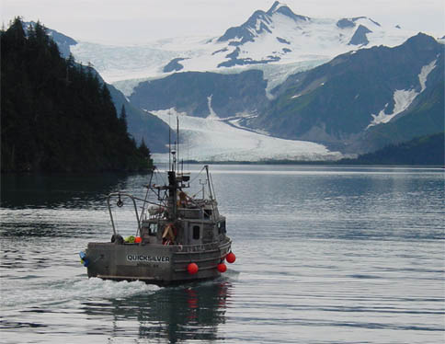
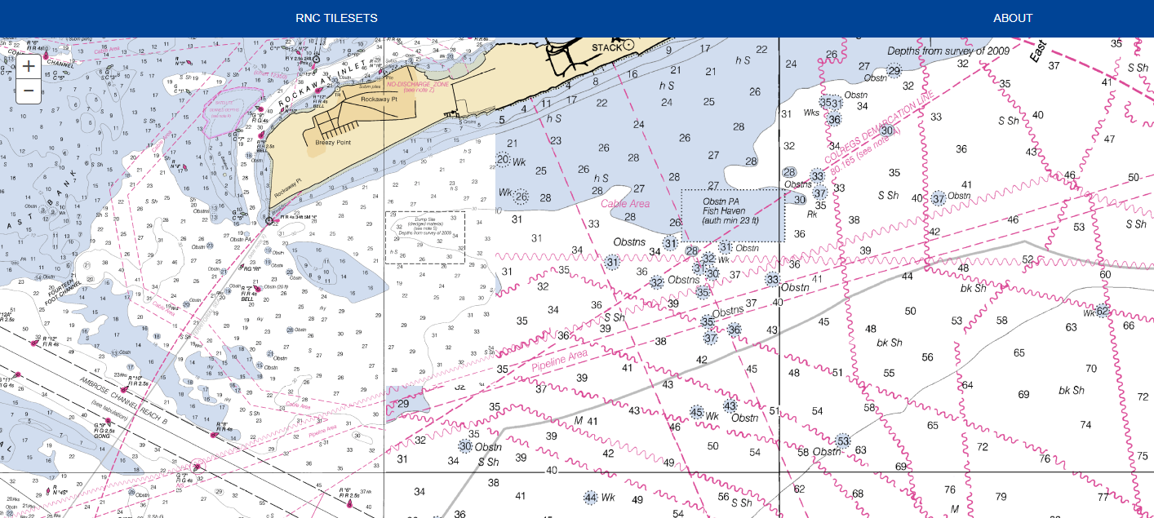
Progress on Surveys and Charting
Surveys:
NBS/Data Licensing & St. Lawrence CHS data sharing
Thomas Jefferson survey in Lakes Erie and Ontario postponed to 2022
KR survey in Whitefish Bay (near Soo Locks) continuing to move forward
Charting:
NGA creating Worldwide ENC grid for use in building future ENC portfolio.
NOAA has begun raster sunset process; will complete by Jan 2025
NOAA ENC rescheming ~10% complete, work continues in Great Lakes
NOAA Custom Chart v. 1.0 release date 25 March
NOAA crafting high level S-101 transition plan

Slide 5
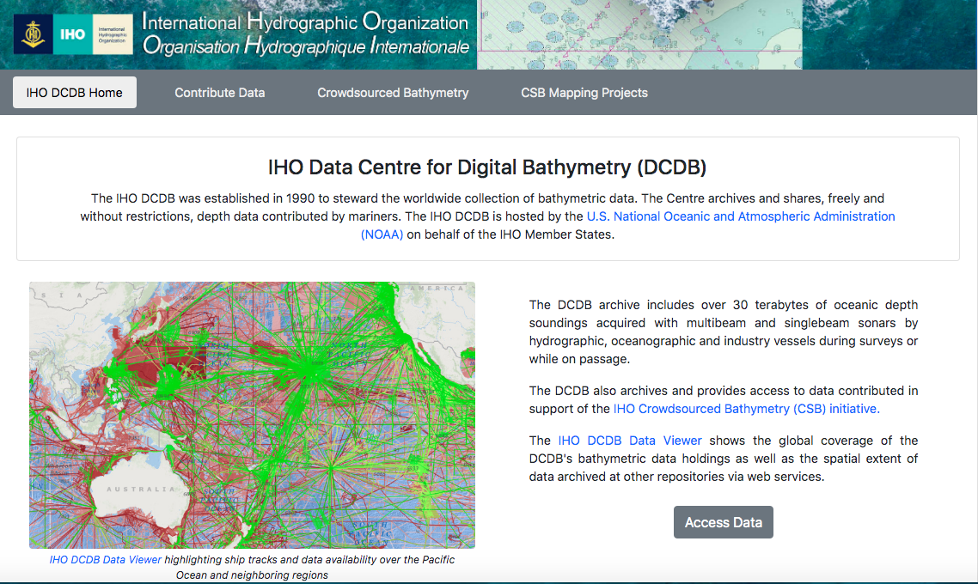
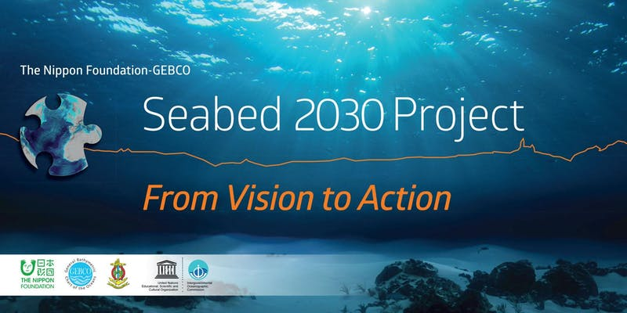
Contributions to the IHO DCDB and GEBCO
Crowdsourced bathymetry
Within US waters, all CSB data is being made available via the IHO DCDB
US supporting CSB globally via support to the IHO DCDB
Seabed 2030
US supports the IHO DCDB use within the Seabed 2030 project. Many enhancements underway for data discovery and accessibility
To be discussed further at the meeting today (agenda item 14)

Slide 6
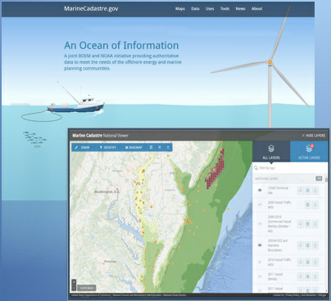
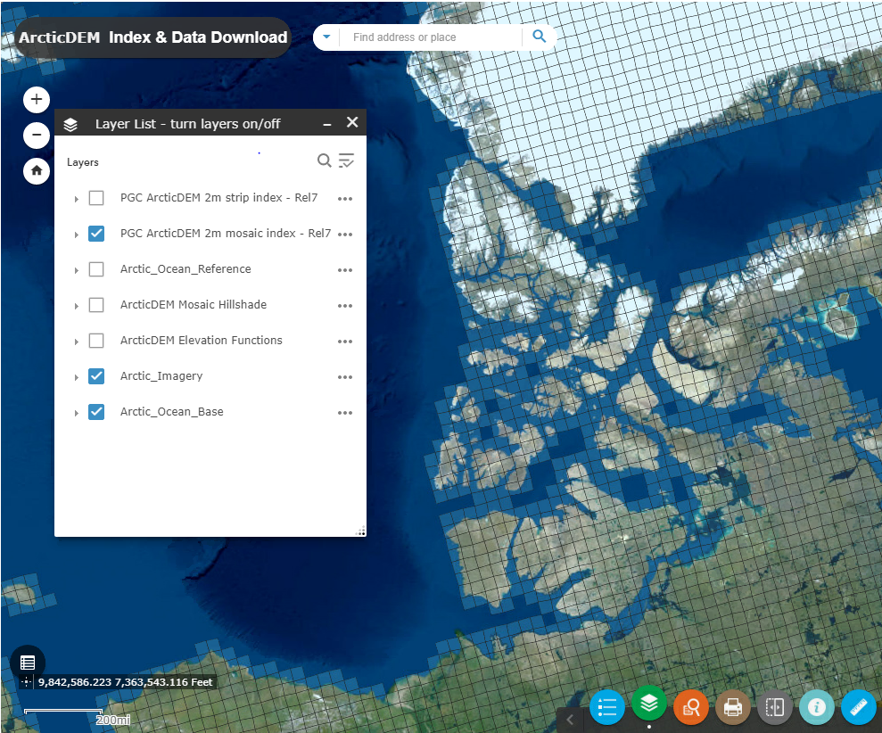
Progress on MSDI
Policies and Governance
IHO MSDIWG + regionally-focused MSDIWGs, UN-GGIM WG-MGI, OGC Marine DWG
Standards
IHO S-100, Open Geospatial Consortium, Federal Geospatial Data Committee
Information Systems
Product-centric to data-centric approach
Data
MarineCadastre.gov
NGA Arctic Digital Elevation Model (DEM)
Data.gov
Notes:
The US continues to be engaged in MSDI efforts whenever possible, but specifically at the IHO, UN, and OGC levels through the IHO Marine Spatial Data Infrastructures Working Group and and regionally-focused MSDI working groups like the Arctic Regional Marine Spatial Data Infrastructures Working Group (ARMSDIWG) and Meso American and Caribbean Sea Hydrographic Commission Marine Spatial Data Infrastructures Working Group (MMSDIWG).
Whenever possible, we seek to employ the S-100 standard, OGC Standards, etc.
We’ve had a product-centric approach to production for so long, but are finally employing a more data-centric approach through the use of centralized production databases and more advanced software.
We encourage the accessibility of as much data as possible for various users and have a number of platforms from which to download available datasets. Ex: Marine Cadastre, Data.gov, and NGA’s Arctic DEM.

Slide 7
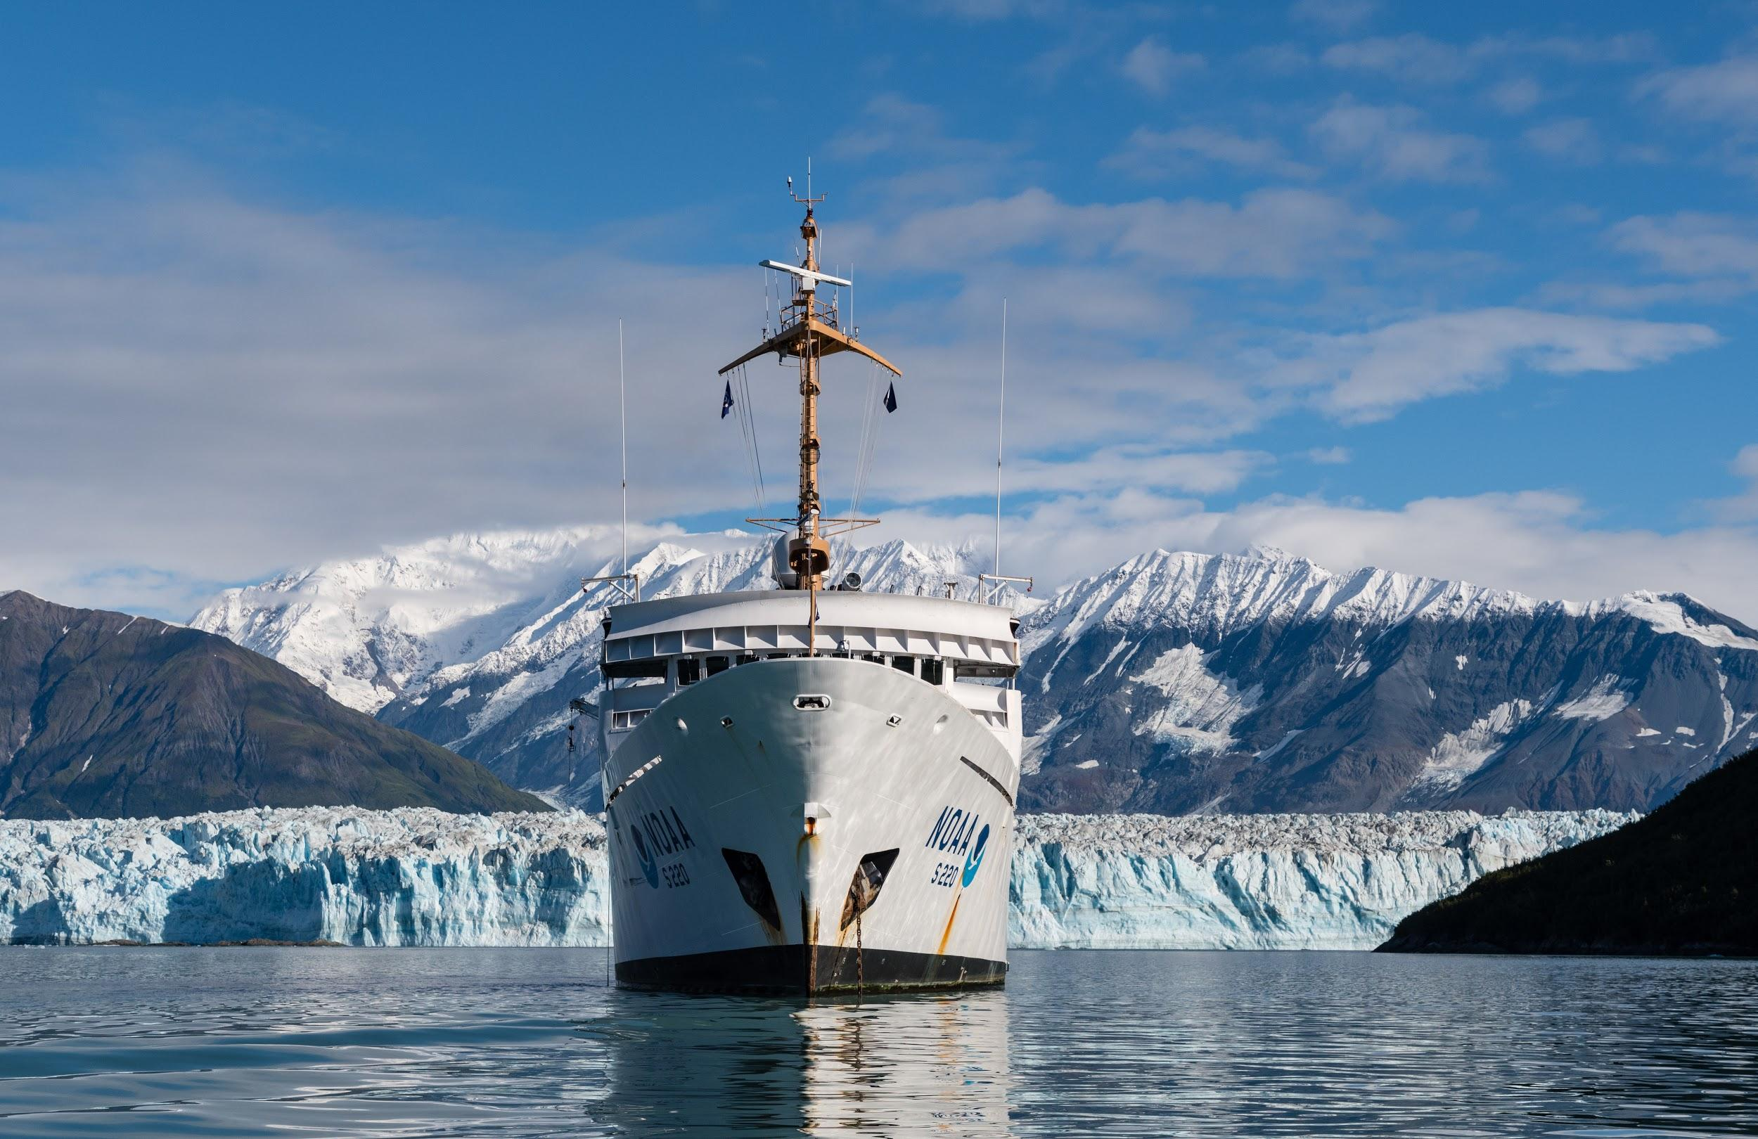
Plans that Affect the Region
ENC rescheming in the Great Lakes and Maine
Raster chart cancellations - Lake Superior later this year
NOAA Ship Fairweather in front of Hubbard Glacier, AK

Slide 8
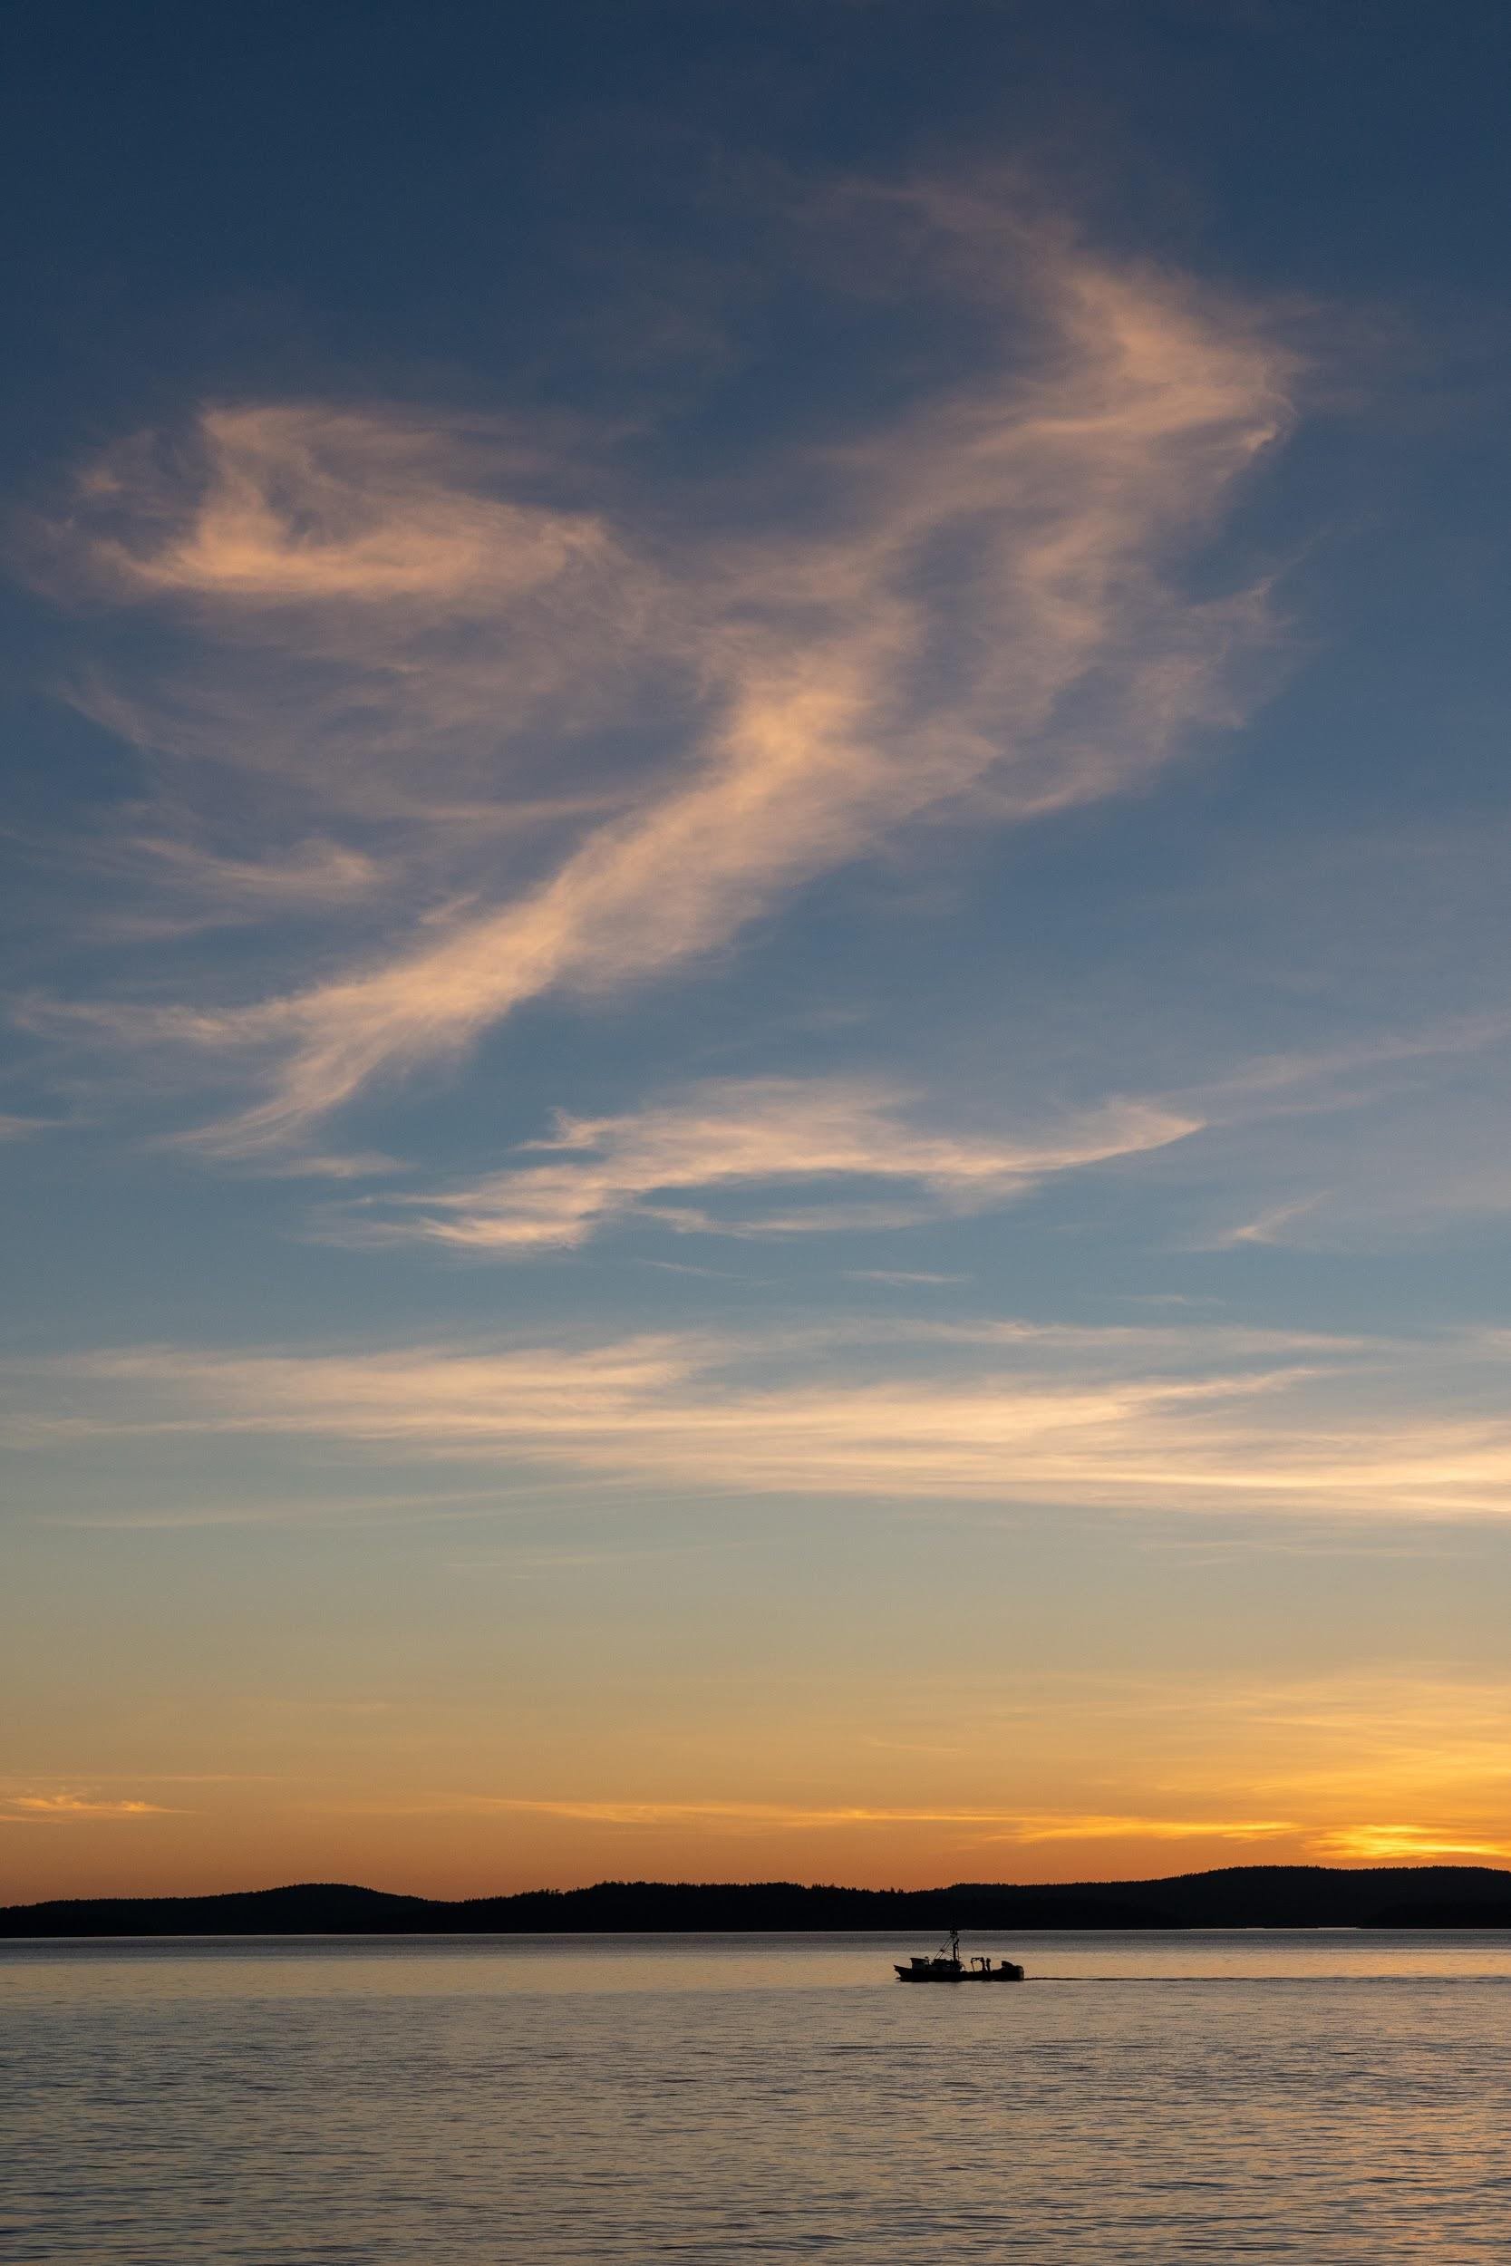
Lessons Learned to Share
Social distancing and quarantine has provided a planning opportunity for considering future services and innovative approaches to work. This is also reflected in the USCHC agenda and discussions we will be having
A sunset highlights a fishing boat in Puget Sound, WA

Slide 9
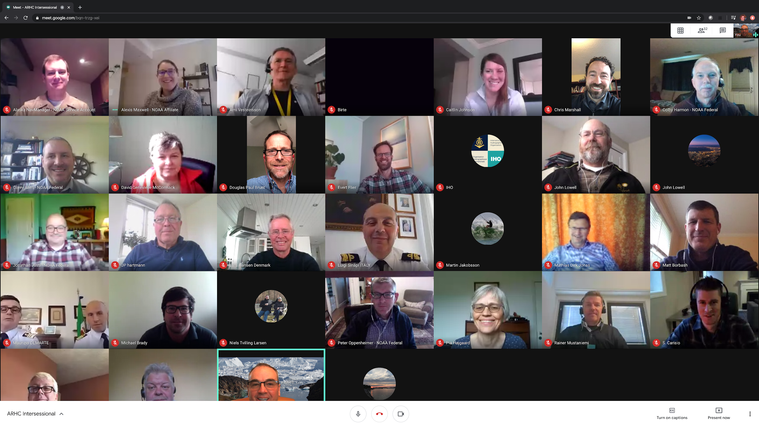
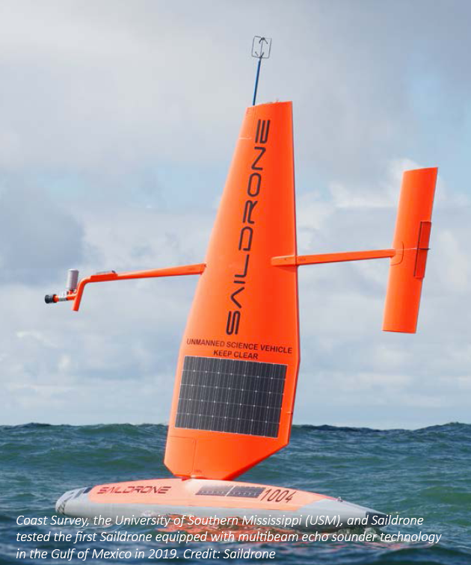
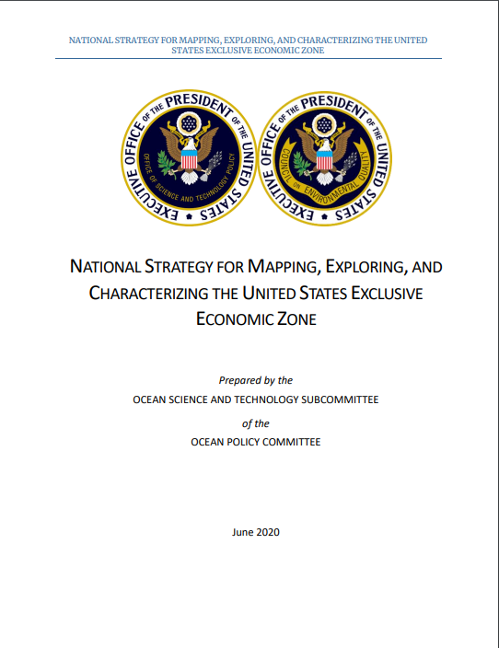
Success Stories to Share
Successful Saildrone project from California to the US-CA arctic boundary area
National planning and coordination: NOMEC established
New global ESTOFS coastal model released
Broad use of VTC for improved frequency of contact
IHO success using VTC for broad access to technical and regional meetings
NOMEC = National Ocean Mapping, Exploration and Characterization Council

Slide 10
Thank you!

Slide 11
Reference Slide
2019 Raster Chart Sunset Timeline 2025
NOAA Custom Chart Prototyping
1st Interagency Sunset Meeting
Sep 2019
Raster Sunset Federal Register Notice
Nov 2019
Gather User Feedback
Complete NOAA Custom Chart (NCC) Development
Complete NTM and LNM Process Modifications
Complete Chart Cancellation Prioritization Methodology
Systematically Cancel Traditional Paper Charts
Complete Raster Sunset Program - 2025
11
Now
Mid 2021

