Slide 1

Tiered approach to WENS
Considering the UN-GGIM Integrated geospatial information framework principles

Slide 2
Principles for geospatial information
The WENS principles will be expansive in nature, including a wide variety of data types that must accommodate principles that range from more to less stringent depending on the intended use of the data, the source of the data, frequency of updates, method of distribution, and other factors. This paper proposes to divide marine data into three basic categories that aim to conform to three levels of principles.

Slide 3
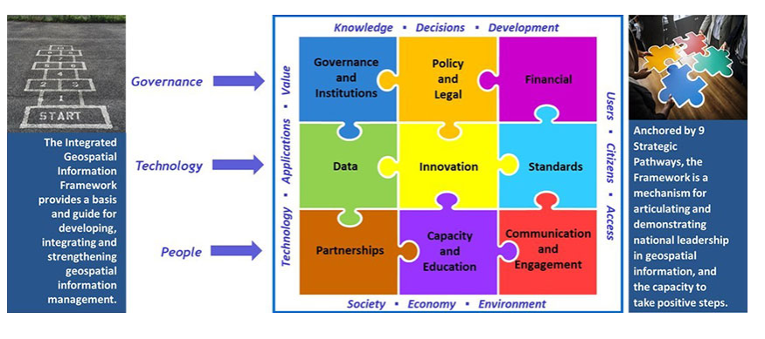
UN-GGIM Integrated Geospatial Information Framework (IGIF)
https://ggim.un.org/IGIF/part2.cshtml
Notes:
Each of the nine pathways has a set of basic principles for geospatial information

Slide 4
IGIF principles are agreed upon at the united nations
Examples
Pathway 4 – Standards: Appropriate and recognized standards are adopted and enforced throughout the data lifecycle to enhance integration and interoperability of individual and disparate data sets.
Pathway 4 – Metadata: Appropriate metadata is applied according to standards and used to accurately define and describe geospatial data, including content, geographic extent, purpose, characteristics, currency and provenance etc., together with contact details for further information.
Pathway 2 – Secure and Safeguarded: Ensure secure and trustworthy data sharing, dissemination and use. Geospatial information are stored, maintained and accessed in a secure environment and through secure methods.
Pathway 1 – Accountability: The responsibility for the decisions and laws that affect the strengthening of geospatial information management rests with government and is responsive to stakeholders’ needs and is in the interests of the community.
Pathway 7 - Leadership, commitment and empowerment: Leadership and commitment is necessary to sustain a collaboration or partnership through ownership of purpose, empowerment in processes and collective responsibility for outcomes.

Slide 5
Three-tiered approach
Category 1 data would include the most stringent, regulated data types such as S57 and S101. It would be categorized under the principles outlined in the UN-GGIM IGIF with a subset of additional principles specific to those outlined in the original WEND Principles.
Category 2 data would be less stringent, including weather, current, and other data that would only apply to the principles outlined in the UN-GGIM IGIF
Category 3 data would be the least stringent and wouldn’t have any principles that apply. These would include crowd sourced, non-IHO, and other unofficial data.

Slide 6
The major work with this approach
Determining which data types belong in each tier
Refining the information in tier 1 – narrowing the old WEND Principles so the are not duplicating IGIF Principles but are strengthening the principles that are most important, overlaps, gaps, distribution, etc.

Slide 7
Tier 1 possibilities
S-101 Electronic Navigational Chart | S-122 Marine Protected Areas | S-126 Marine Physical Environment
S-102 Bathymetric Surface | S-123 Marine Radio Services | S-127 Marine Traffic Management
S-104 Water Level Information for Surface Navigation | S-124 Navigation Warnings | S-128 Catalogue of Nautical Products
S-111 Surface Currents | S-125 Marine Navigational Services | S-129 Under Keel Clearance Management

Slide 8
Tier 2 possibilities
S-122 Marine Protected Areas | S-412 Weather Overlay | S-121 Maritime Limits and Boundaries
S-411 Ice Information | S-413 Weather and Wave Conditions | S-414 Weather and Wave Observations
Marine Spatial Data Infrastructure | S-402 Bathymetric Inland ENC | S-412 Weather Overlay

Slide 9
Tier 3 Possibilities
Crowd Sourced Bathymetry | ArcGIS Online Data | NON-Governmental Data

Slide 10
Thank you!

