Slide 1
IC-ENC & WENS PRINCIPLES WENDWG10 – April 2020 – Online James Harper IC-ENC General Manager

Slide 2
Contents
Seeking IC-ENC member input
IC-ENC CL2020/03
IC-ENC CL2020/08
IC-ENC positions at WENDWG10 (paper)
10 high level conclusions

Slide 3
IC-ENC CL2020/03
Steering Committee opportunity to comment – WENDWG10
“…this Circular Letter is not for each IC-ENC member to return a detailed analysis of the clauses, but instead it is more an opportunity for the Steering Committee members to provide high level input/comment …”

Slide 4
IC-ENC CL2020/08
IC-ENC WENS positions at WENDWG10
“The enclosed paper includes IC-ENC member comments in the IC-ENC positions, which will be used during the online meeting.”

Slide 5
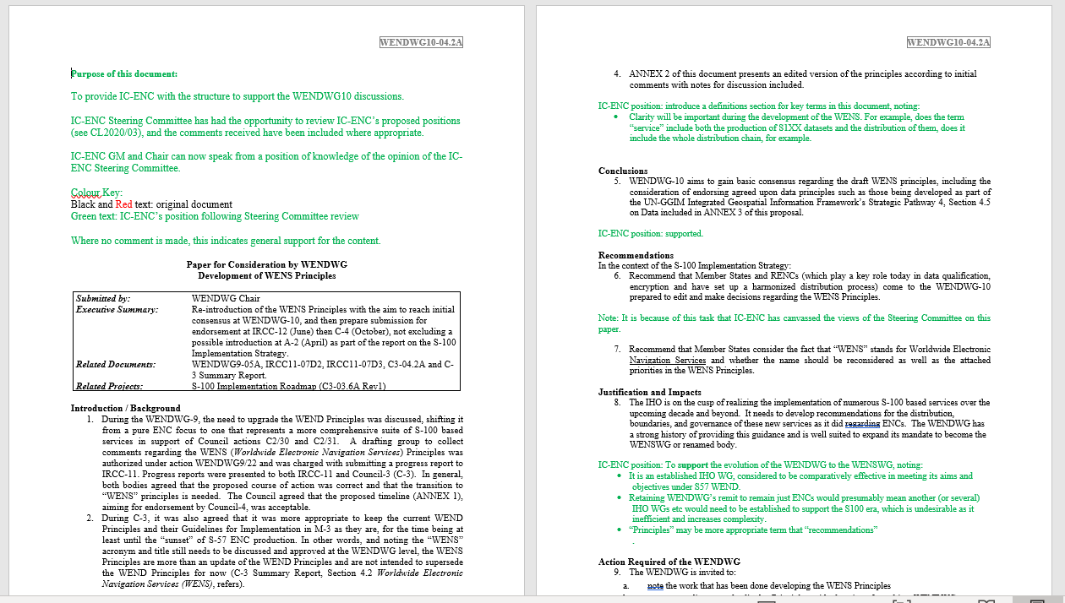
See WENDWG10 web page…

Slide 6
10 high level conclusions… …based on IC-ENC Steering Committee (i.e. Member HOs) inputs…

Slide 7
1 – Overall Support for WENS
Support the evolution of the WENDWG to the WENSWG
And by inference, the overall support for evolving the WEND concept to become the WENS

Slide 8
2 – Good Data Governance
Support the use of other existing data governance principles to assist with the development of WENS.
Lets use the work of others where appropriate
The UN GGIM references are to be discussed at WENDGW10

Slide 9
3 – Flexibility within a structure
Whilst WENS Principles should be clear and unambiguous, stakeholders should retain an appropriate level of flexibility within them.
Examples of this include:
RENC membership should remain optional
Commercial service providers should remain free to innovate to best meet customer needs/demands

Slide 10
4 – S10X: What’s in & what’s out?
The list of S10X product specifications under WENS may increase or decrease as experience grows
Comments:
Note the new concept of the tiered approach
Make the framework generic and futureproof

Slide 11
5 – Remember the end user
Analysing user groups may offer benefit (e.g. (navigational and non-navigational users) and acknowledge these may have different requirements/responsibilities (e.g. update frequency)
WENS paper does state “these same coordinated services must be available to support mariners not subject to the provisions of ECDIS”
Considering WENS by user group may help us focus our energy/attention where brings most value

Slide 12
6 – “Co-ordination of Services”
Reference 3.1 and 3.2
It is a valid ambition to have agreed production (technical) boundaries/agreed areas of responsibility, and for the large portion of the globe this is achieved. This should be maintained in the S100 era.
But, what is the right WENS approach in those particular areas where this has not been possible to achieve for WEND (S57)?

Slide 13
7 - What is the Role of RHCs?
We should be cautious of being too prescriptive on how RHCs are going to operate in the WENS era.
The are a large range of RHCs – size, geopolitics, resources, experience, technology
The WENDWG is made up of representatives of RHCs who should be able to advise on this.

Slide 14
8 - Defining the Role of RENCs
As is currently the case under WEND, it will be for the members of a RENC to determine and agree the role of that RENC in the WENS
IC-ENC does this via the Steering Committee – note that change and decisions (progress) via this method can be swifter than via other established IHO processes
WENS descriptions of RENCs should remain high level only

Slide 15
9 – What does success look like?
WENSWG should agree “WENS success metrics” early on
Noting the trouble we’ve had in defining ‘global coverage’ of ENCs – e.g. the struggle to produce a definitive top ports list for example.
The assumption is that these metrics will be important for any (eventual) IMO regulation changes

Slide 16
10 – Clear definitions required
Recommend introducing a Definitions section for key terms in the WENS Principles, including:
S10X Data
S10X Product
S10X Service

Slide 17
Summary List
Overall Support for WENS
Good Data Governance
Flexibility within a structure
S10X: What’s in & what’s out?
Remember the end user
“Co-ordination of Services”
What is the Role of RHCs?
Defining the Role of RENCs
What does success look like?
Clear definitions required

