Slide 1
Volcanic Activity and MSI
Hazards to shipping and sources of information
Are there any gaps and can we do better?
Presented by NAVAREA & METAREA XIV

Slide 2
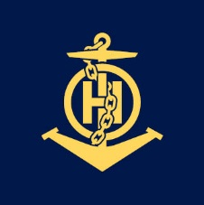
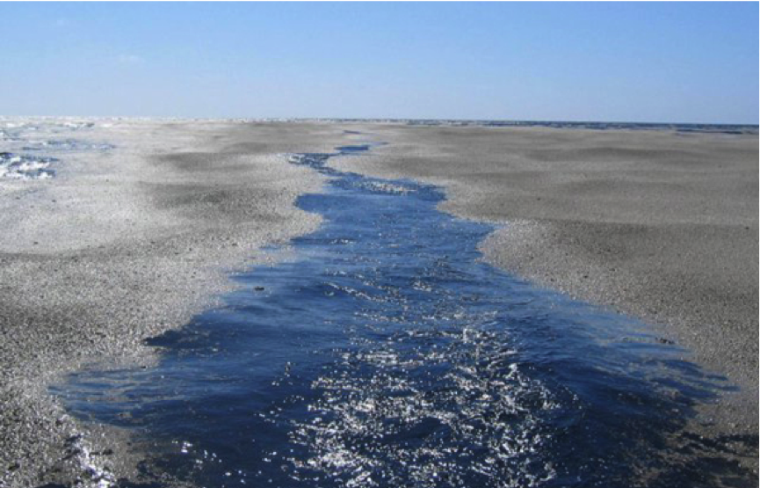
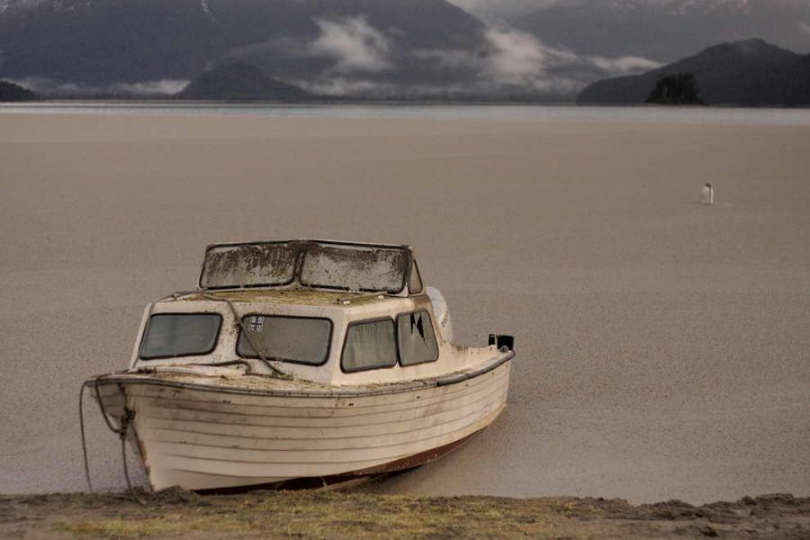
Volcanic activity and msi
Is it a hazard to ships?
https://volcanoes.usgs.gov/volcanic_ash/marine_transportation.html
https://www.youtube.com/watch?v=6lmKUGj_5fc (Paul Cragg Start 15:13)
Credit: USGS both images
Notes:
Why do I ask?

Slide 3
Volcanic activity and msi
Is it a hazard to ships?
Volcanic Activity | Hazard to Ships
Pumice rafts | Blocks seawater cooling systems, overheating engines
Gas emissions (sub-sea) | Impact to instruments on the ship’s hull. E.g. Echo sounders, speed logs
Explosive surtseyan (shallow water) eruption | Physical damage to, or destruction of ship
Pyroclastic flows (speeds of hundreds KM/h, temperatures hundreds of degrees C) | Heat and impact damage, ship stability
Tephra (from ash to larger objects) | Loss of stability, navigational data, engines, abrasion/corrosion damage Loss of visibility Hazardous to people
Sulphur dioxide | Potential corrosion Hazardous to people
Tsunami | Dependent on depth of water. Loss of stability, etc.
Notes:
Why do I ask?

Slide 4
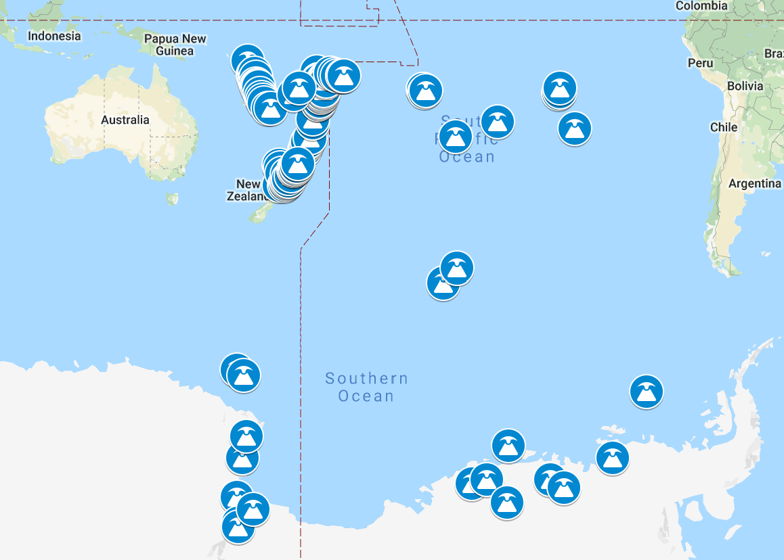
Volcanic activity and msi
What sources of information are available?
Volcanic Ash Advisory Centres (VAAC)
Notes:
Why do I ask?

Slide 5
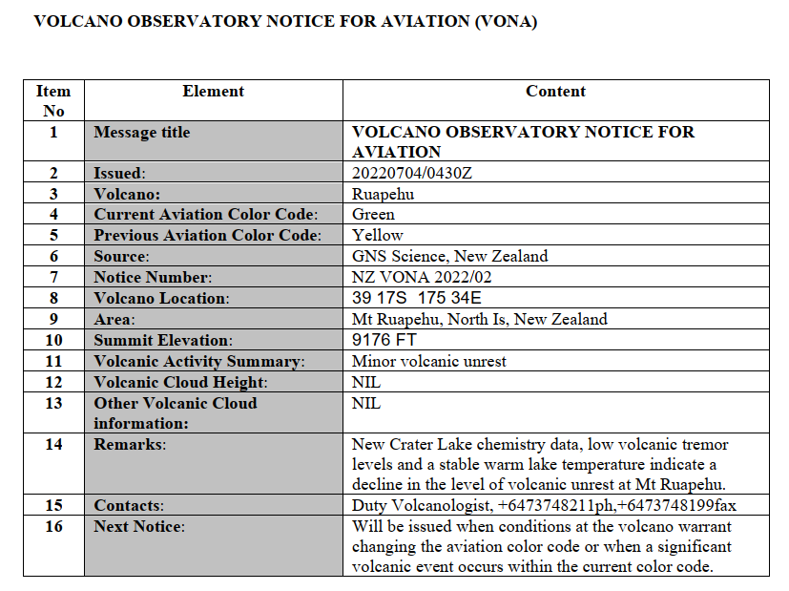
Volcanic activity and msi
Volcanic Observatory Notice to Aviation (VONA) Portal
Notes:
Why do I ask?

Slide 6
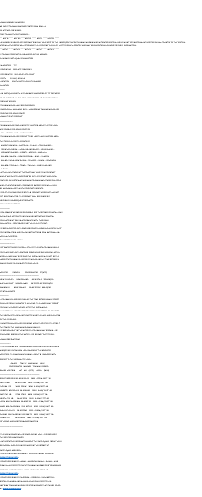
Volcanic activity and msi
Tailored messages for Mariners?
Notes:
Why do I ask?

Slide 7
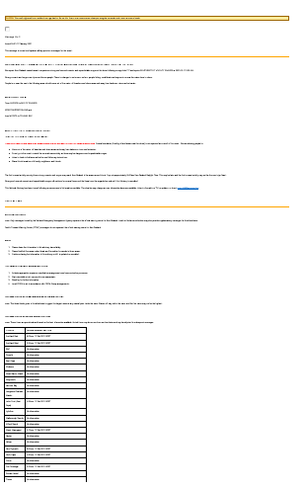
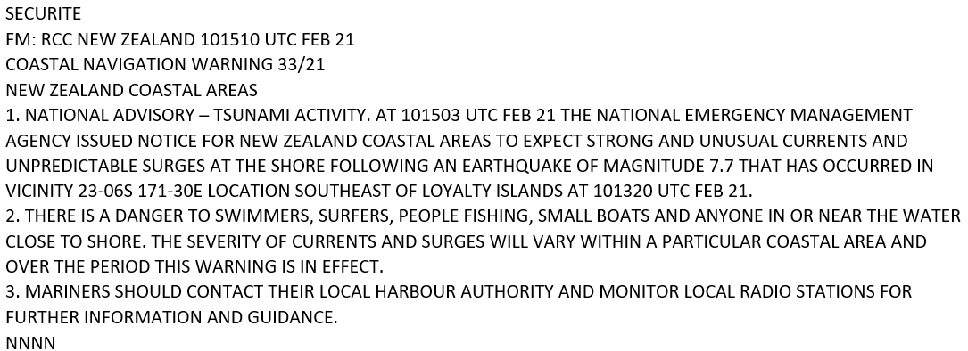
Volcanic activity and msi
Tailored messages for Mariners?
Notes:
Why do I ask?

Slide 8
Volcanic activity and msi
Next steps?
Should “we” (MET/NAV) collaborate on this?
Discuss the benefits of developing standard navigational warning text, specific to volcanic activity?
Consider the benefits of engaging in the aviation/meteorological work underway in the Southwest Pacific?
Anything else?
Notes:
Why do I ask?

