Slide 1
World-Wide Navigational Warning Service Sub-Committee
Report to IRCC15 and IRCC15 Outcomes
By Christopher Janus
WWNWS Chair

Slide 2
Agenda
Outcomes from IRCC15
IHO WWNWS Strategic Performance Indicator
WWNWS support to IHO C-55
Iridium SafetyCast Implementation
Capacity building
S-124 update

Slide 3
Outcomes from IRCC15
Assembly 3 Decisions
Use of gender-inclusive language (Decision 9b)
Approved the proposal to establish an ad hoc Project Team under IRCC to explore the possible establishment of reliable alternative funding for activities including capacity building and GEBCO (Decision 20)
IRCC established a scoping Team under the leadership of Dr John Nyberg to investigate potential additional sources of funding and the Team’s objectives for a presentation to C-7.

Slide 4
Outcomes from IRCC15
Hydrographic Services and Standards (HSSC15)
Tasked Nautical Cartographic Working Group (NCWG) to make an impact study and develop a standard for NtM (XML) if appropriate
HSSC established an ISO Cell after HSSC13 to experiment with the application of ISO 9001 in the development of S-101 Product Specifications. On this, HSSC invited IRCC to consider mirroring such an ISO Cell on S-101 via the RHCs

Slide 5
Outcomes from IRCC15
Capacity Building
e-Learning Center Guidelines approved
2024 Capacity Building Work Programme
IHO WP Element: Capacity Building Provision - Technical Workshops, Seminars, Courses (Adopted 2024 CBWP V1)
No. | Events | Responsible | Budget | Status | Resources
P-08 | MSI (training on establishment of MSI structure and basic MSI procedure) | NIOHC/ RSAHC | 22,120 € | Led by Dates | IHO

Slide 6
Outcomes from IRCC15
Worldwide ENC Database Working Group (WENDWG)
The WENDWG noted that many of the RHCs have not yet established the S-100 Coordinator roles and would like the IRCC/RHCs to consider how the S-100 Coordinator role will be implemented and what their responsibilities will be
Some RHCs requested more guidance on what the role entails
Considered an amendment to S-11 (Part A) to describe the Coordinator responsibilities
S-11 (Part A) is the Guidance for the Preparation and Maintenance of International (INT) Chart and ENC Schemes

Slide 7
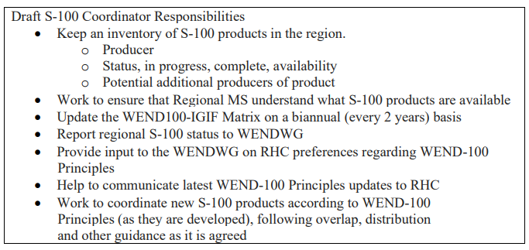
Outcomes from IRCC15
Worldwide ENC Database Working Group (WENDWG)
Draft S-100 Coordinator responsibilities

Slide 8
Outcomes from IRCC15
General Strategic Issues
IRCC encouraged RHCs to consider the requirements (including regulations) for non-ECDIS mandated vessels (e.g. small commercial, fishing, leisure, etc), with national, regional and global discussions on this topic…to allow for the transition from paper nautical charts via the provision of digital maritime data for these users
IRCC requested HSSC to direct the NCWG to liaise with WWNWS for the definition of the impact of the future of the paper chart production on the navigational warnings. IRCC decided to discuss RHC requirements regarding the future of all paper products (charts and publications) at IRCC 16.
IRCC15-09.1 – Effects of amended paper chart production practice

Slide 9
14th meeting of the WWNWS-SC
Held from 12-16 September 2022, hybrid meeting, Geneva, Switzerland
Joint meeting with the WMO Worldwide Met-Ocean Information Warning Service
80 Participants
BDMSS – Regional system with partial coverage of NAVAREA VIII, X, XI, and XIII
NAVDAT – Navigation Data Exchange
Space Activities Working Group established
Task Team on Volcanic Activity established
S-124 Progress
Iridium SafetyCast Implementation
North Sea RHC MSI Working Group

Slide 10
IHO Strategic Plan – SPI for MSI
Target: 3.1 Collaborate with other bodies who deliver capacity building and training to improve effectiveness of capacity building activities and programmes
Measure: 3.1.1 Percentage of Coastal States that are capable to provide maritime safety information (MSI) [navigational warnings] according to the joint IMO/IHO/WMO manual on MSI (2026 - 90%)
NAVAREA will confirm successful communications (via email/phone) twice per year

Slide 11
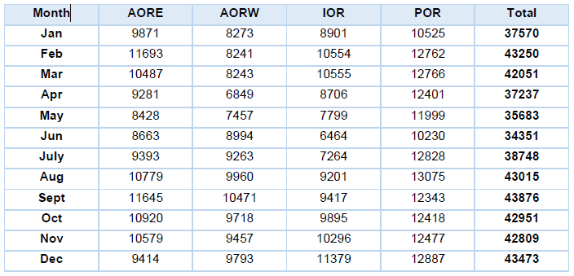
SPI - Navigation Warnings by year
“On average, there were 40,418 [Inmarsat] messages per month, including repeated messages. The average messages per month decreased by 1,130 compared to the last reporting period” (NCSR 10/10/4)

Slide 12
Navigational warnings issued in 2022

Slide 13
SPI - MSI Support for 2022(Derived from WWNWS14 NAVAREA Self Assessments)

Slide 14
SPI - Coastal States by NAVAREA
NAVAREA | Coastal States with MSI Capacity | Total Coastal States
NAVAREA I (United Kingdom) | 11 | 11
SUBAREA Ib (Sweden) | 9 | 9
NAVAREA II (France) | 18 | 26
NAVAREA III (Spain) | 22 | 24
NAVAREA IV (United States) | 39 | 46
NAVAREA V (Brazil) | 1 | 1
NAVAREA VI (Argentina) | 4 | 4
NAVAREA VII (South Africa) | 12 | 13
NAVAREA VIII (India) | 10 | 11
NAVAREA IX (Pakistan) | 8 | 13
NAVAREA X (Australia) | 7 | 8

Slide 15
SPI - Coastal States by NAVAREA
NAVAREA | Coastal States with MSI Capacity | Total Coastal States
NAVAREA XI (Japan) | 21 | 21
NAVAREA XII (United States) | 9 | 10
NAVAREA XIII (Russian Federation) | 1 | 1
NAVAREA XIV (New Zealand) | 10 | 12
NAVAREA XV (Chile) | 1 | 1
NAVAREA XVI (Peru) | 1 | 1
NAVAREA XVII (Canada) | 1 | 1
NAVAREA XVIII (Canada) | 1 | 1
NAVAREA XIX (Norway) | 1 | 1
NAVAREA XX (Russian Federation) | 1 | 1
NAVAREA XXI (Russian Federation) | 1 | 1
WWNWS | 189 | 218
SPI = 87%

Slide 16
Inmarsat Data Usage – Most to Least

Slide 17
Navigational Warnings issued– Most to Least
(KB)

Slide 18
Navigational Warnings broadcast – Most to Least

Slide 19
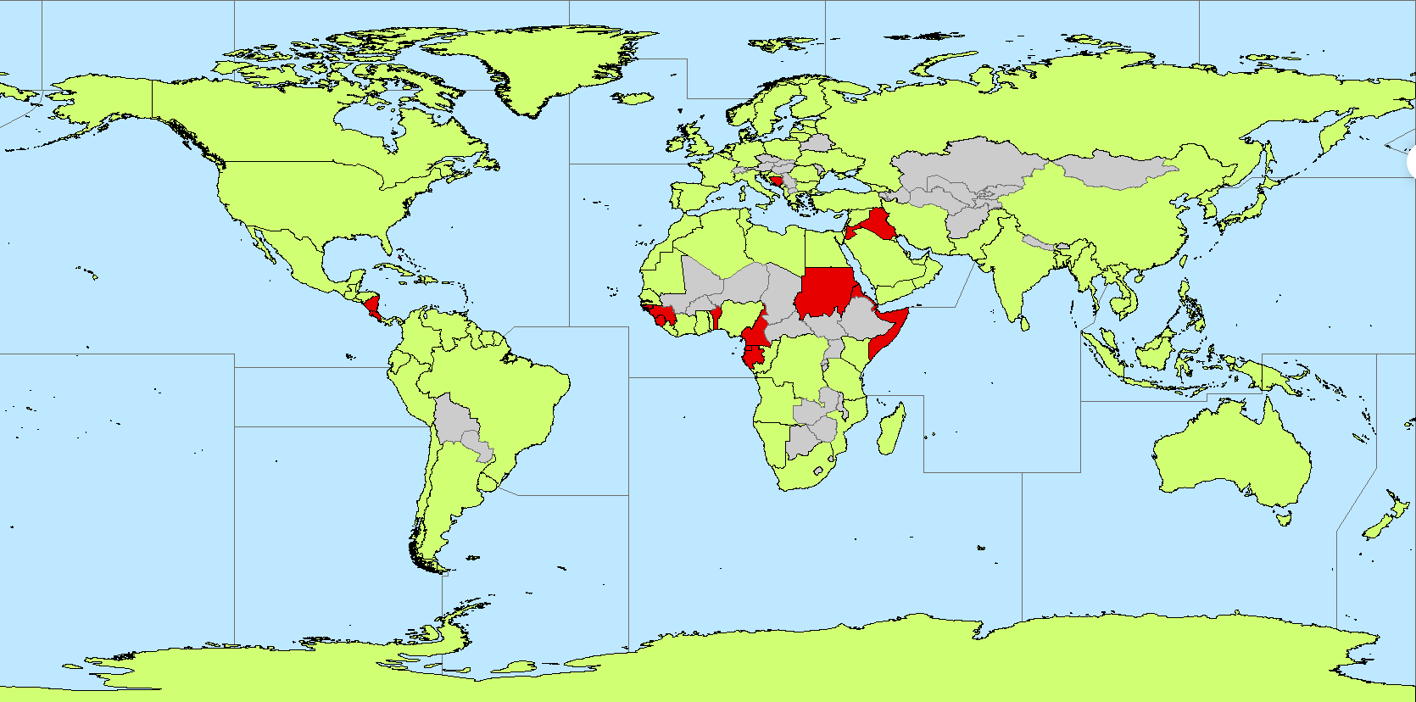
C-55 GIS Project
Meets MSI SPI
Does not meet MSI SPI

Slide 20
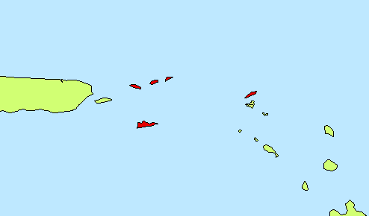
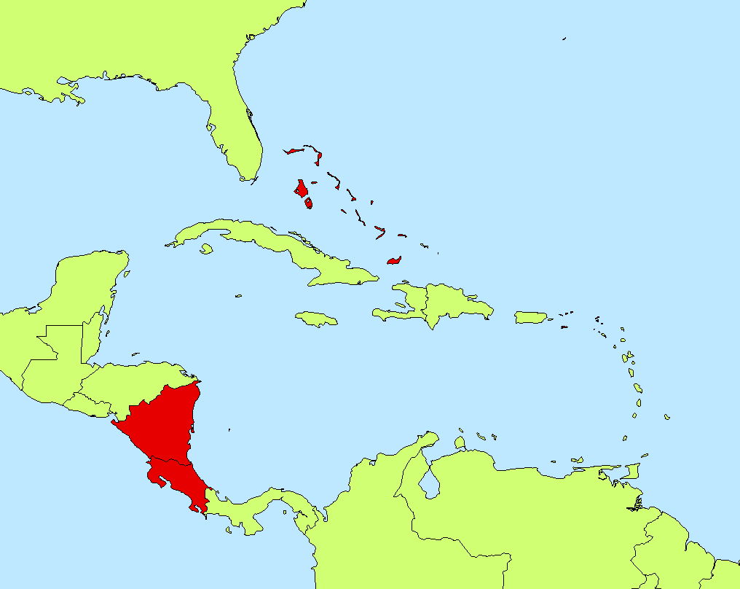
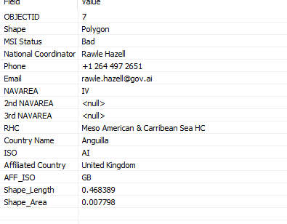
Coastal State attribution

Slide 21
Iridium SafetyCast Implementation
At the 105th session of the IMO Maritime Safety Committee (MSC 105),the Committee agreed that the use of all IMO RMSSs should be mandatory.
Iridium noted that it had deferred charging for MSI for the last two years and, as a temporary measure, Iridium offered to continue to defer charging to Member States that had informed IMO about having financial difficulties with the implementation.
Iridium confirmed that this temporary initiative would continue until the cost issue was resolved and Member States agreed to more permanent solutions.

Slide 22
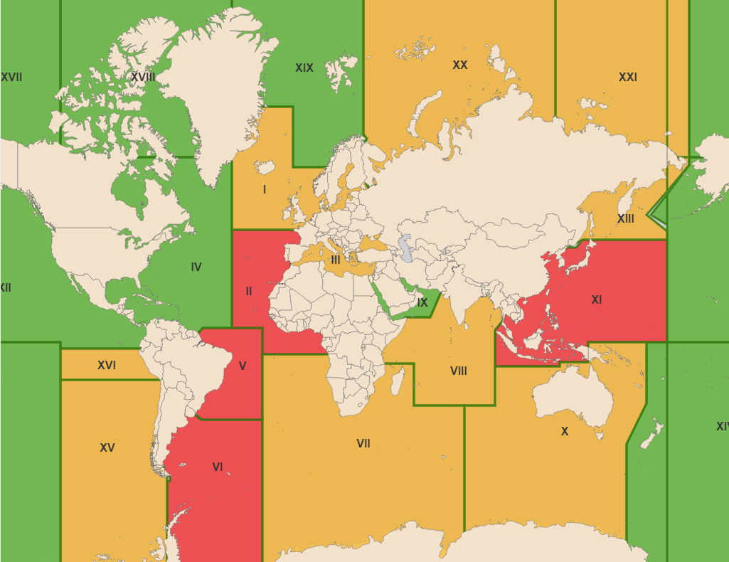
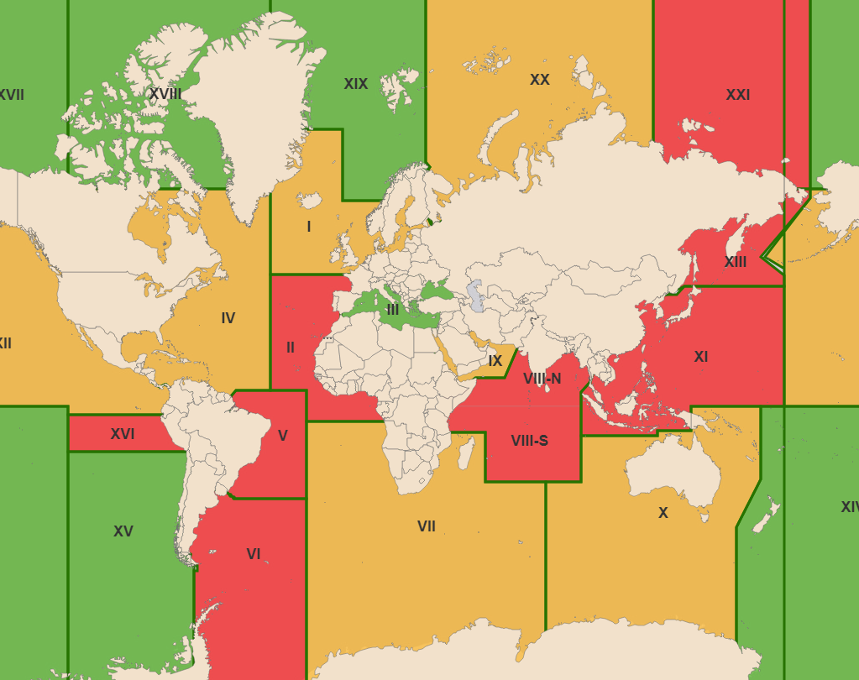
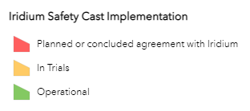
Iridium SafetyCast Implementation 2022
NAVAREAS
METAREAS

Slide 23
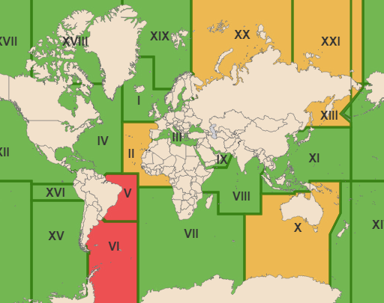
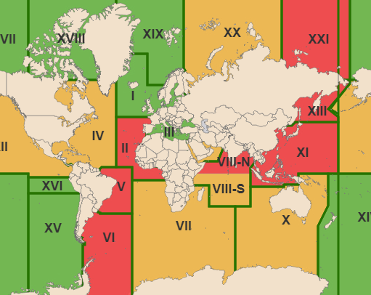
Iridium SafetyCast Implementation 2023
NAVAREAS
METAREAS

Slide 24
MSI Capacity Building
Last courses: Cabo Verde (EAtHC) September 2022 Colombia (SEPHC) October 2022
Next Courses: Fiji (SWPHC) July 2023 Oman (NIOHC) October 2023

Slide 25
S-124 Update
S-124 version 1.0.0 endorsed by WWNWS14 and submitted to HSSC15 for approval.
NCSR10 approved the updated Joint IMO/IHO/WMO Manual on Maritime Safety Information
S-124 Document Encoding Guide draft version complete.
Future work:
Testing portrayal of NAVWARN in user systems.
Testing options for distribution of S-124
Enhance and improve the S-124 product specification as needed.

