Slide 1
BDMSS progress update
IMSO & CTTIC
Notes:
Hello, I’m Philip Lane, Technical Officer at IMSO.

Slide 2
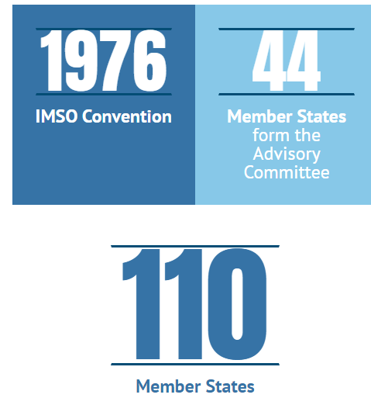
About IMSO
IMSO contributes to the safety and security of seafarers and passengers around the world by:
providing oversight of the satellite providers of the Global Maritime Distress and Safety System, or ‘GMDSS’ and
Acting as the Co-ordinator for the Long-Range Identification and Tracking of Ships, or ‘LRIT’.
Notes:
The International Mobile Satellite Organization (IMSO) is an intergovernmental organization established by the United Nations International Maritime Organization (IMO) in 1976.
IMSO contributes to the safety and security of seafarers and passengers around the world by:
providing oversight of the satellite providers of the Global Maritime Distress and Safety System, or ‘GMDSS’ and
Acting as the Co-ordinator for the Long-Range Identification and Tracking of Ships, or ‘LRIT’.
Today, we will look at the aims of the GMDSS and LRIT, their practical uses and their respective regulatory environments, and the role that IMSO plays in them.

Slide 3
IMSO NEWS
New IMSO Director General
following his election on 29th September 2022 by the IMSO Assembly, Mr. Laurent Parenté (Vanuatu) begun his four-year term as the Director General of IMSO on 17 April 2023
Notes:
We have some IMSO news ….
On 17 April 2023 Mr. Laurent Parenté begun his four-year term as the new Director General of IMSO
Next …

Slide 4
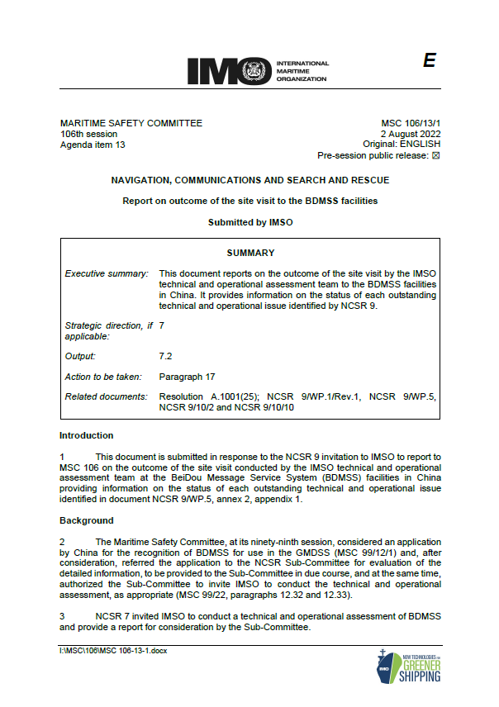
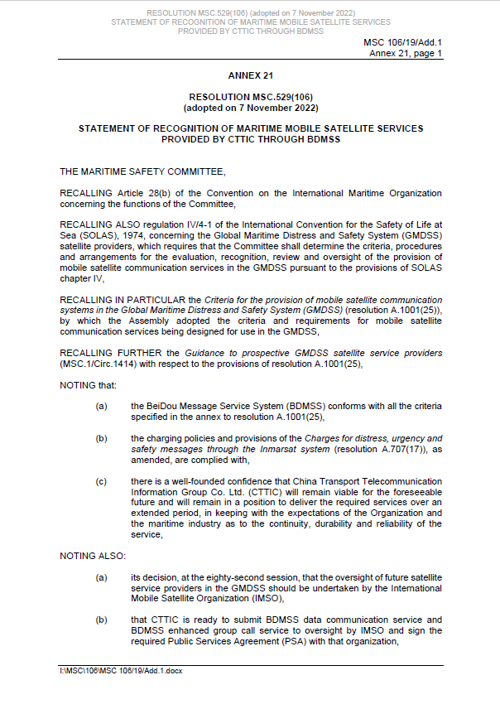
CONCLUSION of BDMSS ASSESSMENT stage
Notes:
CONCLUSION of BDMSS ASSESSMENT stage
In November 2022 IMO MSC 106 considered IMSO's report on the outcome of the site visit by the IMSO technical and operational assessment team to the BDMSS facilities in China.
The Committee agreed to recognize the maritime mobile satellite services provided by CTTIC through BDMSS for use in the GMDSS and noted the commitment of the delegation of China and CTTIC to address the outstanding implementation issues. The Committee also invited IMSO to monitor the implementation of BDMSS and to report to the Committee when the Public Services Agreement with CTTIC had been concluded and the Letter of Compliance had been issued.

Slide 5
OVERALL STATUS on BDMSS implementation
Implementation issue | Status
1. MSC to issue a resolution recognizing the mobile satellite GMDSS service provider
2. BDMSS to sign a PSA with IMSO for oversight of the recognized services
3. IMO to make available an MSI manual for the new Enhanced Group Call (EGC) service
4. BDMSS to develop internal operational procedures to support GMDSS recognized services
5. a type-approved terminal to be made available for the operation of the new mobile communication satellite services
6. WRC-23 to complete the necessary regulatory actions to safeguard the availability and full protection of the spectrum used for BDMSS
7. CTTIC to complete contingency arrangements for ground-based components of BDMSS
8. any other issues to be indicated by MSC
9. IMSO to issue CTTIC with a "Letter of Compliance"
Notes:
Update on BDMSS implementation
In November 2022, the Maritime Safety Committee agreed to recognize the maritime mobile satellite services provided by CTTIC through BDMSS for use in the GMDSS and noted the commitment of the delegation of China and CTTIC to address the outstanding implementation issues.
The Maritime Safety Committee noted the commitment of the delegation of China and CTTIC to address any outstanding implementation issues, including those listed in NCSR 9/WP.5, annex 2, appendix 2, before the commencement of services.
The Maritime Safety Committee invited IMSO to monitor the implementation of BDMSS and to report back when the Public Services Agreement with CTTIC had been concluded and the Letter of Compliance had been issued.
From IMSO’s perspective, the latest status of the issues listed in NCSR 9/WP.5, annex 2, appendix 2 is as shown in this table …
Item 1 – done - Resolution MSC.529(106)
Item 2 – in progress
Item 3 – an draft interim manual has been developed and submitted to WWNWS-SC
Item 4 – In progress with CTTIC
Item 5 – in progress
Item 6 – ITU-R WP 4C completed work on the reference material for WRC-23 agenda item 1.11, issue 3. This issue will be decided at WRC-23 in November 2023.
Item 7 - In progress with CTTIC
Item 8 – no other issues raised so far
Item 9 – pending completion of the above issues

Slide 6
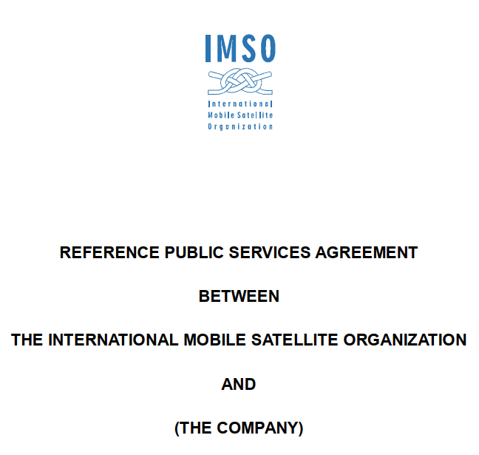
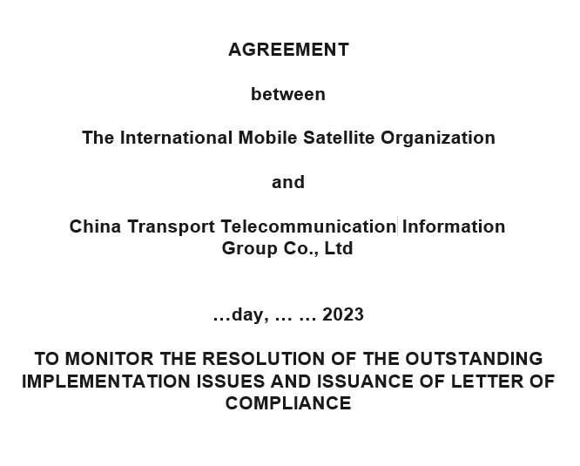
AGREEMENT WITH CTTIC
PSA awaiting to be signed
The signing of the PSA is in general agreed by IMSO and CTTIC, pending the completion of parallel related issues.
Assessment agreement in discussion
Draft agreement on the monitoring of the resolution of outstanding implementation issues are developed. IMSO and CTTIC are in detailed review and discussion on the provisions of the agreement.

Slide 7
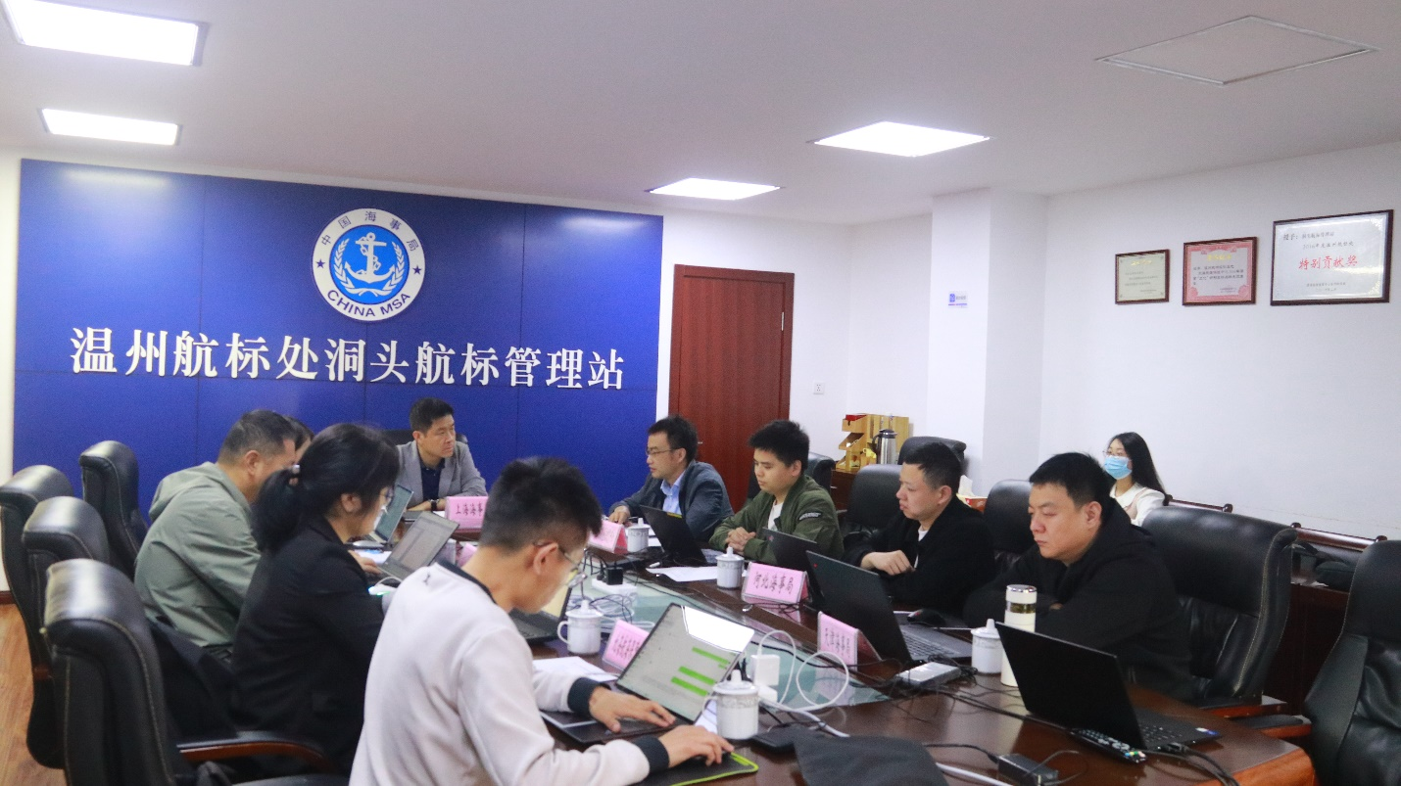
BDMSS safetylink service MANUAL
Developed draft interim BDMSS SafetyLink Service Manual and submitted to IMSO;
Organized detailed review and update on the service manual;
Submitted to WWNWS-15 for review and further actions (3.4.3.1).

Slide 8
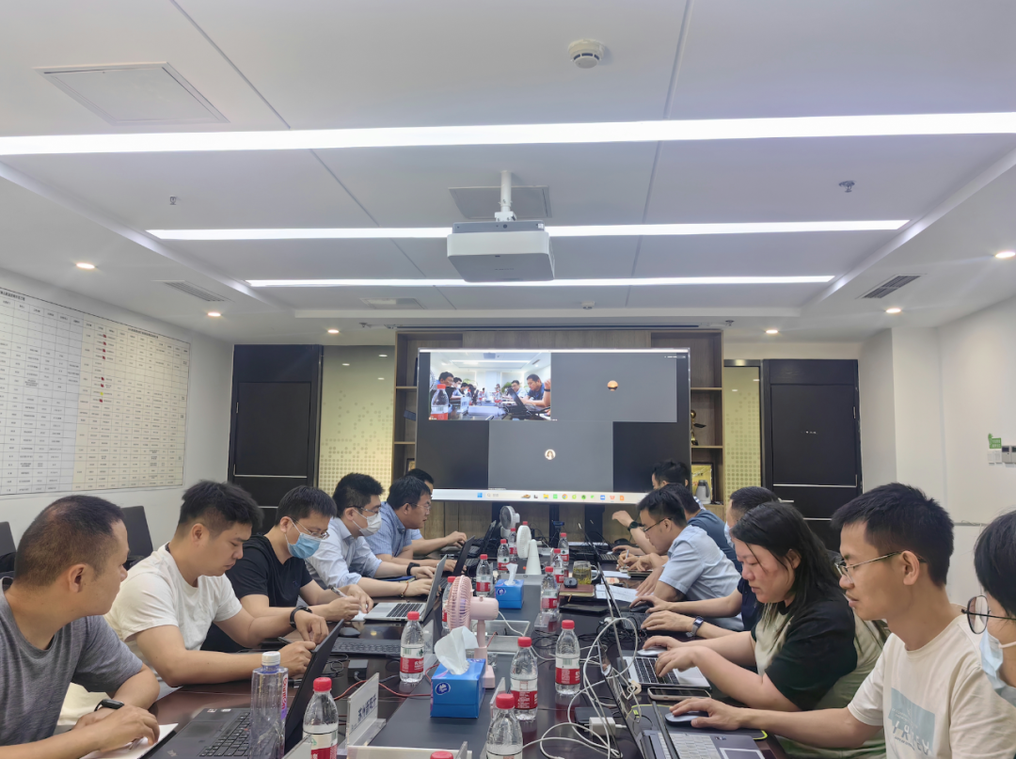
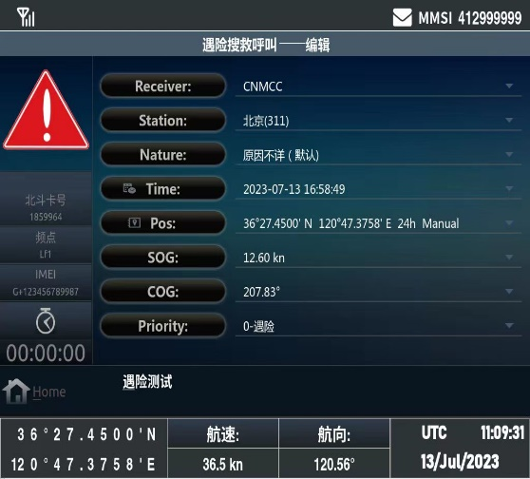
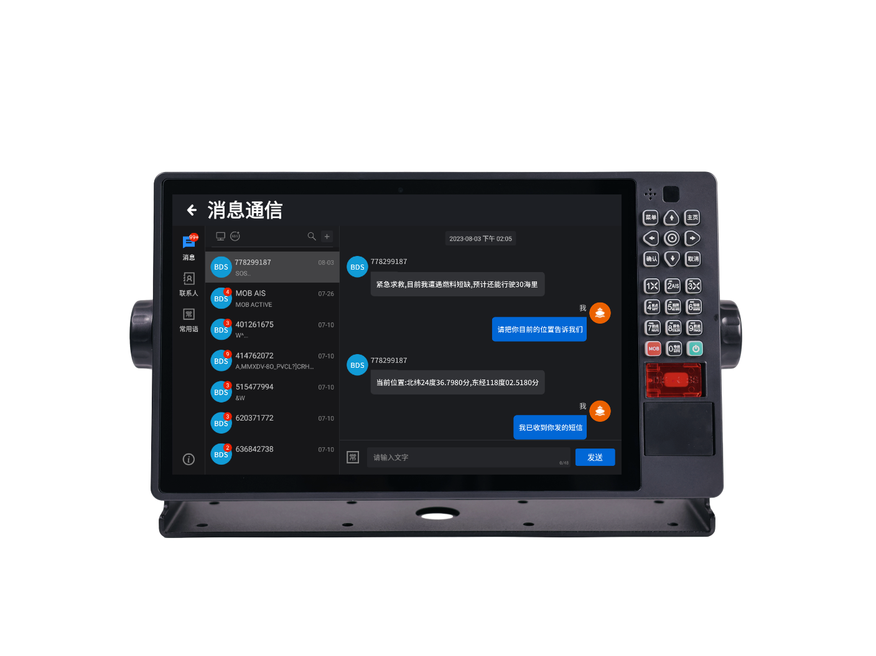
type approval of bdmss terminals
Developed unified interface protocol for the purpose of scale manufacturing;
Developing BDMSS series terminals;
Cooperating with China Classification Society on the type approval of BDMSS terminals.

Slide 9
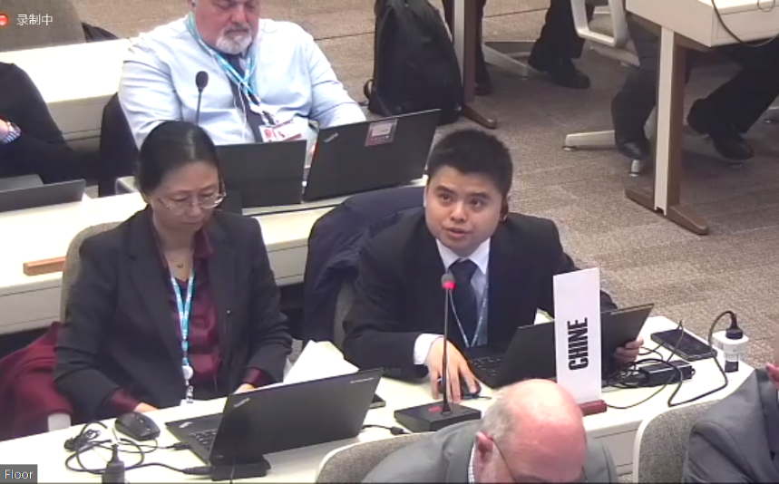
BDMSS Frequency coordination
CPM 23-2
Finalized the CPM report, including methods to address the BDMSS frequency issue
APG 23-6
Developed the APT common view on BDSS frequency issue
Bilateral coordination
Conducted several times of bilateral coordination with Globalstar.

Slide 10
Contingency arrangements
Backup Sites:
Facilities are ready;
Testing and commissioning are being conducted to realize service switchover between the primary and backup sites.

Slide 11
Thank you for your attention！
Philip Lane
Technical Officer
IMSO
philip.lane@imso.org
Liu Falong
International Cooperation Advisor
CTTIC
liufalong@cttic.cn
Notes:
Thank you for your attention. I would be happy to take any questions.

