Slide 1
Demonstration of e-learning materials
French MSI course presentation
Shom - NAVAREA II
Presented by Amandine Lefrançois
NAVAREA II Coordinator

Slide 2
This course was developed by the French Naval Hydrographic and Oceanographic Service (SHOM for Service hydrographique et océanographique de la Marine in French), as part of the International Hydrographic Organization's (IHO) strategic objective of Capacity Building (CB) and national capacity development.
The objective of capacity building is to continuously assess and support the improvement and sustainable development of States, so that they are able to fulfil the IHO objectives, obligations and recommendations in the field of hydrography, cartography and maritime safety.

Slide 3
target audience
This course concerns the first of the three steps of the development of a national capacity: collection and dissemination of nautical information.
This course is shaped to suit the needs of countries where this first step is not fully completed or where there is a need for consolidation
The course is set for training of national coordinator’s staff

Slide 4
Course prerequisites
A computer/laptop/tablet
A good internet connection (video + access to data.shom cartography)
Time needed for full completion :
Theory section : 7h
Practical part : 8h

Slide 5
Msi course Main page

Slide 6
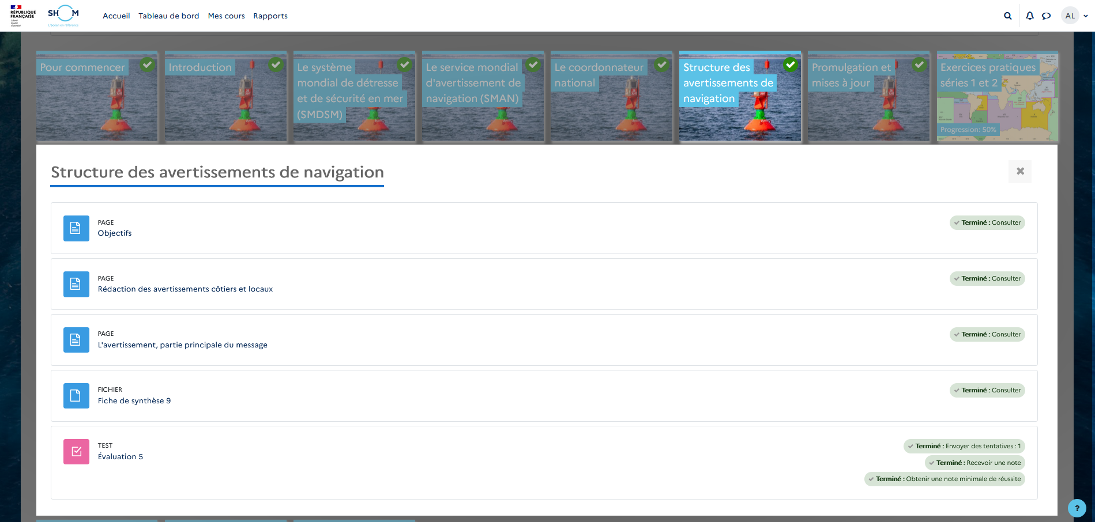
Structure of the modules
The objectives of the module
The course
The summary
The evaluation

Slide 7
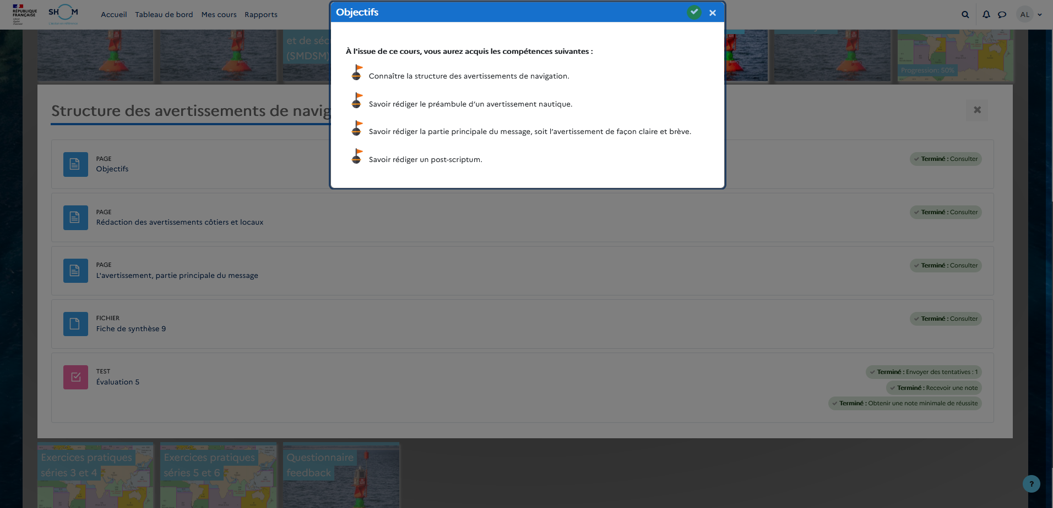
The objectives of the module

Slide 8
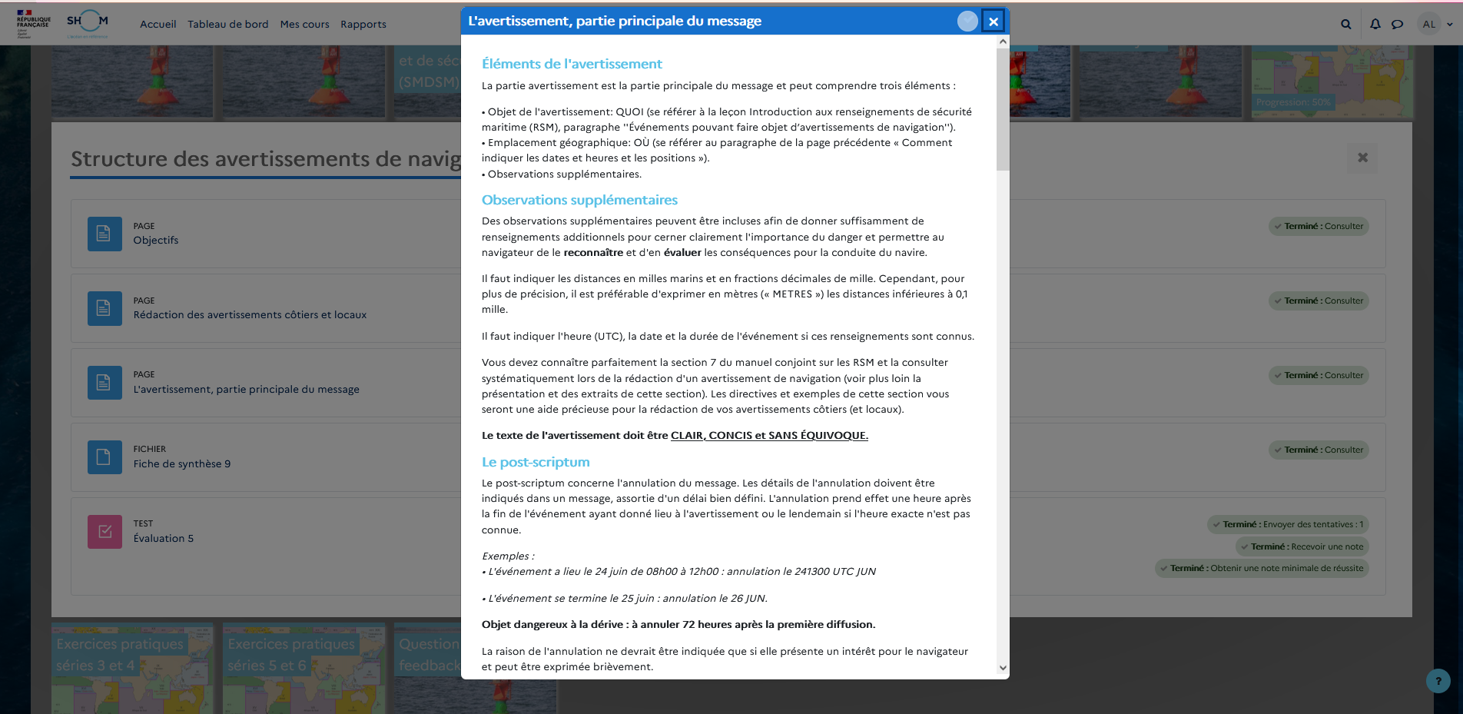
The course

Slide 9
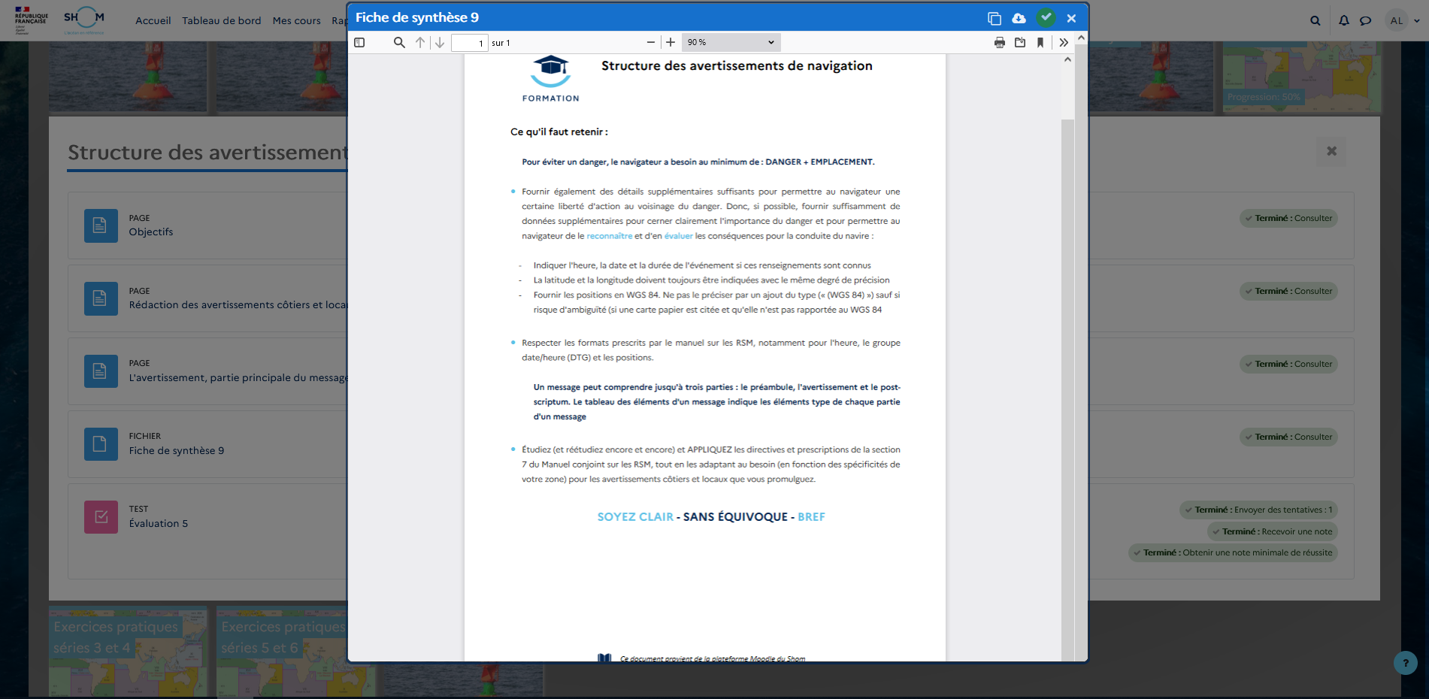
The summary
A one page summary that can be downloaded or printed

Slide 10
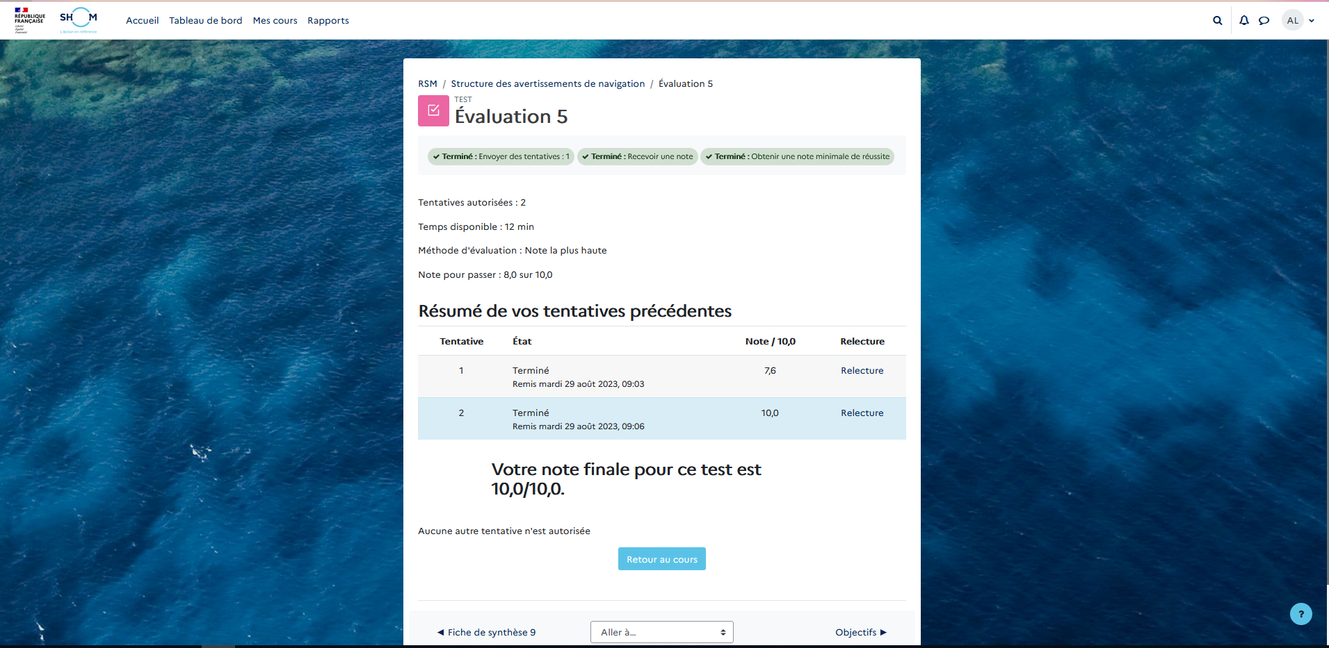
The evaluation
A passing score is required for the evaluation to be completed
2 attempts allowed

Slide 11
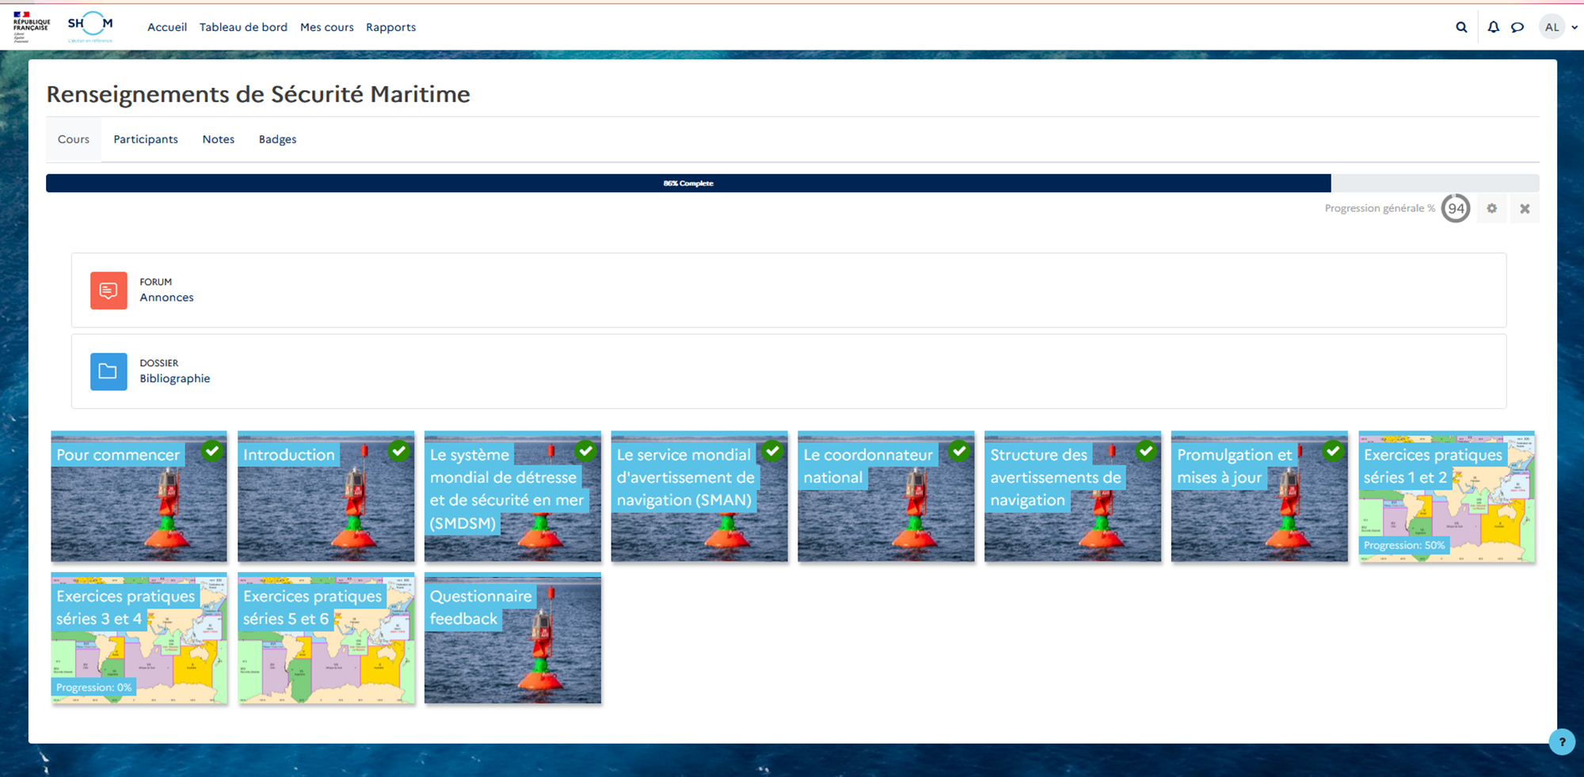
Numerous Practical exercises
6 series of practical exercises. The use of the data.shom portal maintains the exercises realistic

