Slide 1
North Sea Maritime Safety Information Working Group
NAVAREA I

Slide 2
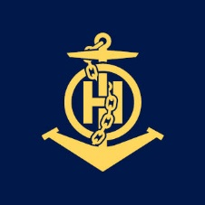
Background
The group was established during the 35th meeting of the North Sea Hydrographic commission
The group has been established to promote and facilitate the below withing NAVAREA I:
To facilitate that the GMDSS MSI services in the NAVAREA are arranged in compliance with the regulations and recommendations of the IMO, IHO and other relevant organisations.
To facilitate cooperation concerning technical and administrative matters related to the MSI service.
To facilitate the exchange of information about events that could affect safety at sea within NAVAREA I.
To facilitate the exchange of advice concerning all aspects of MSI work.
To facilitate harmonization of new and existing methods that make MSI and other relevant information to shipping available, related to navigation warnings.
To evaluate and compile views on new and changed methods of providing MSI and to forward these to the relevant body.
To exchange information about major planned operations at sea that are expected to affect international shipping in coastal waters of neighbouring countries.
Improve and develop capacity building.

Slide 3
Membership
The membership is open to member states of the North Sea Hydrographic commission.
Relevant IHO/IMO bodies may be invited.
Non governmental agencies may be invited by the chair.
Participation from:​ Belgium, ​Demark​, France​, Germany​, Iceland​, Ireland​, Norway​, Sweden​ & United Kingdom

Slide 4
Meetings
We have had two virtual meetings of the Working Group. An in person meeting is planned for November.
Topics:
WWNWS self assessment & Report
Space operation and licensing
Impact of offshore AtoN’s in North Sea on NAVTEX capacity
Space weather
S-124

