Slide 1
S-124 Production and Provision (Trials)
Australian Maritime Safety Authority
Julius Moeller

Slide 2
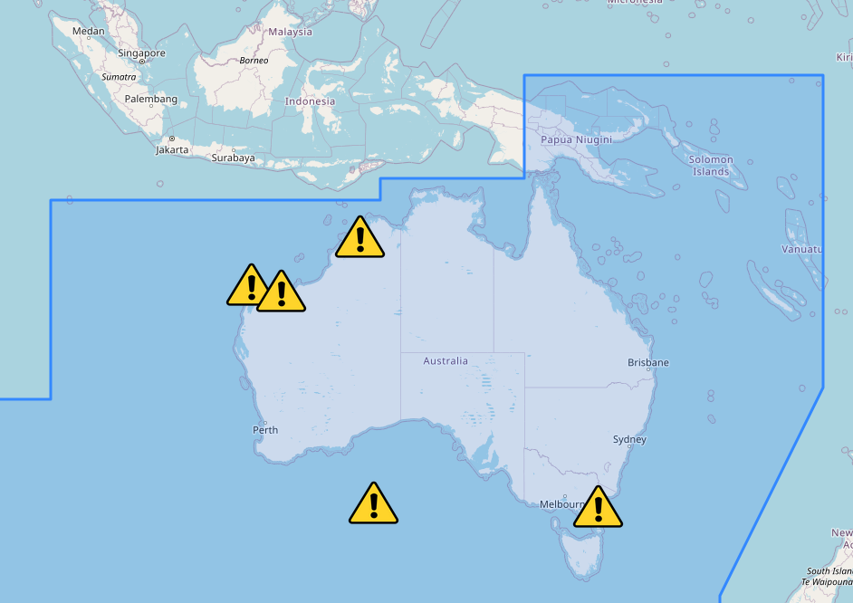
Introduction
Vision: Real-time navigational warning service for Australia, to complement SafetyNet using S-124
Challenges:
Integration with old system
Source data in old systems not sufficient
Cyber Security

Slide 3
Process Overview
Data Export from AMSA’s Nexus System
Extract Required Information
Generate S-124 Data Set
Service for
Transmission
VDES

Slide 4
Data Export
Data export is required to get the source data for S-124 generation
Nexus system uses Inmarsat C-Codes to add metadata for distribution
Envisioned operational set-up:
S-124
new API
VDES Service
NEXUS
S-124 Plug-In
Traditional text-based warnings

Slide 5
Text-based Warning (current State)
SECURITE
FM JRCC AUSTRALIA 112251Z JUL 2014
NAVAREA X 043/14
1. HAZARDOUS OPERATIONS. SPACE DEBRIS RE-ENTRY 141423UTC TO 141705UTC JUL 14 WITH AN ALTERNATE TIMEFRAME 161338UTC TO 161620UTC JUL 14 IN PROJECTED AREA BOUNDED BY:
39-30S 106-10E,
43-20S 116-30E,
44-20S 116-00E,
40-30S 105-45E,
39-30S 106-10E.
NNNN
Information included in human-readable text:
General Area / Warning Type
Warning Number
Category of Warning
Geometry
Validity Period
Further information ?

Slide 6
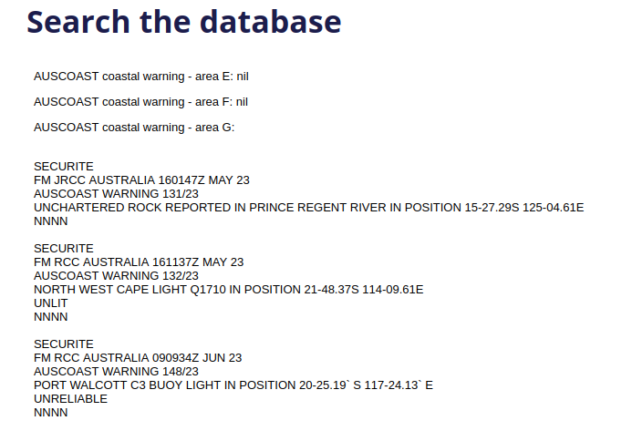
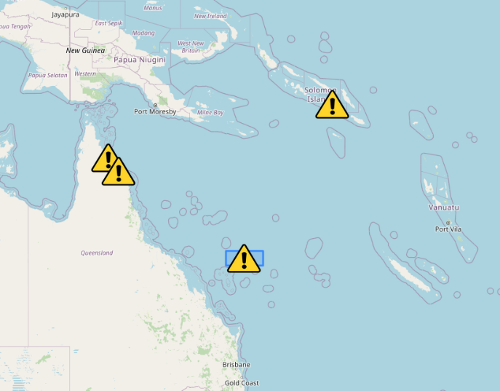
Challenges in Information Extraction
All relevant data is only contained in the text-based warning message
Best solution would be an update of Nexus to support S-124 input mask for producing S-124 (and then generate “old” text-based warning automatically)
Not feasible for trial project: Requires significant modification of safety-critical business processes
Need to extract S-124 attributes from text-based warning on a best-effort basis

Slide 7
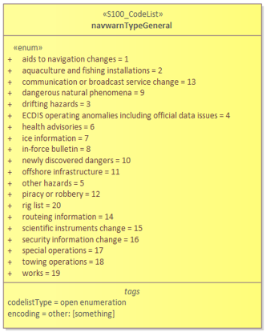
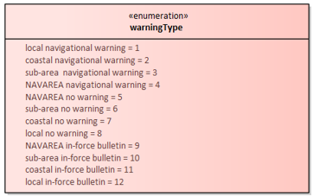
Approach to Information Extraction
Rule-based parsing of the message for simple attributes, e.g.:
“NAVAREA X 043/14”
warningType = NAVAREA Navigational Warning
warningNumber = 43
AI-based parsing (using OpenAI’s gpt-3.5-turbo) in more complex cases:
Category of Warning (19 general types, about 300 specific types)
Validity period
Geometry
AI-assisted data set generation might be used for training or to increase efficiency of business processes (only under human-supervision)

Slide 8
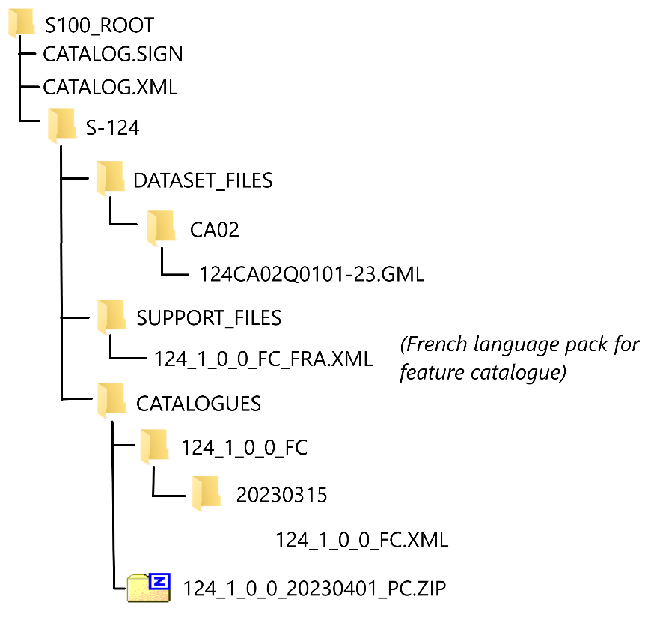
Dataset Generation
Dataset Generation using Java JAXB and the GML Schemas from IHO:
S-124 v1.0.0-draft
S-100 v5.0.0
Dataset generation is automated and can be triggered via UI or REST-API
Minimal implementation for testing: references, cancellation or multiple languages not supported, placeholder for metadata.
ExchangeSet includes digital signatures.
S-124 example of ExchangeSet

Slide 9
Service For the Provision of NW
Data production is the first step, but we also need next-generation digital services for the provision of the data!
International WG (“Open Digital Incubator Initiative”) progresses the specification and implementation of maritime services
Development of a “Technical Specification for the Provision of Navigational Warnings to End-users” (WWNWS14-2-1-1-4)
Service will use the Maritime Connectivity Platform for service discovery, reliable messaging and authentication (digital identities)
IEC 63173-2 (SECOM) for secure data exchange

Slide 10
Demonstration

Slide 11
Thank you for your attention!
Questions?
Contact
Julius Moeller – Julius.Moeller@amsa.gov.au
Ricky Withers – Ricky.Withers2@amsa.gov.au
Stuart Shepard – Stuart.Shepard@amsa.go.au

