Slide 1
S-124 Navigational Warnings
Data Capture and Encoding Guide (DCEG)
Presented by Timothy “Ed” Stacy (United States)
Deputy NAVAREA IV/XII Coordinator

Slide 2
Agenda
Background
S-124 DCEG Examples
Next Steps
Actions Requested of the Sub-Committee.

Slide 3
Background
In 2019 the previous NAVAREA XVII/XVIII coordinator and the S-124 Project Team (PT) Chair developed an initial S-124 Training Manual for NAVAREA Coordinators and Annex containing S-124 encoding examples.
The Deputy NAVAREA IV/XII Coordinator presented a S-53 to S-124 mapping presentation at WWNWS14. Within the next steps presented, one was the development of a S-124 Data Capture and Encoding Guide (DCEG).
At WWNWS14 the S-124PT Chair gained approval from the Sub-Committee to take the required steps to get a 1.0.0 standard approved.
The Annex Developed in 2019 was updated and expanded. At the Virtual meeting of DRWG21 a draft S-124 DCEG, was presented under agenda item 8. The DCEG mapped the Joint IMO/IHO/WMO Manual on Maritime Safety Information, submitted to NCSR10, to the current S-124 data model.
HSSC15 approved and published the S-124 1.0.0 standard in June of 2023.

Slide 4
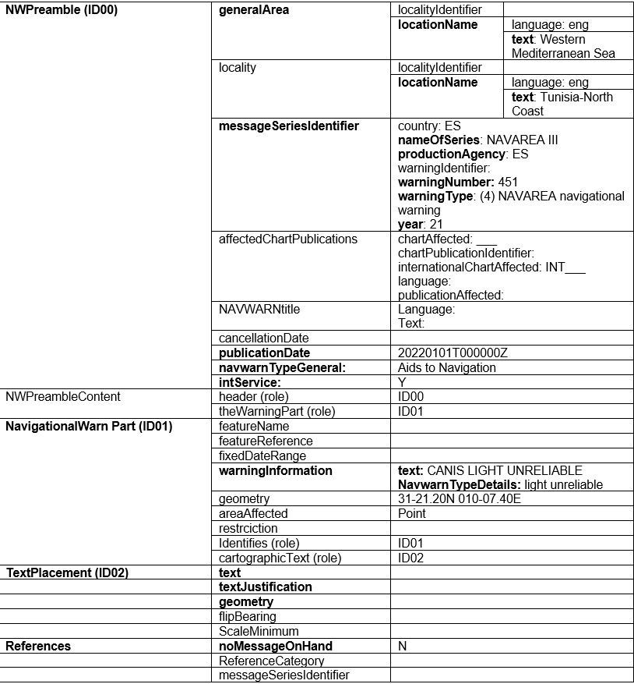
S-124 DCEG Examples – Basic Information

Slide 5
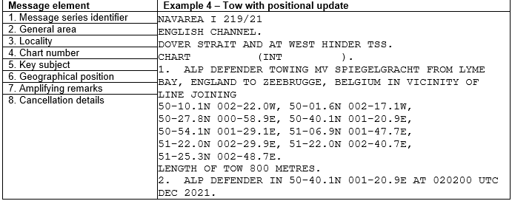
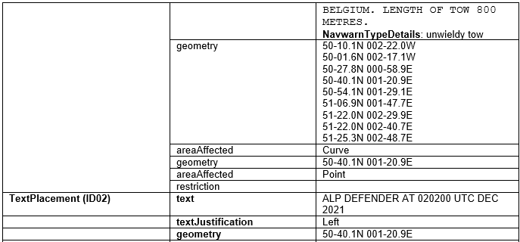
S-124 DCEG Examples – multiple geometries

Slide 6
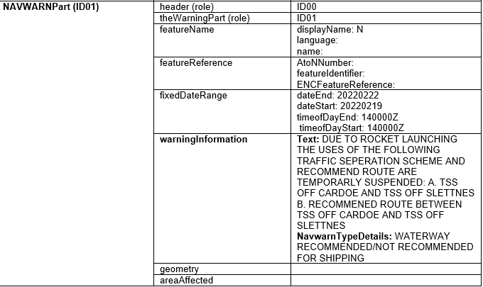
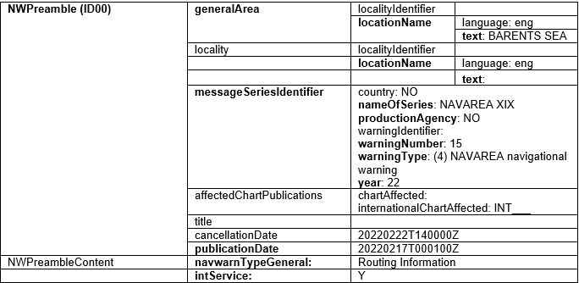
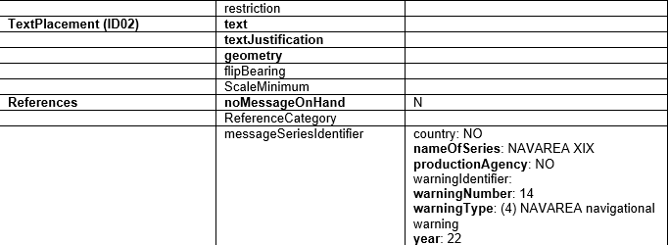
S-124 DCEG Examples – cancellations

Slide 7
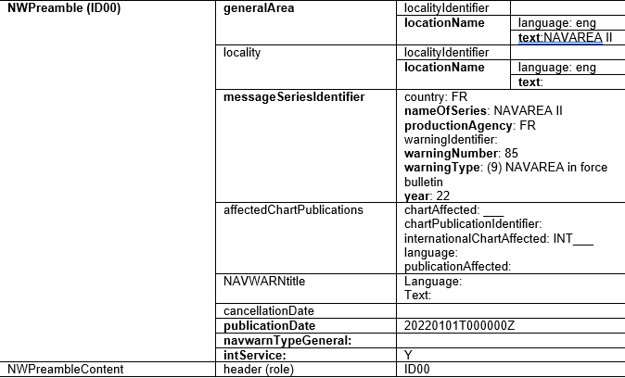
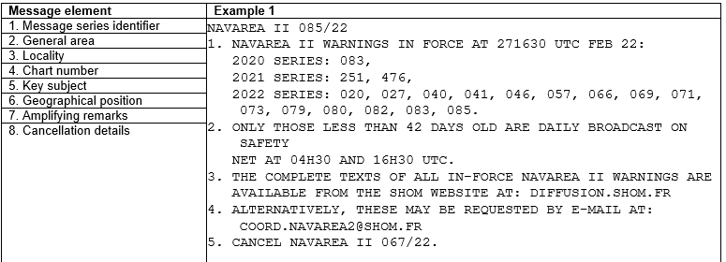
S-124 DCEG Examples – in force bulletin

Slide 8
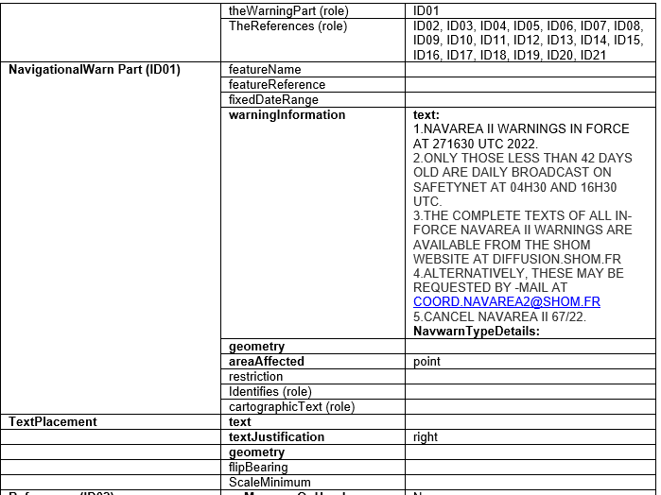
S-124 DCEG Examples – in force bulletin – Cont.

Slide 9
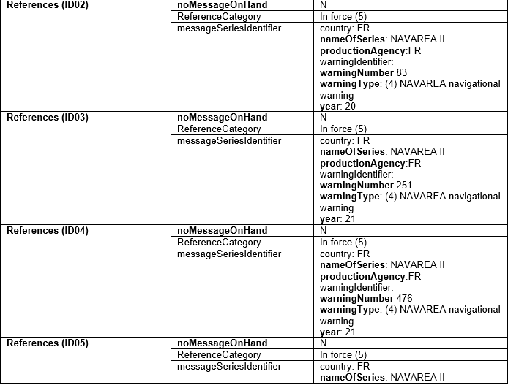
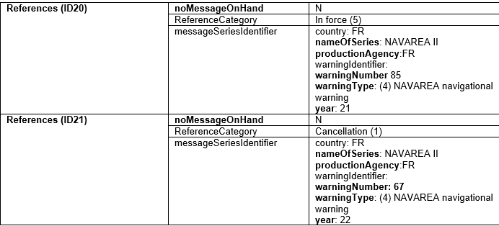
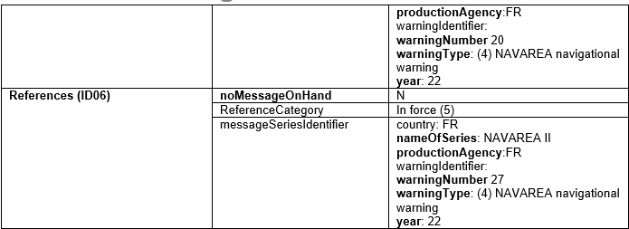
S-124 DCEG Examples – in force bulletin – Cont.

Slide 10
Next steps and
The S-124 standard is flexible, as more MSI Providers create S-124 prototypes there will be a need to update and document best encoding practices into the S-124 DCEG to ensure consistency in S-124 navigational warnings across the WWNWS.
While it is expected that in the near term the S-124 DCEG will be a living document, due to the expedited timeline to approve edition 2.0.0 it is imperative Navigational Warning providers provide feedback into the S-124 DCEG.
The S-124 Training Manual for NAVAREA Coordinators is in need of update, to provide practical, easy to read, documentation explaining the S-100 framework, and how S-124 fits into it.

Slide 11
Actions requested of the sub-committee
Invite members of the sub-committee to note the background provided and practical encoding examples provided.
Encourage all members to the sub-committee to provide feedback to the S-124 PT on their testing efforts or to commence testing efforts as soon as possible.
Invite members to the sub-committee to contribute to the work of the S-124PT and in particular the continued development of the S-124 DCEG.
Encourage members of the subcommittee to assist the S-124PT in its work on the DCEG and have the S-124PT report back to DRWG22 and WWNWS16 on updates to the S-124 DCEG.

