Slide 1
S-124 Progress
WWNWS15, Monaco, Sept. 2023
Eivind Mong (S-124PT Chair, CCG)

Slide 2
Agenda
September 6th, 2023
Time | Agenda | Event/Topic | Lead
 | 3.6.1 | S-124 Progress
0900 | 3.6.1.1 | S-124 Development Story, including approval of Edition 1.0.0 | Chair S-124 PT
0930 | 3.6.1.1.1 | Feature Catalog | Chair S-124 PT
 | 3.6.1.1.2 | Portrayal Catalog | Chair S-124 PT
 | 3.6.1.1.3 | Production Specification Parts | Chair S-124 PT
1030 |  | Coffee Break
1100 | 3.6.1.1.4 | Trial and Testing | Chair S-124 PT
1130 | 3.6.1.1.5 | Expedited timeline to approve edition 2.0.0 | Chair S-124 PT
1200 | 3.6.1.2 | Service Delivery Needs / S-53 to S-124 conversion and delivery trials | Chair S-124 PT/AUS
1230 |  | Lunch Break
1400 | 3.6.1.3 | Guidance Documentation | Chair S-124 PT
1445 | 3.6.1.4 | End user Systems | Chair S-124 PT
1530 |  | Coffee Break
1600 | 3.6.1.5 | Validation | Chair S-124 PT
1630 | 3.6.1.6 | Implementing S-124/S-412 into the GMDSS | Chair S-124 PT
1700 |  | End of Day Three

Slide 3
S-124 Development Story, including approval of Edition 1.0.0
The S-124 NW PT has worked on finalizing the submissions to the GI Registry for the first Edition of S-124.
WWNWS14 gave permission for S-124PT to submit a draft of the PS to HSSC when the project team members reached consensus of its readiness.
Submission was sent to HSSC15 in June 2023, and approved as edition 1.0.0 (HSSC 15/44)
This is the culmination of work started by Yves Le Franc (SHOM) as the first chair of S-124CG back in 2014/15.
- An enormous amount of work has been done by a large group of people to get to this point.
Edition 2.0.0 must be done 1st half of 2024, but more on this later

Slide 4
S-124 Development Story, including approval of Edition 1.0.0
IHO Geospatial Information Registry
To download

Slide 5
Feature Catalog
S-100 Part 5 – XML machine readable representation of the data model with bindings and definitions
S-124 Appendix B – This is where to find the XML file
Should be created by the IHO Feature Catalogue Builder…but…
From HSSC15 submission
Notes:
Sub group worked long and hard putting the FC together. Yves, Lucia/Valerie, Johan, Elena and Eivind hand numerous meetings to refine the definitions and work out details around the data model. Elena did a huge job putting all the information into the Registry. WR Systems and Dr. Ed Weaver’s team fought challenges with the Feature Catalogue Builder and produced a final Feature Catalogue.

Slide 6
Feature Catalog – what next?
Translations (S-100 Part 18) and management of these.
Process needed
See WWNWS15/3/5/1/6
Infrastructure Centre Project Team (under HSSC)
Can help with the FC management, but still being developed.
Work towards edition 2.0.0
HSSC 16 deadline
Doable, but significant work is needed to succeed
Notes:
Sub group worked long and hard putting the FC together. Yves, Lucia/Valerie, Johan, Elena and Eivind hand numerous meetings to refine the definitions and work out details around the data model. Elena did a huge job putting all the information into the Registry. WR Systems and Dr. Ed Weaver’s team fought challenges with the Feature Catalogue Builder and produced a final Feature Catalogue.

Slide 7
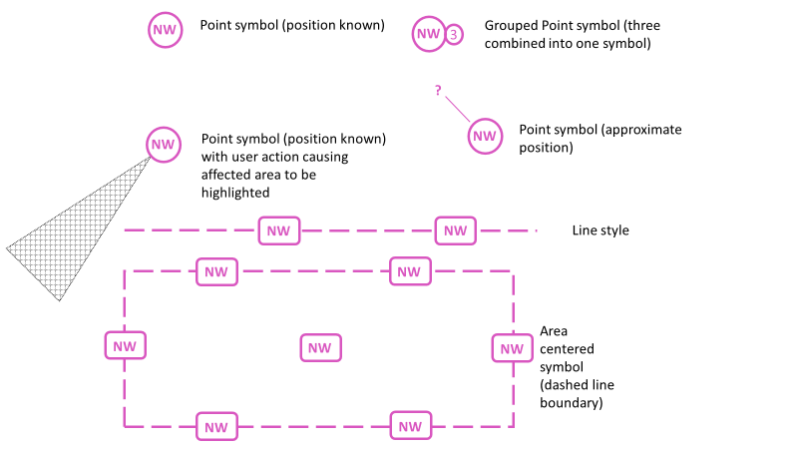
Portrayal Catalog
Key point to consider, anything unique in S-124 will require bespoke development in user systems to ensure support.
Raising implementation cost (time and effort).
S-124 therefore strives to utilize S-100 and push change requests to close gaps.
S-100 Part 9, point, line, area symbol needed
Section 12 of PS and S-124 Appendix E
The always on debate and filtering
User Interface
Context parameters (TSM recommendation)
Symbol grouping to be included in 2.0.0
Notes:
Created by KRISO

Slide 8
Portrayal Catalog – what next?
Portrayal need to evolve with lessons learned.
Guidance needed
Continuous engagement with ECDIS stakeholders needed
May require a dedicated group to maintain
S-98 engagement needed

Slide 9
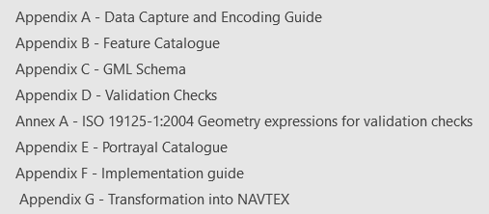
Production Specification Parts
Main document and appendixes
Need to start planning for Maritime Resource Name – MRN
NIPWG working on IHO guidance
IALA Guidance available – G1143
Layout of the documents build on experience from other product specifications

Slide 10
Trial and Testing
STM projects - Website
SMART Navigation Project - Overview slide deck (iho.int)
Canadian trials
PING Project - Introduction slide deck (iho.int)
Others?
Test and trials is where theory meets reality!
How to encourage more trials and tests?

Slide 11
Expedited timeline to approve edition 2.0.0
IHO Resolution 2/2007, as amended, governs PS development
Impact study needed before 2.0.0
IHO ISO Cell - ISO Cell report to HSSC 15
Close gaps found during Ed. 1.0.0 development
IEC 61174 update - IEC HSSC15 update
HSSC 16 (May/June 2024)
Member State approval in September 2024
S-164 Test data needs to be created and verified

Slide 12
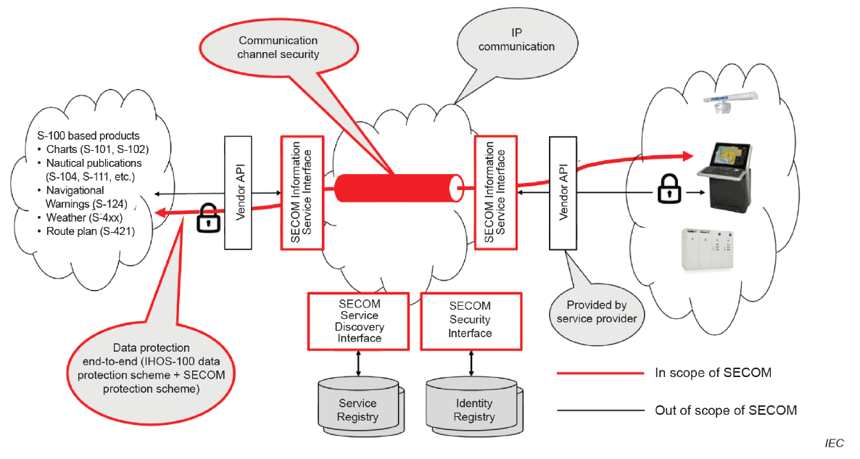
Service Delivery Needs / S-53 to S-124 conversion and delivery trials
S-100 ECDIS (MSC.530(106) Revised ECDIS Performance Standard) and decision to include SECOM (63173-2) support provides the venue to push S-124 into the ECDIS.
SECOM ends at the Vendor API.
S-124 Technical Service Description and IMO Maritime Service 5.
Australian Presentation (3.5.1.1)

Slide 13
Service Delivery Needs / S-53 to S-124 conversion and delivery trials
Open Digital Incubator initiative (digitalincubator.maritimeconnectivity.net)
A specification for how to set up an e-navigation technical service compatible with the IEC 63173-2:2022 framework is available at Maritime Resource Registry Portal (digital-maritime-consultancy.github.io) using the MRN identifier "urn:mrn:iho:techsvc:spec:navwarn"

Slide 14
Guidance Documentation
The Date Capture and Encoding Guide (DCEG)
Update on NGA work
Implementation guide
Producer level – Technical Service Descriptions
Vendor level – Guidance to use service instances (maybe one or more per producer)
User level – Vendors guide for users to utilize S-124 services in their equipment
Probably a need for a group to work on maintaining guidance documents in an evergreen state
Need to also consider other languages

Slide 15
End user Systems
Filtering (PS 12.2)
on chart
off chart
information
S-98 configuration and how that impacts NAVWARN visibility
S-100 ECDIS becomes an option on 1 January 2026
IHO on behalf of its member states committed to IMO that adequate coverage of S-100 services will be available
Language support
If translation files are available, the end user system must also support their use.

Slide 16
Validation
Lessons to learn from S-57 ENC and S-58
S-124 data must be validated before being issued
Production processes must be developed with validation included
Integrity of distribution depends on dataset validation
Format conformance and content conformance type validation checks
May need a dedicated group working to create and maintain the recommended list of validation checks
Validation should be done independent from the production system
3rd party tools

Slide 17
Implementing S-124/S-412 into the GMDSS
Define what it means
Establish timeline
Establish Milestones

Slide 18
S-124 Development Crash course
Not the end…
Lessons learned as we continue this journey will add to the material

