Slide 1
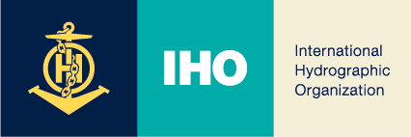
Volcanic Activity and Safety of Marine Navigation
Report of the joint WMO/IHO Task Team

Slide 2
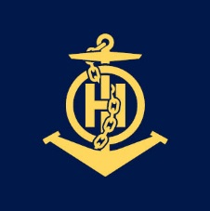
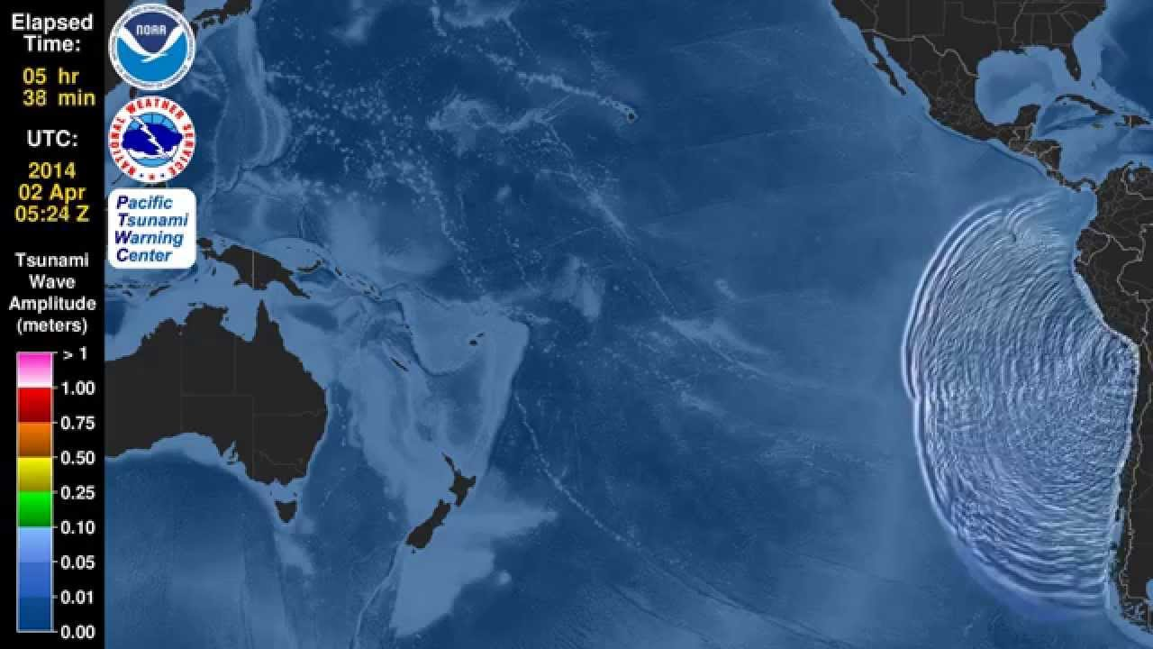
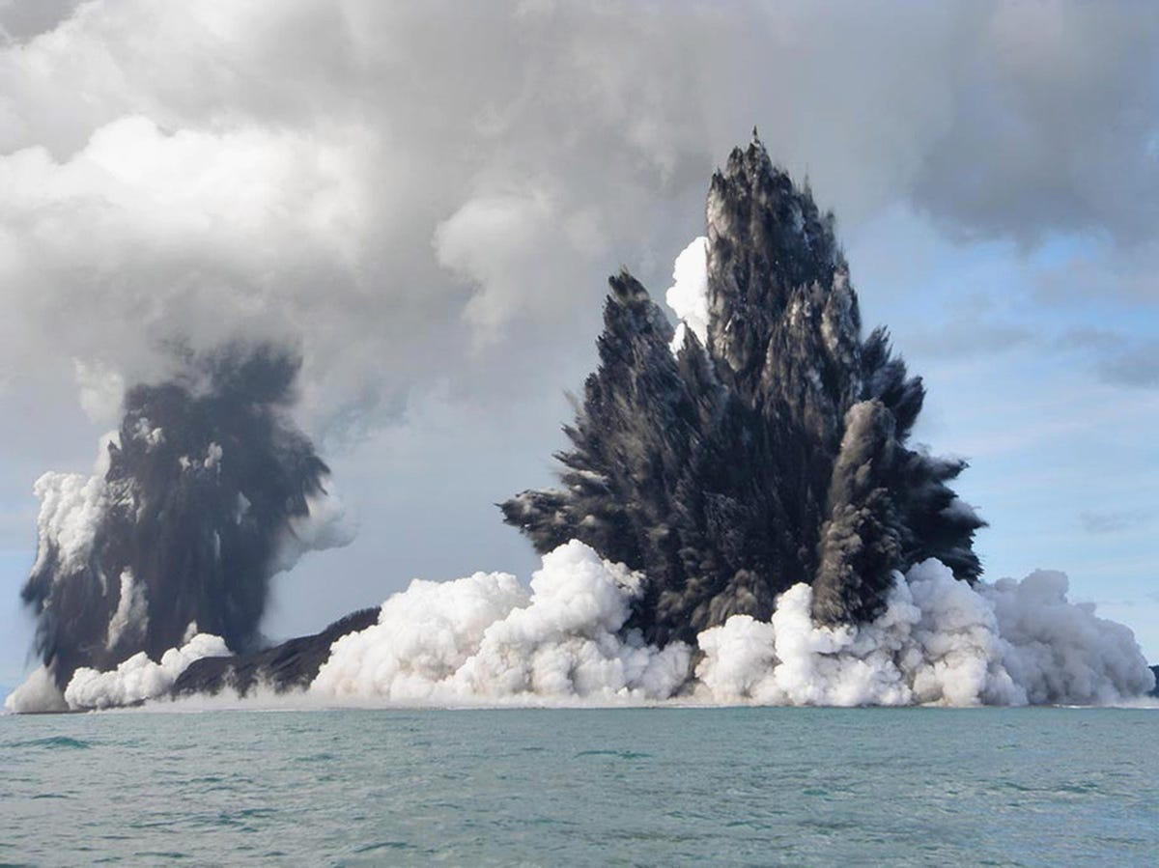
Background
WWNWS14/WWMIWS3 Document 3.2.3
Notes:
NAVAREA and METAREA XIV submitted an information paper to the joint session of WWNWS14 and AG-WWMIWS-SubC-1, document WWNWS14/WWMIWS3 – 3.2.3 “Volcanic Activity and MSI”. This document discussed, inter alia, the potential hazards to marine navigation posed by volcanic activity and the sources of information available to MSI providers.
Following discussions, the meeting agreed that clarity was needed on the roles and responsibilities of METAREA and NAVAREA Coordinators regarding natural hazards, particularly in relation to volcanic eruptions. In this regard, METAREA and NAVAREA XIV agreed to co-lead a combined METAREA Task Team / NAVAREA Project Team (NCSR 10/10 §14), with the following terms of reference.

Slide 3
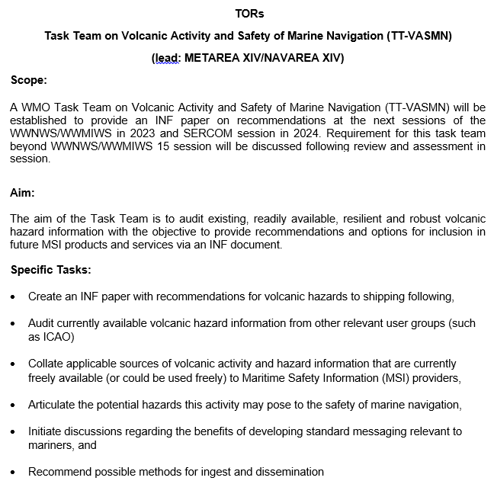
TOR

Slide 4
members
METAREAs | NAVAREAs
METAREA I | NAVAREA I
METAREA IV-XII | NAVAREA IV-XII
METAREA VI | NAVAREA X
METAREA VIII | NAVAREA XIV
METAREA X
METAREA XIV
METAREA XV
Notes:
Members 7 METAREA and 4 NAVAREA

Slide 5
The work of the task team
IAVCEI
Collaborate with their relevant METAREA/NAVAREA coordinator to identify sources of volcanic information within respective regions
Engage with local/regional agencies (E.g., VAACs, state volcano observatories, etc.)
Consider seeking input from professional mariner/s on their assessment of the potential impacts from volcanic activity.

Slide 6
OUTPUTS
Audit/collate applicable sources of volcanic activity and hazard information
Broadcast Responsibilities
Articulate the potential hazards this activity may pose to the safety of marine navigation
Initiate discussions regarding the benefits of developing standard messaging relevant to mariners
Recommend possible methods for ingest and dissemination

Slide 7
Regional Information Sources and Processes
Region | Information Sources | Marine Navigational Warning Process
NAVAREA/METAREA I | VAACs/British Geological Survey/State Volcano Observatories | Warnings broadcast by NAVAREA
NAVAREA/METAREA IV-XII | VAACs/US Geological Survey/State Volcano Observatories | Warnings coordinated between METAREA and NAVAREA. NAVAREA broadcasts warnings but volcanic information is included in the Synopsis of METAREA forecasts. Volcanic Ash Warnings (and Advisories) are included as Headlines in the METAREA forecasts.
NAVAREA/METAREA VI | VAACs | Noted as a new item for discussion between METAREA and NAVAREA.
METAREA VIII | VAACs | Warnings broadcast by METAREA
NAVAREA/METAREA X | VAACs/ US Geological Survey/State Volcano Observatories/Joint Australian Tsunami Warning Centre | Warnings broadcast by NAVAREA
NAVAREA/METAREA XIV | VAACs/Geological and Nuclear Sciences Limited/State Volcano Observatories | Warnings broadcast by NAVAREA
METAREA/NAVAREA XV | VAACs/National Geology and Mining Service/State Volcano Observatories | Warnings broadcast by NAVAREA

Slide 8
Volcanic Activity to Hazard Mapping Guidance
Volcanic Activity | Hazard to Ships | Warning Text
Pumice rafts | Blocks seawater cooling systems, overheating engines | “BLOCKAGE OF SEAWATER COOLING SYSTEMS POSSIBLE”
Gas emissions (sub-sea) | Impact to instruments on the ship’s hull. E.g. Echo sounders, speed logs | “GASSES MAY BE CORROSIVE TO HULLS AND ASSOCIATED INSTRUMENTS”
Explosive surtseyan (shallow water) eruption | Physical damage to, or destruction of ship | “EXTREMELY HAZARDOUS TO SHIPS AND PEOPLE”
Pyroclastic flows (speeds of hundreds KM/h, temperatures hundreds of degrees C) | Heat and impact damage, ship stability | “EXTREMELY HAZARDOUS TO SHIPS AND PEOPLE”
Tephra (from ash to larger objects) | Loss of stability, navigational data, engines, abrasion/corrosion damage Loss of visibility Hazardous to people | “ASH CAN BE CORROSIVE, EFFECT STABILITY, NAVIGATIONAL SYSTEMS AND BE HAZARDOUS TO PEOPLE” “LARGE OBJECTS EXTREMELY HAZARDOUS TO SHIPS AND PEOPLE
Sulphur dioxide | Potential corrosion Hazardous to people | [As per Gas Emissions above]
Tsunami | Dependent on depth of water. Loss of stability, etc. | “VESSELS ALREADY AT SEA SHOULD REMAIN WELL OFFSHORE AND AT DEPTHS OF 100 METRES OR MORE WHILE THIS WARNING IS IN EFFECT. CREWS OF VESSELS IN HARBOURS AND ESTUARIES MUST CONSIDER EITHER IMMEDIATE RETURN ASHORE OR MOVE TO DEEPER WATER.” “UNUSUALLY STRONG AND HAZARDOUS CURRENTS AND UNPREDICTABLE SURGES ARE EXPECTED NEAR THE SHORE. THE SEVERITY OF CURRENTS AND SURGES WILL VARY WITHIN A PARTICULAR COASTAL AREA”
Notes:
Similarly, Coastal Warning templates have been created from the NEMA messages. NEMA is the NZ authority for issuing tsunami messages, and in the case of Coastal Warnings, have provided specific guidance to mariners in NZ coastal waters.

Slide 9
Action requested of the Sub-Committee
The WWNWS-SC is invited to:
Agree that the Task Team has fulfilled its obligations under the Terms of Reference;
Recommend NAVAREA/METAREA Coordinators engage within their regions to further develop their procedures in this space, if necessary, considering the examples from the members of the task team when developing their procedures, and update the Sub-Committee as appropriate;
Note the outcomes from participation at the International Association of Volcanology and Chemistry of the Earth’s Interior (IAVCEI) 2023 Post-Conference Workshop "Developing the future visions for seamless multi-hazard warning for volcanic eruptions";
Consider the request from volcanologists at the IAVCEI workshop, for NAVAREA Coordinators to create a “feedback loop” in the ship-shore direction, providing volcanic activity observations from ships to the volcanology community;
Encourage NAVAREA and METAREA Coordinators, if volcanic activity is likely to pose a hazard to navigation in their areas of responsibility, to consider the guidance in the Volcanic Activity to Hazard Mapping Guidance at Annex 2, and
Note the report in general

Slide 10
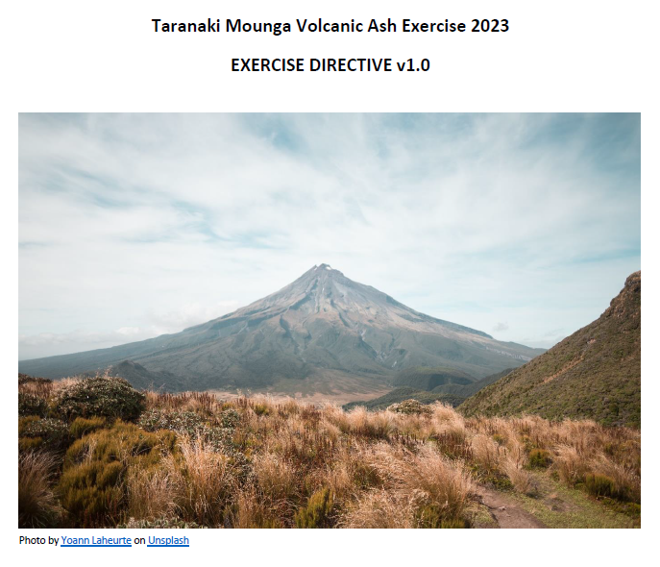
Notes:
Move to presenting exercise report

