Slide 1
Outcomes from HSSC16 and IRCC16
By Christopher Janus
Chari, WWNWS

Slide 2
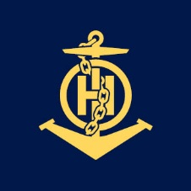
Relevant outcomes from HSSC16
The 16th meeting of the Hydrographic Services and Standards Committee (HSSC) took place in Tokyo, Japan from 27-31 May 2024
Discussed the use of Secure Exchange and Communication (SECOM) with S-100 based products and services.
Requested that the IHO Council recognise the St. Lawrence River as an “IHO Canada Sea Trial Area” (for S-100 testing) along with the possibility to identify additional official areas around the world.

Slide 3
HSSC16-07C — S-124 Data Dissemination issues related to e-navigation.
Noted the MSI dissemination systems information transmission options identified by IMO MSC.1/Circ.1645
Predicted that MSC.1/Circ.1645 would be updated to include NAVDAT in the near future
Highlighted that radio frequencies are required to disseminate MSI and these frequencies are protected
MSI is part of the GMDSS and a new transmission method can only be implemented in the GMDSS structure by modifying the Radio Regulations. This modification can only be carried out by a World Radio Conference (WRC).

Slide 4
Document HSSC16-07F — Comment on S-124 data dissemination issues related to e-navigation by the Chair of the IHO WWNWS
Addressed NAVDAT and VDES as potential new dissemination methods and the challenges that remain for each
Noted that MSC 108 was expected to adopt the draft resolution MSC.530(106)/Rev.1 on ECDIS performance standards
Noted that IEC Publication 63173-2, Maritime Navigation and Radiocommunication Equipment and Systems – Data Interface – Part 2: Secure Communication Between Ship and Shore is referenced in MSC.530
Communication between SECOM information services for data exchange relies on IP-based web services
The result of the adoption of the draft resolution MSC.530(106)/Rev.1 at MSC 108 is that Member States acknowledged the requirement for the use of a broadband and IP-based connection to the S-100 ECDIS when it approved route exchange via SECOM

Slide 5
Relevant outcomes from IRCC16
The 16th meeting of the Inter-Regional Coordination Committee (IRCC) took place in Santa Cruz Island – Galapagos, Ecuador from 10-12 June 2024
Harmonized development and implementation of S-100 products and services
Progress in the readiness of S-100 data migration through exchange technology, experience, workshop and seminars between member states
Allocate additional resources to start S-101 and S-102 production and how to better serve Sub-ECDIS customers with reliable, affordable and easy to access digital navigational products.

Slide 6
Relevant outcomes from IRCC16
Limited funds available to the Capacity Building programme proved that strengthening collaboration across RHCs is very beneficial for cooperation amongst coastal states
Challenges with S-101 scheming and the possible high workload during the dual fuel period due to parallel production of both S-57 and S-101 ENCs
Substantial achievement for enhancing gender balance in hydrography in some RHCs
Revision of the IHO Strategic Plan (2021-2026)

Slide 7
IRCC16 Action for the wwnws
The IRCC Chair and WWNWS Chair will coordinate and send a letter to the specific RHCs where there is a need to implement IMO recognized mobile satellite services for MSI transmission to encourage relevant Member States to do so.

Slide 8
World-Wide Navigational Warning Service Sub-Committee
Report to IRCC16
Santa Cruz Island - Galapagos, Ecuador
10 – 12 June 2024
By Christopher Janus
WWNWS Chair
IRCC16-07.XX

Slide 9
Agenda
WWNWS15 meeting summary
IHO WWNWS Strategic Performance Indicator (C-55)
Iridium SafetyCast Implementation
Capacity building
S-124 update
New document review schedule
Actions requested

Slide 10
15th meeting of the WWNWS-SC
Held from 4-8 September 2023 as a hybrid meeting at the IHO Secretariat in Monaco
63 Participants
BDMSS – Regional system with partial coverage of NAVAREA VIII, X, XI, and XIII
NAVDAT – Navigation Data
Space Activities Working Group report
Task Team on Volcanic Activity report
S-124 Progress and Challenges
Iridium SafetyCast Implementation
22nd meeting of the WWNWS Document Review Working Group

Slide 11
IHO Strategic Plan – SPI for MSI
Target: 3.1 Collaborate with other bodies who deliver capacity building and training to improve effectiveness of capacity building activities and programmes
Measure: 3.1.1 Percentage of Coastal States that are capable to provide maritime safety information (MSI) [navigational warnings] according to the joint IMO/IHO/WMO manual on MSI (2026 - 90%)
NAVAREA will confirm successful communications (via email/phone) twice per year

Slide 12
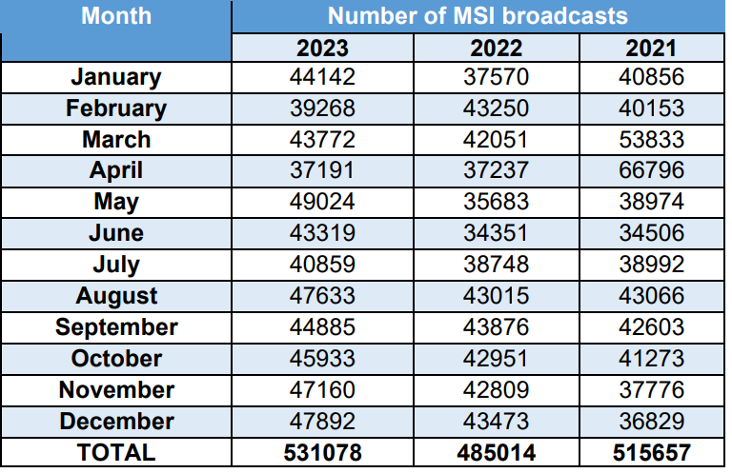
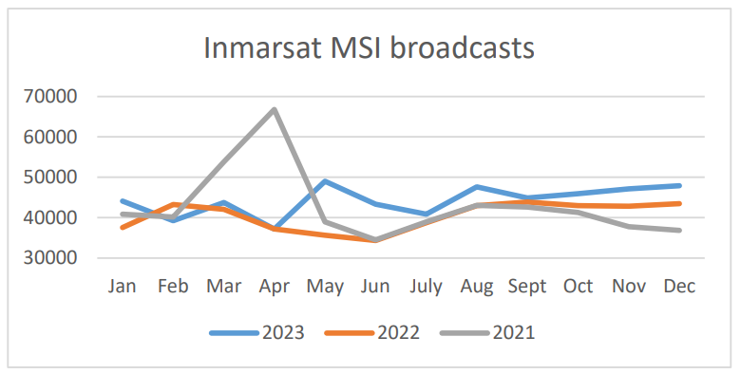
SPI - Navigation Warnings by year

Slide 13
Navigational warnings issued in 2023

Slide 14
Navigational warnings issued in 2022

Slide 15
SPI - MSI Support for 2023 (Derived from WWNWS15 NAVAREA Self Assessments)

Slide 16
SPI - MSI Support for 2022 (Derived from WWNWS14 NAVAREA Self Assessments)

Slide 17
SPI - Coastal States by NAVAREA
NAVAREA | Coastal States with MSI Capacity | Total Coastal States
NAVAREA I (United Kingdom) | 11 | 11
SUBAREA Ib (Sweden) | 9 | 9
NAVAREA II (France) | 20 | 26
NAVAREA III (Spain) | 24 | 24
NAVAREA IV (United States) | 41 | 46
NAVAREA V (Brazil) | 1 | 1
NAVAREA VI (Argentina) | 4 | 4
NAVAREA VII (South Africa) | 10 | 13
NAVAREA VIII (India) | 10 | 11
NAVAREA IX (Pakistan) | 8 | 13
NAVAREA X (Australia) | 4 | 4

Slide 18
SPI - Coastal States by NAVAREA
NAVAREA | Coastal States with MSI Capacity | Total Coastal States
NAVAREA XI (Japan) | 21 | 21
NAVAREA XII (United States) | 9 | 10
NAVAREA XIII (Russian Federation) | 1 | 1
NAVAREA XIV (New Zealand) | 12 | 12
NAVAREA XV (Chile) | 1 | 1
NAVAREA XVI (Peru) | 1 | 1
NAVAREA XVII (Canada) | 1 | 1
NAVAREA XVIII (Canada) | 1 | 1
NAVAREA XIX (Norway) | 1 | 1
NAVAREA XX (Russian Federation) | 1 | 1
NAVAREA XXI (Russian Federation) | 1 | 1
WWNWS | 190 | 212
SPI = 89.2%

Slide 19
2024 Inmarsat Data Usage – Most to Least (Estimated)

Slide 20
2024 Navigational Warnings issued– Most to Least (Estimated)

Slide 21
2024 Navigational Warnings broadcast– Most to Least (Estimated and includes repetitions)

Slide 22
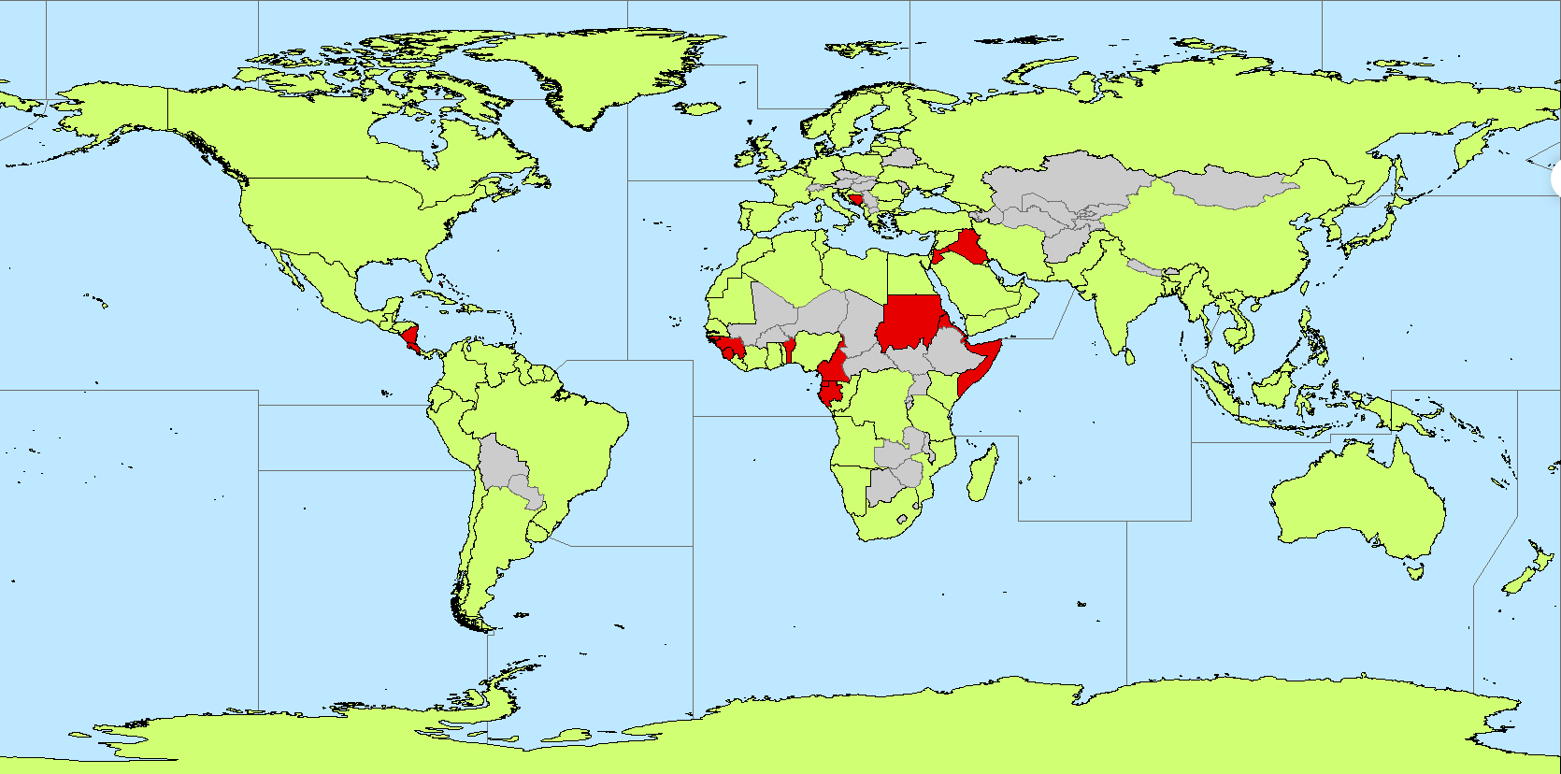
C-55 GIS Project to identify MSI capacity
Meets MSI SPI
Does not meet MSI SPI

Slide 23
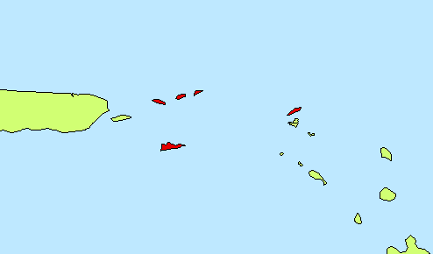
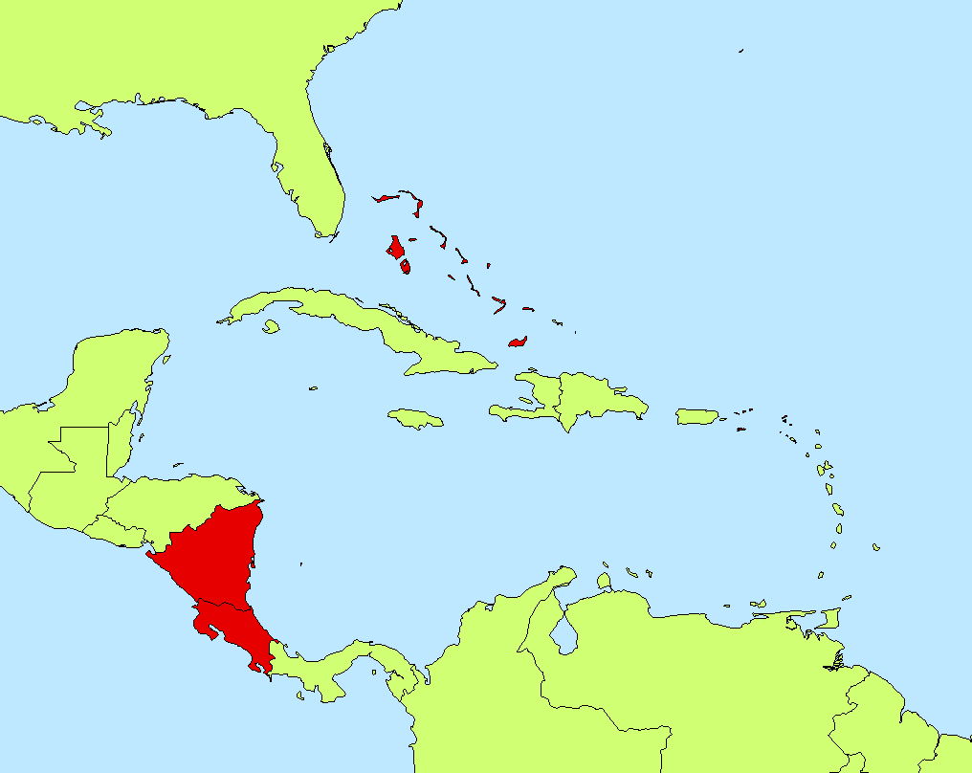
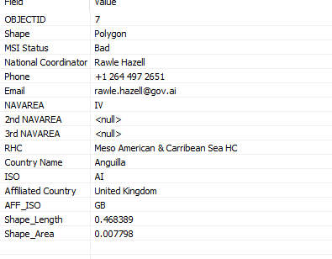
Coastal State attribution

Slide 24
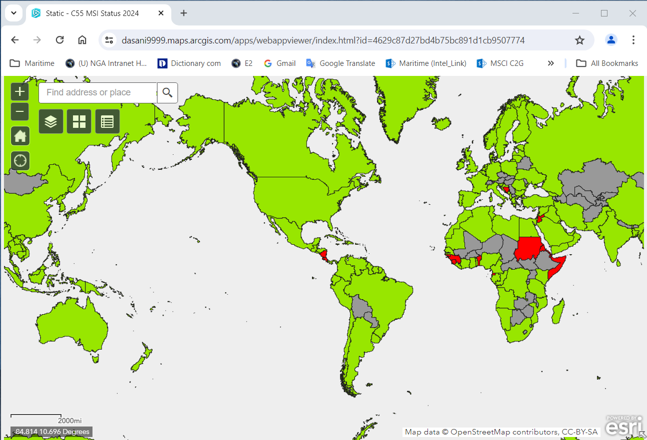
C-55 GIS Project to identify MSI capacity
maps.arcgis.com
Meets MSI SPI
Does not meet MSI SPI

Slide 25
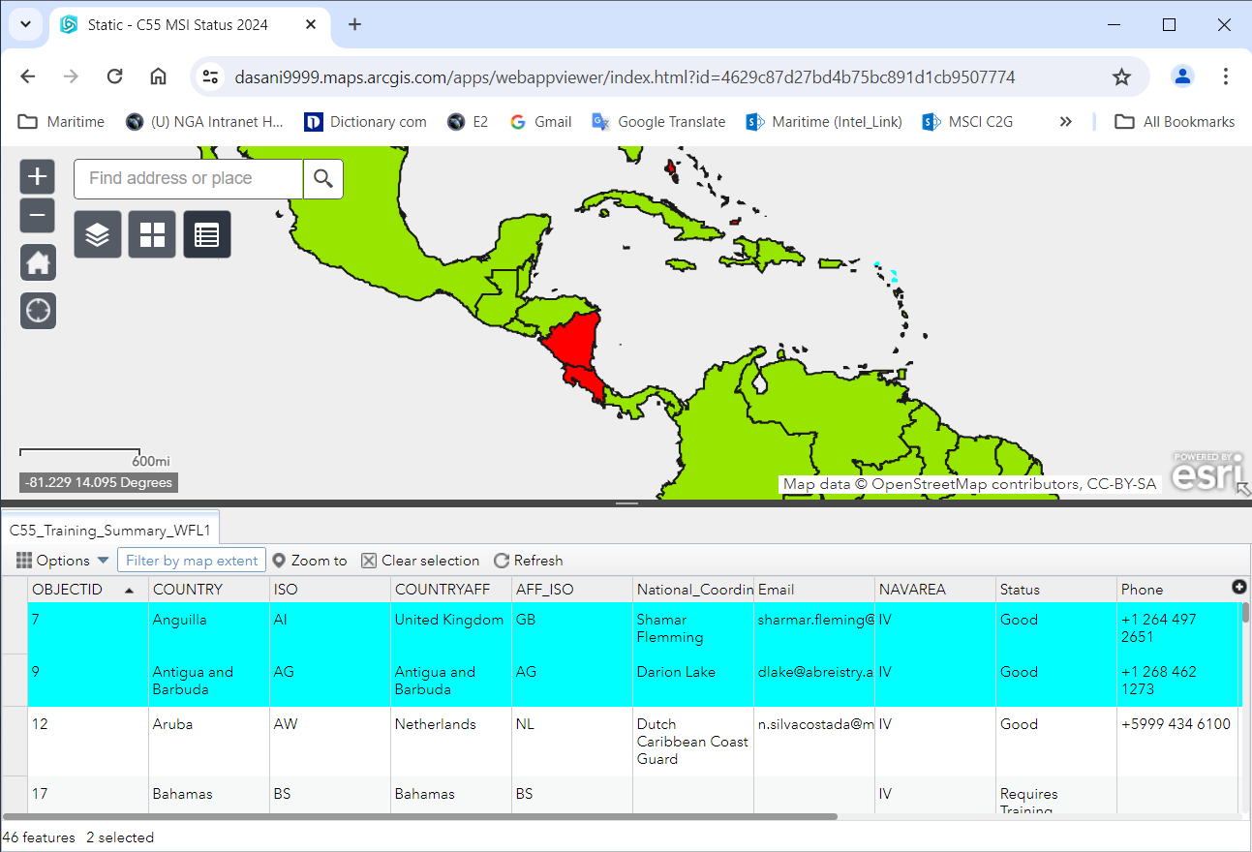
C-55 GIS Project to identify MSI capacity
Next step: move the web map to the IHO’s ArcGis online server and add a link to the WWNWS web page
maps.arcgis.com
IHO.maps.arcgis.com

Slide 26
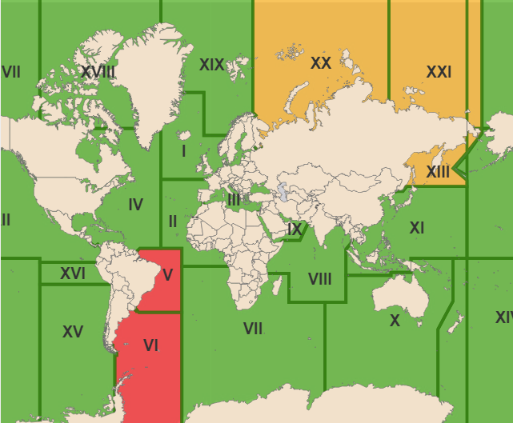
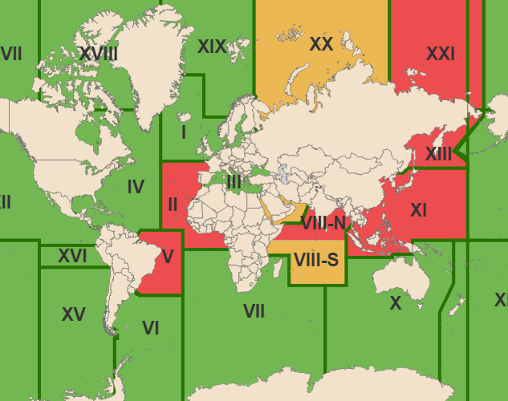
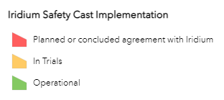
Iridium SafetyCast Implementation 2024
NAVAREAS
METAREAS

Slide 27
MSI Capacity Building
Last courses: Istanbul, Turkey (MBSHC) May 2024 Muscat, Oman (RSAHC/SAIHC/NIOCH ) October 2023
Next Courses: NIOHC and MACHC

Slide 28
S-124 Update
S-124 version 2.0.0 endorsed by WWNWS15 and submitted to HSSC16 for approval.
MSC 108 approved the updated Joint IMO/IHO/WMO Manual on Maritime Safety Information
S-124 Document Encoding Guide draft version complete and continues to be improved
Future work:
Create a dedicated WWNWS S-164 working group with a representative to the S-164WG to create a test data set.
Develop a method to validate S-124 data

Slide 29
WWNWS Document Review Schedule
Resolution MSC.468(101) – Amendments to Promulgation of Maritime Safety Information (Resolution A.705(17), as amended)
Resolution MSC.469(101 – Amendments to World-wide Navigational Warning Service (Resolution A.706(17), as amended)
MSC.1/Circ.1310/Rev.1 – Revised Joint IMO/IHO/WMO Manual on Maritime Safety Information
MSC.1/Circ.1403/Rev.1 – Amendments to the Revised NAVTEX Manual
EGC Manual
MSC.1/Circ.1364/Rev.2 – International SafetyNET Services Manual
MSC.1/Circ.1613 – Iridium Safetycast Service Manual
MSC.1/Circ.#### – Safety Link Manual

Slide 30
WWNWS Document Review Schedule
2024
2025
2026
2027
2028
Daft NAVTEX Manual
Finalize MSI Manual
Finalize MSI Resolution
Finalize WWNWS Resolution
Submit to NCSR14
Submit to MSC115
Draft MSI Manual
Draft EGC Manual
Finalize NAVTEX Manual
Finalize EGC Manual
Enter into force 1 January 2028

Slide 31
Actions requested of the IRCC
Note the information provided in this report on the outcomes of WWNWS15;
Encourage relevant Member States to implement all IMO recognized mobile satellite services;
Take any other action it considers appropriate.
The IRCC suggested that the WWNWS consider developing additional actions in the future that might contribute to better coordination

