Slide 1

NAVAREA II Self Assessment
FRANCE / Shom

Slide 2
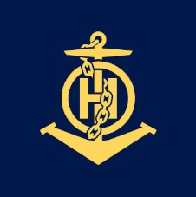
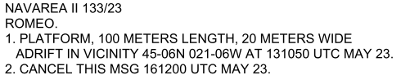
NAVAREA ## Operations and updates
Operational Issues NAVTEX trials at Corsen NAVTEX station Positive impact of the use of PING drafting tool on the quality of warnings (visual verification of points/area, standardization of the warning) | Changes in National Coordinator Contact Information and IRCC Strategic Performance Indicator (SPI) for MSI capacity Nigeria in the process of studying the means to disseminate MSI
Changes to the GMDSS Master Plan NAVTEX Sao Miguel station – Temporarily Suspended EGC SafetyCast – broadcast schedule updated | Vital or Urgent Navigational Warnings Issued 21 Urgent NAVAREA warnings (14 drifting hazards, 5 piracy/armed attacks, 2 lighthouses) Example:

Slide 3
Future NAVAREA OPERATIONS
S-124 Development (see update details in dedicated document - presentation) Shom is aiming to have NAVAREA II, coastal and local navigational warnings S-124 datasets available at January 1, 2026 S124 Navigational Warnings Database developed and operational since April 2024 for NAVAREA II and national coordinator delegates in mainland France: via the PING platform (demo planned) No validation checks implemented S-124 exchange sets: next step | Other Future NAVAREA Initiatives Will stay informed of the development of the YARIS (Yaoundé Architecture Regional Information System) platform → PING Will continue its efforts to engage with decision makers in Ivory Coast on MSI issues Will continue to promote safety of navigation and MSI dissemination necessity at any occasion

Slide 4
Actions requested of the sub-committee
Note the report

