Slide 1
NAVAREA 1 Self Assessment
United Kingdom

Slide 2
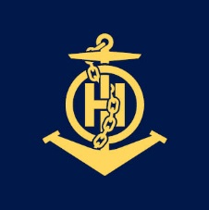
NAVAREA I Operations and updates
Operational Issues None | Changes in National Coordinator Contact Information and IRCC Strategic Performance Indicator (SPI) for MSI capacity IRCC SPI 100%
Changes to the GMDSS Master Plan NAVTEX Cullercoats, UK - Service currently operating at reduced power and is unreliable Portpatrick, UK – Service currently operating at reduced power and is unreliable EGC SafetyCast – Broadcast Schedule added | Vital or Urgent Navigational Warnings Issued Belgium - Person overboard in vicinity of Dover Strait TSS.

Slide 3
Future NAVAREA OPERATIONS
S-124 Development Guidance (examples) S124 coordination is done via NSMSIWG UK S-124 development – See UK S-124 Development submission. Danish Maritime Authority (DMA) is part of the Interreg MaDaMe Project, which seeks to establish a prototype setup for promulgation and receipt of Navigational Warnings in S-124 format. The Faroe Islands are following the S-124 WG with one member, but nothing is in place or implemented in the Faroe Islands yet. Germany is a member of the S-124 Project Team and participating in meetings. The participation in Sub-group meetings is currently under discussion. DE is planning to provide the Emden Maritime Warning Service (Seewarndienst Emden) with suitable software to convert S-53 Navigational Warnings into S-124 Warnings by 1.1.2026. The technical development for the dissemination of S-124 data still needs to be conceptualized. | Other Future NAVAREA Initiatives: None

Slide 4
Actions requested of the sub-committee
Note the report

