Slide 1

NAVAREA ## Self Assessment
PERÚ

Slide 2
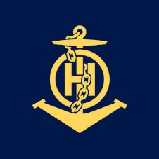
NAVAREA XVI Operations and updates
Operational Issues The NAVTEX Mollendo station, which covers the southern coastal area of PERÚ, has been inoperative for some time | Changes in National Coordinator Contact Information and IRCC Strategic Performance Indicator (SPI) for MSI capacity None
Changes to the GMDSS Master Plan NAVTEX Station Paita – Operational Station Callao – Operational Station Mollendo – Inopeartive EGC SafetyCast – Operational SafetyNet – Operational | Vital or Urgent Navigational Warnings Issued Messages are transmitted immediately upon receiving the information, and while they are in force, every four hours, they are not classified as vital messages. (examples) NAVAREA XVI 081/23 FIRING EXERCISE OF NAVAL UNITS AGAINST DRIFTING TARGETS 081200 TO 082200 UTC JUN 23 IN AREA BOUNDED BY A. 12-45-00S 077-25-00W B. 12-45-00S 077-05-00W C. 13-05-00S 077-05-00W D. 13-05-00S 077-25-00W CANCEL THIS MESSAGE 082300 UTC JUN 23.

Slide 3
Future NAVAREA OPERATIONS
S-124 Development Currently, NAVAREA XVI is in the evaluation process for future implementation of S-124.Implementation | Other Future NAVAREA Initiatives It is planned to coordinate a new exercise within the existing contingency plan with NAVAREA XV, for the safetynet and safetycast platforms.

Slide 4
Actions requested of the sub-committee
Increase MSI training for Southeast Pacific Hydrographic Committee staff

