Slide 1

Advisory Group on the Worldwide Met-Ocean Information and Warning Sub-Committee
(AG-WWMIWS-SubC)
Progress report (item 3.3.3)
Erik de Groot
Vice-Chair, AG-WWMIWS-SubC, WMO
METAREA XVII & XVIII
Environment and Climate Change Canada
Valparaiso, Chile, 2 – 6 September 2024 (WWNWS16)

Slide 2
WMO Governance in support of WWMIWS/GMDSS
an Advisory Group within the WMO Standing Committee on Marine Meteorological and Oceanographic Services (SC-MMO), Services Commission (SERCOM).
WWMIWS: the internationally coordinated service for the promulgation of meteorological warnings and forecasts to vessels undertaking international or national voyages (A.1051(27)/MSC.470(101))
the WMO responsible body for monitoring and coordinating the provision of meteorological maritime safety information (MSI) within the International Maritime Organization’s (IMO) Global Maritime Distress and Safety System (GMDSS)
WMO Congress
Exec. Council
SERCOM
SC-MMO
ETs
AG-WWMIWS-SubC

Slide 3
AG-WWMIWS-SubC update
Updated METAREA Coordinator list at https://community.wmo.int/en/WMO-Approved-METAREA-Coordinator-list. Recent updates include:
  METAREA III (Greece) – Dr Dionysia Kotta
  METAREA VI (Argentina) – Mr Matias De Oto
  METAREA VIII(N) (India) – Dr Amit Bhardwaj
  METAREA XI (N) (Japan) – Mr KATO Koji
  METAREA XIII, XX & XXI (Russian Federation) – Ms Anastasia Belgesova
Chaired by METAREA XIX (Norway) Coordinator, supported by two Vice-Chairs METAREA XVII & XVIII (Canada) and XIV (New Zealand)
Next meeting: AG-WWMIWS-SubC-2, Exeter, UK, 18-20 Sept. 2024
  Ongoing discussion on Contingency and Resilience

Slide 4
Implementation Iridium SafetyCast
Current status:
  13 METAREAs operational (one more compared to last year)
  3 METAREAs in trials
  6 METAREAs not started
This state matches the information on the IHO website but not completely consistent with GISIS.

Slide 5
MSI Publications/Guidance
Update MSI related pubs/docs - A.1051(27) and A.705(17) - ongoing
Comprehensive review of WMO No. 558/471, following SERCOM approval of recent ‘light’ revision - ongoing
S-41X – scope descriptions submitted to IHO/HSSC16, designating focal points for
  S-411 (Ice information) – Nick Hughes (MET Norway)
  S-412 (Weather and wave hazards) - Thomas Cervone-Richards (NOAA/NWS, USA)
  S-413/S-414 development on the completion of S-412

Slide 6
WMO relevant updates
Sea-ice information and services (WMO-No.574), 2024 editions
Operational Handbook for METAREA Coordinators, Oct 2023 update
WMO’s role in Tsunami early warnings (MMO-No. 5)
Marine Emergency Response – support to environmental & SAR operations
Marine services courses
WMO is also considering actions and initiatives to increase the representation of women within the meteorological community

Slide 7
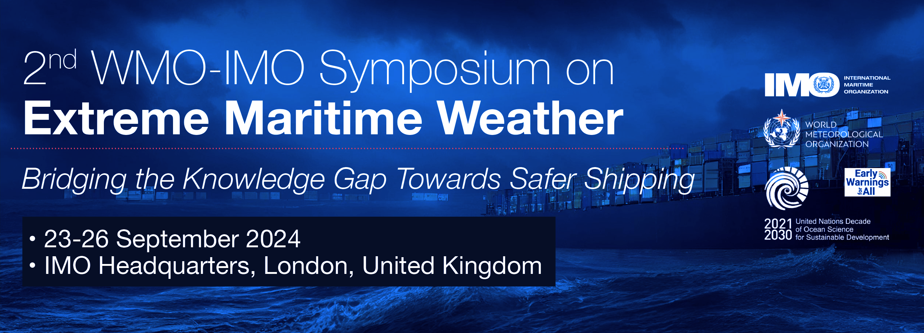
Engagement with IHO/IMO
Support DRWG 22, Vice Chair/AG-WWMIWS-SubC attended
IMO MSC 108 and NCSR 11
SC-MMO-Q2-2024, where IMO and IHO are ex-officio
IMO EGC Panel meeting
WMO/IMO Symposium 2024 Registration Open Now ! (link)

Slide 8
Thank you
wmo.int

