Slide 1

BDMSS progress update
CTTIC & IMSO

Slide 2

content
IMSO Update
CTTIC Update
Update on BDMSS implementation
Next steps …

Slide 3
IMSO Update

Slide 4
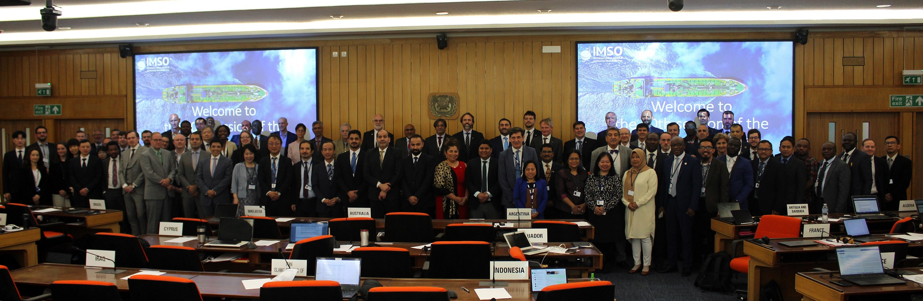
IMSO UPDATE

Slide 5
IMSO UPDATE

Slide 6
IMSO Online feedback system for GMDSS satellite services
clause 7.2 of IMO resolution A.705(17), as amended by resolution MSC.468(101):
“Cases of difficulty affecting the broadcast of MSI and SAR related information through the EGC system(s) of a recognized mobile satellite service provider in ways that limit the ability of information providers to monitor the EGC broadcasts that they originate, or the ability of ships to receive EGC broadcasts intended for reception throughout their intended voyages, should be brought to the attention of IMSO as and when necessary for the purpose of discharging IMSO's technical oversight responsibilities in respect of the recognized satellite service provider(s) involved.”

Slide 7
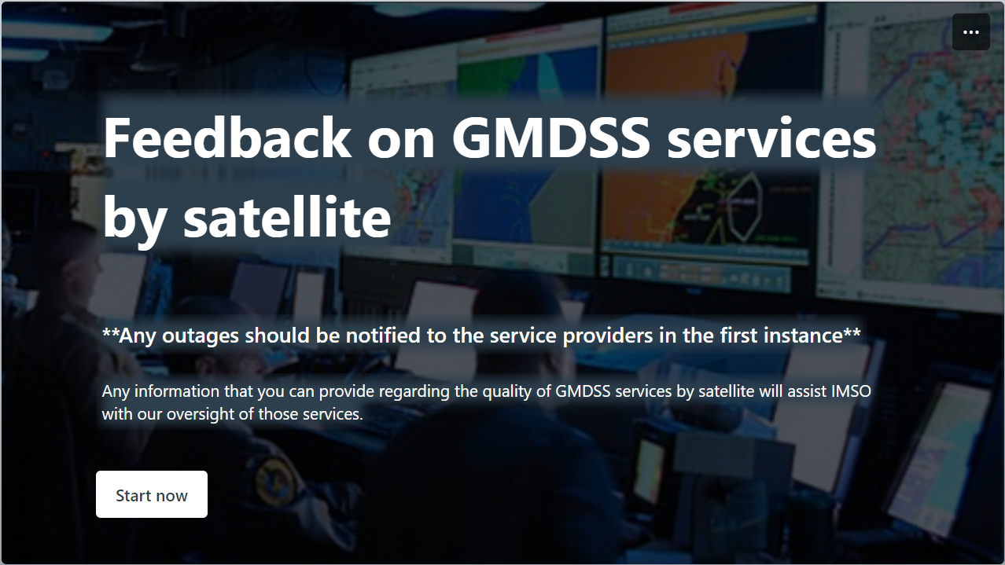
IMSO UPDATE

Slide 8
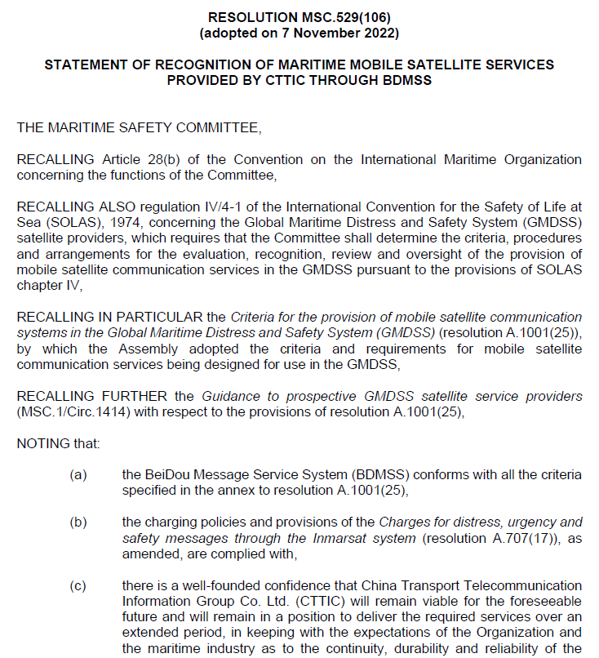
BDMSS implementation - BACKGROUND
In November 2022, MSC 106:
agreed to recognize the maritime mobile satellite services provided by CTTIC through BDMSS for use in the GMDSS (IMO resolution MSC.529(106));
noted the commitment of the delegation of China and CTTIC to address the outstanding implementation issues; and
invited IMSO to monitor the implementation of BDMSS and to report back when the Public Services Agreement with CTTIC had been concluded and the Letter of Compliance had been issued.

Slide 9
OVERALL STATUS oF BDMSS implementation
Implementation issue | Status
1. MSC to issue a resolution recognizing the mobile satellite GMDSS service provider
2. BDMSS to sign a PSA with IMSO for oversight of the recognized services
3. IMO to make available an MSI manual for the new Enhanced Group Call (EGC) service
4. BDMSS to develop internal operational procedures to support GMDSS recognized services
5. a type-approved terminal to be made available for the operation of the new mobile communication satellite services
6. WRC-23 to complete the necessary regulatory actions to safeguard the availability and full protection of the spectrum used for BDMSS
7. CTTIC to complete contingency arrangements for ground-based components of BDMSS
8. any other issues to be indicated by MSC
9. IMSO to issue CTTIC with a "Letter of Compliance"
Key:
Completed
In progress
Not started
Valparaiso, Chile 2 - 6 September 2024

Slide 10
Update on BDMSS implementation

Slide 11
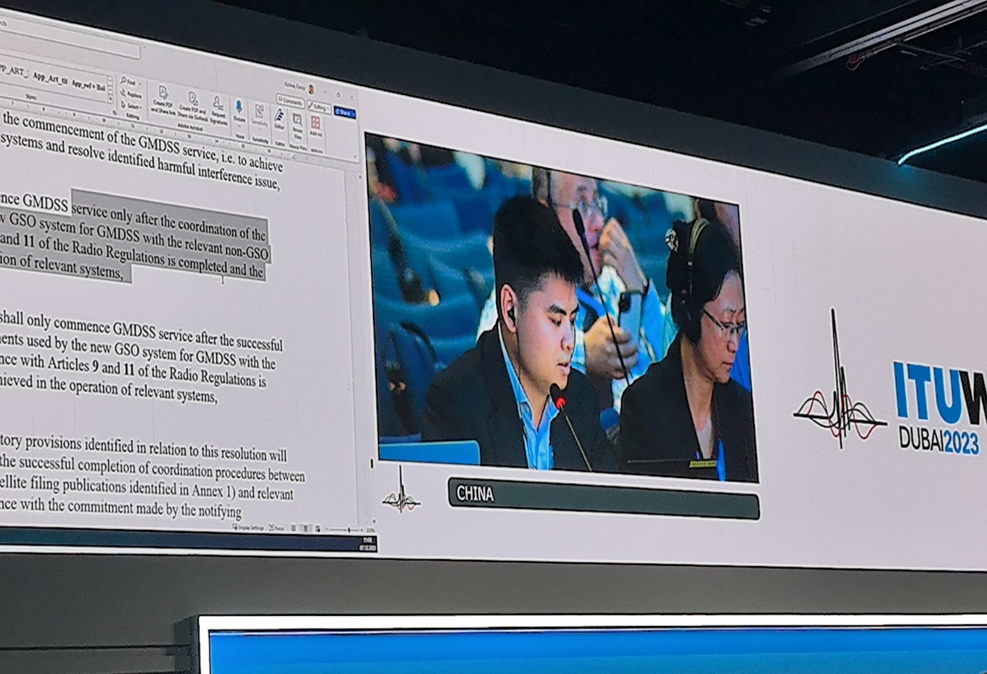
BDMSS implementation – OUTCOME OF WRC-23
The ITU World Radiocommunication Conference (ITU-R WRC-23):
took place between 20 November and 15 December 2023 in the United Arab Emirates
considered regulatory provisions to support the introduction of BDMSS into the GMDSS under agenda item 1.11 Issue C, WRC-23
decided on a provisional allocation to Appendix 15 of the Radio Regulations with two frequency band options pending completion of frequency coordination with other satellite systems

Slide 12
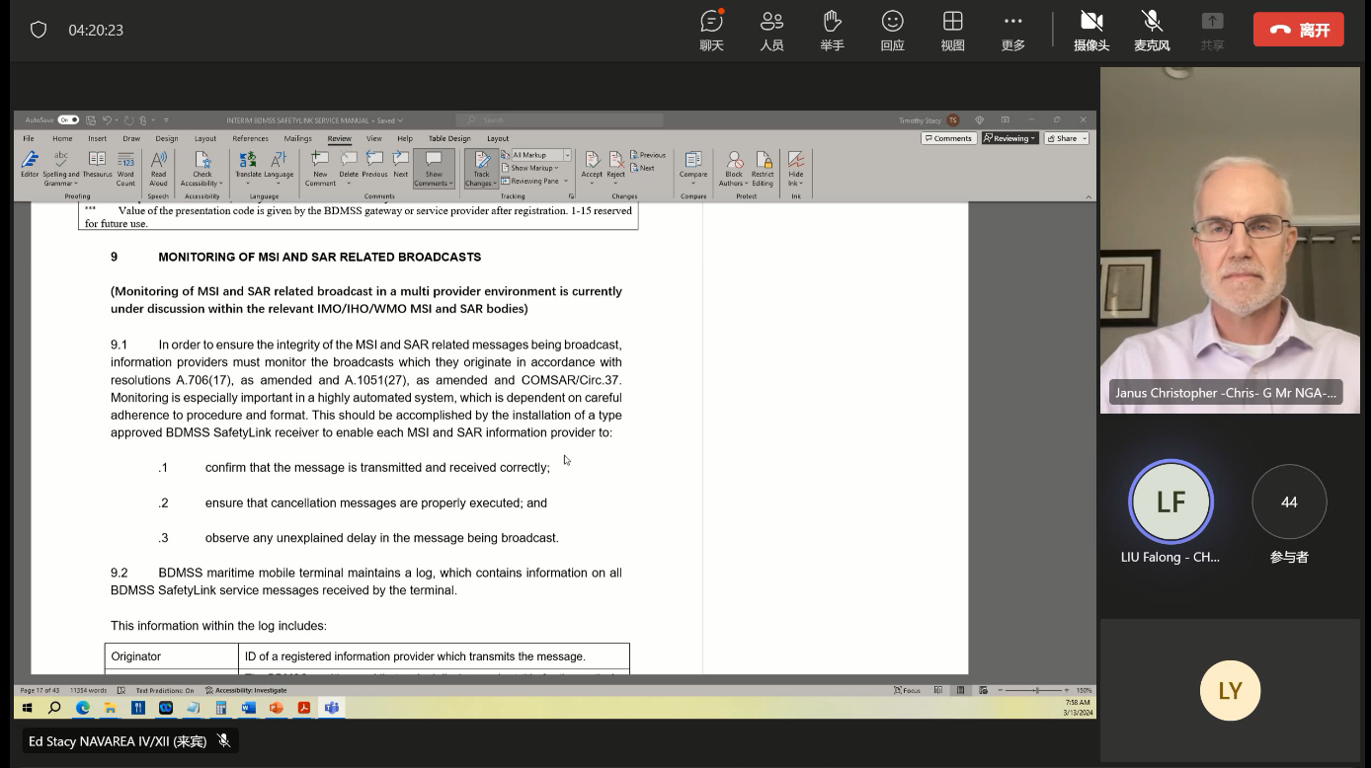
BDMSS implementation – Safetylink Services Manual
DRWG 22 conducted a detailed technical review on the Interim Draft BDMSS SafetyLink Service Manual;
CTTIC updated the service manual based on DRWG 22 outcomes and decisions.

Slide 13
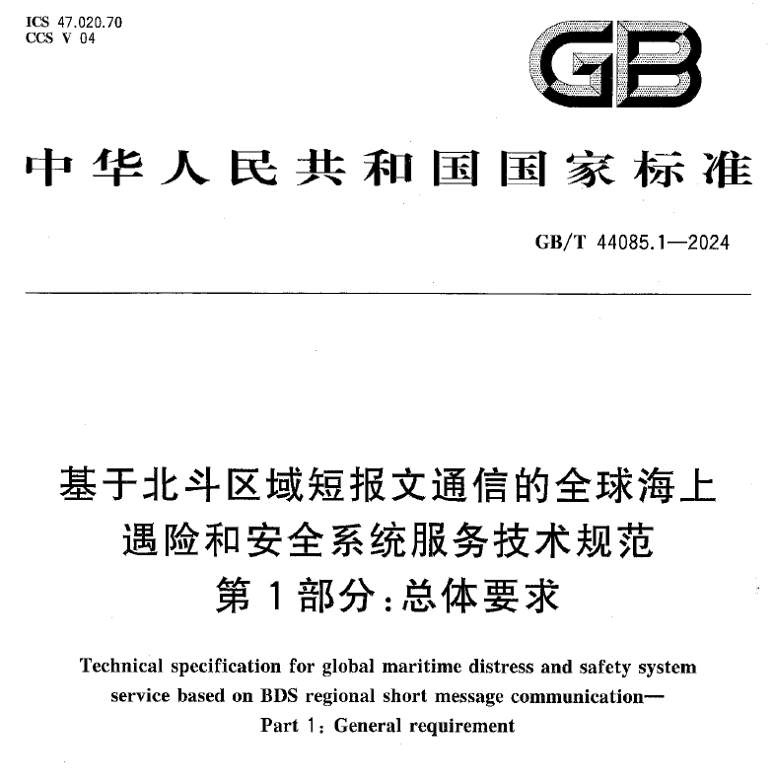
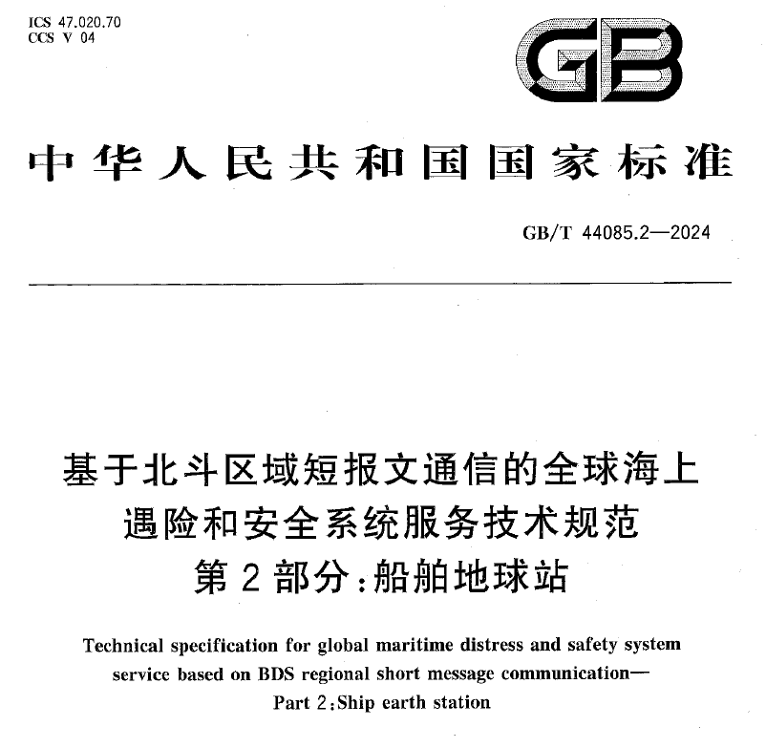
BDMSS implementation – Type Approval
A series of national standards for BDMSS GMDSS services have been released, including the standard for GMDSSs maritime mobile terminals;
Type approval standards and procedures are initially determined by China Classification of Society.

Slide 14
NEXT STEPS
Further plan to commence GMDSS service provided through BDMSS:
Frequency coordination: in progress; expected to be completed at WRC-27 in 2027;
EGC service manual: to be reviewed and approved by WWNWS-16; to be reviewed and approved by WWMIWS; to be reviewed and released by IMO;
Type approval: expected to be completed by the end of 2024;
PSA: in internal process meanwhile in discussion with IMSO; and
Letter of Compliance: final step of the implementation process.

Slide 15
Thank you for your attention
Liu Falong
International Cooperation Advisor
CTTIC
liufalong@cttic.cn
Philip Lane
Technical Officer
IMSO
philip.lane@imso.org

