Slide 1

S-124 Development
French PING project
Shom

Slide 2
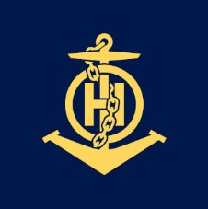
S124 developments
Shom is aiming to have NAVAREA II, coastal and local navigational warnings S-124 datasets available on January 1, 2026
Use of PING, the new web national platform for nautical information
  Online tools for NWs production and NWs cycle of life management
  Used by Shom (NAVAREA II) and French regional coordinators (coastal and local NWs)
  S-53 and S-124 automatic dual issuing
  Online delivery of NWs

Slide 3
Where we stand
Since April 10th, 2024 PING is officially the primary system for issuing NWs in mainland France and PING’s portal is open to the public. (https://portail.ping-info-nautique.fr)
Operators create and manage NWs using an HMI designed according to their job and skills and reflecting S-124 data model in an ergonomics manner, including drawing tools for geometries.
NWs created are stored in the PING’s database based on S-124 data model.
S-53 form of NWs are automatically generated from PING’s database, and next S-124 datasets will also be generated,

Slide 4
considerations
Dual S-53 and S-124 issuing: Principles
  When a NW is published in PING, the S-53 and the S-124 forms are automatically generated from the same entered data.
  There is no possibility to alter manually the S-53 form after the generation (no failure in translation encountered). PING automatically delivers the S-53 NW to the NAVTEX station.
  PING software guarantees that the S-53 and the S-124 forms convey the same information (the two forms are equivalent) with the unique condition that the operator inserts the Position into the Information field.
  PING provides a facility to insert the figures of the position from the drawing of the geometry.
  When editing a NW, the operator can see the draft S-53 result.

Slide 5
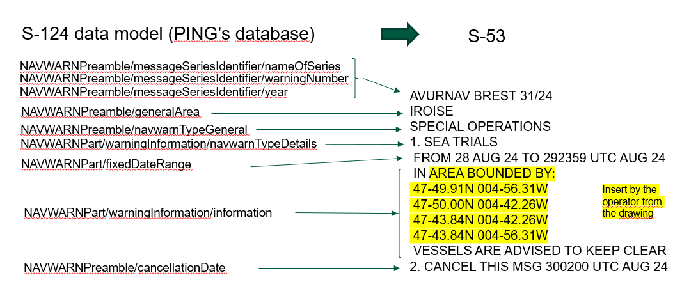
translation into S-53

Slide 6
considerations
NAVAREA II and French regional coordinators in mainland France used PING since 2023 (dozen of operators)
French coordinators had the habit to use a lot of S-53 NWs text models. Ergonomics adjustments were necessary to facilitate the drafting of the structured NWs. Ergonomics of HMI is crucial to swift from a textual NW to a structured NW.

Slide 7
considerations
Thousands of NWs had already been produced using PING and so, using the S-124 data model. There is no case where it was impossible to apply the data model. In some cases, different encoding options are possible.
The NW is drafted and published in few minutes (less than the maximum 30 minutes).
To reduce the drafting of free text, we added a list of standardized expressions to be inserted into WarningInformation/information
  Wide berth requested, Navigate with caution, Hazardous to navigation, In progress, Until further notice, etc.
  => The quality of NWs is improved (less typos, less position mistakes)

Slide 8
considerations
The use of some S-124 concepts by coordinators still needs to be reinforced:
  Hazards types
  Period of an hazard
  NW divided into parts

Slide 9
considerations
Some notions of the S-124 data model are not implemented because, for the time being, we consider that they are not useful for French NWs. This simplifies the drafting of the NW. Not implemented:
  NAVWARNPreamble/title
  NAVWARN/affectedChartPublication
  NAVWARNPart/featureName
  NAVWARNPart/featureReference
  NAVWARNPart /restriction
  TextPlacement
No validation checks implemented - We expect to use a third-party software when available

Slide 10
NEXT – 2024-25
First experimental delivery of S-124 ed.1 datasets from the PING database
  S-124 Exchange sets including metadata, based on files (1 NavWarning is 1 file), files signed for authentication & integrity
  With a basic implementation of SECOM: secured delivery in pull mode of all the NWs in-force in a series using SECOM GET REST API
  Note : PING already offers a REST API but it is not compliant with S-124 ed. 1 and SECOM. This API is used by our Nav&Co mobile app for pleasure boaters.
PING’s code in open source (EUPL)
PING to be deployed in French oversea territories

Slide 11
NEXT – 2024-25
A training instance is available for everyone to experiment NW production using PING at your pace
Contact Yves Le Franc to get an access (your IP address is the only requirement) yves.le.franc@shom.fr

