Slide 1
Update - North Sea Maritime Safety Information Working Group
NAVAREA I (UK)

Slide 2
NSMSI WORKING GROUP 23/24 Meetings
The working Group have met twice since WWNWS 15;
in person between 28 – 29th November 2023 and
a virtual meeting on 25th June 2024
Headline Topics:
Obligations and awareness of S-124 provisions and update on S-124 implementation across the NAVAREA (S-124 questionnaire)
Consideration of other Product Specifications/Technical Services supporting and or complimenting S-124; Met (S-4XX), AtoNs (S-125) and AtoNs Service Spec (S-201) and their interaction.
Space Weather to improve warning consistency and awareness.
Geometry of NAVAREA, applicable service areas and generalised coastline geometry.
Redundancy and resilience – including NAVAREA co-ordination agreements.
Application of S-124 test case criteria.
Engagement on NAVAREA I self –assessment to improve regional awareness and depth of information from Member States and national co-oridnators.
Brief on Maritime Connectivity Platform, SECOM and the Digital Incubator Project from T. Christensen (DMC)
Updates on International– Outcomes of MSC108, NSCR11, HSSC16

Slide 3
NSMSIWG Notes and outcomes
Improved understanding of proposed data exchange principles for S-124, testing opportunities and the relationship between Maritime Services, Technical Services and Product specifications in the context of E-navigation. Decision 11 NSHC37 – approval of updated Terms of Reference: “Promote the development of IHO S-124 Navigation Warning standards and coordinate its implementation in the North Sea Hydrographic Commission area, whilst considering other S-100 based MSI services.” Requirement for improved clarity on the issuance of Space Weather warnings. S-124 should be co-ordinated in collaboration with Baltic Sea MSI Working Group. | Outcomes of Initial evaluation of S-124 status: States in early stages of understanding S-124 and were not in a position to provide test data at this stage. current GMDSS framework must be prioritised, however, agreed that resources should be made available to develop an S-124 product. 6 of the 11 attending member states feel confident in reaching January 2026 goal. All states were, however, unclear on method of delivery, supporting regulatory framework, implementation and the ‘hierarchy’ for S-124 in relation to S-125. Clearer direction from governing bodies needed; how will complimentary standards and services interact. Requirement to review and update the Joint Manual MSI to establish/include operational standards on encoding S-124. Consider producing iterations of the manual as processes develop and establish a new estimated timeline for a revision. Clarification and requirement for digital signatures and encryption? Who can issue what and where? Clarification and requirement for SECOM and interface.

Slide 4
NSMSIWG ACTIONS of note
Action 3.5 – Chair to enquire with WWNWS and S-124 PT will a ‘digital signature’ identify and restrict what type of warning can be broadcast and by who? As it stands, it is assumed that any authority can create and distribute NAVAREA/Coastal/Local information. Action 3.6 – Chair to encourage the WWNWS SC/DRWG to further review the Joint Manual MSI to establish/include operational standards on encoding S-124. Consider producing iterations of the manual as processes develop and establish a new estimated timeline for a revision. Action 3.7- Chair to request IHO NSHC/WWNWS establish/provide expected time frames and guidance on how various S-100 standards will interact. | Action 3.14 – Chair to request clarification from IMO/WWNWS on why a connectivity platform is required and establish what MSI providers responsibilities in the provision of an S-124 service. Is it just to generate data set or does it extend further in to validating, security and delivery. Action 4.3 – Chair to request clarification from WWNWS on the requirements for NAVAREA Geometry. Action 4.6 – Chair to submit a paper to WWNWS identifying the need for warning threshold, improved guidance and awareness on Space Weather.

Slide 5
NSMSI WORKING GROUP 23/24 Meetings
Proposed Schedule for 2024/25
Next meeting to be held circa Nov 2024
Preliminary in person meeting to be held in Hamburg in co-operation with the Baltic Sea MSI Working Group in November 2025.
Work to progress:
Report on resilience and redundancy to identify areas for support.
Finalise NAVAREA and NAVTEX service area Geometry.
Review S-124 Test Case Criteria
Identify and invite new members in different disciplines to align and unify a singular approach to S-124, S125, S-201, S-4XX implementation.
Joint Meeting of the BSMSI Working Group and NSMSI Working Group

Slide 6
Actions requested of the sub-committee
Note the information provided,
Consider the questions raised during the Working Groups deliberations.

Slide 7
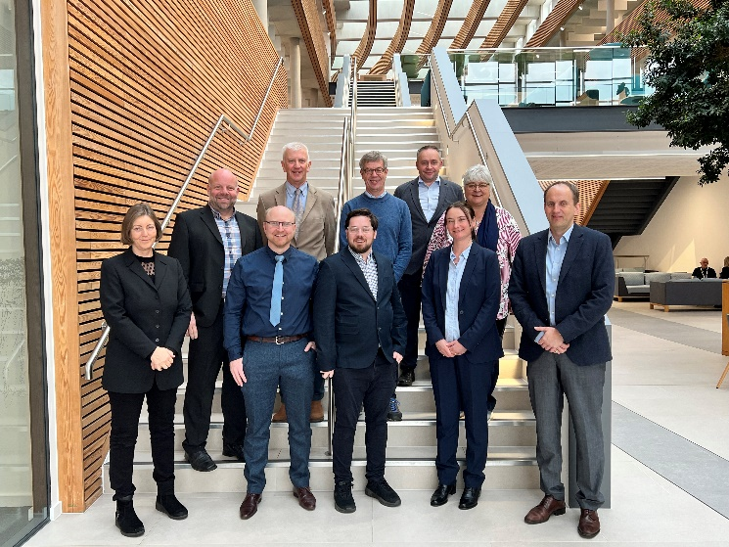
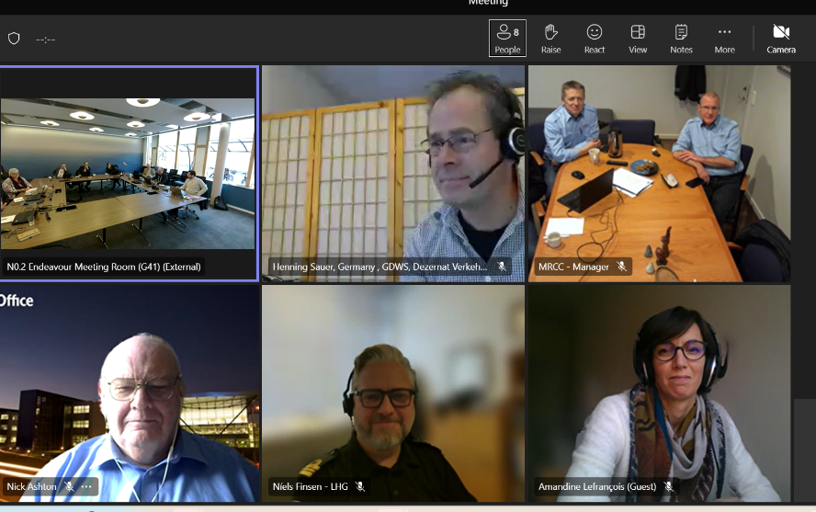
3rd meeting of NSMSI Working Group

