Slide 1
15th meeting of the DQWG
IT Test Data Analysis
Approach to Venice
DQWG15-05.2A
DQWG15, IHO Secretariat, Monaco, 4 – 7 February 2020

Slide 2
ABOUT TEST DATA (1)
S-57 ENC cells were provided for testing
Approach to Venice IT400222
ENC compilation scale 1:45.000
Considerations about the new method to visualize the quality of bathymetric data

Slide 3
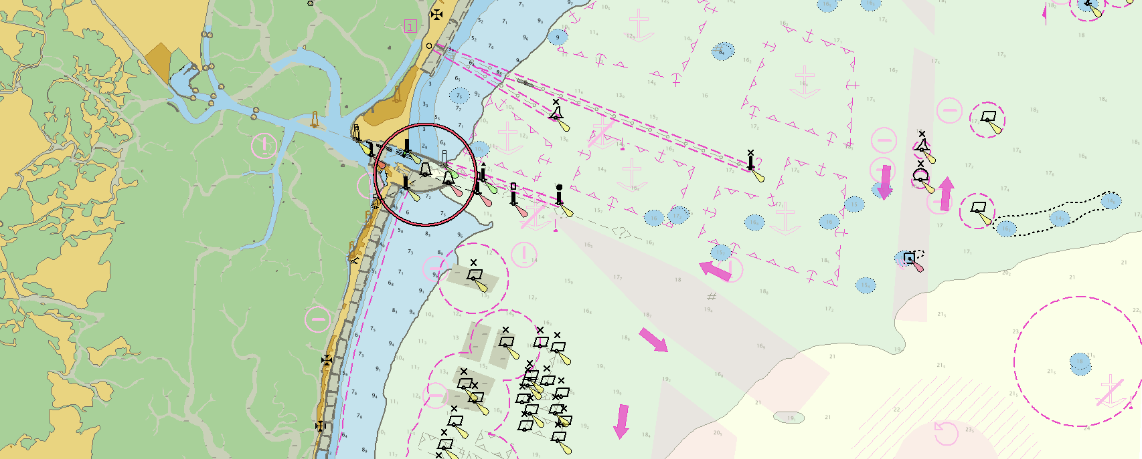
ABOUT TEST DATA (2)
Proof of concept using existing software
S-57 object RESARE used for testing
CATZOC A2 (20 mt)
CATZOC B (50 mt)
(A2)
(B)

Slide 4
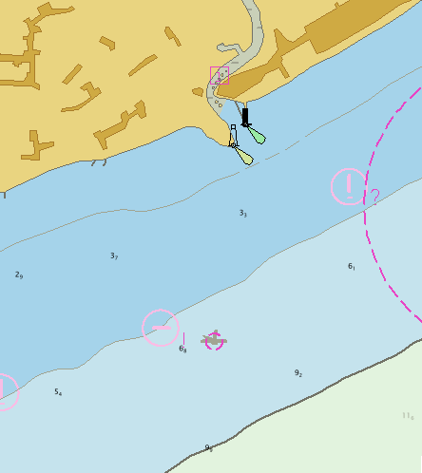
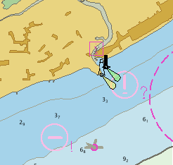
VISUALIZATION AT DIFFERENT SCALE
Display scale = Compilation scale 1:45.000 Radar Range 3 NM
S-65 definition of compilation scale: “Optimum display scale of ENC data”
Display scale 1:22.000
Radar Range 1.5 NM
Notes:
The symbol (in this case a wreck) is almost not visible covered by the circle (CATZOC A2)

Slide 5
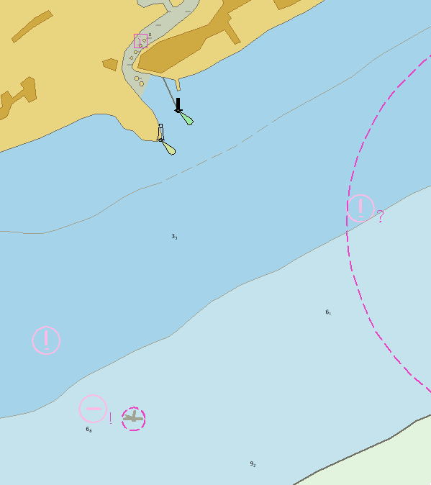
VISUALIZATION AT DIFFERENT SCALE
Portrayal symbol larger than object only over zooming
Display Scale 1:12.000
Radar Range 0.75 NM

Slide 6
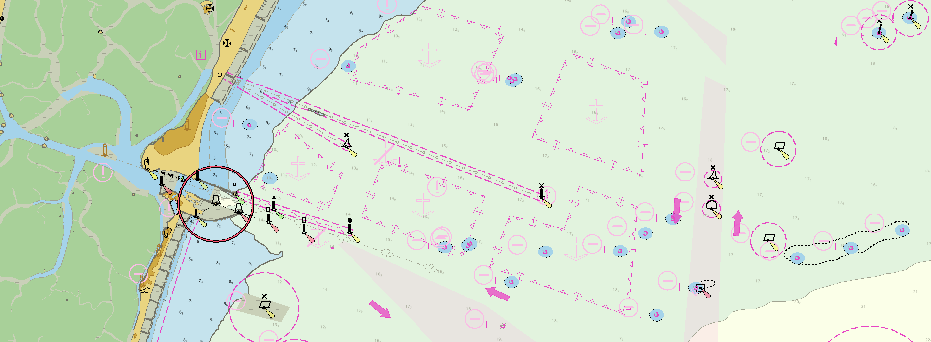
QUALITY INFORMATION AND SCALE
Possible clutter at compilation scale: Feature object larger than the circle
Display/Compilation Scale 1:45.000

Slide 7
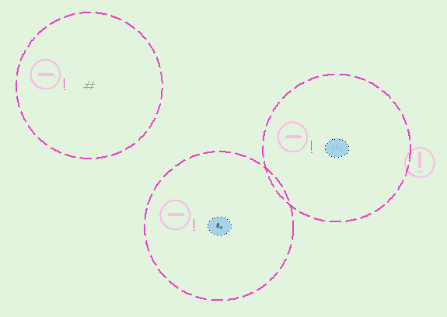
VISUALIZATION AT DIFFERENT SCALE
Display Scale 1:2.000
Display Scale 1:45.000
Display Scale 1:22.000
CATZOC B – 50 mt

Slide 8
QUALITY OF DATA
Display Scale 1:2.000
POSACC and SOUACC not available in IT ENC
Positional and sounding accuracy of isolated features from M_QUAL (quality indicator of the area)
CATZOC value attributed to all ENCs for IT
Wreck
Obstruction overlap
CATZOC B – 50 mt

Slide 9
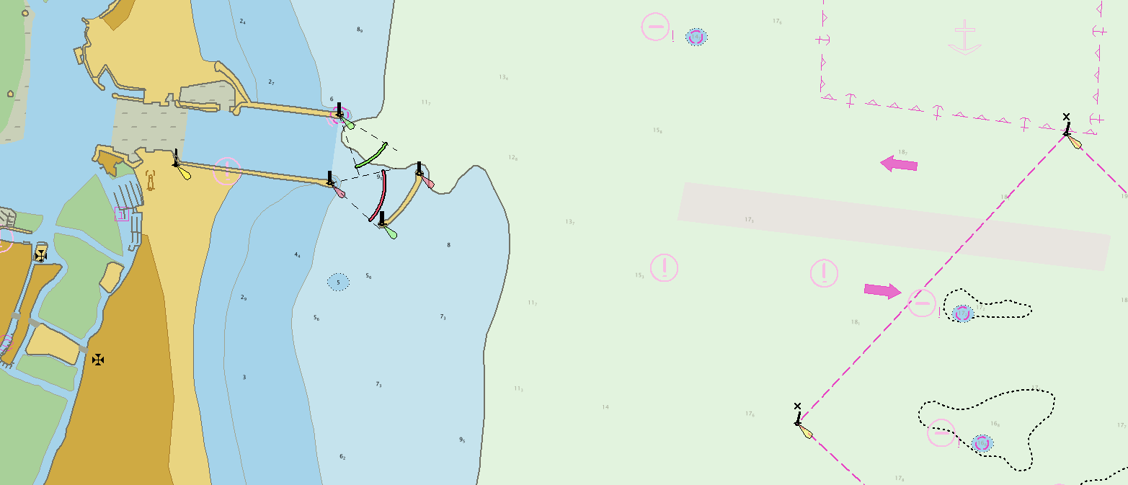
Approach to the port
Display Scale 1:22.000
1.5 NM Radar Range
CATZOC A2

Slide 10
IT Test Data Analysis
Good quality Chart: benefits are “less effective and less appreciable”
Possible clutter at smaller scale
Direct visible relation between the size of the symbol and the scale
Adjacent isolated objects should be surrounded by a single polygon, a safety alert area. This will avoid screen clutter.
Which is the solution for obstruction with geometry area?
What if the position of the object is approximated?

Slide 11
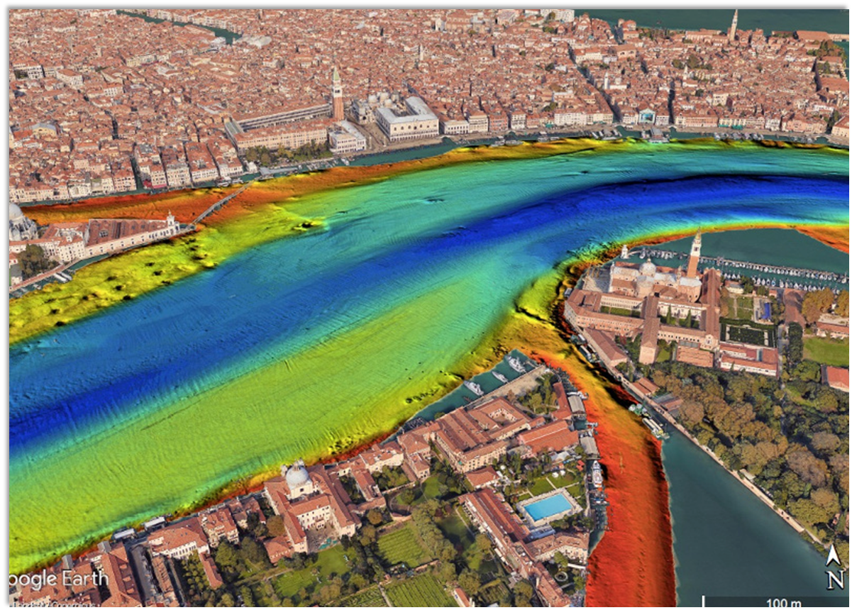
Concept proven for the «Port of Venice»

