Slide 1
S-123 Data Model Revision for Ed.1.1.0
Shwu-Jing Chang
2024/01/26

Slide 2
List of Major Changes
Remove feature types:
Landmark, Building, CoastguardStation, InmarsatOceanRegionArea
Add information types:
RadioControlCenter, TransmissionDetails, BroadcastDetails
Remodel feature types:
RadioStation, RadioServiceArea, WeatherForecastWarningArea
GMDSSArea(merged InmarsatOceanRegionArea)
Rename & remodel:
NavtexStationArea→NavtexServiceArea
NavigationalMeteorologicalArea → NavArea, MetArea
Add data model to support remote control
ConnectivitySubscriptionArea (feature type)
ConnectivityQualityOfService (Information Type)

Slide 3
List of Changes
Revise complex attribute:
Remove ‘timeReference’
Add attribute:
hoursOfWatch, to support common situations such as 24 hour service
acceptAMVER
Add ‘language’ indication to ContactDetails of S-123
Remove ‘radiocommunications’ from ContactDetails of S-123
‘radiocommunications’ in S-123 has been remodeled into (replaced by) some Information Types, as presented in NIPWG VTC2, June 2023

Slide 4
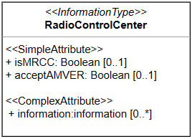
Radio Control Center

Slide 5
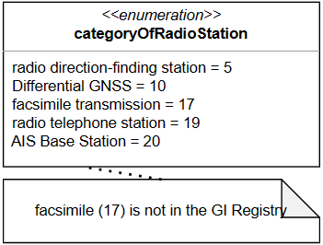
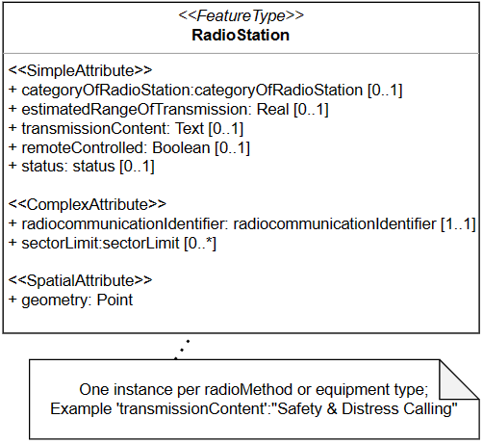
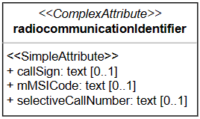
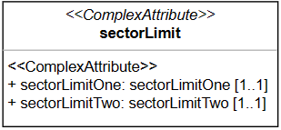
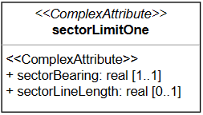
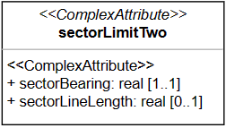
Radio Station

Slide 6
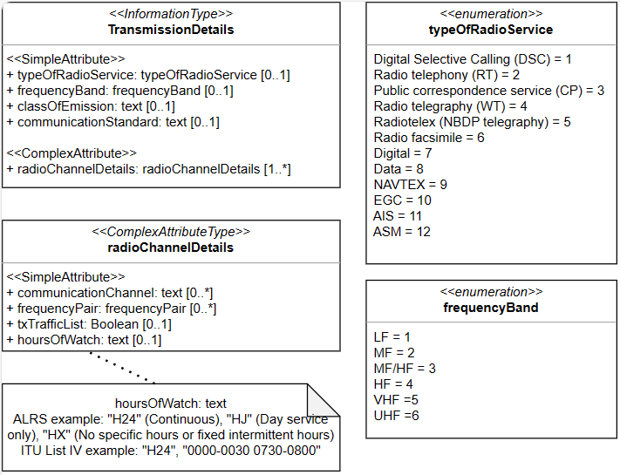
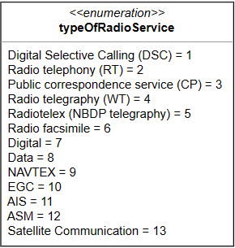
Transmission Details
Or
<<ComplexAttribute>>
+ radioMethod

Slide 7
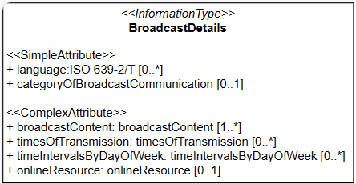
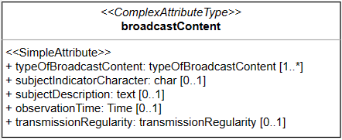
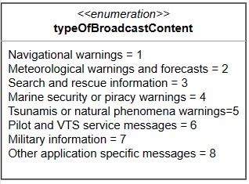
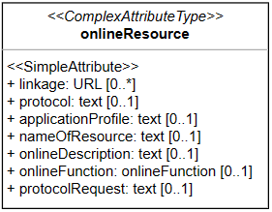
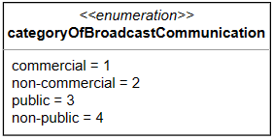
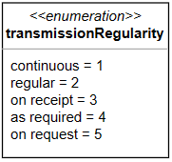
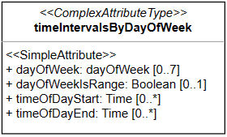
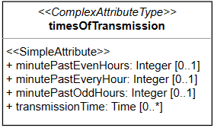
Broadcast Details

Slide 8
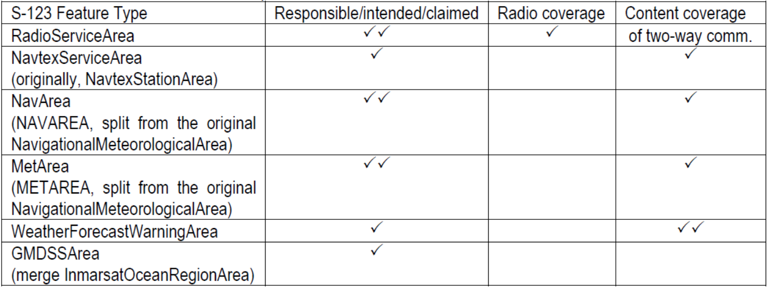
Aspects of Service Areas to be Modelled in S-123
When impractical to encode the radio coverage, e.g. in HF band,
(1) Encode the extent of the service by using ‘estimatedRangeOfTransmission’ of ‘RadioStation’ feature
(2) Encode the intended area, associated with Information types (TransmissionDetails, BroadcastDetails)

Slide 9
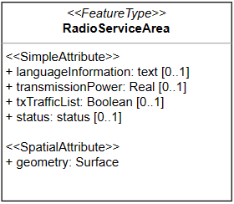
Radio Service Area
Information bindings and Feature bindings : all optional

Slide 10
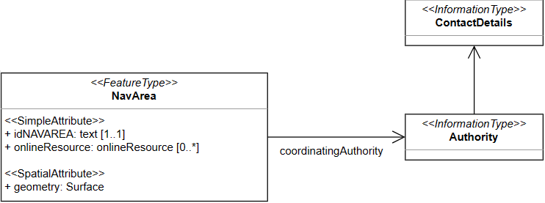
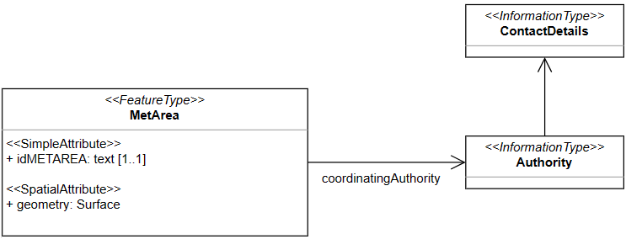
NavArea and MetArea
(issuingAuthority,
not the preparationAuthority)

Slide 11
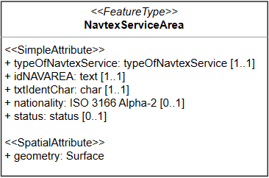
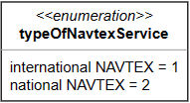
Navtex Service Area

Slide 12
NavtexServiceArea - Baltic Sea sub-area of NAVAREA I
Sub-Area Coordinator (Sweden)

Slide 13
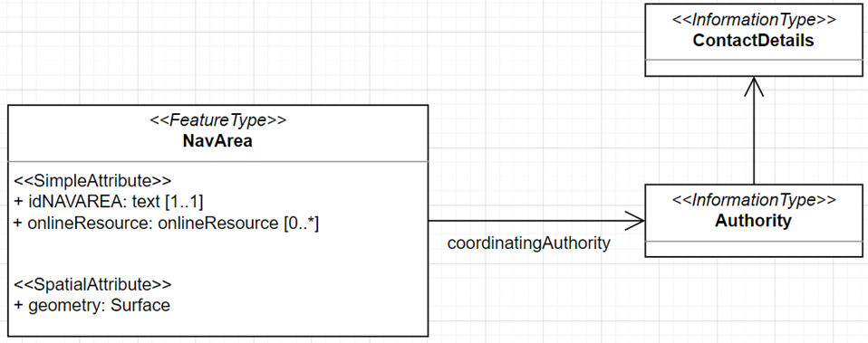
Subarea of NAVAREA - Baltic Sea sub-area of NAVAREA I
In case Baltic Sea Sub-Area will broadcast MSI via SafetyCast, etc.
+ featureName = Baltic Sea Sub-Area
+ idNAVAREA = NAVAREA I
Sub-Area Coordinator (Sweden)

Slide 14
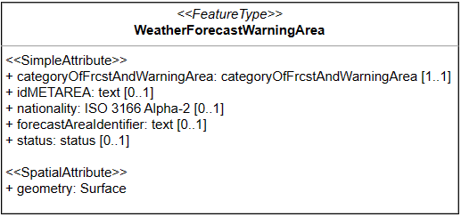
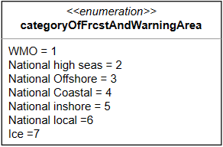
Weather Forecast Warning Area

Slide 15
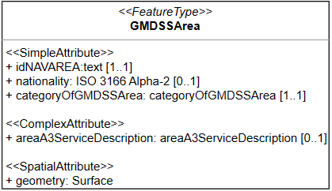
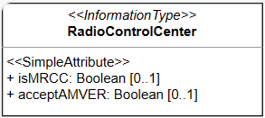
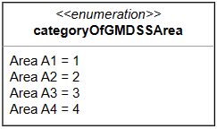
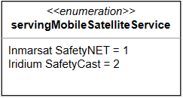
GMDSS Area

Slide 16
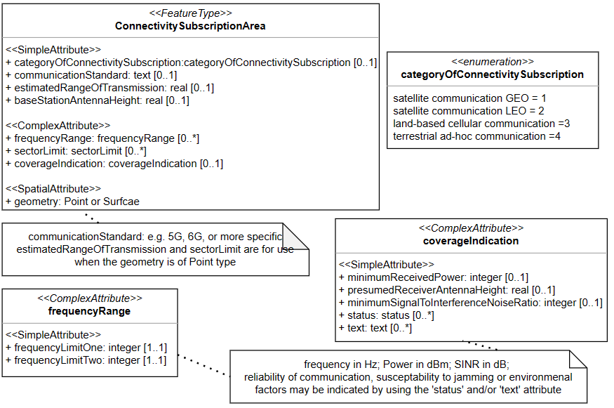
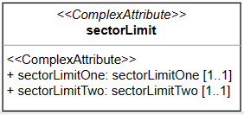
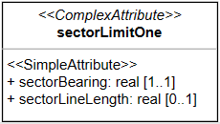
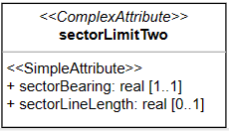
Connectivity Subscription Area

Slide 17
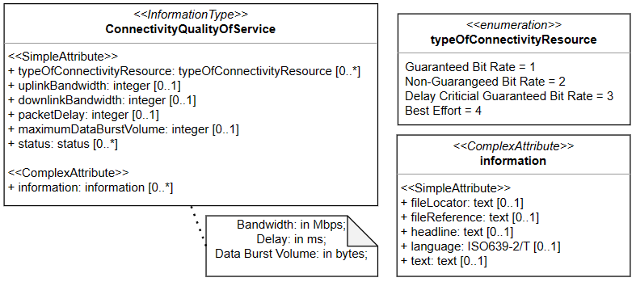
Connectivity Quality Of Service

Slide 18
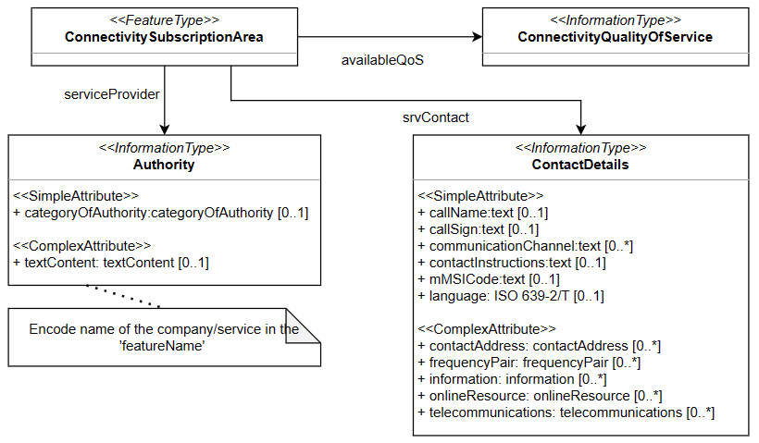
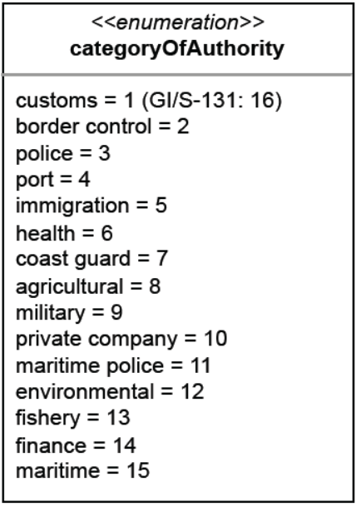
Connectivity Subscription Area - informationBinding

Slide 19
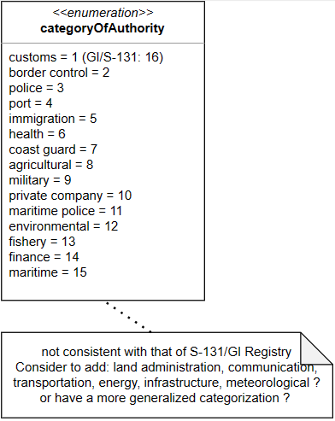
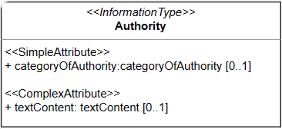
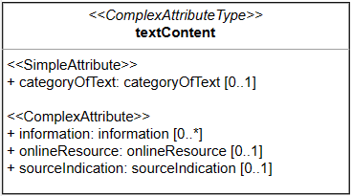
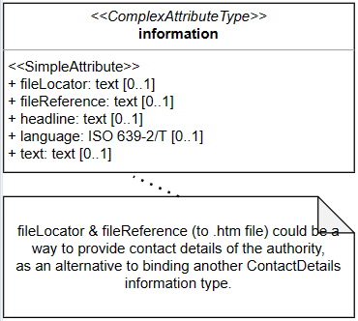
Authority

Slide 20
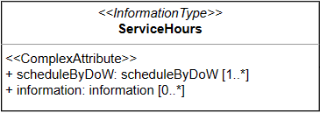
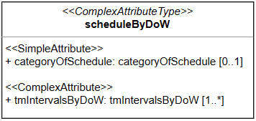
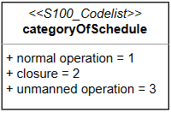
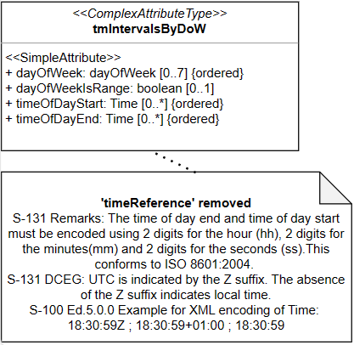
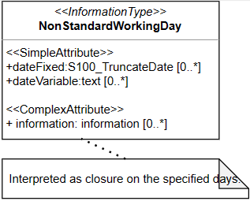
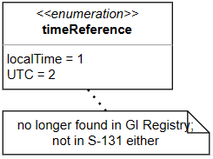
Service Hours
exceptionalWorkday

Slide 21
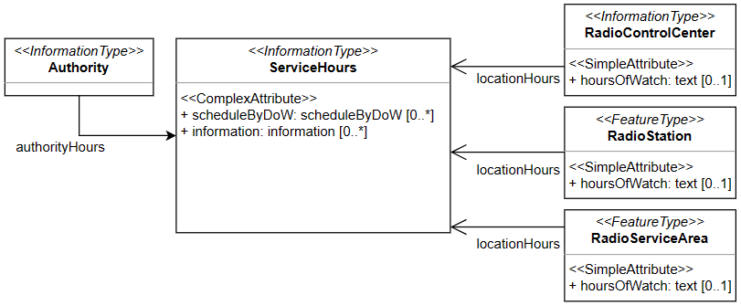
Service Hours: common situations of H24
To answer the feedback : “Consider simplifying service hours to support common situations such as 24 hour service ( instead of using the entire ServiceHours information type)”
Add ‘hoursOfWatch’ to locationHours (& radiochannelDetails)

Slide 22
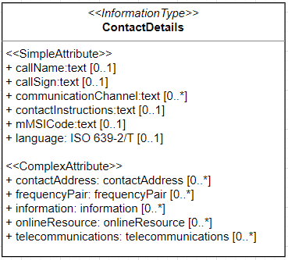
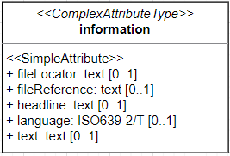
Contact Details : language indication
To answer the feedback:
to offer information such as contact details and instructions in different languages
Add
Simple attribute of ContactDetails
language: ISO639-2/T
Sub-attribute of contactAddress
language: ISO639-2/T
Remove ‘radiocommunications’
‘country’→’countryName’

Slide 23
Contact Details : relationships

