Slide 1
NIPWG S-128 VTC (2023)
S-128 Ed 1.1.0 Release Plan
NIPWG S-128 VTC 01 (18 October 2023)

Slide 2
items to be discussed
NIPWG8 Minutes and Action Items (related to S-128 VTC)
(Action Item 23) Product Type attribute; check PS 1.1.0 for the inclusion of traditional paper products (List of Light, SDs etc.) and other different use cases
(Action Item 24) DCEG guidance for the different uses to be reviewed in preparation of PS 1.1.0. S-128PT. Mid-October
(Action Item 25) NIPWG is invited to provide comments on product type when PS is open for review. All. November 2023 (Including catalogue.xml updates)
(Action Item 26) NIPWG invited to test S-128 1.1.0 when ready for review and to provide feedback to S-128 PT. All. November 2023

Slide 3
items to be discussed
NIPWG8 Minutes and Action Items (related to S-128 VTC)
(Action Item 27) Dedicated S-128 VTC to be held monthly. Strict focus on finalizing PS development. All. 3rd week October.
(Action item 30) Consider and feedback to NIPWG if a simple portrayal catalogue will delay draft of PS 1.1.0. S-128PT. 15th Sept 2023 (Draft PC created)
(Action Item 32) Review S-128 and find any gaps between Data model and registry. (S-128 FC and GML data updated)

Slide 4
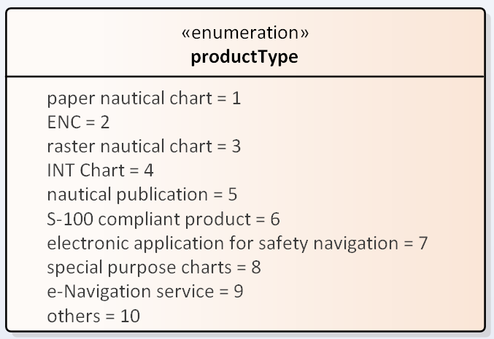
S-128 Ed 1.1.0 Release preparation
Action Item 23 : Use case scenario of product Type
S-128 Category | Product |  | Product Type
PaperChart | Paper chart |  | 1: paper nautical chart
 | INT |  | 4: INT Chart
 | Raster navigational chart |  | 3: raster nautical chart
ElectronicChart | ENC | S-57 | 2: ENC
 |  | S-101 | 2: ENC
 |  | S-102 | 2: ENC
 |  | S-10X | 6. S-100 compliant product
 | Digital chart |  | 8: special purpose charts
 | Special chart | Fishery chart | 8: special purpose charts
 |  | Location chart | 8: special purpose charts
 |  | Territorial chart | 8: special purpose charts
 |  | World route chart | 8: special purpose charts
NauticalProduct | S-100 compliant product |  | 6: S-100 compliant product
 | 항해서지 | List of lights and fog signals | 5: nautical publication
 |  | Pilot guide | 5: nautical publication
 |  | Tidal currents table | 5: nautical publication
 |  | Ocean currents chart | 5: nautical publication
 |  | Nautical distance table | 5: nautical publication
 | e-Navigation Service |  | 9: e-Navigation service

Slide 5
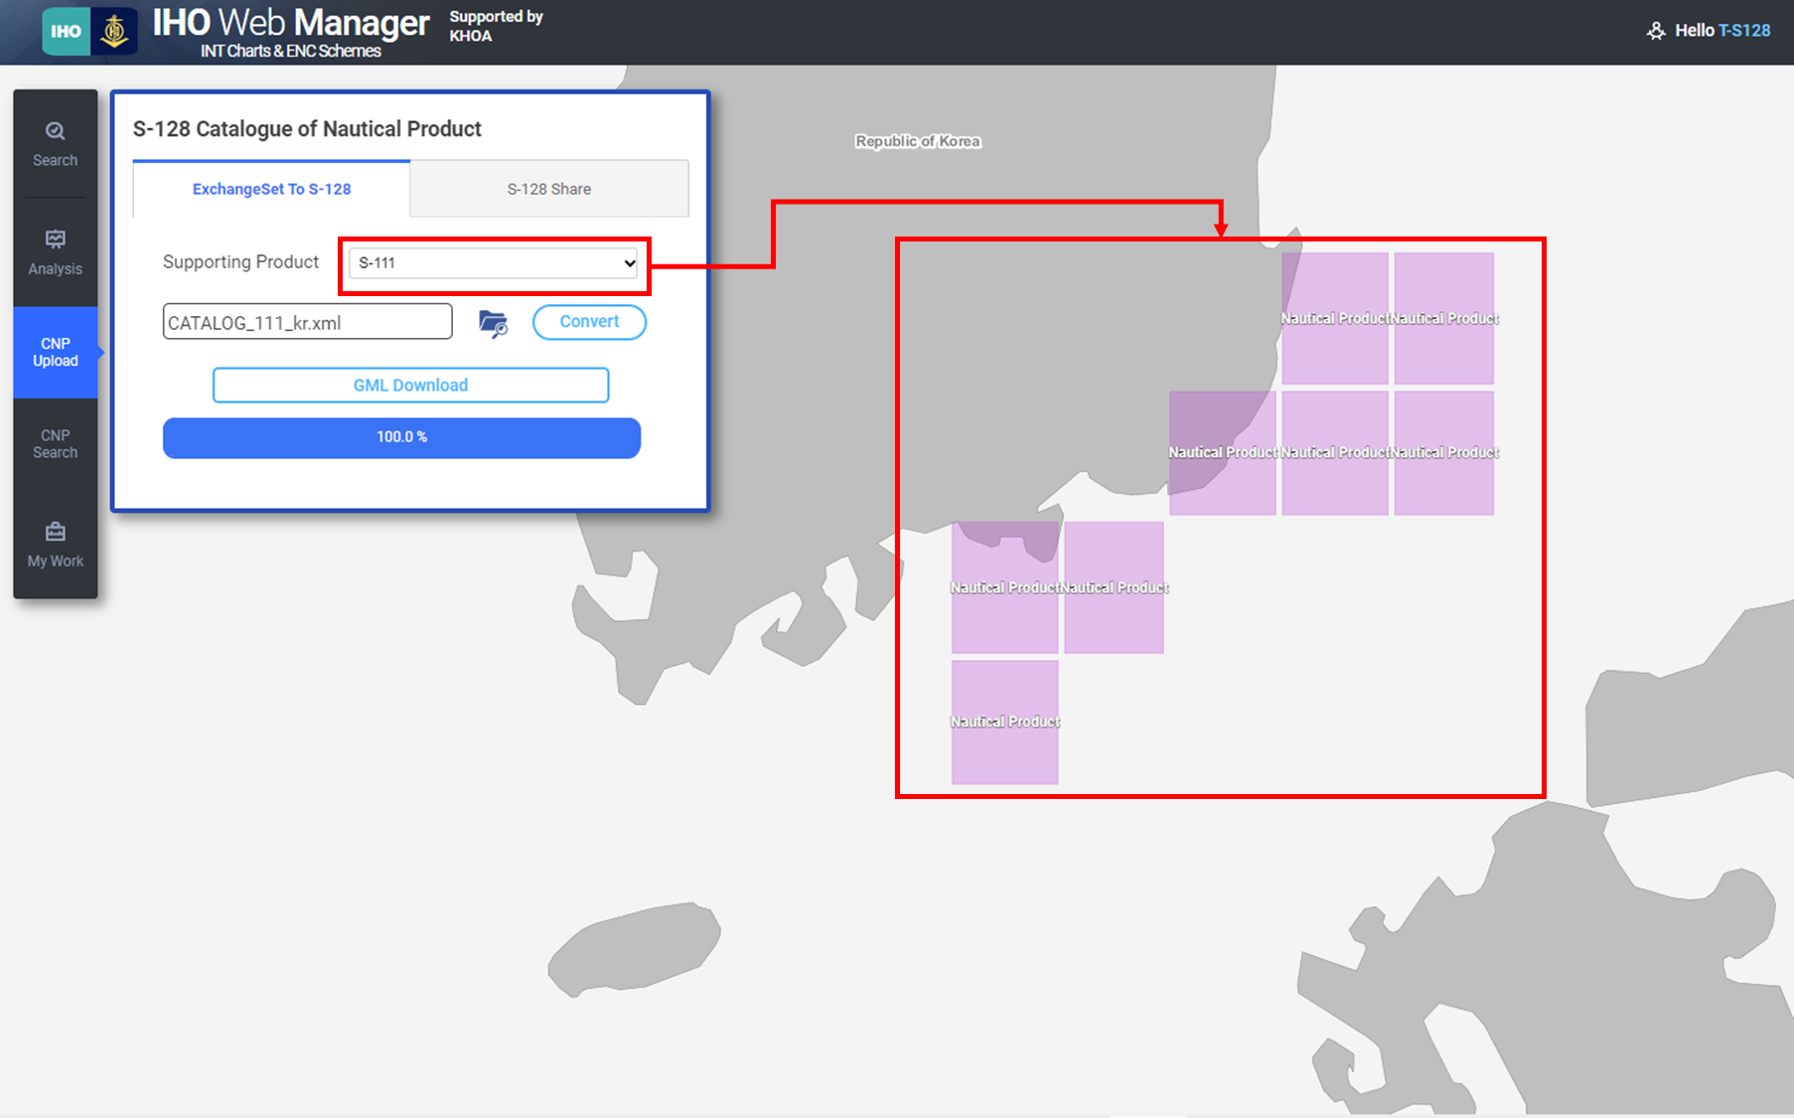
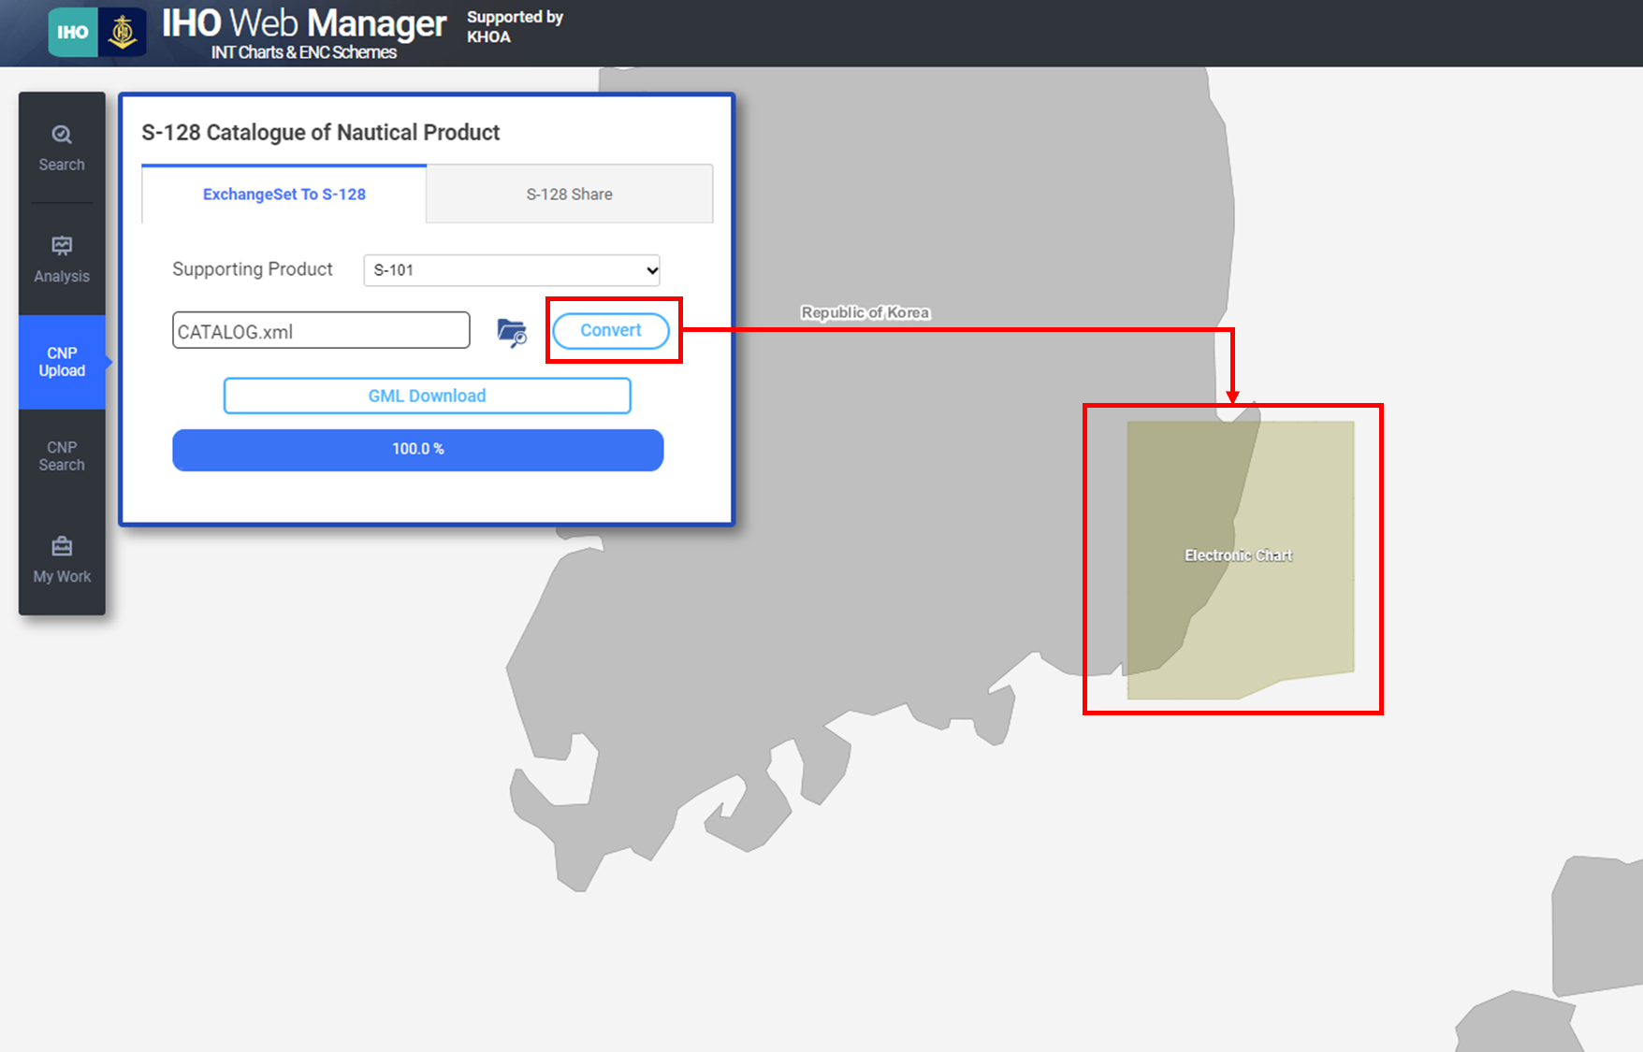
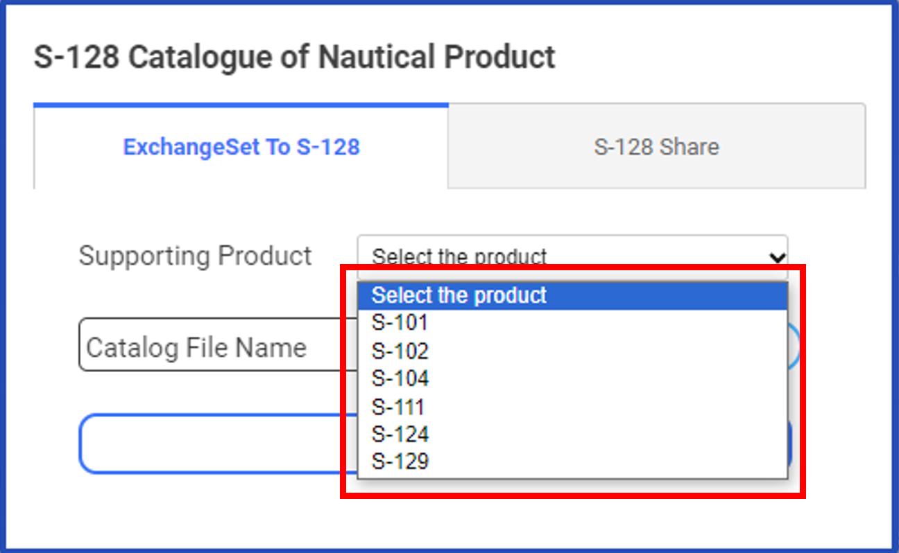
S-128 Ed 1.1.0 Release preparation
Action Item 25 : Support S-100 Ed 5.0.0
INTOGIS supports input catalogue.xml based on S-100 Ed 5.0
Users can create S-128 data by loading S-10X data’s catalogue
Supports S-128 GML data download based on S-100 ed 5.0.0

Slide 6
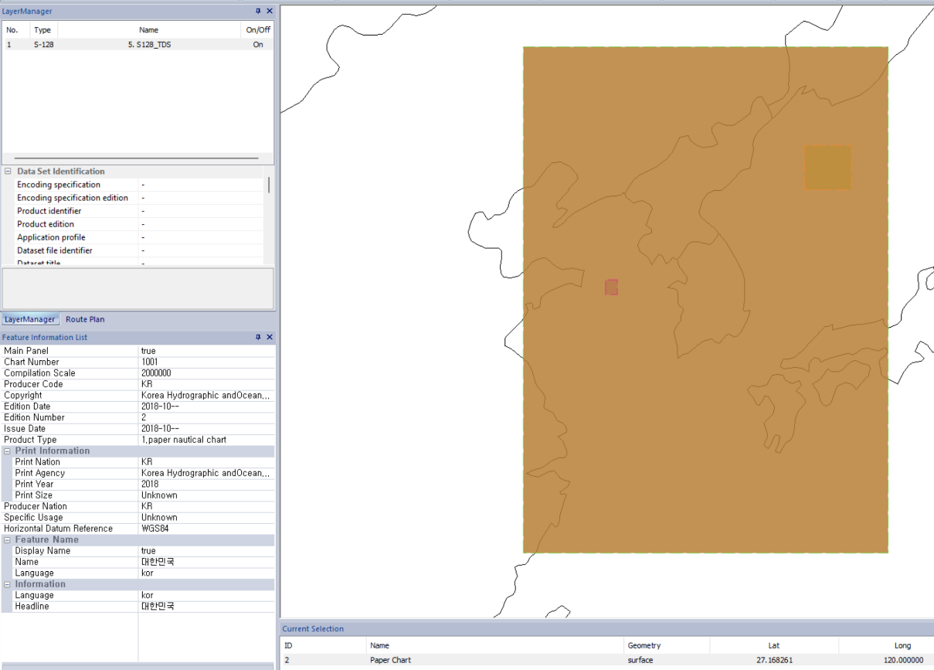
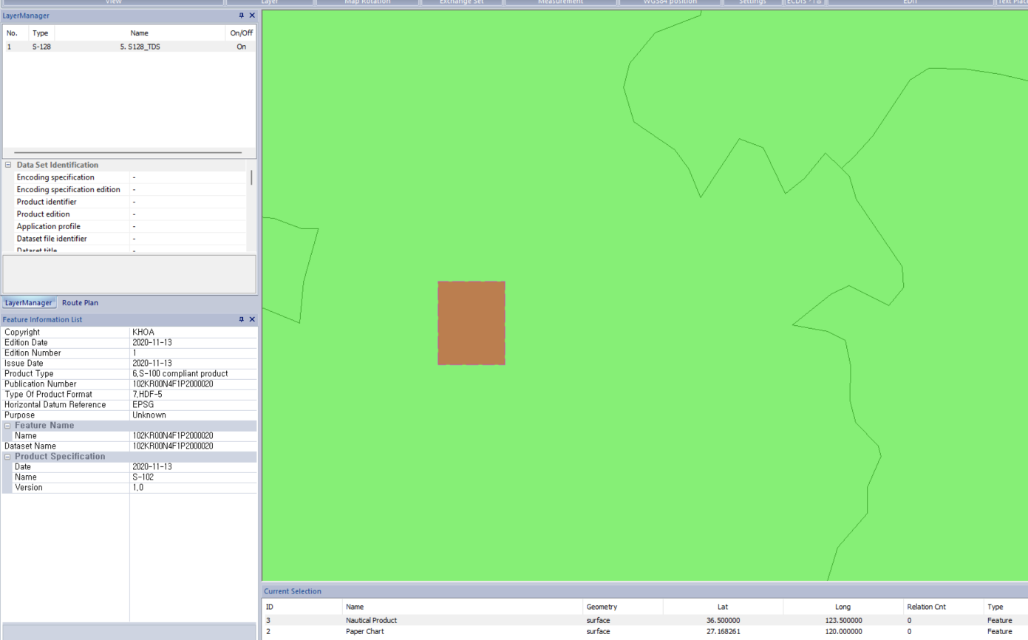
S-128 Ed 1.1.0 Release preparation
Action Item 30 : S-128 portrayal catalogue (draft)
Portrayal catalogue was created based on XSLT format
Validated through KHOA Viewer with S-128 TDS creating by INTOGIS

Slide 7
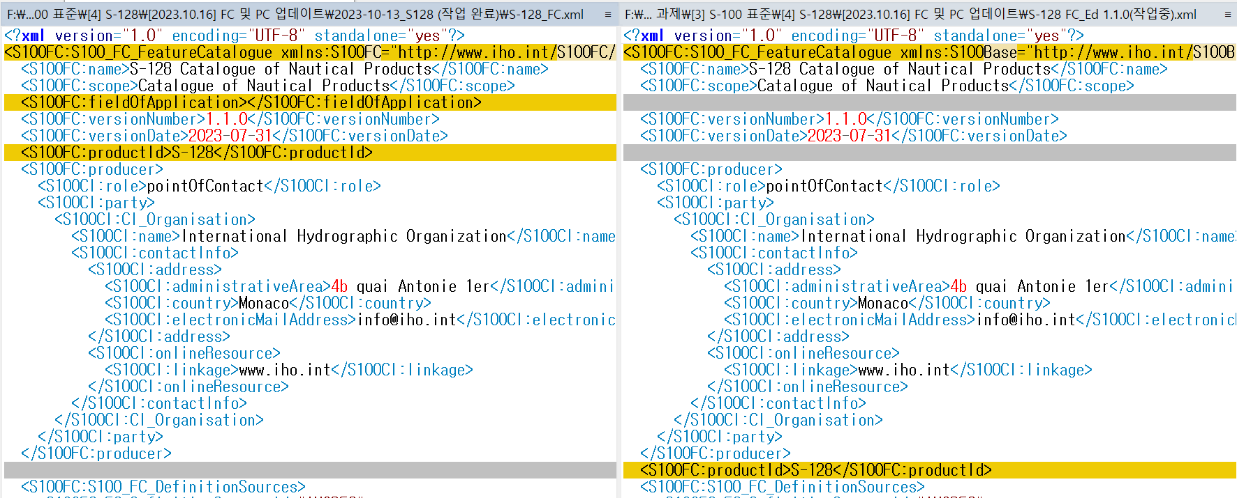
S-128 Ed 1.1.0 Release preparation
Action Item 32 : Find gaps of S-128 regarding model/registry
Feature catalogue has been updated to support S-100 Ed 5.0.0
Schema information, productID, field of application
Coordinate system and reference of S-128 data has been modified

Slide 8
Conclusion of s-128 vtc meeting
KHOA S-128 team plans to:
Release S-128 Ed 1.1.0 draft (middle of October)
Updated INTOGIS open (based on S-100 Ed 5.0.0)
The NIPWG members are invited to:
Review S-128 Ed 1.1.0 draft including catalogues, DCEG, and others
Create S-128 data using local S-10X data through INTOGIS
Leave comments about Primar’s S-128 feedback (13th September)

