Slide 1
NIPWG VTC (2023)
Development update of S-125 Marine AtoN
Agenda Item 7.3.1
NIPWG VTC01 (2 March 2023) 13:00 - 16:00 (UTC+1, CET)

Slide 2
Working draft
S-125 Marine AtoN – version 0.0.3 (Oct. 22)
16th ARM Committee has undertaken a review and update
updated considering the discussion results of a joint workshop on S-100/200 development and portrayal in Norway
Resulting drafted product specification
https://nextcloud.iala-aism.org/index.php/s/DDgzrmxJB9GtpZ7
The components of S-125 Marine Aton PS
S-125 main document
S-125 feature catalogue
S-125 GML schema
S-125 Portrayal catalogue
Liaison note from IALA to IHO NIPWG

Slide 3
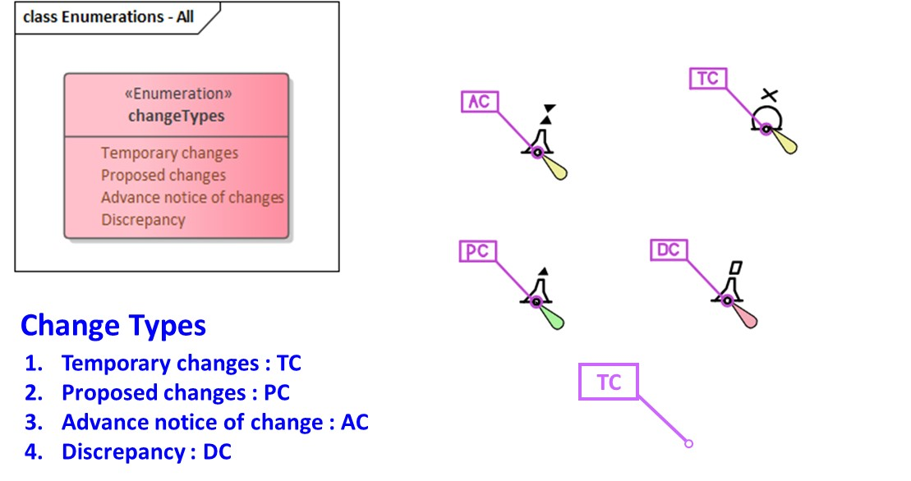
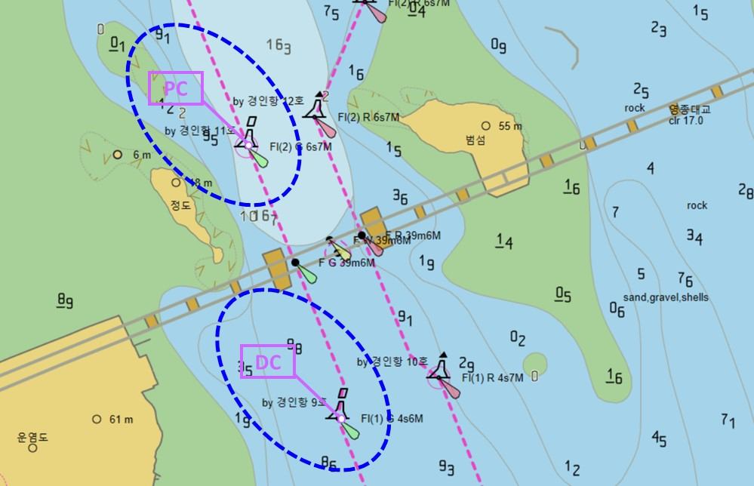
Working draft
Portrayal of Aton change
Display Aton change symbol as overlay or interleaving

Slide 4
Demonstration project
Joint workshop on S-100/200 development and portrayal
Between IALA and IHO, September 2022
Recommended that the relevant WG and TG prepare presentations and demonstrations of S-125 data service
IHO-Singapore Lab project
MPA suggested KRISO to demonstrate the S-125 service at the Singapore water at the end of April.
MPA, KRISO and NIPWG Chair agreed to conduct the sea trial on the S-124 NW and S-125 Marine Aton data service

Slide 5
Demonstration project
Major schedule

Slide 6
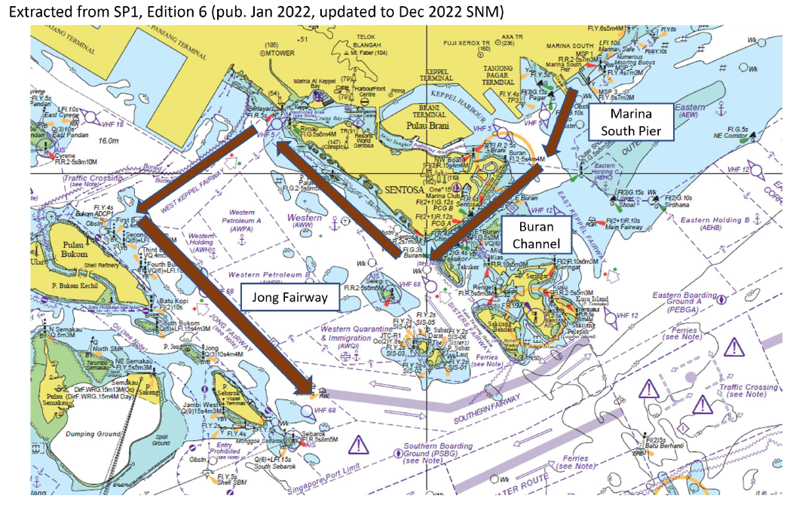
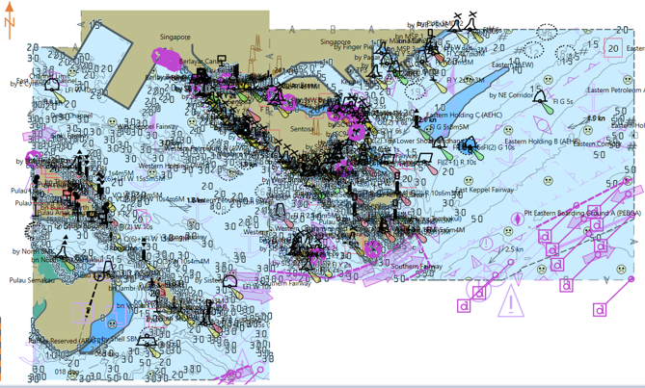
Demonstration project
Planned Sea Route

Slide 7
Demonstration project
S-125 related parts of service scenarios
Service scenario | Contents
1. Retrieve S-125 dataset | 5~6 S-125 datasets available from the service 3~4 S-125 datasets are relevant for the voyage and are sent to the navigation system 1~2 S-125 datasets do not intersect with the route + buffer and are not sent to the navigation system Verify the availability of the right data and the absence of the not applicable data
2. Transit from S-124 to S-125 | A change is made to the status of an AtoN in a dataset from scenario 2b that nullify a NAVWARN dataset from scenario 1b resulting in a new edition of the S-125 dataset and it is made available in the service 1 new S-124 dataset that cancel the S-124 dataset impacted by scenario 4a is issued Navigation system receives S-125 dataset and S-124 dataset and AtoN marked by NW is changed to being marked by S-125 status flag. - Verify the visual change to the AtoN data - Verify the absence of the S-124 NW on the screen - Verify the presence of the S-125 AtoN dataset in the system

Slide 8
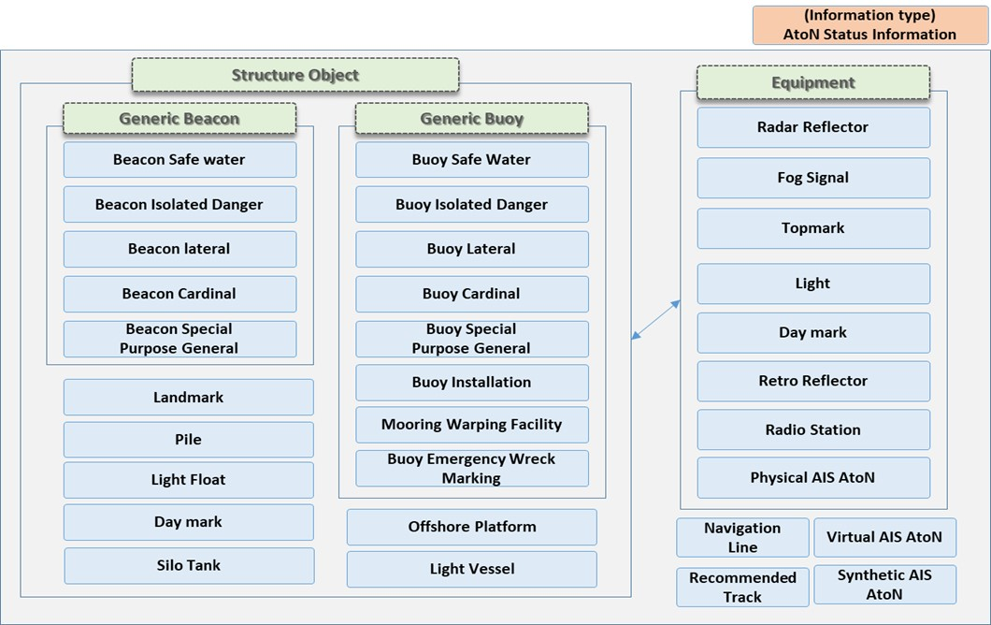
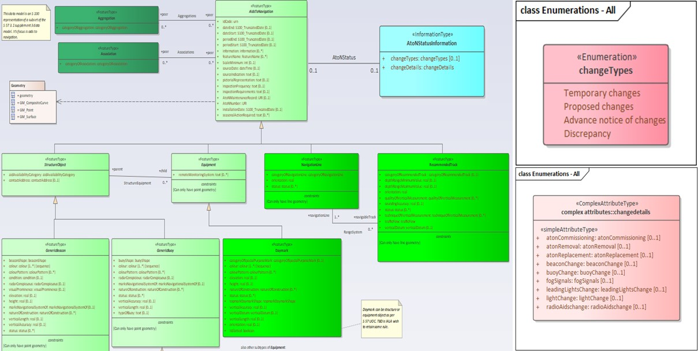
Demonstration project
S-125 Data Model

Slide 9
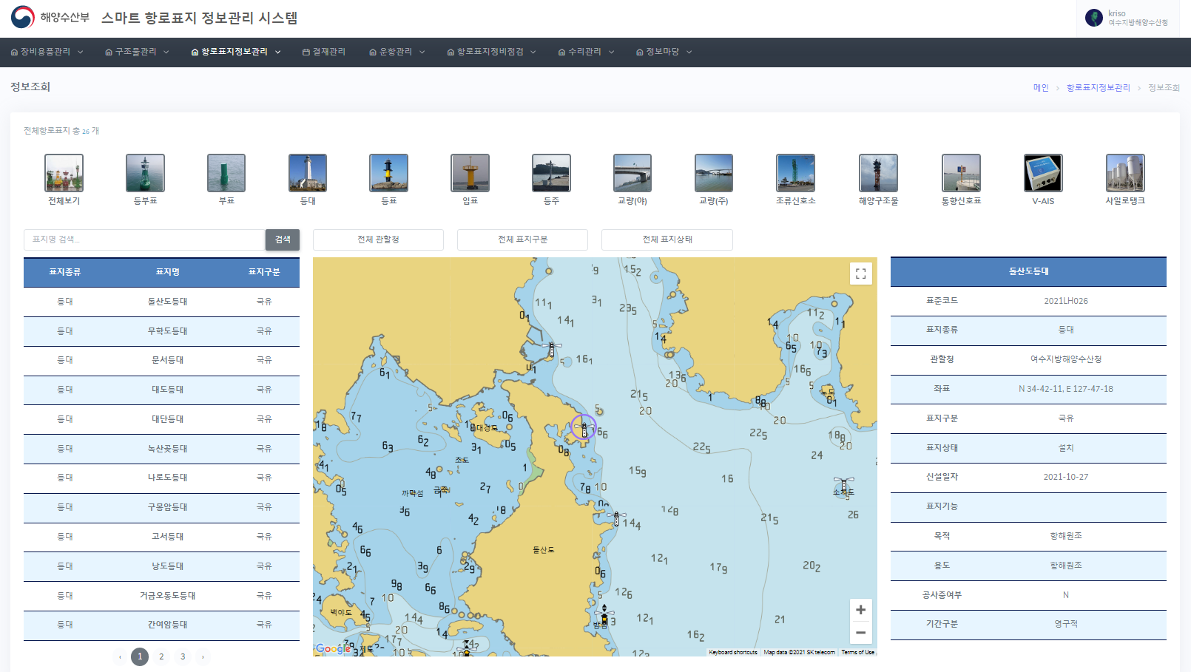
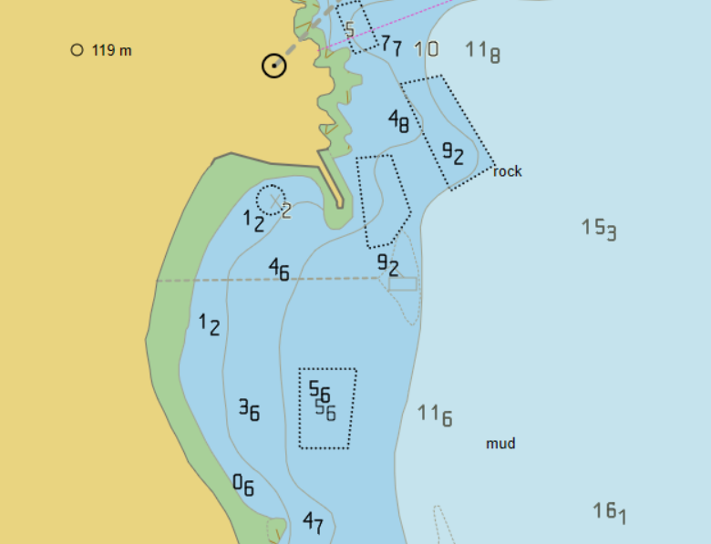
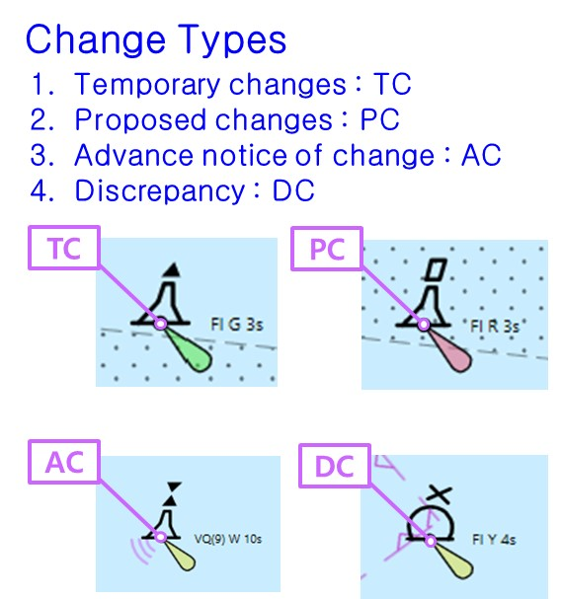
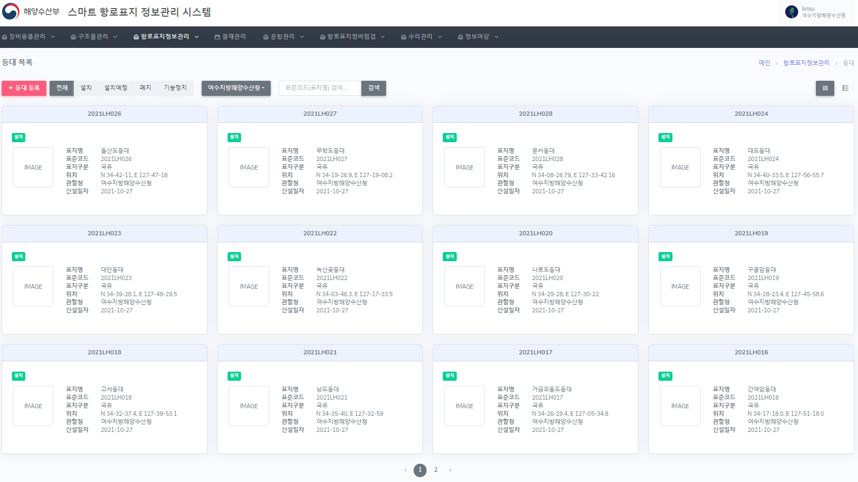
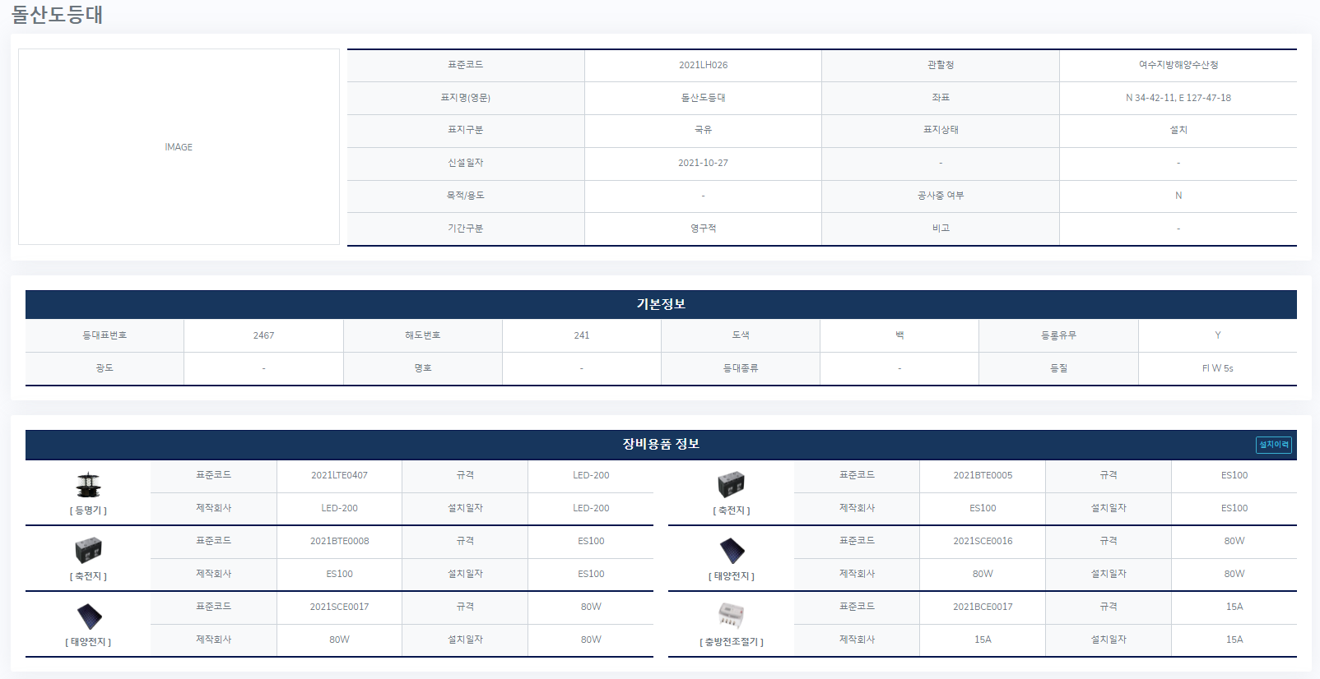
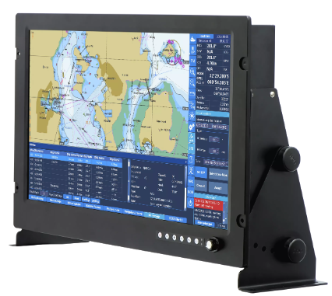
Demonstration project
Aton information management system
S-100 testbed system
AtoN Information
Management System
(Compatible with S-201)
TC
S-124/S-125 (AtoN info only)
Maritime Service
(RESTful API)
4/5G Network
S-124 NW
dataset
S-125 AtoN
dataset
(Interoperability)
S-124
S-125
S-101

Slide 10
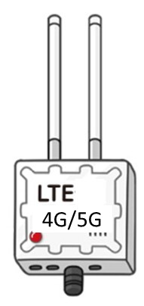
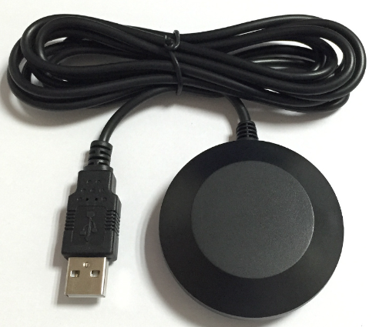
Demonstration project
Network diagram of S-124/S-125 Service Sea Trial
Daejeon
Korea
KT/SK/LG
Singapore Port
Marina
South
Pier
Wired connection
MPA Survey Ship
S-124 NW Data
S-125 AtoN Status
Wireless
MPA
WI-FI
KRISO/Bluemap
S-124 NW Data
S-125 AtoN Status
GPS
Receiver
For S-100 ECDIS
(Nav System)
~
~
~
~
~
Laptop1
S-101 ENC
AtoN Information System
(Singapore AtoN Info for
S-124/S-125 Service Demo)
For S-100 ECDIS SW Developer
S-124 NW Service
Laptop2
S-125 AtoN Service

